Slide 1
Internal Analytics
Professor
School
Digital Analytics and Monitoring
Notes:
Greetings, oh wise one who imparts knowledge to the masses! Your lecture is about to be the talk of the town (or at least the classroom). With your wit and wisdom, you'll have your students eating out of the palm of your hand. So, put on your teaching cape and soar into that lecture like the superhero you are!

Slide 2
Learning Objectives
Learning and understanding how to use the PESO model.
Learning to describe what you can consider a success when it comes to posting content and being able to measure it.
Knowing when and why it is best to post content at a particular time.
Notes:
By learning and understanding how to use the PESO model, you will gain a comprehensive understanding of how to effectively integrate different communication channels to achieve maximum impact for your brand.
Learning to describe what you can consider a success when it comes to posting content and being able to measure it will help you to develop a data-driven approach to your social media strategy and achieve meaningful results.
Knowing when and why it is best to post content at a particular time will enable you to reach your audience when they are most active and engaged, helping you to increase your visibility and engagement on social media.

Slide 3
Topics
PESO Model
Social Media Analytics
Hootsuite
Coosto
Do it yourself: perfect post calculator

Slide 4
PESO Model
The PESO model is a framework used in public relations and marketing to categorize different types of media channels. PESO stands for Paid, Earned, Shared, and Owned media, and each category represents a different way to distribute content and reach an audience.
Here's a brief overview of each category:
Paid media: This refers to any content or advertising that a brand pays for, such as display ads, sponsored posts on social media, or pay-per-click (PPC) ads.
Earned media: This is content that a brand receives through publicity or media relations efforts, such as news coverage, reviews, or social media shares.
Shared media: This includes social media platforms, where users can share content that a brand has created or posted. Shared media can also include user-generated content or influencer partnerships.
Owned media: This is any content that a brand creates and controls, such as a website, blog, or email newsletter.
By using the PESO model, brands can create a more holistic approach to their marketing and communications strategies, and can better understand how to leverage each type of media channel to reach their target audience.
Topic 1
Notes:
The PESO model is a framework that categorizes different types of media based on their source (paid, earned, shared, owned) to create an integrated marketing strategy.
By leveraging all four media types in a strategic way, marketers can maximize their brand's exposure, build trust and authority, and drive engagement with their target audience.
The PESO model is particularly relevant in today's digital landscape, where consumers have access to a vast array of media channels and expect personalized and authentic content from brands.

Slide 5
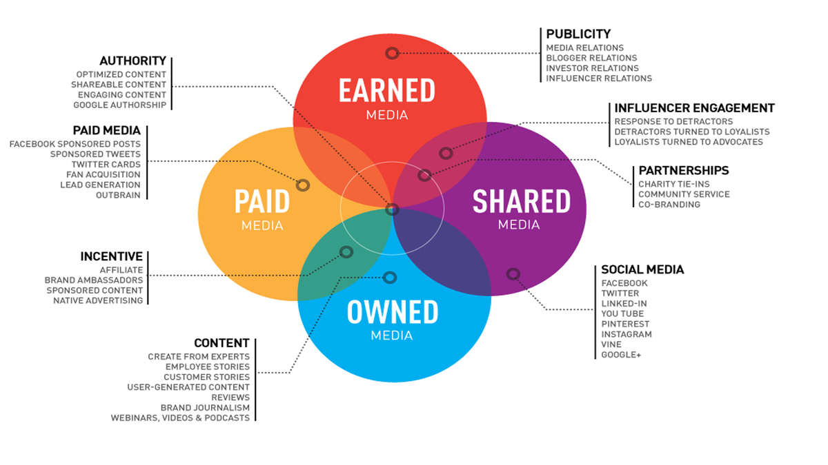
PESO Model
Image credit: Mashable
Notes:
Example:
Let's say a company wants to promote a new product launch. They can use the PESO model to develop an integrated marketing strategy that leverages all four media types:
Paid media: The company can run paid advertising campaigns on social media, search engines, or other digital platforms to reach their target audience and promote their new product.
Earned media: The company can reach out to journalists, influencers, and bloggers to review their new product and generate buzz and publicity through positive reviews and mentions.
Shared media: The company can create shareable content such as videos, infographics, or blog posts that highlight the benefits and features of their new product and share them on social media and other online communities to engage with their target audience and encourage them to share the content with their own networks.
Owned media: The company can use their own channels such as their website, email newsletters, or social media accounts to promote their new product, provide in-depth information, and offer special promotions to their loyal customers.
By using the PESO model, the company can create a comprehensive and cohesive marketing strategy that integrates different media types to maximize their reach, build trust and authority, and drive engagement and sales for their new product launch.

Slide 6
Social Media Analytics
What does it mean?
The goal of Social media analytics is to find meaning in the social media data from social channels to support marketing decisions.
It also measures the performance of actions.

Slide 7
Important concepts social media analysis
Click-through-rates: the number of clicks that you receive divided by the number of times your ad is shown.
Conversion rate: a percentage to evaluate performance of marketing campaigns, conversions or traffic.
Cost per mille: price per one thousand views (impressions)
Engagement rate: metric that track how actively involved your audience is with your content
Leads: a contact already determined to be a (potential) customer

Slide 8
Hootsuite
Notes:
Hootsuite is a social media management platform that allows businesses and individuals to manage their social media presence from a single dashboard.
With Hootsuite, users can schedule posts, engage with their audience, and monitor their social media performance across multiple social networks such as Facebook, Instagram, Twitter, and LinkedIn.
Hootsuite offers a range of features such as social media analytics, team collaboration, and social listening that help businesses to optimize their social media strategy and improve their social media ROI.
Source: Hootsuite.

Slide 9
Hootsuite: Social Media Trends 2023: welcome to the wildest future, y'all
https://www.youtube.com/watch?v=5A2NDsibmZI&t=9s&ab_channel=Hootsuite
Notes:
An example video how Hootsuite works with the trends in social media for 2023.
Source: Hootsuite.

Slide 10
Coosto
Notes:
Coosto is a social media monitoring and analytics tool that helps businesses to listen to and engage with their audience across different social media channels.
With Coosto, users can track and analyze social media conversations related to their brand, industry, or competitors in real-time.
Coosto offers a range of features such as sentiment analysis, keyword tracking, and social media publishing that help businesses to improve their social media strategy and optimize their online presence.
Source: Coosto.

Slide 11
Perfect Post Calculator
Notes:
The Perfect Post Calculator of Coosto (is free to use) analyzes a user's social media post based on factors such as content, tone, length, and timing to determine how likely it is to be engaging and effective.
The tool provides users with a score for their post and suggestions for how to improve it, such as adding more visuals, adjusting the tone, or posting at a different time.
The Perfect Post Calculator is available for Facebook and can be a valuable tool for businesses and individuals looking to improve their social media performance and increase their engagement with their target audience.
Source: Coosto.

Slide 12
Perfect Post Calculator
“Timing still is an important factor when it comes to engagement on your Instagram posts. Small changes in time of publication can lead to significant changes in the number of views, likes and comments.”
Uncover your best time to post, ideal post length, hashtag use and more, all in one spreadsheet.
https://www.coosto.com/en/knowledge-center/content-marketing/perfect-post-calculator

Slide 13
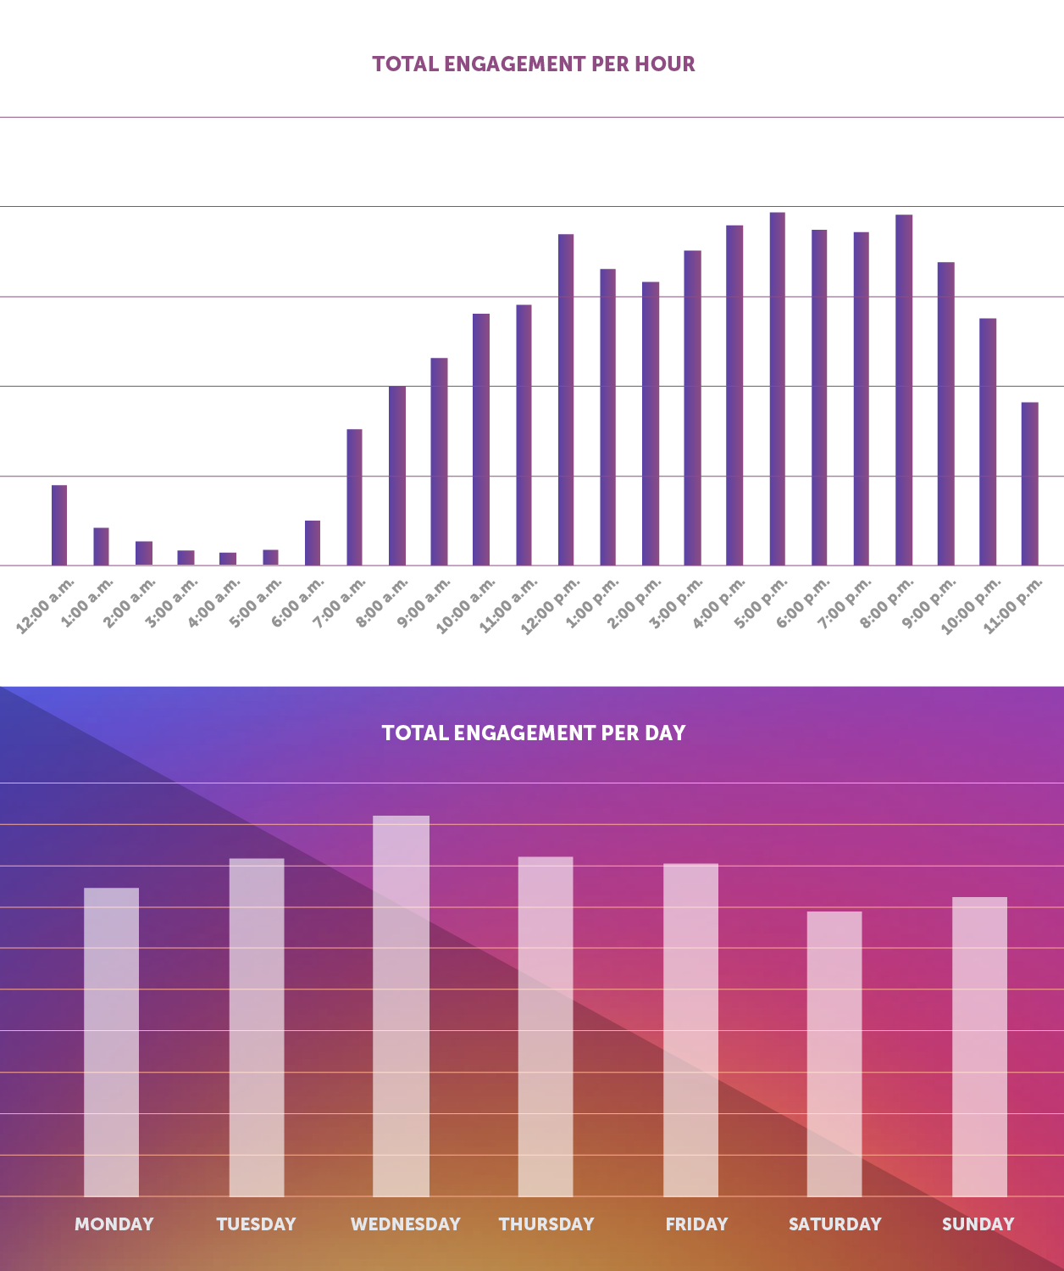
Best time to post on Instagram
https://www.coosto.com/en/blogs/best-time-post-instagram
Notes:
Source: Coosto.

Slide 14
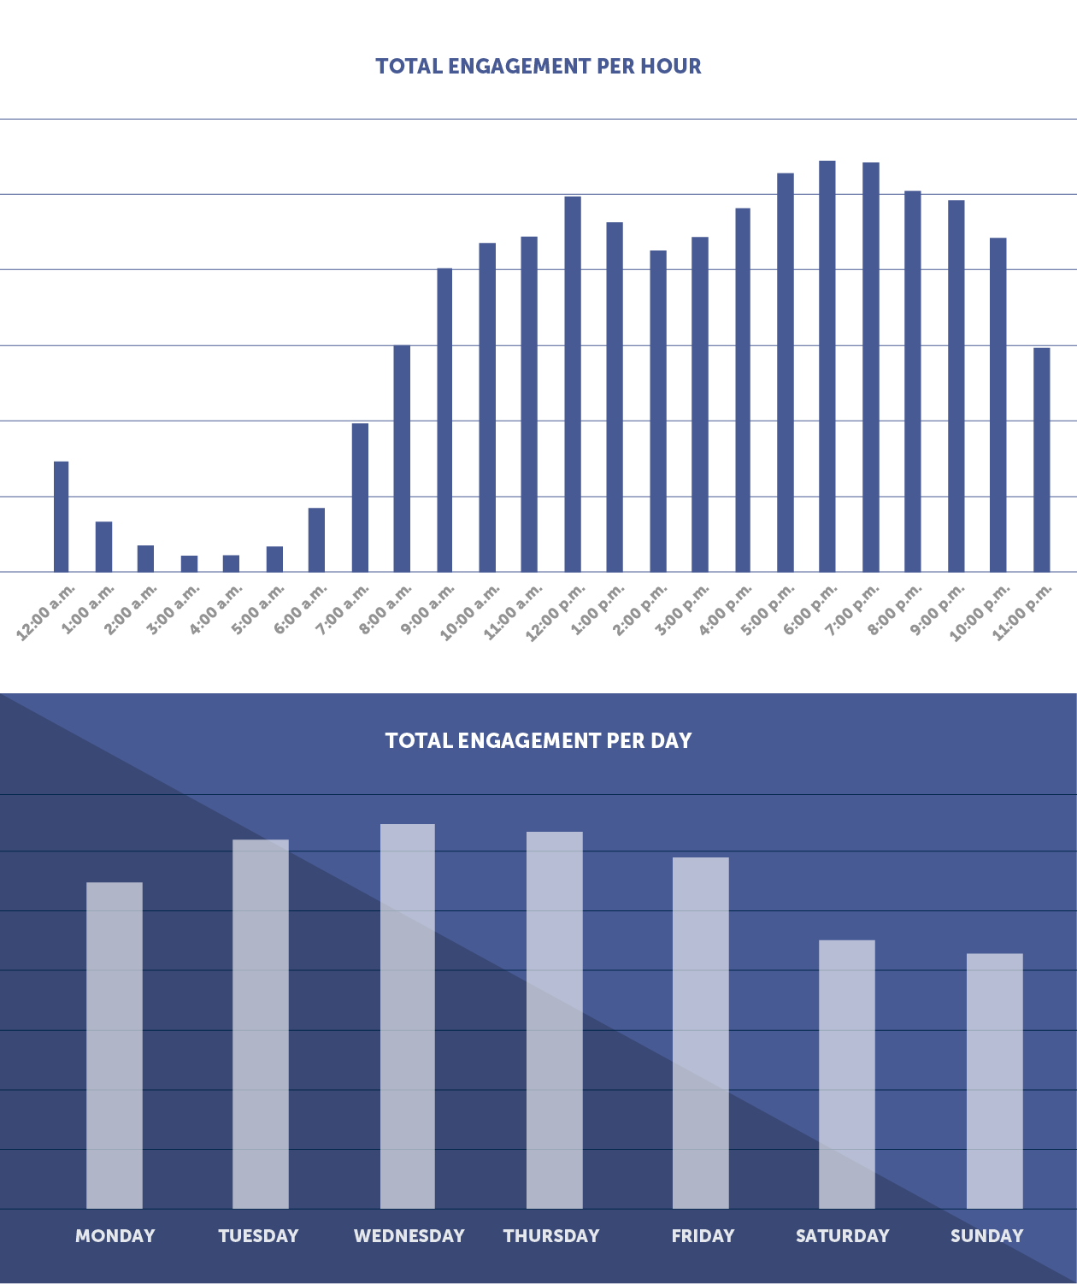
Best time to post on Facebook
https://www.coosto.com/en/blogs/best-times-post-facebook-2020
Notes:
And a Facebook example, source: Coosto.

Slide 15
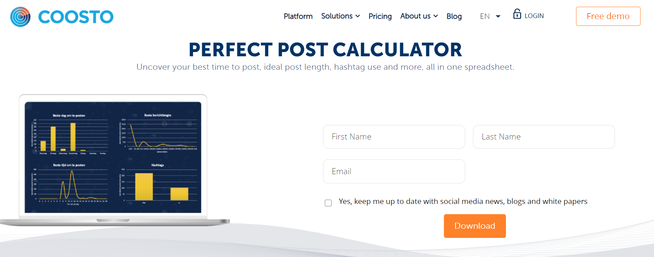
For your own business:
https://www.coosto.com/en/knowledge-center/content-marketing/perfect-post-calculator

Slide 16
OK. And more concrete now:
01
02
03
04
1. Download the calculator
2. Download the data
3. Paste the data in the calculator
LIVE DEMO!
Notes:
Download link: https://www.coosto.com/en/knowledge-center/content-marketing/perfect-post-calculator

Slide 17
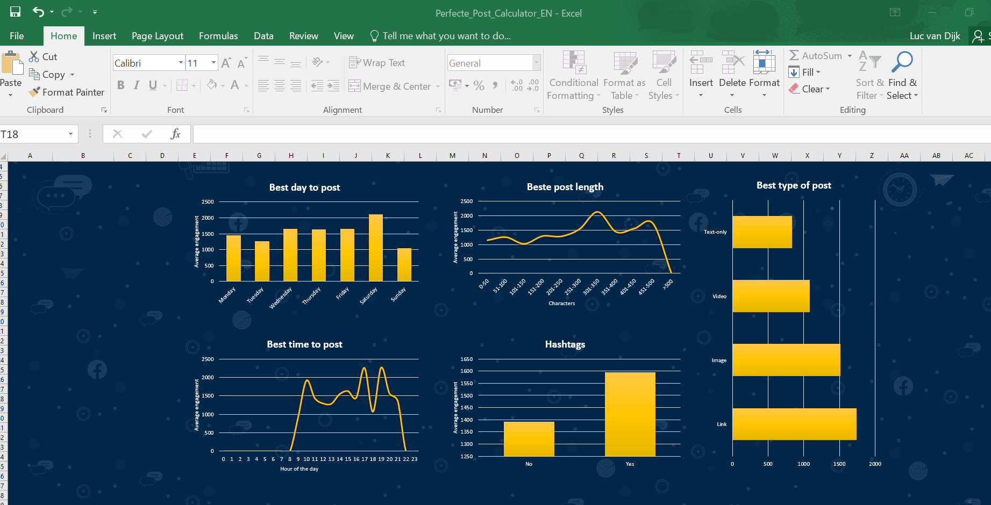
Notes:
Example of the calculator

Slide 18
Questions?

Slide 19
Do’s and Dont’s for your listening report
Figure out three do’s and dont’s regarding your theme for marketing professionals.
Make your recommendations as practical as possible

Slide 20
Disclaimer
The DEMS material aims to enhance digital marketing skills in higher education, comprehending the essential needs in organizations. You have access to extensive slide sets with in-class activities and assignments, as well as detailed user instructions for teacher.
Note: The material includes contents and figures retrieved from the internet and is thus subject to changes. The sources have been announced according to the rules of fair use. The publisher´s responsibility is restricted to the original material stored at www.dems.pro. All material is produced for open use and co-funded by Erasmus +.

