Slide 1
To Work! Create your own listening report
Professor
School
Digital Analytics and Monitoring
Notes:
Hey there, teacher extraordinaire! Get ready to rock the stage and leave your students wanting more! Your witty remarks and charming personality are sure to keep everyone engaged and entertained. So, go ahead and dazzle them with your brilliance!

Slide 2
Learning Objectives
Students can use online tools to research their own trend
Students can substantiate and present why their trend is relevant to their audience
Students are able to perform a systematic listening analysis using digital tools.
Notes:
By learning to use online tools to research their own trend, students will gain practical experience in conducting online research and identifying key trends in their industry or field of interest.
Being able to substantiate and present why their trend is relevant to their audience will help students to develop their communication and presentation skills, as well as demonstrate their ability to think critically and strategically about their marketing efforts.
Learning to perform a systematic listening analysis using digital tools will equip students with a valuable skill set that is in high demand in the marketing industry, and enable them to make data-driven decisions that can drive real results for their business or organization.

Slide 3
Topics
Personal Pitches
How to?
Questions?

Slide 4



Personal presentations
Pitch, max. 2 minutes
Give your feedback!
Tops and tips
What is your topic?
Why is your topic important to today’s marketers?
Notes:
In today's fast-paced marketing landscape, it's crucial to stay up-to-date with the latest trends and topics to succeed. As marketers, it's important to be able to pitch our ideas and strategies effectively to capture the attention of our audience. In this assignment, you will have the opportunity to pitch your topic in a two-minute presentation and explain why it's important for today's marketers. This exercise will help you refine your communication skills and develop a persuasive pitch that resonates with your audience.

Slide 5
Assignment: write a Listening report
How to make a Listening Report? After selecting your theme :
Step 1: Use a multichannel approach and map relevant blogs, websites, offline magazines, papers and thought leaders regarding your theme.
Step 2: Read what they are writing about your theme.
Step 3: Summarize what they are talking about and write your Listening Report.
Suggestion: limit yourself to 5 sources per paragraph but use at least 3.

Slide 6
Enough inspiration. Start doing it yourself!
Make your own listening report!

Slide 7


Possible trends for your essays
Blockchain technology
Social Business
VR in advertising / advertising in VR
Storytelling
Content marketing
Mobile
Online customer experience
Native Advertising
Fashion
Cultural sector
Journalism future
… et cetera
In what theme/topic do I want to be a specialist?
Post Covid theme: what is the new normal in customer service or advertising or branding?

Slide 8
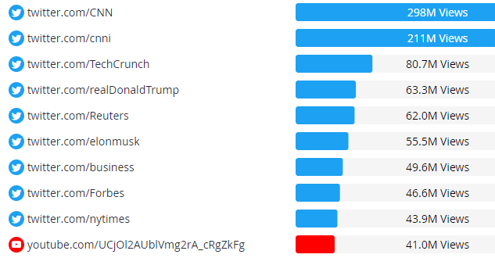
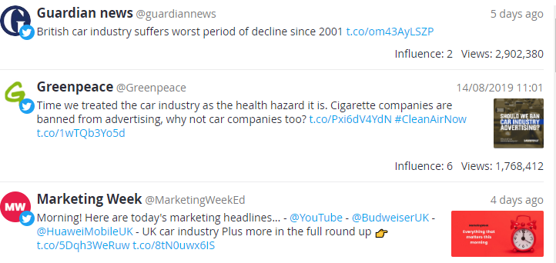

Practice at home:
Example car industry:
Start researching your theme.
Use it as starting point for your listening report.
Prove that you used a social listening program in your listening report.

Slide 9



Select your theme, map your ‘playing field’
Use searching tools to map relevant blogs, websites, offline magazines, papers and thought leaders about your theme (personal branding).
Write your listening report for today’s marketers.
Requirements:
Listening report: 1500 words (plain text).
APA references
Include a title page

Slide 10
Questions?

Slide 11
Disclaimer
The DEMS material aims to enhance digital marketing skills in higher education, comprehending the essential needs in organizations. You have access to extensive slide sets with in-class activities and assignments, as well as detailed user instructions for teacher.
Note: The material includes contents and figures retrieved from the internet and is thus subject to changes. The sources have been announced according to the rules of fair use. The publisher´s responsibility is restricted to the original material stored at www.dems.pro. All material is produced for open use and co-funded by Erasmus +.

