Slide 1

Content Marketing:
Content Planning

Slide 2

Learning Objectives
• Relate content to goals
• Choosing the best channels according to the content to be broadcasted
• Planning content strategy
• Planning global digital content
• Planning website content for each channel

Slide 3

• Planning Content and Goals
• Planning Channels and Content
• Planning the Content Strategy Canvas
• Digital Content Plan
Topics
• Website Content Plan
ꢀ
• Blog Content Plan
• Social Media Content Plan
• Emailing Content Plan
• Advertising Content Plan
• Bibliography

Slide 4

“A goal without a plan is just a wish.”
Antoine de Saint-Exupéry

Slide 5

Planning Content and Goals

Slide 6
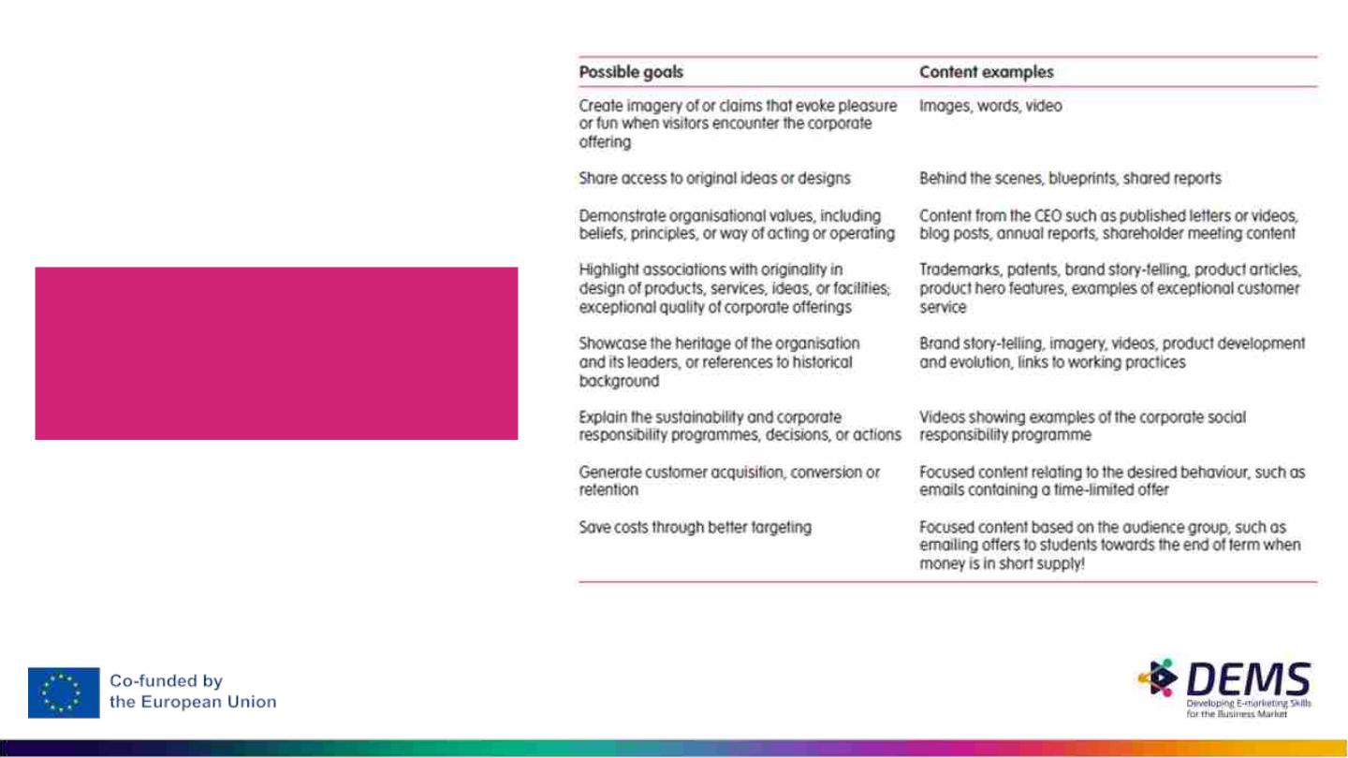
Planning Content
and Goals
Choosing the most
suitable content for the
intended goals
Source: Molleda, 2010.

Slide 7
Planning Channels and Content

Slide 8
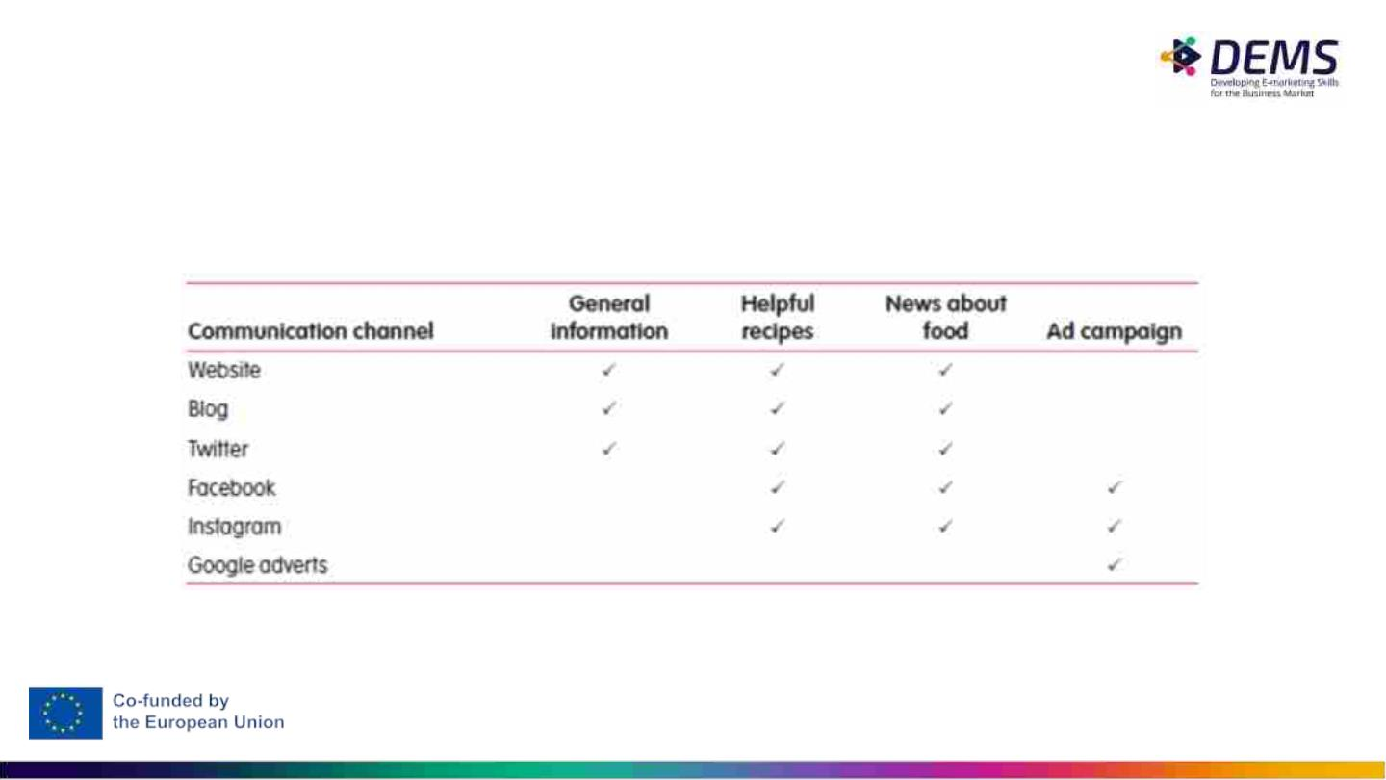
Planning Channels and Content
The channel should be chosen according to the content
Source: Hanlon, 2019, p. 267.

Slide 9
Planning the Content Strategy
Canvas

Slide 10
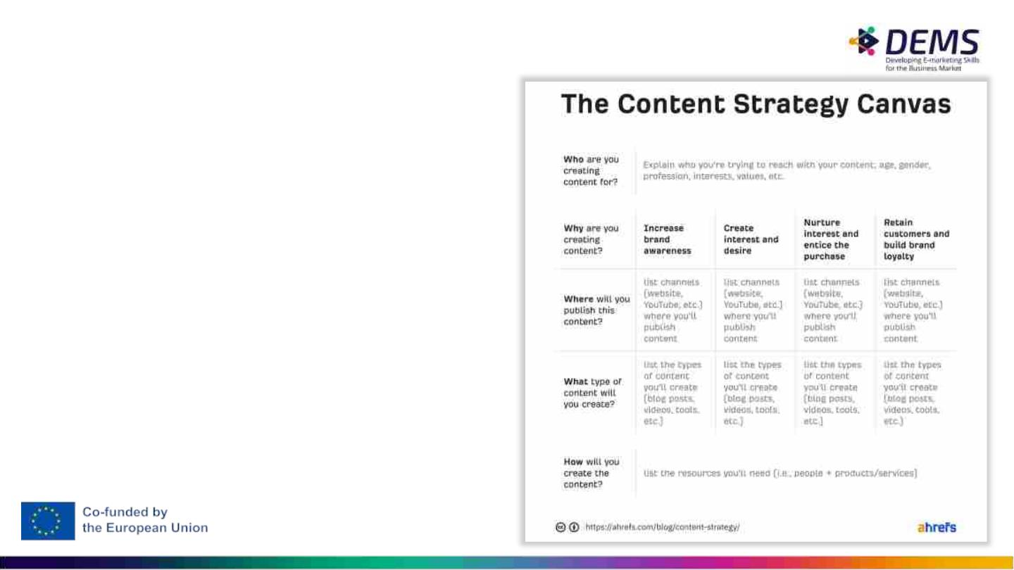
Planning the Content
Strategy Canvas
• We should try to plan the
content taking into
consideration objectives,
channels, type of content,
subjects to be covered
• Diversity should be privileged
in the planning

Slide 11
Content Plan
• Content creation is often planned and managed within a content calendar
• per channel can be good practice
• allows you to check where there are gaps in the content
• make sure the content is ready in plenty of time
• enables responsibilities to be assigned
• Planning content allows timely finding of themes and convenient illustration
of content

Slide 12
Digital Content Plan

Slide 13
Digital Content Plan
• Presents the global vision of the content that is intended to be distributed
through all channels
• Facilitates the analysis of the distribution of content by personas
• Facilitates the analysis of the distribution of content by goal
• Allows an overview of the distribution of content throughout the month
• Allows to check that all three areas of the funnel are being fed content

Slide 14
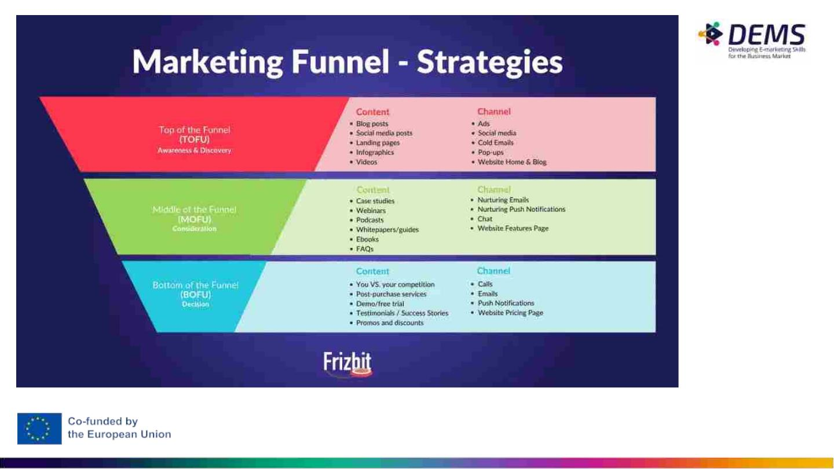
Source: https://frizbit.com/blog/marketing-funnel-explained-optimize-your-full-funnel-strategy/

Slide 15
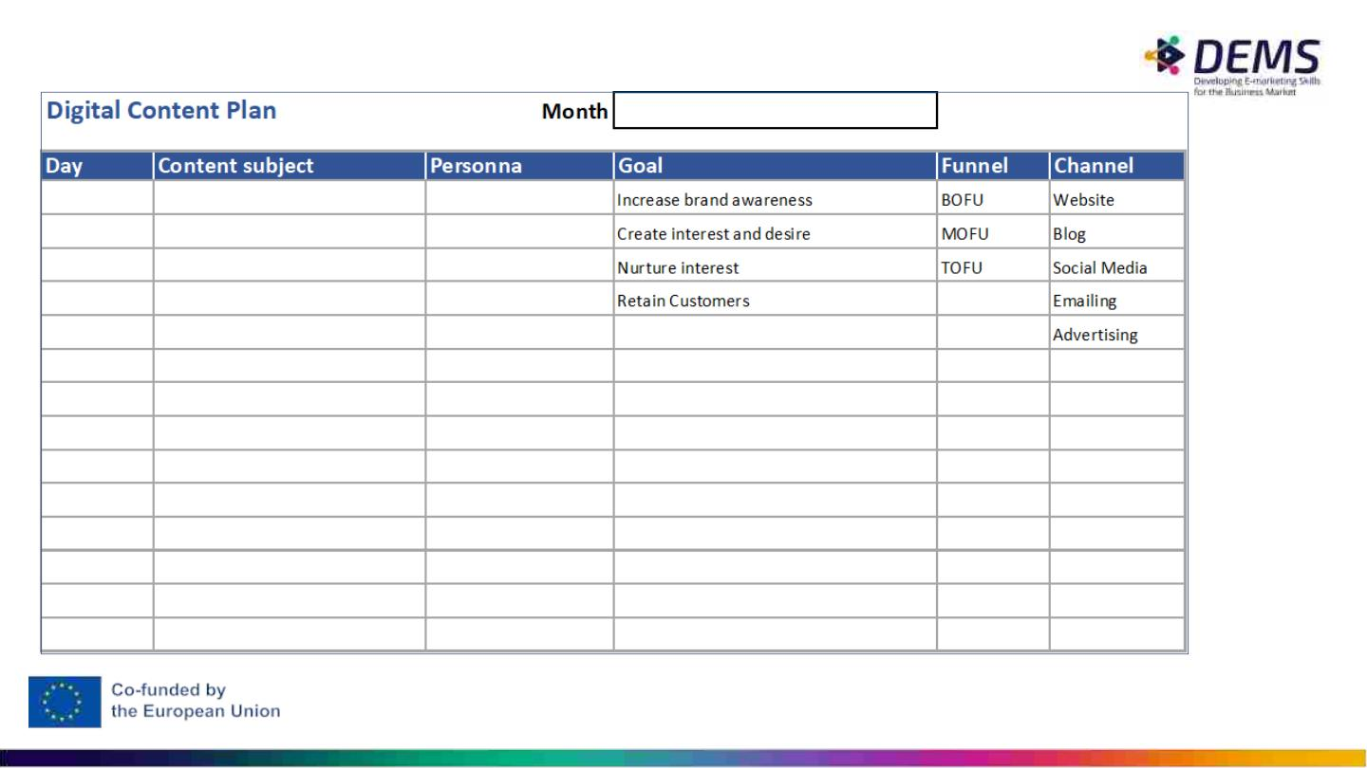

Slide 16

In-Class Activity
● In group (2 or 3 persons).
● Choose a brand and make the planning for one week.

Slide 17
Website Content Plan

Slide 18
Website Content Plan
• Review periodically the content of the website
• Review/update the existing content
• Create new sections with new content
• Choice graphic elements and other elements that add value
• Define the role of each page in the funnel
• Disseminate the page through the organisation's other channels

Slide 19
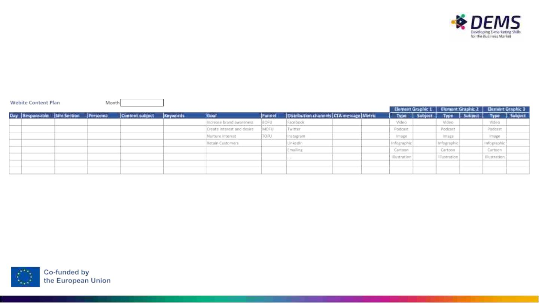

Slide 20
In-Class Activity
● In group (2 or 3 persons).
● Keeping the brand or company chosen previously, using the
map presented above, propose content for 7 pages of the
brand website.

Slide 21
Blog Content Plan

Slide 22
Blog Content Plan
• Promote different subjects
• Motivate choice graphic elements and other elements that add value
• Define the role of each blog post in the funnel
• Facilitates the blog post dissemination through the organisation's other
channels
• Stimulates the use of CTA

Slide 23
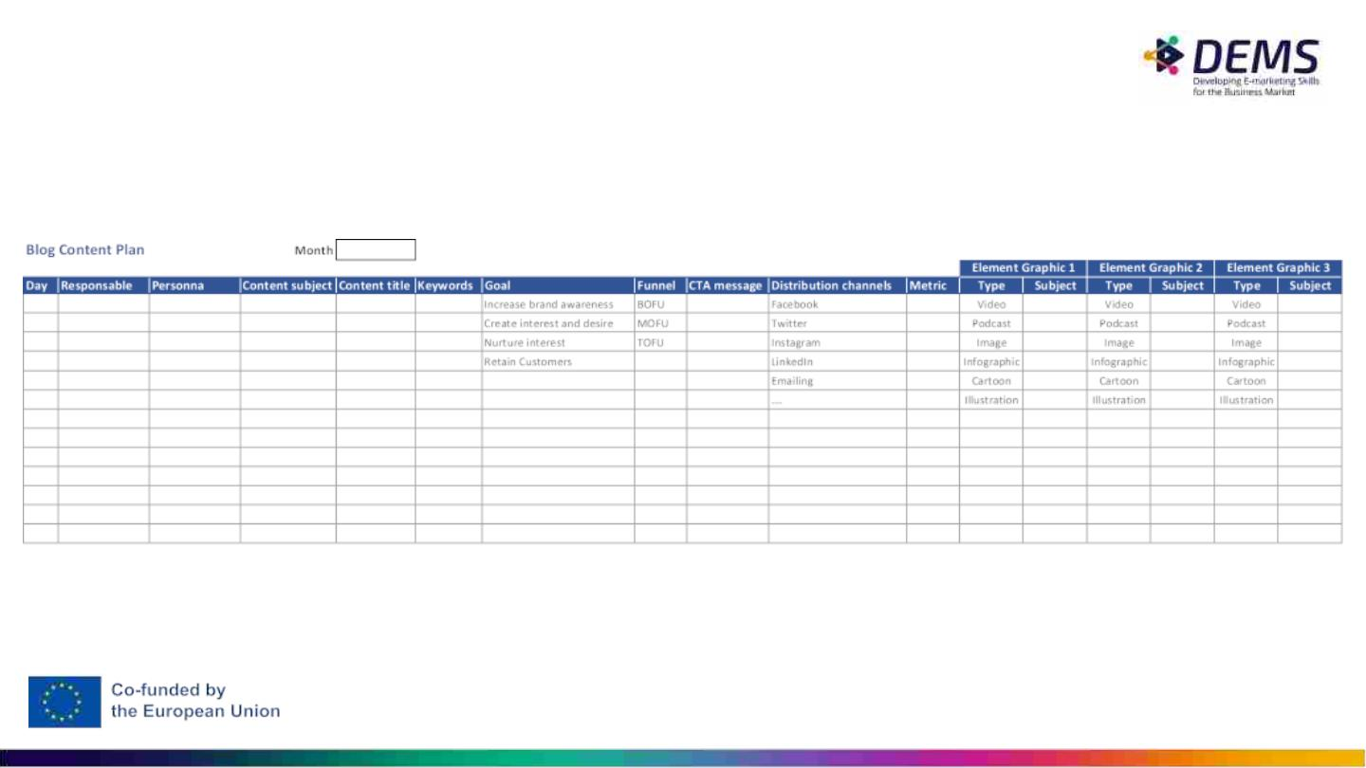

Slide 24
In-Class Activity
● In group (2 or 3 persons).
● Keeping the brand or company chosen previously, using the
map presented above, propose blog content for one month.

Slide 25
Social Media Content Plan

Slide 26
Social Media Content Plan
• Helps distribute content across different social networks
• Facilitates diversification of the subjects to be covered
• Encourages reflection on the graphic elements to be used
• Supports the publication of third-party content
• Define the role of each post in the funnel

Slide 27
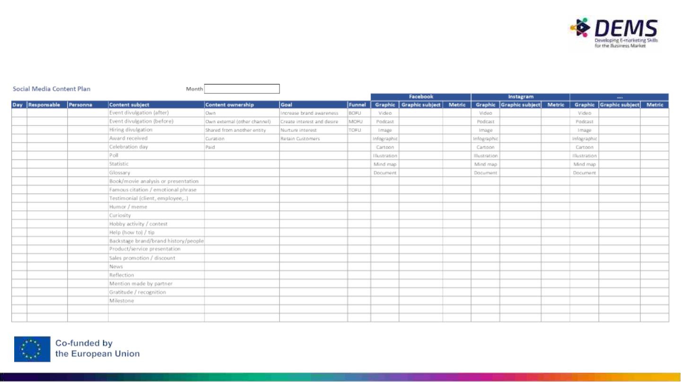

Slide 28
In-Class Activity
● In group (2 or 3 persons).
● Keeping the brand or company chosen previously, using the
map presented above, propose social content for 7 days.

Slide 29
Emailing Content Plan

Slide 30
Emailing Content Plan
• Helps distribute content across different emailing type
• Facilitates diversification of the subjects to be covered
• Encourages reflection on the graphic elements to be used
• Define the role of each communication in the funnel
• Stimulates the use of CTA

Slide 31
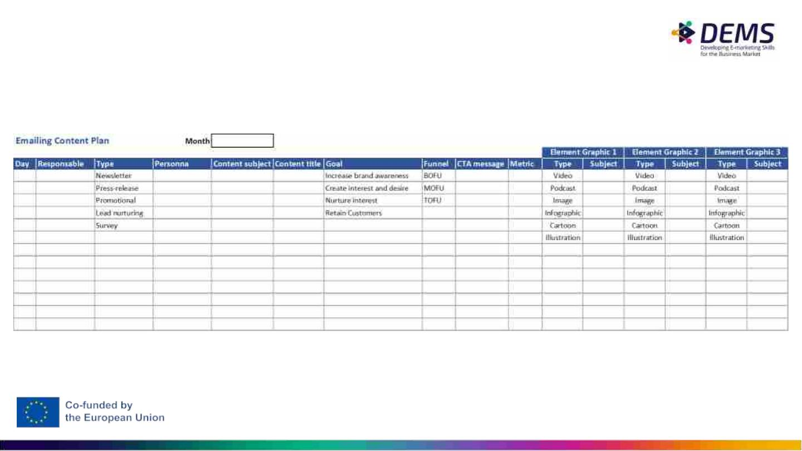

Slide 32
In-Class Activity
● In group (2 or 3 persons).
● Keeping the brand or company chosen previously, using the
map presented above, propose emailing content for one
month.

Slide 33
Advertising Content Plan

Slide 34
Advertising Content Plan
• Helps distribute advertising content across different platforms and have
a timeline vision
• Facilitates diversification of the ads to be covered
• Facilitates integration with other content
• Encourages reflection on the graphic elements to be used
• Define the role of each ad in the funnel
• Stimulates the use of CTA

Slide 35
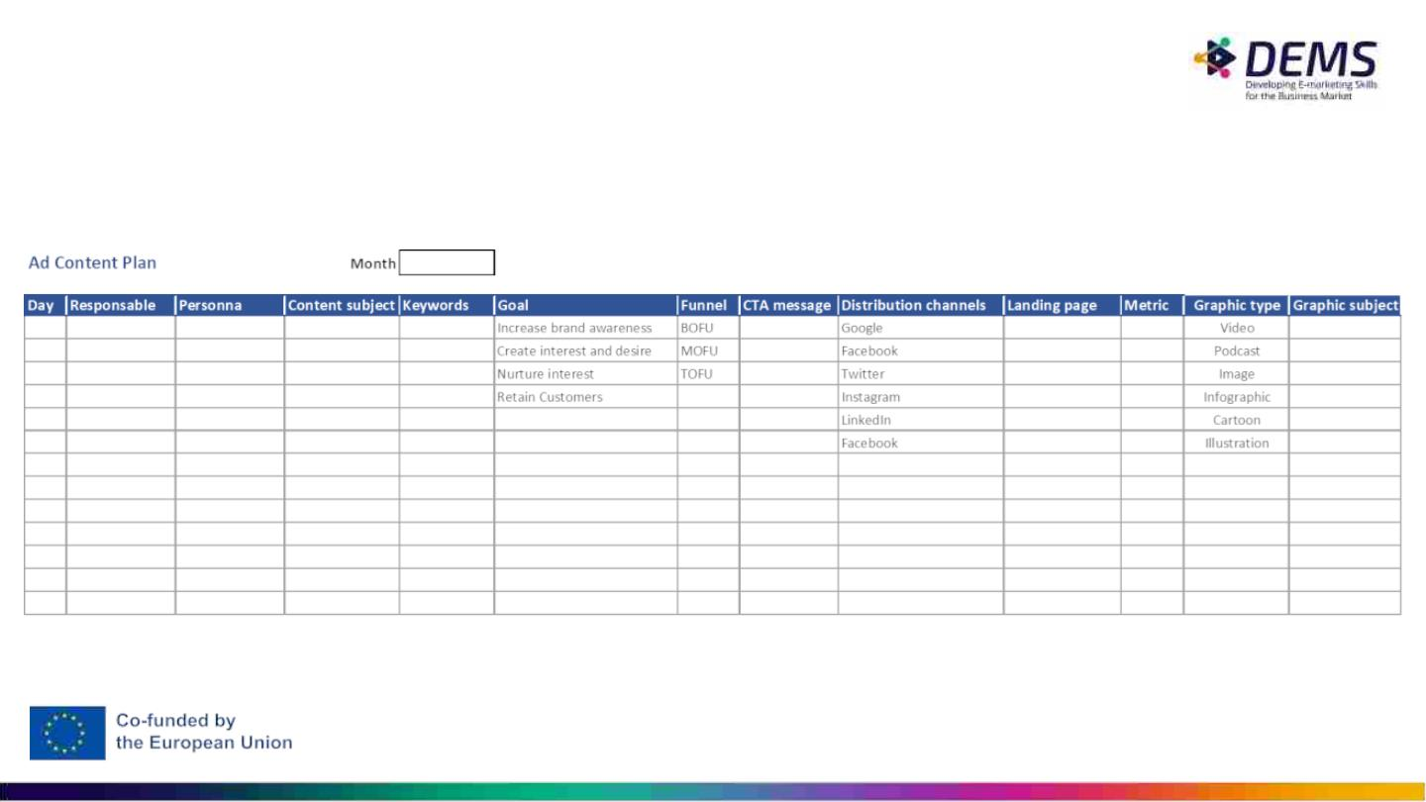

Slide 36
In-Class Activity
● In group (2 or 3 persons).
● Keeping the brand or company chosen previously, using the
map presented above, propose advertising content for 7 days
(one ad for each day).

Slide 37

Assessment Activity
• Individual assessment
• Having in mind the map that synthesises the content and the other
maps, per channel, that incorporate more detailed information, the
student must analyse the programmed content, analysing aspects such
as periodicity, diversity of content, diversity of channels used and other
aspects that were presented throughout this course.
• The student should analyse the maps made by another group.

Slide 38
Bibliography

Slide 39
Bibliography
Hanlon, A. (2109). Digital Marketing: strategic planning & integration. Sage.
Molleda, J. (2010). Authenticity and the construct’s dimensions in public relations and communication
research. Journal of Communication Management, 14(3), 223–236.

Slide 40
Important Notice
The DEMS material aims to enhance digital marketing skills in higher
education, comprehending the essential needs in organizations. You have
access to extensive slide sets with in-class activities and assignments, as
well as detailed user instructions for teacher.
Note: The material includes contents and figures retrieved from the
internet and is thus subject to changes. The sources have been
announced according to the rules of fair use. The publisher´s
responsibility is restricted to the original material stored at www.dems.pro.
All material is produced for open use and co-funded by Erasmus +.

