Slide 1
Content Marketing:
Social Media

Slide 2
Learning objectives
Pre-requisite for student: Introduction to digital marketing is recommended.
The student is able to
describe the social media landscape and its development
understand the benefits of social media marketing
assess the effectiveness of the social media performance of the organizations
create engaging content in social media
create a social media strategy

Slide 3
Topics
What is social media?
Social media marketing
Campaigns in social media
Content creation
Assignments

Slide 4
What is social media?

Slide 5
What is social media - Definitions
“Internet-based platforms that allow users to create profiles for sharing user-generated or curated digital content in the form of text, photos, graphics, or videos within a networked community of users who can respond to the content.”
(Burns 2017)
COMMON TO ALL DEFINITIONS
  Web-based
  Users create a profile for themselves
  Possibility to share material with the rest of the community (e.g. text, images, graphics, videos)
  Other users can react to and respond to shared material
“Forms of electronic communication (such as websites for social networking and microblogging) through which users create online communities to share information, ideas, personal messages, and other content (such as videos)”
(Merriam-Webster Dictionary)
Notes:
There is no single definition for social media. However, all the definitions share the features stated in the box.
The first modern social media channels started in the early 2000s
LinkedIn & MySpace launched in 2003
Facebook started in 2004
Twitter 2006
Weibo 2006
Instagram and Pinterest 2010
Snapchat 2011
TikTok 2017
Read more about the history of social media:
https://www.searchenginejournal.com/social-media-history/462643/#close
https://online.maryville.edu/blog/evolution-social-media/

Slide 6
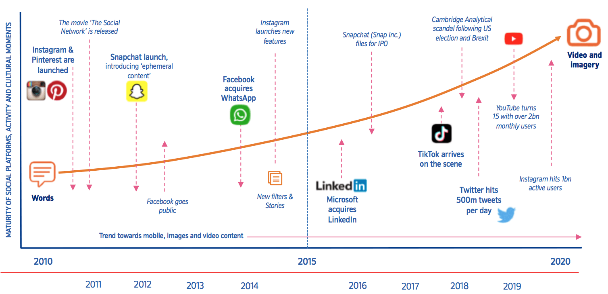
Social Media under constant change
https://www.smartinsights.com/ecommerce/ecommerce-strategy/social-commerce-trends/
Notes:
The social media landscape changes all the time:
New channels are launched, old channels lose their share of users.
E.g. Facebook was originally THE social media for young adults. Now the youngsters use TikTok and Snapchat, and Facebook is the social media of the middle aged and older.
Also the types of contents in the social media channels have changed.
There has been a shift from simple, text-based updates, to increasingly visual and ephemeral contents.
https://www.smartinsights.com/ecommerce/ecommerce-strategy/social-commerce-trends/

Slide 7










The numbers of users (2022)
Facebook 2,9 billion users
TikTok 1 billion users
YouTube 2,5 billion users
FB Messenger 0,9 billion users
Whatsapp 2 billion users
Snapchat 0,6 billion users
Instagram 2 billion users
Twitter 0,5 billion users
WeChat 1,3 billion users
Pinterest 0,4 billion users
https://datareportal.com/reports/digital-2023-global-overview-report
Notes:
This is not the list of the most popular social media: Amongst 20 most-used social platforms there are several Chinese social media platforms, e.g.
WeChat (1,3 billion users)
Sina Weibo (0,6 billion users)
Kuaishou (0,6 billion users).
The favorite channels are different for different age groups. Also female and male users have different preferences. Find more information: https://datareportal.com/reports/digital-2023-global-overview-report

Slide 8




Social Media plays a significant role in our everyday lives
THE TYPICAL USER HAS AN ACCOUNT ON MORE THAN 6 DIFFERENT SOCIAL MEDIA PLATFORMS AND SPENDS AN AVERAGE OF CLOSE TO 2½ HOURS USING SOCIAL MEDIA EACH DAY.
ASSUMING THAT PEOPLE SLEEP FOR BETWEEN 7 AND 8 HOURS PER DAY, THESE LATEST FIGURES SUGGEST THAT PEOPLE SPEND ROUGHLY 15 PERCENT OF THEIR WAKING LIVES USING SOCIAL MEDIA
THE TYPICAL USER FOLLOWS DIFFERENT TYPES OF SOCIAL MEDIA ACCOUNTS. HOWEVER, THE ACCOUNTS OF FRIENDS AND FAMILY MEMBERS ARE THE MOST FOLLOWED.
SOCIAL MEDIA USERS ARE MORE LIKELY TO SAY THEY HAVE LEARNT PRACTICAL LIFE SKILLS FROM SOCIAL PLATFORMS (57 %) THAN FROM UNIVERSITY (51%)
https://hootsuite.widen.net/s/gqprmtzq6g/digital-2022-global-overview-report

Slide 9



Main reasons why we use social media
Keeping in touch with friends and family 47,6%
Filling spare time 36,3%
Reading news stories 35,1%
Finding content 31,6%
Seeing what’s being talked about 29,5%
Finding inspiration for things to do and buy 27,7%
Finding products to purchase 26,3%
Sharing and discussing opinions with others 24,5%
Making new contacts 23,9%
Watching live streams 23,8%
Seeing content from your favourite brands 23,1%
Source: https://hootsuite.widen.net/s/gqprmtzq6g/digital-2022-global-overview-report

Slide 10
In-class activity
Form a group of 4-5 people.
Choose an interesting company or organization, and analyze its social media presence.
Provide the following information:
A brief overview of the company (e.g. industry, size, products/services)
Which social media channels it uses?
What kind of content does the company produce for social media? (posts, videos, competitions, etc.)
Who do you think their social media content is aimed at?
Do you think the content is interesting to the company's target group?
What do you think the company is aiming for with its social media?
How actively does the company publish on social media?
What kind of suggestions for improvement would you give the company regarding the use of social media?
Make a presentation about your insights and present them in the class.

Slide 11
Social media marketing

Slide 12
Why to use social media marketing (SMM)
To build company’s brand & increase brand exposure
To reach new customers & engage with the existing ones
To grow sales
To drive traffic to the website
To learn more about your customers
To deliver customer service
https://blog.hootsuite.com/smart-social-media-goals/
https://blog.hootsuite.com/social-media-customer-service/
https://www.contentstadium.com/blog/how-to-drive-traffic-from-social-media-to-your-website/
https://buffer.com/library/social-media-goals/
Notes:
https://www. socialmediaexaminer.com/13-facebook-engagement-tactics-business-page/
Brand
- As the numbers of social media users are high, it provides a possibility to reach potential customers
- The company can humanize the brand e.g. by showing how the products works in real life (images, videos)
- The contents shared by the users important 🡪 when peers recommend the product & share posts using them – considered more trustworthy than advertising
2) New customers & engaging with existing customers
- Generate leads e.g. with CTA, clickable contents, contests, discount codes- Interact with customers – e.g. comments,
- SMM helps a company to get direct feedback from the customers. Important to react and answer to the comments from the customers and make them feel that they are being heard. The right tone is important, when communicating with the customers. This aspect of SMM is called social customer relationship management (social CRM).
3) Grow sales
With interesting, timely and relevant social media posts, the company can engage the audiences, and increase sales.
4) Driving traffic to website
It is important to get the audience to visit the company website/blog/webstore, where the company can provide solutions to their problems and needs. The more visitors there are, the more possibilities there is to get more customers.
5.) To learn more about your customers
Social media provides a lot of possibilities to learn more about your customers, their needs and values.
You can follow the analytics to learn what kinds of content is appreciated by your audience.
You can discuss with you audience by e.g. asking questions or comments (just remember to reply to them!)
One can also study their profiles, see what kind of content they themselves publish and whom they follow.
6) To deliver customer service
Social media provides more channels for delivering customer service. You might get comments, questions or mentions through social media - and you should use this opportunity to reply and thus help your customers. By using a right tone of voice and answering quickly, your customers feel that you care for them.
You can also use social media proactively in customer service e.g. by creating content which provides answers to the most frequently asked questions.

Slide 13

Organic Post, Ad or Boosted Post?
Organic contents mean the contents published on the company’s own social media channels.
Organic contents are visible to those who follow the company or brand.
Advertising means the paid contents (videos, posts, other contents) which are targeted to the desired audience. These are visible also to those who do not follow the company’s channels.
Boosted Posts are organic contents published on company’s social media channels, but by paying they are shown also to larger audiences.
Why to use paid ads?
The business of social media channels is based on advertising algorithms don’t support organic reach
The organic reach has declined most in Facebook, but the trend is similar also in Instagram
  Source: https://neilpatel.com/blog/13-secrets-thatll-boost-your-facebook-organic-reach/

Slide 14

Social Media Influencers
Influencer marketing is now a mainstream form of online marketing.
Who is an influencer?
  A person who has the power to affect the purchasing decisions of others because of his/her authority, knowledge, position, or relationship with his or her audience.
A celebrity isn’t an influencer.
  Most influencers have systematically built a keen and enthusiastic audience à It is not accidental that these people follow influencers rather than a brand.
  The audience doesn't care about the brand, they only care about the opinions of the influencers.

Slide 15
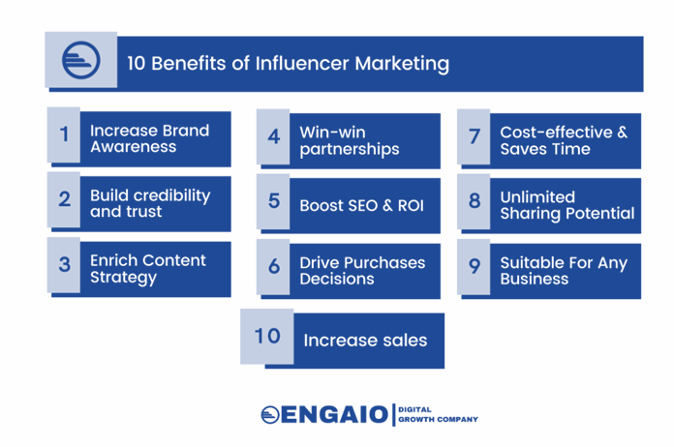
Influencer Marketing
Influencer marketing is a relationship between a brand and an influencer.
The influencer promotes the brand's products or services through various media outlets such as Instagram and YouTube.
Influencer marketing allows brands to locate and advertise directly to their target audience.
Consumers are becoming increasingly skeptical of brands and their marketing tactics, and building trust is crucial.
Advertising through influencers allows brands to promote through someone that a niche community watches, engages with and trusts on a daily basis.
https://engaiodigital.com/influencer-marketing/

Slide 16
Social Media & customer (decision) journey
Videos, materials produced by other users, social media communities, etc. strengthen the purchase decision and promote the enjoyment of the product
Following brands, likes, own posts about them engage the customer and increase loyalty
The buyer can share information about his/her own purchase on social media and others can react to it.
Social Media ads, posts, likes from influencers etc.
Content shared by users about the product, reviews, etc. effective marketing
Content, reviews, etc. shared about the product by other users.
CONSIDER
EVALUATE
BUY
ENJOY
ADVOCATE
BOND
(Adapted from: Atherton 2020 Social media strategy : a practical guide to social media marketing and customer engagement.)
Notes:
Social media has different roles in the different phases of the customer decision journey.
See Atherton 2020 Social media strategy : a practical guide to social media marketing and customer engagement for more details.

Slide 17
Social media strategy
1. Set goals
  The goals have to be linked to the company’s overall strategy
  Goals can be e.g.
    To generate leads
    To increase sales
    To raise awareness
    To increase customer engagement
2. Create buyer personas
  You have to know whom you are reaching for:
    Age, gender, location, education
    Which channels do they use? How? When?
    What are they looking for?
    What kind of contents do they like?
    What are their painpoints / goals in which your brand can help?
3. Choose channels and create contents
  Be where your buyer personas are!
  Make a content plan with
    Timing of the post
    For which buyer persona is it aimed for
    Summary of the planned contents
    In which channel will it be published
    How will the success be measured
    Who is responsible for this post?
4. Set the metrics
  How do you know if your SMM is successful or not?
  Possible metrics e.g.
    Sales, clicks, likes, increased traffic on website
  Set the metrics according to your goals and monitor systematically.
Notes:
Remember SMART goals
Who are your customers:
What channels does your customer use?
How do your customers use the channel?
What do your customers want from your business?
What information are customers looking for?
What are your customers interested in?
What kind of content do your customers like?
And above all – how your brand can help them in their painpoints / to achieve their goals?
3) The role of Social media as a vital part of content marketing is to be a channel to share the content. Ie. to promote it to your buyer personas
Therefore it is very important you find out which social media channels your personas use. And then be active in those channels.
4) Which metrics are the best to describe whether your campaign succeeded or not depends on what you aimed to achieve. E.g. Number of likes on Instagram posts does not necessarily correlate with increased sales.

Slide 18
Campaigns in social media

Slide 19
What Makes a Good Social Media Ad
(or boosted post)
A clearly defined goal
  More fans or likes? Drive website traffic? Event attendance? Leads? Traffic ads or conversion ads? See video
Target audience
  Not too wide! In content marketing sharp targeting is key
  Keep in mind your buyer personas goals & interests (you cannot target to them, though!)
Grab attention!
  ”1 second rule” = you have one second to stop the thumb
  Visuals + heading + copy
  High quality, eye catching images and videos
Call to action (CTA)! What do you want him/her to do?
  to read your blobpost, what is the key benefit for him/her? Why would he/she read it? Tell it!
Make sure your post links to a relevant landing page

Slide 20
Why SMART?
They direct your marketing to the right direction. Ie. align with business goals.
They are measurable. If objectives are not measurable, they’re not worth much.
Good and useful for all objectives in digital marketing
Specific
Measurable
Achievable:
Relevant
Timed
EXAMPLE:
A local garden company (sells plants, garden equipment, etc.) from Turku is expanding their services. Next year’s focus is on a new service, garden planning.
Which of the following is/are SMART objectives?
Our objective is to grow by 20%.
Our objective is to sell garden planning service worth 10 000 € in 2024.
Our objective is to be the biggest garden planning company in Finland during 2024.
Notes:
No: T is missing, and also S (grow in what? Nr of customers, sales?)
Yes: all SMART criteria is met
No: objective is not achievable. It is not realistic that a new player would immediately become the biggest one in Finland.

Slide 21
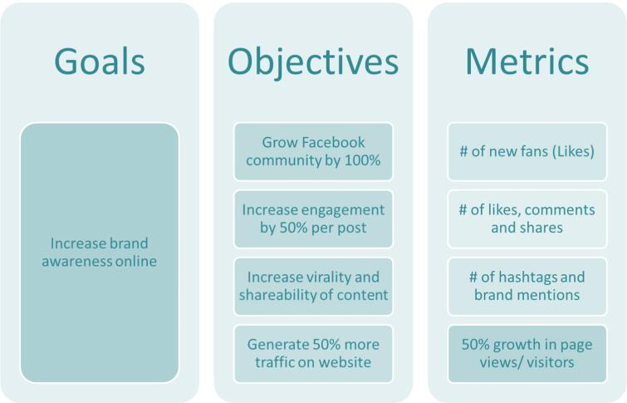
Notes:
Example of a smart goals and objectives & how to measure their success.

Slide 22
Targeting your ads / boosted posts
With Meta Business Manager you can create ads and campaigns to
  Facebook
  Facebook Audience Network
  Instagram
If you want to reach e.g. TikTok or LinkedIn users, you have to create ads to these channels separately
When choosing targeting criteria for your ads, keep your buyer personas in mind!
Facebook ad targeting criteria e.g.
Location
Demographics (age, gender)
Interests
Relationship situation
Education, work
Generation
Life event.

Slide 23
Campaign Period
Typically 2-4 weeks
You can choose when your ad/boosted post is shown. Day + time of the day.
Typically Mon-Fri daytimes are very common, because during those hours the traffic in social media is heaviest. BUT so is the competition
In the evenings and on weekends it is possible to get the best reach and engagement. People have more time then.
Test!

Slide 24
Budgeting
Buying method CPC or CPM
  CPC = cost per click
  CPM = cost per mille = cost per 1000 impressions
No fixed prices. Bases on the same principles as in Google Ads: the best quality, the lowest CPC.
Location, timing, business and goal effect, too. ”The only true answer is: It depends.” See examples
Instagram: female and 18-34 yo targeted campaigning more expensive than to other target groups.
You can choose either total budget or daily budget. Even when choosing total budget you can set the maximum daily spend.

Slide 25
Content creation

Slide 26
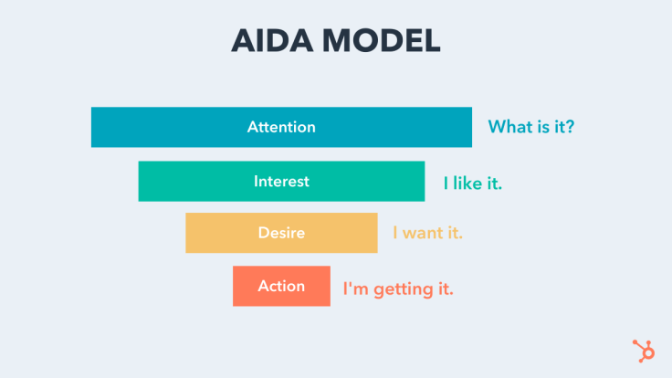
When planning the contents, keep the AIDA model in mind
https://blog.hubspot.com/marketing/aida-model
Notes:
It is essential to keep the goals in mind, when creating content to social media.
As an individuals we can post just for fun. However, when a company is posting in social media, the posts should always have a purpose.
The posts should be suitable for the different stages of the customer buying journey, as represented in the AIDA model.

Slide 27
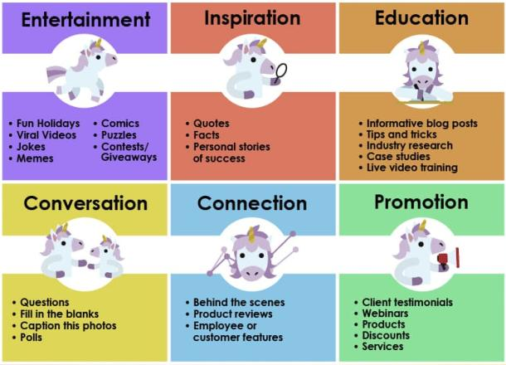
Types of Social Media Content that drive most engagement
https://mobilemonkey.com/articles/social-media-content-that-drive-most-engagement

Slide 28
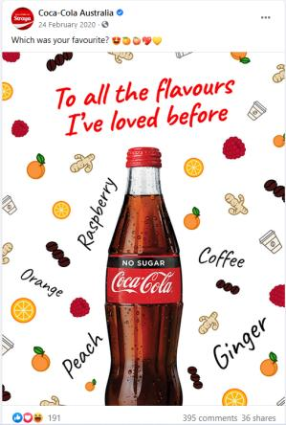
Engagement Tactics
Run a comment contest
Ask brand-related questions
Collect questions via comments
Share a Shout-Out for Content Created by Your Fans and Customers
Ask for audience feedback
Anticipate and Meet Your Community’s Needs With Content
Tap into what’s topical
Talk about community involvement and impact beyond business
Go live
https://heyorca.com/blog/social-media-strategy/142-engaging-social-media-question-ideas-with-tips-examples/
https://blog.hootsuite.com/content-idea-cheat-sheet/
https://blog.sagipl.com/social-media-post-content-ideas/
https://www.socialmediatoday.com/social-business/buzzsumo-releases-analysis-100-million-facebook-videos
Notes:
Run a comment contest
A fast and effective way to increase engagement is to run a contest or giveaway on your Facebook page and ask people to comment on a post to enter.
Brand related questions
Brand related questions that help promote or reflect the page’s or business’s brand should be included in your regular updates
Post a lot of brand related questions, but ensure that you inter-space them with general questions to make it more interesting and engaging.
Collect questions via comments
Encouraging your audience to ask you questions is a great way to attract engagement and responses.
This tactic works best if you designate a theme or topic for the questions.
Share the answers on your page as a video or in writing or answer the questions via Facebook Live to generate even more engagement.
Share a Shout-Out for Content Created by Your Fans and Customers Sharing photos or content sent or posted by fans is a great way to show how much your community and customer's matter. Just remember to ask permission and credit the creator.
Ask for audience feedback. People love to be included and feel like they matter. How better to make the most of this human trait than to ask your audience for feedback or help with making choices in your business? This tactic can work wonders for increasing engagement.
Anticipate your community’s needs. Providing information your audience wants and finds helpful not only attracts comments and shares, but it’s also the third most common reason consumers decide to buy from a business. The better you know and understand the people you want to attract and interact with, the easier it is to share information they value. And don’t think you have to create all of information yourself. You can get great engagement from sharing content created by others too!
Tap into what’s topical. Sharing posts that discuss what’s happening in your audience’s world is a great way to encourage responses. This lets you join in the conversations that people are already having, so your presence becomes more like that of a friend than an entity that’s trying to sell. And humans respond much better to friends than salespeople. All businesses talk about the seasons and key moments in every marketing calendar. To really stand out, create posts that align with news that you know your audience cares about or that affects them.
Talk about community involvement beyond business. People love businesses that stand for more than just making money. Share updates about non-profits you support, fundraising activities you’re involved with as a business, or any community projects you’re working on.
Go Live. One of the quickest ways to ramp up engagement is to go live on your page. A BuzzSumo study found that Facebook Live videos should be a minimum of 12 minutes long to gain maximum engagement. To get the most engagement, make sure to promote your Facebook live in advance. If your audience doesn’t know you’re live, they won’t join the stream and you’ll miss the opportunity to engage with them. According to Facebook, live videos on average get six times as many interactions as regular videos. More than half of the brands publish instagram stories on a regular basis. By adding stories, users' time on Instagram increased by almost 28 minutes

Slide 29
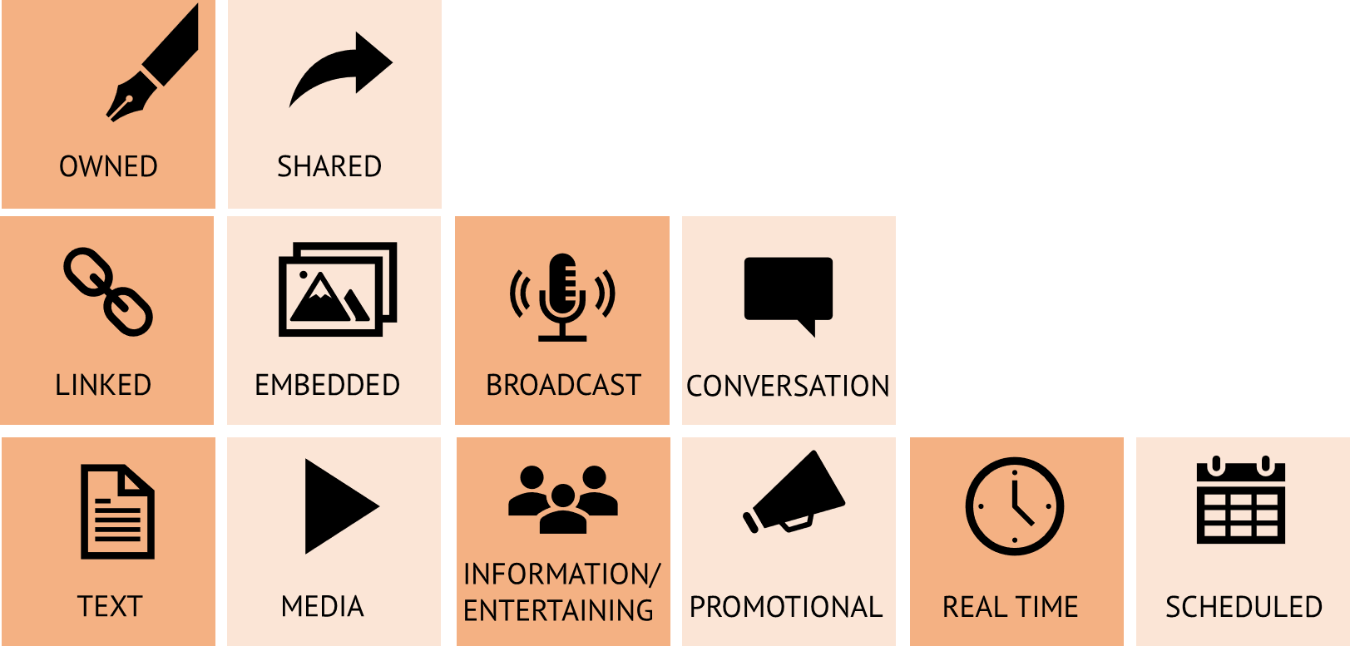
Variety of content
https://www.postplanner.com/blog/types-of-social-media-content
Different Types of Content for Social Media - feedalpha
https://www.cutedigitalmedia.com/blog/en/what-types-of-content-work-best-for-each-social-network/
Notes:
Nobody wants to come to a restaurant that only has one type of food. Without drifting too far from purpose, ensure your content is not boring and has variety.
Try a mix of social media content types to keep your feed fresh.

Slide 30

How often should you publish in social media?
Minimum | 1 time/day | 1 time/ week | 1 times/week | 1 time/day | 2 times/week
Ideal | 3-4 times/day | 1-2 times/day | 1 time/day | 5 times/day | 1 time/day
Maximum | 5 times/day | 3 times/day | 2 /times day | 30 times/day | 1 time/day
https://louisem.com/144557/often-post-social-media
https://blog.hootsuite.com/how-often-to-post-on-social-media/
Notes:
There are a lot of different opinions about the frequency of publications in social media.
In reality, companies are different, thus it is difficult give a one rule in the frequency of publications. In a multinational corporation there might be several staff members focusing solely on social media, whereas in a small company the same person is responsible for all marketing and communications tasks.

Slide 31
When to post?
The best time to post on social media is different in different channels
Instagram
  Best times are 6 p.m. - 9 p.m. and 12 p.m. - 6 p.m.
  Best day for posting is Saturday
Facebook
  Best times are 6 p.m. - 9 p.m. and 12 p.m. - 3 p.m.
  Best days for posting are Friday and Saturday
There are differences between businesses and target groups’ behavior – test!
Source: https://blog.hubspot.com/marketing/best-times-post-pin-tweet-social-media-infographic
Notes:
There are a lot of different opinions about the frequency of publications in social media.
In reality, companies are different, thus it is difficult give a one rule in the frequency of publications. In a multinational corporation there might be several staff members focusing solely on social media, whereas in a small company the same person is responsible for all marketing and communications tasks.

Slide 32
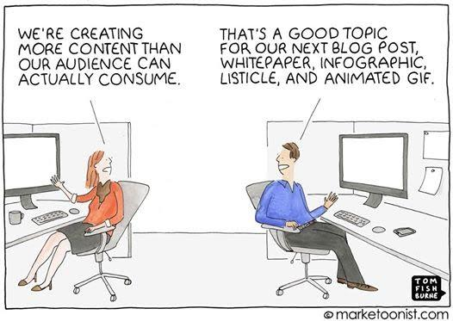

Slide 33
Assignments

Slide 34
In-class activity
Form a group of 4-5 people.
Choose an interesting company or organization, and analyze its social media presence.
Provide the following information:
  A brief overview of the company (e.g. industry, size, products/services)
  Which social media channels it uses?
  What kind of content does the company produce for social media? (posts, videos, competitions, etc.)
  Who do you think their social media content is aimed at?
  Do you think the content is interesting to the company's target group?
  What do you think the company is aiming for with its social media?
  How actively does the company publish on social media?
  What kind of suggestions for improvement would you give the company regarding the use of social media?
Make a presentation about your insights and present them in the class.

Slide 35
Group assignment
Form a group of 4-5 people.
Choose two social media channels and familiarize yourself with them.
Find out:
What kinds of content are typical to this channel?
Number of users in your country? Describe the typical user of the channel.
Can the channel be used in marketing? How? What is the budgeting based on?
Most common mistakes made in this channel? How can one avoid these?
Provide a .ppt presentation about your insights. Remember to mention your sources.
Assessment:
Fail:
The work is missing most of the required elements. The use of sources is limited. The work does not show understanding of the use of social media in marketing.
Pass:
The group has studied social media channels but only superficially, and the use of sources is limited. They have some understanding about the possibilities of using social media in marketing.
Outstanding:
The group has studied social media channels thoroughly from different angles. Their work demonstrated profound understanding of the possibilities of using social in marketing.
Notes:
This assignment can be done either as an individual work or as a group work.

Slide 36
Individual assignment
Social media trends
The social media landscape is in current transition.
Search information about the latest developments and trends.
Which channels are losing their popularity
Which channels are gaining more users
Which content types (e.g. videos, images) are most popular amongst the users, and which are not
What kind of content the customers expect from brands?
What are the most effective ways to use social media in marketing?
Write a short essay (1,5-2 A4) about the social media trends. Remember to mention the sources.
Assessment:
Fail:
The work is missing most of the required elements. The use of sources is limited. The work does not show understanding about the social media and the latest trends.
Pass:
The work includes all the required elements, but the analysis is superficial. The use of sources is limited. The work shows some understanding about the social media and its latest trends.
Outstanding:
The student has studied the topic thoroughly from different angles. The work demonstrated profound understanding about the social media and the latest trends.

Slide 37
Group Assignment
Plan social media campaigns for your company
Justify why you chose the social media channels you chose
Tell us the goals, objectives and metrics for each campaign
Write posts, choose pictures. Tell us your targeting. Please also tell us the budget. That is, organic posts are not enough. You will not be able to do ("real" promotions, with for example. Business Manager, to do.)
Assessment:
Fail: several elements of the assignment are missing
Pass: goals, objectives, metrics are mostly correct. Budget and targeting relevant. Posts have been made.
Outstanding: the performance demonstrates expertise; the campaign is professionally planned.
Notes:
channel justification: company should choose the channels, which their buyer personas use

Slide 38
Important Notice
The DEMS material aims to enhance digital marketing skills in higher education, comprehending the essential needs in organizations. You have access to extensive slide sets with in-class activities and assignments, as well as detailed user instructions for teacher.
Note: The material includes contents and figures retrieved from the internet and is thus subject to changes. The sources have been announced according to the rules of fair use. The publisher´s responsibility is restricted to the original material stored at www.dems.pro. All material is produced for open use and co-funded by Erasmus +.
Social MediaSocial Media

