Slide 1
Content Marketing:
Video Marketing
Notes:
The role of video in content marketing keeps growing year after year. Video continues to be a widely used marketing tool – trusted by around 9 out of 10 businesses. (source: https://www.wyzowl.com/video-marketing-statistics/ )

Slide 2
Learning Objectives
Student gets acquainted with key videotrends
Student understands the key elements of a successful video marketing strategy
Student learns to brief – and even make – a successful marketing video

Slide 3
Contents
1. Why video content?
2. Trends in video content
3. Essentials of a successful video strategy
4. Video production brief
5. Assignments

Slide 4
Why video content?

Slide 5





Some Statistics
Video viewing increased:
two full working days each week.
Cisco 2022:
video share of
online traffic 82%
2016: 63% of companies used video as marketing tool
2021: 86% of companies
used video as
marketing tool
Notes:
”This year is a year for video” has been said over the past 15 years.
No stop in growth can be seen in the horizon.
Let me show you some more research insights on video marketing….

Slide 6
Comprehensive Set of Video Statistics 2023
Six Sections:
Usage
Financials
ROI
End Users
Channels
Click here! https://www.wyzowl.com/video-marketing-statistics/
Notes:
This source covers almost any data - and even more! - which you as a teacher can think of. Pick data, which you find relevant and interesting. A pdf download is available, too (click link).

Slide 7


81%
of marketers say
their videos perform better with music
Notes:
Figures from adQuadrant from October 2020 help to substantiate the case for moving content. For example, they see a doubling of the number of clicks on video content versus static content. However, the success of video is (partly) dependent on the optimisations. For example, 80% of users are extremely annoyed by videos where sound starts playing automatically and loudly.
In short, make sure you take into account the 'rules of the game' and design your video from the 'sound off' perspective. And, you've probably heard it before, but make sure your branding is recognizable from the first moment and that the message of your story is clear within a few seconds.Source:
frankwatching.com
You can find new data at www.bitable.com and just adjust the percentage
Source: bitable.com

Slide 8

of marketers say their videos perform better with a voice over
66%
Notes:
You can find new data at www.bitable.com and just adjust the percentage
Source: bitable.com

Slide 9

64%
of marketers say
their videos perform
better with captions
Notes:
You can find new data at www.bitable.com and just adjust the percentage
Source: bitable.com

Slide 10

78%
of marketers say
their videos perform
better with less text
Notes:
You can find new data at www.bitable.com and just adjust the percentage
Source: bitable.com

Slide 11
of marketers say
it is either “very important
or “extremely important”
to show diversity in videos
65%
Notes:
You can find new data at www.bitable.com and just adjust the percentage
Source: bitable.com
Bitable state of marketing surveyed 694 marketers and small business owners using SurveyMonkey Audience

Slide 12
2. Trends in Video Content

Slide 13
Videotrends 2023
The video market continues to grow – how to stand out from the competition?
Short videos booming! Now latest the time to take over Reels/Shorts/Tiktok. Majority of people prefer short videos over written content when learning about a new product.
Videos play an ever more important role in purchase decisions
Search optimized videos
Influencers to help conquer social media platforms
More ad formats = more complexity of video marketing
Understanding storytelling in the digital environment is more important than ever
Source: https://www.videolle.fi/en/ (these trends were picked in a webinar in Nov 2022. In Finnish only.),
https://financesonline.com/video-marketing-trends/
Notes:
2. Videos and their role in marketing is evolving constantly and quickly. People don’t seem willing to take the time and effort to read so much anymore. Note! This does NOT mean there wouldn’t be time and place for written content and traditional marketing methods any more. These are not ads (but a great asset in content marketing; they help your potential customer) - don’t brag about your product!
if your video is interesting enough, leads will click to watch it
3. Nowadays, more consumers are discovering brands through video. Eighty-four percent of buyers have decided to purchase a product after they watched a brand’s video. On top of that, 80% of consumers went on to buy software or an application after they watched a video about it. These numbers show that video is becoming an integral part of the customer journey. Plus, the pandemic has increased video consumption, with 96% of consumers saying that they have increased the time they spent watching videos (HubSpot, 2021).
Does this mean that traditional marketing methods are no longer relevant? Not at all. However, supplementing your current marketing strategy with video means that you are covering more bases. Eighty-seven percent of consumers search for product information online before they make any purchasing decisions (Retail Dive) and video can help push them to buy from your brand.
Moreover, this leads consumers to interact with brands, as they might have further questions before completing the purchase.
4. The more there is (video) content, the more it is necessary to optimize your videos for search, just as written content.
Some tips:
Using video file names, titles, and descriptions that contain your target keyword.
Adding relevant tags, particularly popular keywords, related to your video’s topic.
Adding subtitles and closed captions.
Creating original thumbnail images for your videos.

Slide 14
3. Essentials of a Successful Video Strategy

Slide 15
Video strategy in the stratergy hierarchy:
it must align with content marketing strategy
Business Strategy
Marketing Strategy
Content Marketing Strategy
Social Media Strategy
Video Strategy
etc.
Notes:
Source: Jaana Merikallio

Slide 16
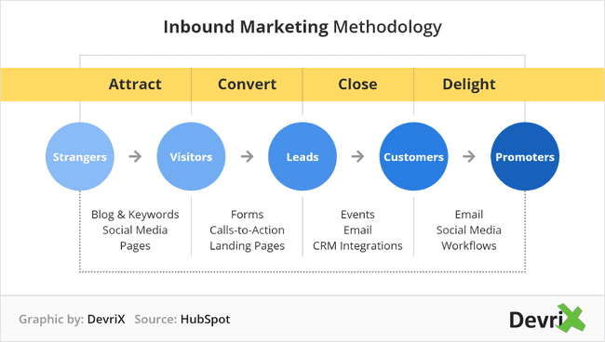
How to Succeed in Videomarketing?
Campaign Planning Starts from Video Strategy
What do you want to achieve by using videos?
  Increase brand awareness? Sales? Improve employer brand?
  Set SMART objectives.
Who do you want to reach?
  Define target group(s). Buyer personas very handy and recommended!
  For which stage of buyer’s journey?
Brand videos, entertaining videos. Touch feelings!
Teasers, ads promoting content (ie webinars
Video comparisons, product videos, testimonial videos
FAQ videos, tutorials
Source: Videolle.fi
Notes:
strategy needs to align with business strategy!

Slide 17
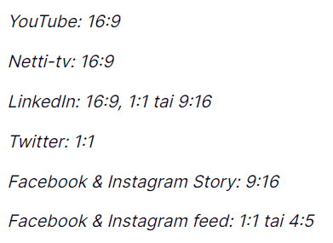
Video Strategy, cont.
Where do you reach your target group / buyer personas?
  take the channel into account in planning your video content
  one video is not fit for different channels!
    different format
    different story telling (skippable or not)
    audio or not
What is the desired conversion after video viewing?
  to move on to webstore? To subscribe to a newsletter?
  effect on CTA: how to guide your buyer persona to move
  closer to the purchase decision
What kind of content suits best to different purposes?
  Do you want to raise feelings to make him/her interested in your brand?
  Or do you want to offer useful and educating content which increases the expertise of your brand? You want to solve a common problem and make a viewer laugh?
  Different type of video needed for different purposes
Set metrics according to your objectives and measure
  increase brand awareness - maximise reach in the right target group. Number of views, average viewing rate
  brand building, position - make before and after customer surveys
  increase sales - the number of conversions
  customer satisfaction improvement- the effect on customer service, customer satisfaction improvement
Formats in different video channels
Web-tv
Notes:
skippable = whether a viewer can skip (like in YOutube after 5 sec) video or not (TV, instream video services, etc).

Slide 18
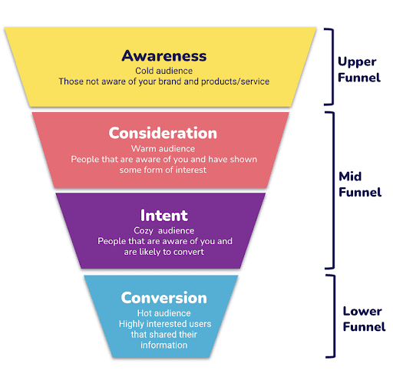
Video marketing for different goals in the online marketing funnel
Notes:
Of course you want the videos to contribute to the goal you have. And the beauty of using video on social media is that it can serve a variety of purposes.
Do you want to create awareness among your target group? Then video contributes to telling the story. Much more than static content. Videos in the awareness phase ideally last 10-15 seconds. So short and sweet. Triggering.
If we are a bit further down the funnel, in the consideration phase, video can provide more information about a product/service. More depth, as it were, to further fuel interest.
But you can also use video to help drive traffic to your website in this phase. It is recommended also testing with video in the conversion layer. Ideally, with a shortened version (about 5-6 seconds) of your video, so that the content does not distract too much from your call to action.

Slide 19
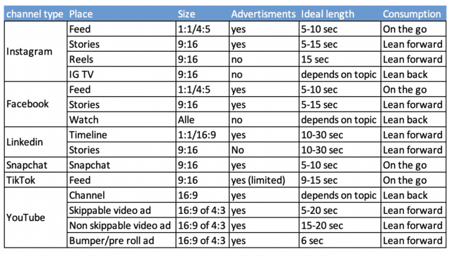
Video on social media:
the channels and formats in one overview
Notes:
Many channel types and even more formats. Lots of information. We understand that the number of opportunities on social media to use motion content (video) can be overwhelming. That is why a summary of the most important (most commonly used) formats are placed in 1 diagram. This schedule also includes an indication of the optimal length, based on our experience.
Please note, this is not an exact science, but purely our own benchmark/experiences. And, it also contains a vision on the optimal consumption moment of the content (last column).
Source: frankwatching.com

Slide 20
4. Video Production Brief

Slide 21
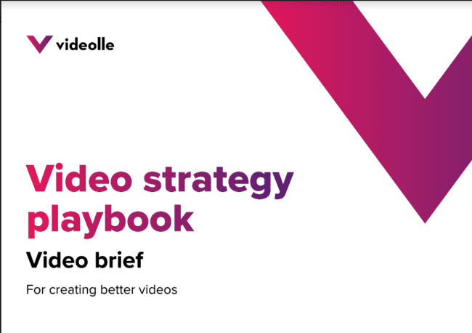
3. A good brief is key to successful outcome
This template makes you think through all the essentials in briefing:
https://www.videolle.fi/en/video-brief

Slide 22
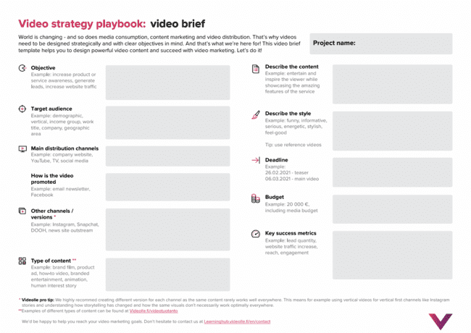
Notes:
When filling this, take a look at the strategy slides ss. 10-11. Going through carefully different strategy elements helps you to fill this form. Also, read tips on this form. Highly useful!

Slide 23
In-class activity
Go to your favorite social media channel,
Choose a branding video,
Analyze the video, keep in mind the video briefing criteria,
Make a gap analyze and give a short advice (max. 2A4).
Notes:
Class assignment:
Make a team of 2 persons.
20 minutes gap analyzes
20 minutes advice
10 minut presentation of your findings to the team next to you

Slide 24
In-class Activity
Go to your favorite social media channel,
  Analyze their main target group,
  Analyze their unique features,
Choose a branding video which pops up in this channel,
  Analyze the video, keep in mind the video briefing criteria,
Make a gap analyze and give a short advice, present it to the class
Notes:
Class assignment:
Make teams of 2
20 minutes gap analyzes
20 minutes advice
10 minute presentation of your findings to the team next to you
A gap analyze is a methode companies can use to compare the current performance with the desires and expectations. In this assignment you will check if the current video is conform the expectations if they had used this briefing format. Where do you see opportunities? Is the briefing form used effectively or where do you see room for improvement? Jaana’s q: how can this be done if not knowing company’s goals? See chat gpt’s answer to gap analysis: (esp. see steps 1-6)
Gap analysis is a process of comparing the current state of a system, organization, or process with its desired or target state. The analysis involves identifying the differences or gaps between the current state and the desired state and identifying the steps that are necessary to close these gaps.
Gap analysis can be applied in different fields, such as business, finance, healthcare, and education. It is a useful tool for identifying areas for improvement and developing action plans to achieve organizational goals.
The gap analysis process typically involves the following steps:
Establish the scope of the analysis: Define the goals, objectives, and expectations of the analysis, and identify the areas to be analyzed.
Determine the current state: Collect data and information about the current state of the system or process being analyzed, including strengths, weaknesses, opportunities, and threats.
Determine the desired state: Define the ideal or target state for the system or process being analyzed, based on best practices or industry standards.
Analyze the gaps: Identify the differences between the current and desired states, and prioritize them based on their impact on the system or process being analyzed.
Develop an action plan: Identify the steps necessary to close the gaps and achieve the desired state, and develop an action plan to implement the necessary changes.
Monitor progress: Track the progress of the implementation of the action plan, and evaluate the effectiveness of the changes made to close the gaps.
Overall, gap analysis is a valuable tool for organizations seeking to identify areas for improvement and take action to achieve their goals.

Slide 25
Recap:
Video tells best about video marketing
https://www.youtube.com/watch?v=cjDdDbAUD5U
about popularity of video in marketing
tips to achieve the best ROI in video marketing
different types of marketing video categories
  Educational
  Inspirational
  Engagement
  Convincing
video strategy and planning (note: the strategy in this Youtube video goes with the assumption of in-house production. Video marketing knowledge is needed although the production would be outsourced!)
Notes:
Video lasts appr 18 minutes, and can be used to further enhance the benefits of video in (content) marketing

Slide 26
4. Assignments

Slide 27
Learning Objectives
Knowlegde of the importance of a good video brief
Apply the video brief and create a video.

Slide 28
Individual Assignment
Look for a brand that you have available at home. For instance a shampoo or your bike/car
Choose a channel type that fits your target audience,
Make a video based on the briefing criteria.
Share your video on your social media channels
Deliverables: video & reflection
Notes:
For this assignment you can ask the students to use:
Apple video
Or download CapCut
Or use a free template from Canva.

Slide 29
Group Assignment
Assessment criteria on the following slide
Choose the company which you make the video for. Recommendation: choose the same company you have built a content strategy for.
Decide a service/product and use video brief form as a planning tool for your video.
Shoot the video, and edit it.
Notes:
For this assignment you can ask the students to use:
Apple video
Or download CapCut
Or use a free templaid from Canva.

Slide 30
Assessment criteria for both assignments
Fail:
The video does not correspond to the assignment at all or has been returned late.
The video uses footage filmed/edited by another person without proper permission and mention. ​It covers hardly any elements of the assignment.
Pass:
The video meets many criteria and elements of the assignment. Its is produced at least relatively high level in relation to the resources.
Outstanding:
The video is produced in full compliance with the assignment and supports the content marketing goals
of the task excellently. The video has been produced to a high level in relation to resources, it is innovative
and insightful in terms of content.
Notes:
Just in case is later needed in criteria (this text was originally in 0-5 scale assessment) 1-2: The video does not have all the elements mentioned in the assignment. The output is not aimed
at the right target group. The video shows little indication of the achievement of the learning objectives
of the assignment. 3-4: The content of the video corresponds to the assignment. It is correctly targeted and
functional in terms of content. The video uses the elements of the assignment and is produced to a high level
in relation to the resources and shows that the student has achieved the learning objectives of the assignment well.

Slide 31
Please upload your video on your own platform write a 1 page reflection:
To what extent does the video suit the target group?
What need, interest or problem of the target group does the video respond to?
Measure your video's engagement, such as views, likes, comments, shares, and average watch time. Use this data to determine how well your video is performing.
To what extent does the length of the video match the chosen platform
Consider adding a clear CTA (Call-to-action) at the end of the video to increase viewer engagement, such as asking for likes, comments, shares, or visiting a website. Substantiate why you have or have not chosen to use a CTA.

Slide 32
Supplementary reading & Pro-tips
Video content consumption on social media

Slide 33
conseption and planning
Problem / need
Core message
Target group (buyer persona)
Budget
Distribution channels
Schedule / timetable
  Synopsis
manuscript
Storytelling
Plot / storyline
Feeling
Audio
Graphic elements
Visual expressions, shooting techniques
shooting
According to the manuscript
edit
Footage review and clip selection
Adding the audio tracks and graphic elements
Color correction and specification
export for different channels
Video Production Process
publishing
Source: Janne Granfors,
Video professional and Lecturer at TUAS

Slide 34

Video Content Consumption on Social Media
Notes:
Content consumption on social media.Your content can only be successful if your target audience is receptive to it. And that in turn depends enormously on the moment at which the content is consumed. A method that was previously widely used by Facebook. The methodology of 'On the go, lean forward and lean back'. What do we mean by that?
Source: frankwatching.com
In simple terms, lean forward media is a type of media where receivers lean forward to interact and control the flow of information in an active manner. In lean back form of media, on the other hand, viewers can lean back and do receive the information in a passive manner. According to categorisations provided above print media can be specified as lean forward media.
Source: Katz (2010)

Slide 35


Notes:
During 'on the go' moments you are in motion and you have little time. You take a quick look at your mobile before the next meeting starts, before you get on your bike or in the car or at moments of rest during your trip (of course not while moving). At times like this, the focus is mainly on the feed of your social media channels and you have little time to really absorb the content. In short, as a brand you can mainly use this moment to grab attention quickly with a short simple message and as the first hook in the (retargeting) relationship with the user.

Slide 36

“Lean forward” moments
Notes:
Lean-forward
During the 'lean forward' moments, your audience has a little more time, for example during a short break. Time to take in a story, for example, or a short video.

Slide 37

“Lean back” moment
Notes:
And finally there is the lean back moment. During lunch, a long tram ride, or at home on the couch.
During these moments you can really get your message across in an extended form.
You can already feel it coming: your choice for the type of video content (and its length/set-up) therefore depends entirely on the impact you want and, above all, can make.

Slide 38


Notes:
We now know the benefits of )moving images) footage within your social media content strategy. Then it's time we took a look at the ways in which you can use video.
Each channel has its own possibilities and target groups. Seeing your video marketing on social media as a whole is not possible. Each channel has its own (unwritten) rules.
By taking this into account when planning your productions, you can save a lot of time and costs. Efficiency is one of the magic words when creating content for social media. T
To make it a little easier for you, Iwe will guide you through the most important channel types.

Slide 39

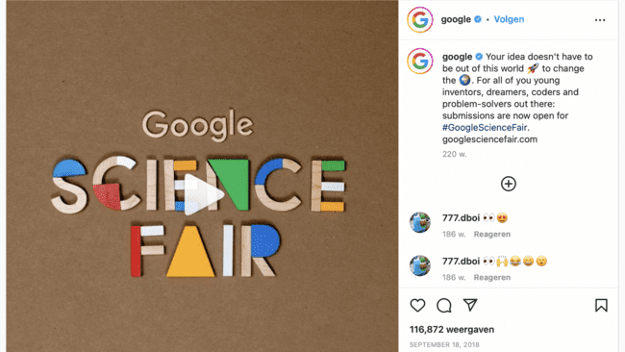
Instragram
Feed
Notes:
Instagram is currently one of the most popular social channels, Instagram has more than 2 billion monthly active users, according to the latest statistics. That's more than nine times Twitter's monthly active users.
In addition, it has good advertising options within Facebook's Business Manager. There are many different placement options that all have their own advantages. The target audience is generally quite young, but the age on the platform is still rising according to NewCom research. You can now use Instagram to reach a wide audience.
Instagram feed
A video on the feed is generally viewed fleetingly and briefly, on the go. Please take this into account when choosing your format.
A short video, gif or cinemagraph is perfect. The message will show you immediately (within 3 seconds), so that it cannot be missed by the volatile scroller. Instagram is pretty much 100% mobile. Choose a format that is optimized for mobile devices (and takes up as much space as possible): 1:1 or 4:5.
Note: click on the picture to go to insta to see the story.

Slide 40
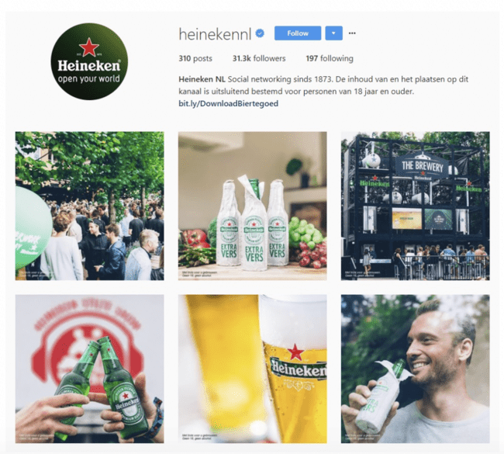
Instragram
Feed
Notes:
1. Start writing a plan
Before you can create a beautiful Instagram feed, you need to know what you want to achieve with Instagram. Is it a business or personal account? Who is your target audience? And what do you want to radiate? Write this all down, you will see that you immediately get new ideas for your Instagram feed.
2. Determine the theme of your Instagram feed
The theme of your Instagram feed is very important. By theme, we mean the colors and photography style you want to use in the feed. It can be useful to make a color palette of at least three colors for this.
To stick to a theme, we always recommend creating social media templates. This is especially useful for business accounts. Templates are easy to create in a program such as Canva. This allows you to easily create a unity in the photos you use.
If there is one company that is good at creating creative expressions, it is Heineken. The beer brand also lives up to that on Instagram. The captions are witty, the images creative ('Beercause of you': need I say more?) and consistent. Every image breathes Heineken. Tight!

Slide 41
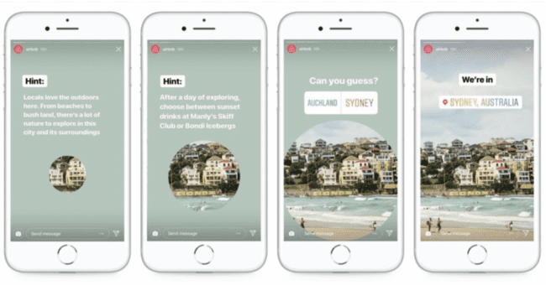
Instragram
Stories
Notes:
Instagram Stories
Your viewer often takes a little more time for Stories, they linger a little longer. A “lean forward- moment”. Take advantage of this! Your Story can take up to 15 seconds per piece (part). Often several fragments are used in succession, but make your point in the beginning (within 3 seconds).
An Instagram Story has a screen-filling format, 9:16, so use this space as well. The Story can contribute organically to your brand awareness and engagement. If your channel has more than 10,000 followers, it can generate traffic to your website with a swipe up.
Note: click on the picture to go to insta to see the story.

Slide 42
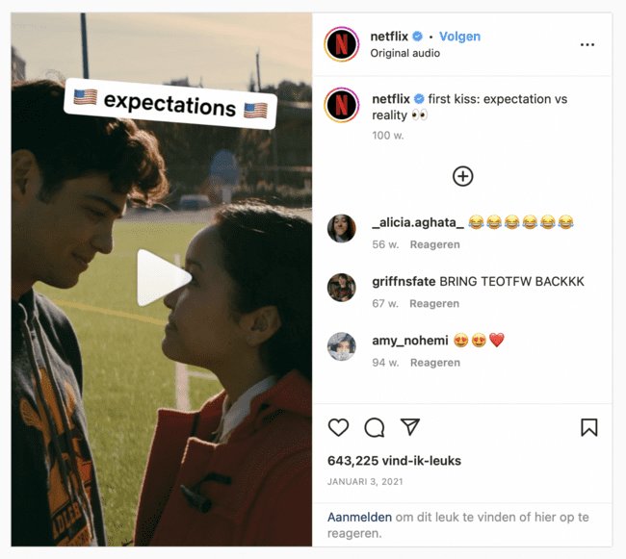
Instragram
Reels
Notes:
Instagram Reels
With Instagram Reels you create a short video of 15 or 30 seconds, with a maximum of 90 seconds (This makes Insta reels more in-dept than Insta stories) after which you edit your video in the app itself. Ideal, because you don't have to switch between different apps.
You have the choice of creating a new video, or using an existing video from your own camera roll. You then add catchy effects, text and music. Satisfied? Upload the Reel to your profile so it appears on your feed or upload it to your stories. Simple as that.
Once you upload a Reel, an additional tab will appear on your profile. The Reels icon now appears between your own feed, IGTV and content in which you are tagged.
Where Instagram stories only stays up for 24 hours, reels is a better choice if you need te promote durable content.
Note: click on the picture to go to insta to see the story.

Slide 43
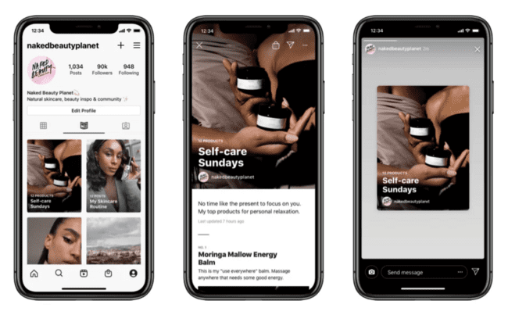
Instragram
Guides
Notes:
Instagram's newest feature is Instagram Guides (May 2020). This guide can only be used organically and can, among other things, consist of a collection of previously posted videos on your timeline or Reels. Very useful to make an overview of a certain product group with advice and the possibility to shop.
You can supplement the images with text. Comparable to Facebook's instant experience, a way to offer inspiration and therefore really lean-forward content. A possibly ideal format for the midfunnel (consideration).

Slide 44
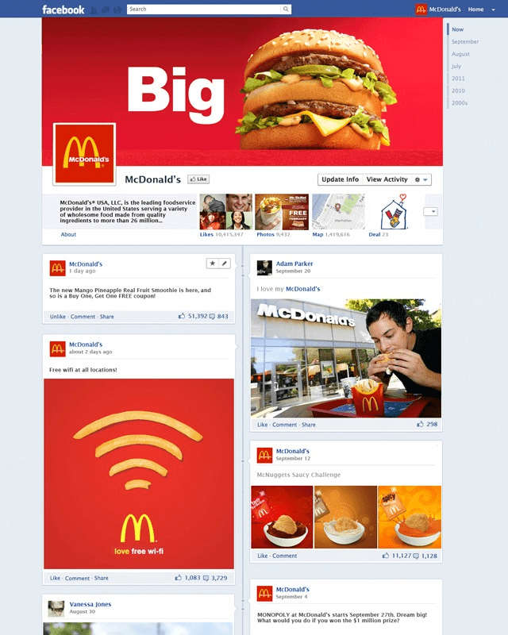

Facebook
Timeline
Notes:
Although many people think that Facebook use is decreasing, nothing could be further from the truth. More than 2 billion people worldwide use Facebook (Facebook).
Moreover, Facebook is very affordable when it comes to purchasing video views compared to many other social channels. The target group on Facebook is slightly older than on Instagram. Facebook is well represented in a broad target group aged 20-79. Ideal if you want to reach a broad adult audience.
Timeline
Users view the Facebook timeline on the go. That is why you must immediately stand out with the video you post on this channel. Therefore, place your message or call-to-action immediately within the first 3 seconds. The average viewing time is only a few seconds. Facebook is also mainly used via the mobile app these days, so I recommend a ratio of 1:1 or 4:5.

Slide 45
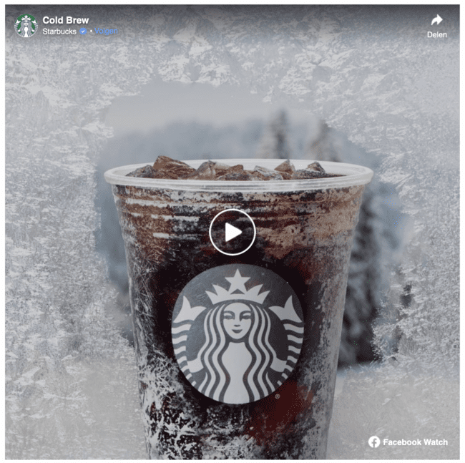
Facebook
Stories
Notes:
Facebook Stories, like Instagram Stories, fall into the lean forward category: your viewer pays a little more attention to you. Here too you have to stimulate them immediately with your message, preferably within the first 3 seconds.
The full-screen video (9:16) gives you the opportunity to tell a beautiful visual story in your awareness layer, or contribute to more clicks through the swipe up.
Facebook Stories got off to a slow start, but are now gaining popularity.
Note: click on the picture to go to facebook stories

Slide 46
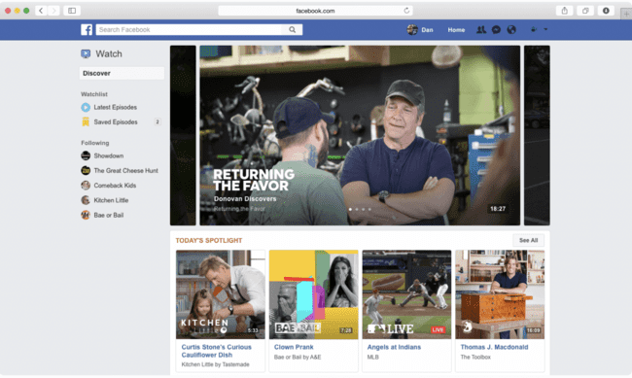
Facebook
Watch
Notes:
FacebookWatch
Facebook Watch is a typical lean back video channel. Users who watch videos here take their time and are engaged. All videos on Facebook end up here and new videos are presented to the viewer based on your interests.
Here too: Facebook is a mobile platform, so take this into account when choosing the format. Ideally: 1:1 or 4:5.
Facebook Watch also provides the option for live streams and even watching series. Pre-eminently formats for which the viewer takes the time, with the aim of entertainment and depth.
Facebook Watch is different from what we're used to. It will be a separate tab within Facebook, where videos are shown based on your interests and, for example, the news of the day. See example on slide.

Slide 47
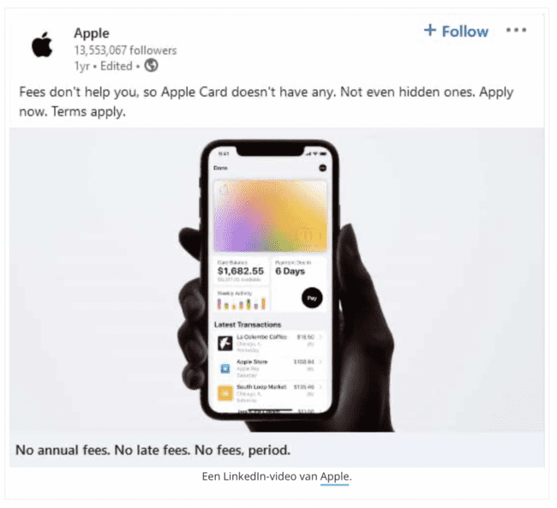

LinkedIn
Feed
Notes:
LinkedIn
LinkedIn is the B2B platform among the social media giants. This channel is perfectly suited to share professional information with a relevant, specific target group. At the moment LinkedIn mainly uses static images, so with video content you will stand out here. A great opportunity to distinguish yourself.
LinkedIn Feed
With a video on LinkedIn you quickly stand out, but here too you have to stop the scrolling thumb. This on-the-go channel therefore requires a short video, in which you quickly make your point. Based on your video, your viewer decides whether or not to click through to your article or website. So trigger, preferably within 5 seconds. A video on your LinkedIn timeline is pre-eminently intended to draw attention to the in-depth content you wish to convey in a blog, article or whatever.

Slide 48
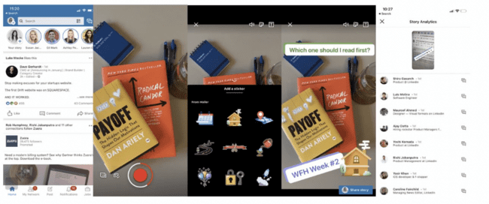
LinkedIn
Stories
LinkedIn identifies 3 major benefits of LinkedIn Stories:
Show your professional side in a human way.
Share your daily activities at work in a creative and informal way.
Grow your community by actively reaching out, maintaining relationships and sharing content.
Notes:
LinkedIn Stories
Since May 2020 it is also possible to post stories on LinkedIn, similar to Instagram Stories and Facebook Stories. So lean forward. Basically the same rules apply here, namely a screen-filling image in 9:16 and your key message within 5 seconds.
Of course, where it differs from the rest is the B2B nature of the platform, so keep that in mind when posting your video content. In addition, every business page has the option to add a link to the story, a direct option to link to your website.
Your story will be visible for 24 hours, after which it will be automatically removed from the platform. Of course you can also keep track of how often your story has been viewed and by whom on LinkedIn.

Slide 49

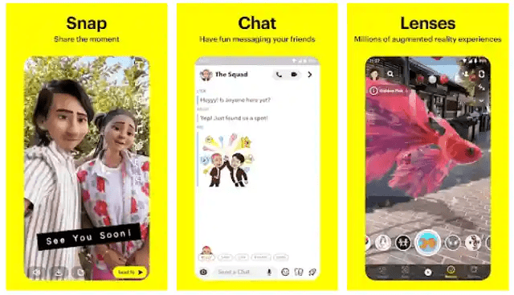
Snapchat
Notes:
Snapchat is the channel where you can reach a young target group between 15-19 years old with fun short video content, both organic and paid. In short videos, a maximum of 15 seconds, you can grab attention and hopefully keep it. Here too, take into account the short attention span and make sure your message is clear in the first 5 seconds of the video.
Snapchat is a mobile-only platform and therefore requires full-screen video material in 9:16 format.

Slide 50
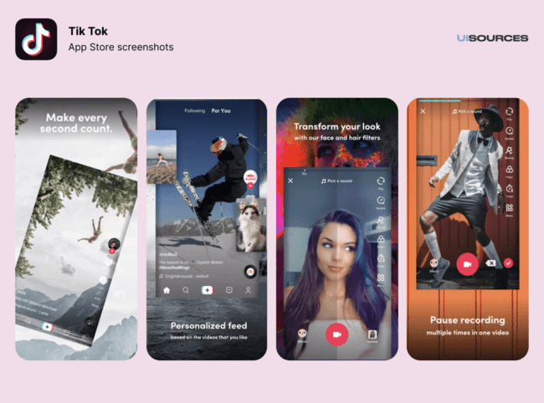

TikTok
Notes:
In 2021, the app had 1.7 million users and the most daily users was 836,000. In 2022, this app will have grown much more. 75% increase in the number of users, which has grown to 3.0 million and the number of daily users has increased to 1.6 million.
In addition to Snapchat, TikTok is the channel par excellence to get in touch with young people. Mainly funny, short videos are shared. As a brand, this is a great opportunity to get on the radar of the target group with suitable video content and to increase your brand awareness.
The 9:16 video is 15 seconds by default and can be extended to 1 minute. As a brand, it is advisable to tell your message in the first 10 seconds. Advertising opportunities are currently limited to a select group of advertisers.

Slide 51
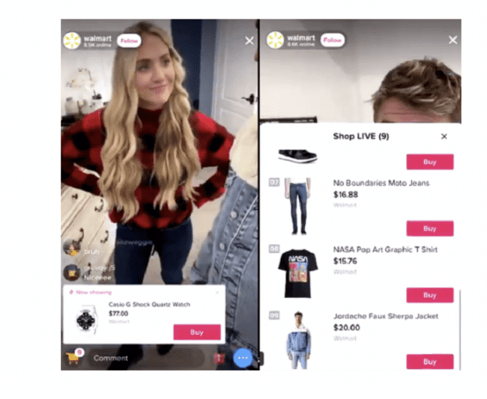
TikTok
Live shopping experience Walmart
source: TikTok
Notes:
TikTok has done a test with live stream shopping together with Walmart. Thanks to a live video format, users could see how products were presented and buy the products directly, without having to leave the platform. Livestream shopping was already popular in Asia and is now being adopted by other markets due to its advantages in terms of interaction and direct audience conversion.
While in-app purchases of tagged products within the application and the option to create a store and a catalog are yet to come for European companies, there are already elements that can help to use the live function of the application. Promotional information can be shared that is written directly during the live event and links to a specific product can be inserted via the bio of an influencer, for example. You can also use the replay function (available for 90 days) to generate more visibility for the products.

Slide 52

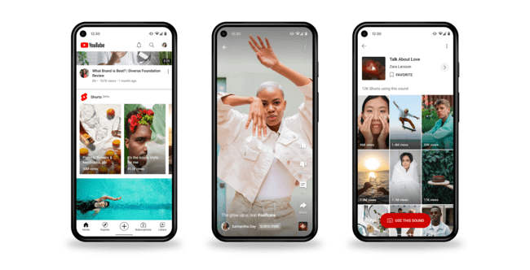
YouTube
Notes:
Where other social media channels are often fleeting, you can use longer videos on YouTube. Here you can provide in-depth information with tutorials, product reviews or vlogs. Perfect for leanback consumption. Because your viewer takes the time, you also have more time to tell your message.
Moreover, YouTube is also widely used as a search engine, so there are great pull marketing opportunities. In addition, there are also many advertising options on YouTube. The ads are often (partially) non-skippable. The viewer must therefore keep watching, so that you as an advertiser can tell your message. Make sure you adjust the structure of your video to the use, so that your message can always be told.
As a channel, YouTube is still strongly focused on horizontal videos (16:9).

Slide 53
Important Notice
The DEMS material aims to enhance digital marketing skills in higher education, comprehending the essential needs in organizations. You have access to extensive slide sets with in-class activities and assignments, as well as detailed user instructions for teacher.
Note: The material includes contents and figures retrieved from the internet and is thus subject to changes. The sources have been announced according to the rules of fair use. The publisher´s responsibility is restricted to the original material stored at www.dems.pro. All material is produced for open use and co-funded by Erasmus +.

