Slide 1

Content Marketing
Blog

Slide 2

Learning objectives
Pre-requisite for student: Basics in marketing is recommended.
The student is able to/understands
• The benefits of blog post
• Good practices in a blog post
• Requirements for a good blog post title
• Blog post categorisation
• Useful tools
• Blog post metrics

Slide 3

• What is blog post?
• The benefits of blog post
• What are the main rules in the blog content
creation?
• Good practices in a post
• Requirements for a good title
• Blog content types
Topics
• How AIDA methodology helps with the blog
content creation?
• Useful tools
• How to get traffic and promote your blog
• Metrics
• Pro-tips and useful reading
• Assignments

Slide 4

What is a blog post?
A blog post is any article, news piece, or guide
that's published in the blog section of a website. A
blog post typically covers a specific topic or query,
is educational in nature, ranges from 600 to 2,000+
words, and contains other media types such as
images, videos, infographics, and interactive
charts.
- Hubspot

Slide 5

One above all -
BLOG BENEFITS
• Preferred by Google
• Blogs have the longest lifespan of web content
• a good format for providing help and advice
• Great for sales: providing information that
promotes purchasing decisions on a voluntary
basis
• Findablity in Google searches is crucial – don’t
forget SEO!
• Always a conversion objective – the visitor needs
to be steered forward along customer journey

Slide 6

Be Customer Centric
Relevant content that helps people solve their problems, satisfy their
needs or wants
• 80% of the content must be
related to topics of interest to
customers
• Only 20% should be branded
publications

Slide 7
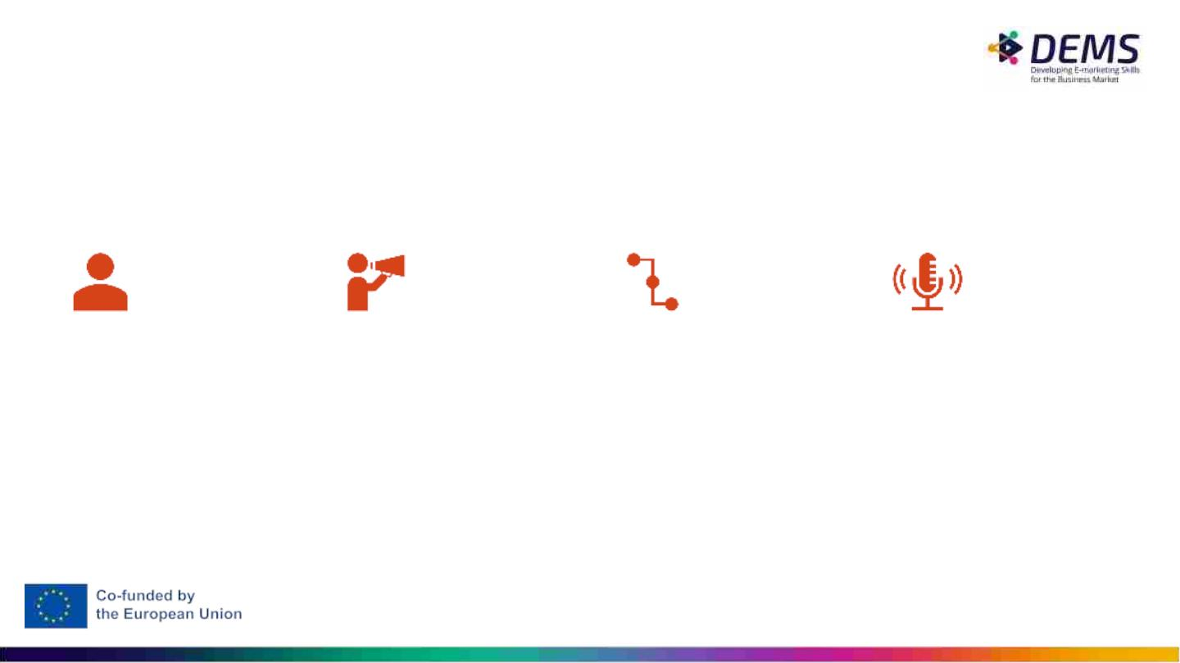
Good practices in a post
1/4 Before You Start
Who are you writing to?
Buyer persona
What is your objective?
What is your persona’s
pain point, in which your
blog post should help?
And how?
What is the conversion
you aim for?
Commit to regular,
frequent posting. Like in
SEO, results can only be
achieved by consistent
blogging.
Conversion = an action
you desire your reader to
take having read your
post. Conversion takes
him/her along the buyer’s
journey to the next step –
towards the final decision
(~purchase)

Slide 8

Know your audience!
Before drafting content, ask yourself these questions:
● Who is my primary audience?
● What about a secondary audience who can influence and inform my primary
audience?
● How will they find my site online?
● Audiences find web content through many different paths—social media
sharing, links from other websites, email sharing, and search engine results.
Think of your audience again: what search terms would they type into Google?
Make sure to include those terms in
headlines and sub-headers, use
your keyphrase in them.

Slide 9
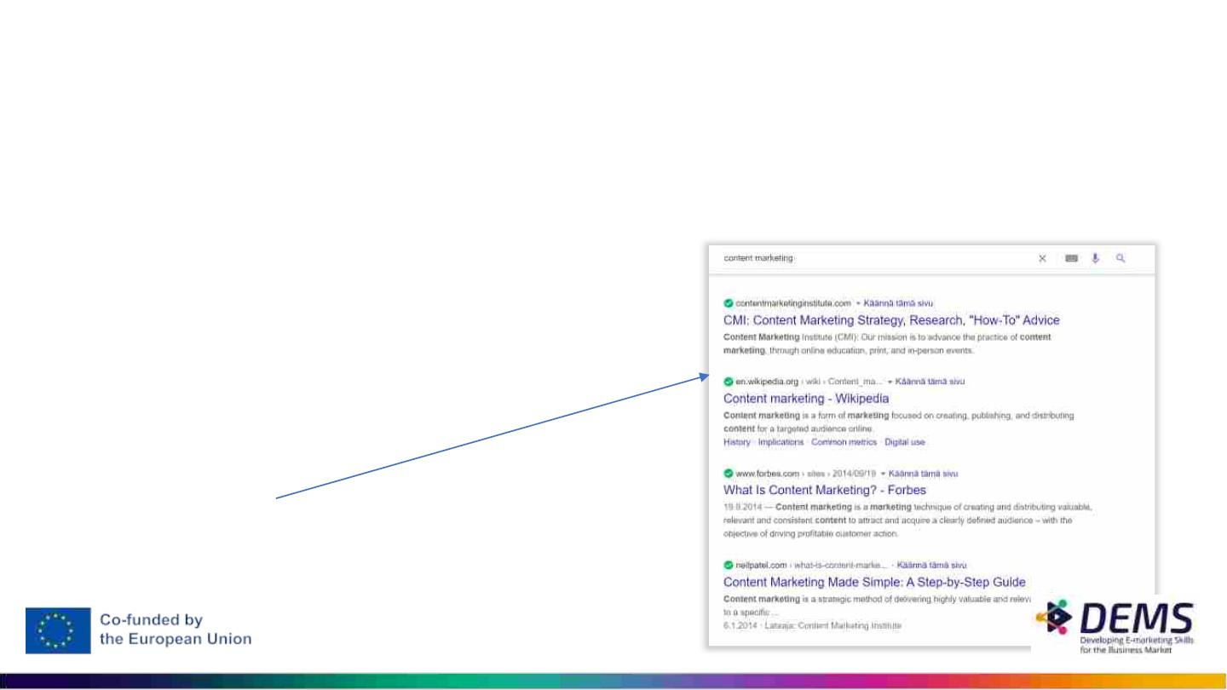
2/4 Enough Words + Other On-Page Optimization
• A blog post needs to be long enough, at least 300 words. Why? Shorter than 300 words are considered too
light to be able to bring value to reader (by Google)
• But remember: quality over quantity! If your content doesn’t add value to your readers, or if it’s of inferior
quality, it will not rank high in search engine results
Remember other SEO requirements, too:
• What are your keywords? =
which keywords you want to be found with?
• Ideal number of keywords: 5
Use both long and short tail keywords
• Include your keywords in your
✔ Title
✔ Title tag
✔ Meta description
✔ Content
✔ Images (alt txt, image title)
✔ Url

Slide 10
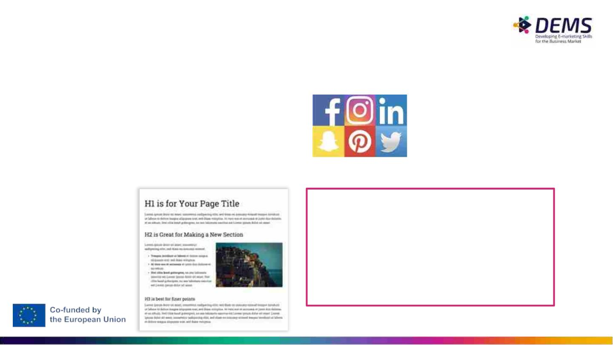
2/4 On-Page Optimization
• Links: both internal and external
• Social media buttons help immediate sharing
• Headings
• H1 the main heading (Headline)
• H2 subheading
• H3 ”sub” subheading
”Interesting content, which
addresses to reader’s needs
and interests, is the best search
engine optimization.”
Hanna Isohanni-Nikula, Advance B2B

Slide 11

Keywords: it is a question of the persona in which she performs a search
based on words. These are important terms for the brand and that lead the reader to
the brand and its products.
• SHORT TAIL
• ## More generic;
• ## High search volume;
• ## High competitiveness;
• ## Less chance of conversion.
• LONG TAIL
• ## Specific;
• ## Lower search volume;
• ## Lower competitiveness;
• ## Greater chance of conversion.
• URL of post

Slide 12

In-class activation
• in pairs or one at a time, go online and search
for the keyword rules of the page you want.
What rules have been included?

Slide 13

3/4 Call to Action
Call to Action = CTA
• CTA is used to guide your reader along the customer journey to the next stage. Ie. to take
the desired action, ie. to convert.
• Make it explicit, easy to find
• Do not place it in the very end of the text only, but in 1-2 visible places of the page
What should it be like?
• Depends on your buyer persona, customer
journey stage and your content

Slide 14
In-class activation
• in pairs or individually, go online and search
for CTA’s. What do you think is good?

Slide 15
4/4 Make It Reader Friendly (=Google Friendly)
• Headline / Title
✔ The most important function of the title is to SELL the blog post to a reader. Keep it as short as possible. Include keyword(s)!
• Lead paragraph / Introduction section
✔ The first paragraph of the post. It should tease about the content, attract the reader to keep on reading. For example: ”In this post blog
post I’ll give you five tips of how to…”
✔ Don’t make it too long – 2-3 lines is enough
• Subheadings
✔ Long and heavy text mass is a turn off, subheadings are eye catchers
• Avoid long sentences. Rather full stop than comma.
• Remember your own voice, your point of view. Stories and personal touch work.
• Images!
✔ Human eye scans images first. They are eye catchers.
✔ Remember source. There are many free photo libraries, but source needs to be marked. (a tip: Unsplash)
• Grammar
✔ No one wants to read text filled with spelling and grammar mistakes

Slide 16
• Title of post (needs to be attractive - catch attention)
• First thing people see, so it should clearly state what the article is about
• Clarity and specificity attract readers and encourage them to share the article with
their circles.
• Well-written and formatted text
• Important for readability
• Short paragraphs
• Consider using headings and tags to signal section breaks

Slide 17
Writing form
Use short sentences and paragraphs;
• Use intertitles: eye-catching and showing benefits to the reader
• Using images, videos and other media;
• Bold important passages and words;
• Make lists: bullet points and numbering.
Conclusion of the post
• Do not give new arguments;
• close the ideas of post;
• Summarize the solution presented;
• Incite the reader to something more (call-to-action)

Slide 18
Length of the post: tips
•
up to 500 words
•
High volume of posting
Very specific keywords
More direct questions
•
•
•
Basic contents
•
Low volume search and low competition
•
•
up to 1000 words
•
Contents a little more comprehensive and detailed
Keywords that would look too shallow at 500 words
•
2000 words or more
•
Very complete and detailed contents
Complete guides, large lists,…
Very competitive keywords with high volume of searches
•
•

Slide 19
• Relevant multimedia content
• To make an article memorable and fun to read
• It also helps break up as text, making the article more pleasing to the eye.
• Dynamic presentations, video and infographics are multimedia content to consider
• consistency with others posts or other means
• Utilization of hashtags
• Use of categories

Slide 20
In-class activation
• in pairs or individually, go online and check the
first website in SERP, related with keywords:
healthy coffee
Discuss why this website is on the first place?

Slide 21

Requirements for a good title
Title of any blog post or
page is equally important as
the content of the post.

Slide 22
Requirements for a good title
Clarity
• Avoid terms that are too far-fetched to attract attention
• The more understandable the headline, the greater the chances that the reader will
connect with it.
Specificity
• What exactly is your text about?
• Use the article's keywords, using creative writing to make that term an invitation to read
the whole thing

Slide 23
Requirements for a good title
Precision
• In the text write only what is relevant
• In the title, this care must be redoubled, since it is necessary to capture the reader's
attention in a few seconds.
• Writing is the art of cutting words
• Look for short and interesting synonyms for big words, when applicable

Slide 24
Requirements for a good title
Persuasion
• Try to be suggestive in the title, leave a blank space that will only be filled by reading
the text
• Use short verbs that prompt an action
• Asking open-ended questions, putting yourself in the reader’s shoes: using the “how”
or “why”

Slide 25
Requirements for a good title
Title example:
The 103 best free image banks you need to know
Let's analyze the elements:
• The number 103 attracts the attention of my readers;
• Best generates an interest in knowing the best image banks;
• free image banks generates a desire in my reader to get good images for free;
• Need to know encourages reading.

Slide 26
Requirements for a good title
Title example:
Yoast SEO: plugin tutorial that will make your text perfect in the eyes of Google
Let's analyze the elements:
• Yoast SEO: quickly catches the attention of my readers who are looking for it
• Plugin Tutorial: arouses interest to learn how to use the plugin
• It will make your text perfect in the eyes of Google: promise that generates a great
desire (who doesn't want to have a text that pleases the search engine?

Slide 27
Please find more useful tips on titles in the end
of the slide set. See ”Pro-tips and useful
reading”

Slide 28
Blog Content Types
• Articles based on studies and data
• Book reviews
• Indication of products and/or applications
• Roadmaps of other content or market trends
• Interviews with other professionals
• Step by step tutorials
• Opinion articles on a particular topic
• Articles with lists
Tip! Read further about
different kinds of post
in the end of the slide
set. See ”Pro-tips and
useful reading”, s. 44
onwards.

Slide 29
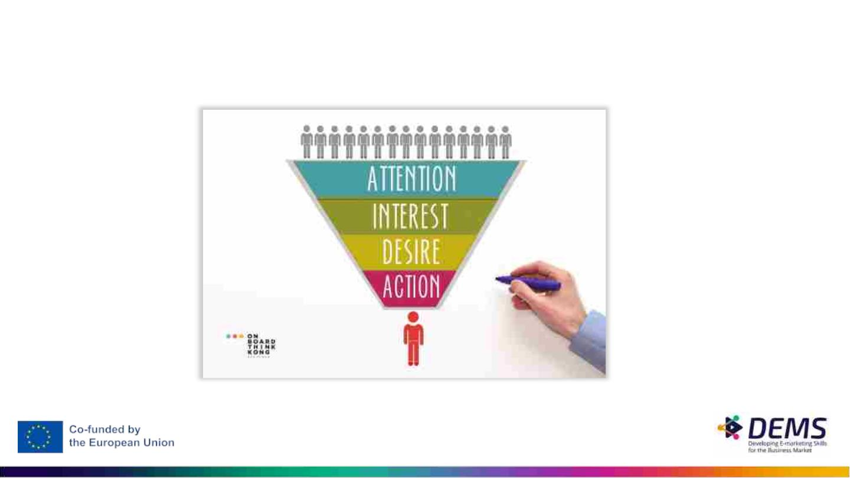
Content creation using the AIDA methodology

Slide 30

Content creation using the
AIDA methodology
• The AIDA methodology makes the message customer-centric
• If the user perceives the value of the content, he will feel compelled to
contribute by responding to the requested action.
• Publication must consist of several parts
• A – Draw Attention (10% of the message)
• I – Create Interest (60% of the message)
• D – Awake Desire (20% of the message)
• A – Lead to Action (10% of the message)

Slide 31

Content creation using the AIDA methodology
The PG in health management for those who want to evolve
The Health area is one of the fastest growing areas in Portugal. If you already work in the area, or want to work, what are
you doing to enhance your training? If you do nothing, nothing will change.
A
I
Investment in education is an ongoing need for a professional who wants to stand out. In turn, the different configurations of
the health units and the very complexity of the national health system, lead to the management and health units forcing the
holding of transversal competences from strategic management, human resources management and marketing. In fact,
users' access to information and the possibility of choosing between different health service providers have made this
market increasingly competitive. In this context, the management of health facilities has a very clear objective: to ensure the
provision of health care in a coordinated manner, through the efficient management of resources. Despite this, when it
comes to careers associated with health, management is perhaps one of the last on the list of options. However, a manager
or director of health facilities assumes a key role. His ability to manage teams, to understand the challenges of financial and
budget management, to analyze data and make decisions, to define the organizational and marketing strategy, to be able to
organize the production system, knowing and using the new technologies applied to health, will help the health units they
manage to be more efficient, effective and competitive.
In order to be able to develop its skills in health management, DEMS Academy launched a Postgraduate Program in
Organization and Management of Health Entities, which is unique in the country and has a faculty made up of professionals
in the area and also academics with professional experience. specialized in the health field. You will have the opportunity to
start managing in the health area, keeping the focus on the strategy, improving the quality of service and with the best
financial results ever.
D
A
Sign up or ask for more information by clicking on this link. Enrollments are limited. Apply today, tomorrow might be too late.

Slide 32
Useful Tools
Buzzsumo
It is not always easy to find topics to write new posts for the blog. This is one of the
biggest headaches of the bloggers. The platform helps to solve this task.
Just type in the search engine a term related to the blog. Hundreds of blog results are
immediately returned, organized according to their popularity on social networks.
Crazy Egg, Hotjar
People are entering post. But are they reading it? with the tool CrazyEgg you can
generate heat maps that let you know if people are doing scroll on the page and
reading the article to the end.
It is also an excellent resource for those who want to test banners or operate color
changes on the blog.

Slide 33
Emails
Emails continue to bring a lot of traffic to blogs. This technique should not be devalued for what
they say about SPAM. Just carefully outline the sequence of emails you want to send to your
followers and make sure they are timely topics. Note! The best opening and click rates are
obtained, when a reader subscribes to your newsletter. (in many countries it is forbidden to send
btoc emails without receiver’s permission)
Tools like the Aweber, E-goi and the MailChimp they also detect flaws that can be improved, in
order to increase the Opening Rate.
GoogleAnalytics
Indispensable tool for any blog or website. Through this free service from Google, you can check
how your page is performing and get to know your target audience better.
The daily analysis of the reports generated by this tool is essential in order to have a real
perception of the growth of the blog or website.

Slide 34
HelloPub
Regardless of the niche market, all websites have specific goals, whether they are converting into
cash, downloading a lead magnet or clicking on a specific link.
To help you understand whether or not your goals are being achieved, you can use the HelloPub.
The trial version allows you to install a bar on the screen that keeps you constantly updated on
how your blog is performing.
Open Site Explorer
This software organizes all URLs of a certain domain, associating the external links (back links)
that are pointing to it.
It is easy to see what kind of posts bring new visitors, and then you should bet on more of this
genre.

Slide 35
Quick sprout
Excellent tool that evaluates the performance of the blog and allows you to make comparisons with 3
competitors.
One of the features unknown to most is to understand, through the “Social Media” tab, which posts of the
competition that are becoming more successful in social networks. From this data, you can get some ideas
about what to do in the future.
W3 Total Cache
Simple tool that promises to improve blog speed.
With this tool, just add a few lines of code and, in half a dozen clicks, the blog will perform better.

Slide 36
Tools
Yet Another Related Posts Plugin (YARPP)
Display posts related is a great way to decrease the abandonment rate of pages by giving
the reader options for similar content.
Most of the themes WordPress do not have the ability to posts related. Others use their
own system, but with very shallow criteria to associate the posts and end up appearing
content that is actually not relevant. There are few themes that do this efficiently.
YARPP is a relationship plugin that finds posts peers to make recommendations. It has a
great system templates, which makes it easy to adapt to the theme used in the blog.

Slide 37

Build a profitable business around your content
and turn your blog into a revenue-generating asset
13x
Contentꢀmarketersꢀwhoꢀblogꢀareꢀ13xꢀmoreꢀ
likelyꢀtoꢀseeꢀpositiveꢀROI
HUBSPOT

Slide 38
How to get traffic and promote your blog
• Motivate to subscribe to blog content in emailꢀCreate landing page
• Write more and moreꢀDeepen topics with greater adherence
• Share on social networks and by emailꢀShare each new blog post across your social media
networks and by email.
• Routine publication scheduleꢀStart with knowing your audience and plan a valuable content
for them
• Invite readers to leave a commentꢀThen respond and let them know you’re engaged.
• Collaborate and write guest postsꢀWhen others write for your blog, you add more content that
you didn’t have to write yourself. As a bonus, those contributors will also share with their
networks

Slide 39

Metrics
•
•
Visitors
Unique visitors
Length of stay
Frequency of publication
Number of views per post
Posts viewed per session
Percentage of organic traffic
Bounce rate (single page session on your site)
Shares on social networks (social share)
Comments
•
•
•
•
•
•
•
•
•
•
External links to the blog
ROI

Slide 40
Assignments

Slide 41
Individual Assignment
Objective: Understand and practice what makes up a good blog post. Even if you don't
write blog posts as a “grown up”, but give the job to writing professionals, it's good for you
as a buyer to know what to expect from a blog post
Assignment: Write a blog post for your business, keeping in mind the instructions
described above "Elements of a good blog post", as well as the rest learned in this class.
(A CTA doesn't have to be really clickable.)
Choose a company you want to write a blogpost for. Tell us in a separate document:
The buyer persona that the blog post is aimed at. Remember the comprehensive buyer
persona description.
Which goals do you set for your blog post: a) what pain point and in what ways a blog post
should help b) which conversion you are aiming for; c) What are your KPIs d) which SEO
activities you have taken into account in your text N.B! The documentary doesn't have to
be an essay, but rather a bullet point-type doc where things are listed succinctly.

Slide 42
Individual Assignment
Fail: Late return. The writing is too short, SEO is ignored. The buyer persona is not told, there are plenty of
grammatical errors in the text. It turns out that the text or part of it is plagiarized.
Pass: The writing is at least 300 words long, and content matches the title. SEO has been taken into account
at least to some extent. The text is enriched with images. The description of the buyer persona is satisfactory,
including the pain point of the persona. The blog post helps the buyer persona at least to some extent. For the
most part, the writing meets the instructions given.
Outstanding: The text is 400-500 words long, it is in accordance with the title. The CTA is explicit, the text is
pleasant to read, and the blog post takes into account all the instructions given and helps the buyer persona.

Slide 43
Group assignment
Provide a .ppt presentation about your
insights. Remember to mention your
sources.
Form a group of 4-5 people.
Choose one brand and familiarize yourself with them.
Assessment:
Fail:
The work is missing most of the required elements.
The use of sources is limited. The work does not
show an understanding of the blog post in content
marketing.
Find out:
• What is the audience?
• What are competition?
• What kind of keywords could be used by this audience?
• Who are the authorities, influencers, potential authors;
• What kind of blog categories could be suitable for this group?
• Prepare the plan for blog post, including: titles of blog post, list of
keywords, sources, try to plan internal linkages.
Pass:
The group has studied blog posts, but only
superficially, and the use of sources is limited. They
have some understanding of the possibilities of
using blog posts in marketing.
• Prepare the plan for the next quarter - assign the goal
of each post, plan how you will promote it.
• Choose the metrics.
Outstanding:
The group has studied blog posts thoroughly from
different angles. Their work demonstrated a
profound understanding of the possibilities of using
blog posts in content marketing.

Slide 44
Pro-tips and useful reading

Slide 45

Titles centered on learning
Everything you need to know about _______________
What everyone should know about __________
__________ step by step
The world of __________ step by step
What you should never do in __________
__ key ideas for choosing _________ perfect
The __ rules/rules of _________
The Lessons I Learned About __________
__ steps to create __________ in __________
___ __________ mistakes you should not fall into
The most common __________ mistakes
The art of __________
How to start from zero to be one__________

Slide 46
Popularity-centric titles
Best __________ to/from __________
The most popular __________
The most __________ examples of __________
The most __________ of __________
The _____ best reasons to __________
The perfect plan for __________
The most __________ success stories in __________
Make the most of __________
The popularity of __________ and __________
The most viral __________
The word of mouth of __________

Slide 47
Confession-centric titles
My secrets about __________
Which say__________ about yourself / your brand / your business?
The __________ really want
The x stuff what no body tell about __________
My advices in __________most well saved
What never was told about __________
My__________ experience to obtain __________

Slide 48
Titles centered on temporality
The future/present of __________ in __________
____ keys of success for to reach (time/money) in __________
Convert You_________ in 15 days
No get lost __________ in 5 minutes
Create a__________ minute by minute

Slide 49
Need-centric titles
How to find the best__________ in __________
As if to convert in a__________ in __________
How to lose the fear of __________
X __________ that need for __________
Increase your__________ sales with__________
How to convince your boss of (that) __________
Calculate how many__________need for __________

Slide 50
Titles centered on contraposition
Benefits and is advantages in __________
The best and the worse in __________
Lies and Truths in/from __________
__________ vs. __________[phrase about the point that opposes both the
concepts]
The day and the night in __________

Slide 51
Titles centered on justification
Why __________?
Reasons for __________
The arguments most__________ for __________
The importance from __________ to __________

Slide 52
Kind of post
Educational: has as main mission to educate the audience of a certain market about
a product/service in which it is inserted
Based on doubts: blog readers' doubts are powerful insights for creating new content
Tutorial: ideal for teaching your audience to perform a certain action in a practical way
Guide: complete content on a given subject; has the characteristic of being a long and
detailed content
News: about the market where the blog is inserted
Material launch: promote by placing the summary (for example, from a ebook)
Post institutional: Something important about the company/brand (e.g. logo update)
Curatorship: content production from existing content (don't forget to credit the
authors)

Slide 53
Kind of post
Opinion: post more subjective, but which must have solid arguments
Review: analysis, review of a product, book, movie,….
Experience: describe sporadic or continuous event
Check list: can be based on a set of questions for the reader to see if they
thought/executed a set of ideas/tasks
Video: description of a video that has been made available and promotion of this
Podcast: promotion and/or transcription
Image gallery: presentation of an image album (example: coverage of an event; a
project,…)
Interview: with influencers, personalities, associated with the sector; don't forget to
value the interviewee

Slide 54
Kind of post
List: easily display multiple items
Search: statistics and data referring to a study carried out
Experience: describe sporadic or continuous event
Infographic: graphic element to simplify the presentation of ideas;
convenient to have a supporting text to give body to the text
interactive content: use of small questionnaires that allow the reader to
make an assessment/obtain a solution
Case study: way of demonstrating/proving the value of a product/service by
presenting a concrete situation
Template: ready-to-use preconfigured example
Guest post: interesting to involve business partners

Slide 55
Kind of post
Translation: post translated from another language, with due authorization and
citation
Glossary: post which explains what are the most common terms of the business in
question. Often very popular.
Comparative: can be useful to resolve queries about different products or services
Expert tip: post which gathers tips from various experts on a particular topic
Problem x solution: post about the error/problem that the persona tends to make
and showing what can be done to improve the situation
Live broadcast: post where information is placed about a live broadcast that will take
place and with the possibility of inserting information in real time of what is happening
Contents seasonal: seize seasonal occasion
Quotes: use phrases from personalities to demonstrate the importance of the subject

Slide 56
Important Notice
The DEMS material aims to enhance digital marketing skills in
higher education, comprehending the essential needs in
organizations. You have access to extensive slide sets with in-
class activities and assignments, as well as detailed user
instructions for teacher.
Note: The material includes contents and figures retrieved from
the internet and is thus subject to changes. The sources have
been announced according to the rules of fair use. The
publisher´s responsibility is restricted to the original material
stored at www.dems.pro. All material is produced for open use
and co-funded by Erasmus +.

