Slide 1
Topic 1
Users behaviours

Slide 2
Users behaviours
There are four types of behaviour (remember the funnel)
Acquisition
Interaction
Conversion
Retention or loyalty
Notes:
User behavior definition in web analytics refers to the actions and interactions of website visitors as they engage with a company's digital presence. This includes activities such as page views, clicks, form submissions, time on site, and more. By tracking and analyzing user behavior, businesses can gain valuable insights into how their target audience interacts with their website, what content is most engaging, and how to optimize the user experience to drive more meaningful engagement and conversions.
From an expert perspective, understanding user behavior is a crucial component of any comprehensive web analytics strategy. By tracking the actions and interactions of website visitors, businesses can identify trends, patterns, and areas for improvement, which can inform their marketing and content strategies and help them deliver a more personalized and relevant user experience. For example, if a business finds that a significant portion of its website visitors abandon the site after only a few seconds, it may indicate a problem with the website's design or the quality of its content, which can then be addressed to improve the user experience.
There are several methods for tracking user behavior in web analytics, including website analytics tools, heat mapping software, and A/B testing. Website analytics tools, such as Google Analytics, provide a comprehensive overview of user behavior, including page views, time on site, bounce rate, and more. Heat mapping software, such as Hotjar, allows businesses to visualize how website visitors interact with their site, including where they click, what they hover over, and where they spend the most time. A/B testing is a method of comparing two versions of a website or landing page to determine which version is more effective at driving conversions and engagement.
In order to effectively track and analyze user behavior in web analytics, businesses must have a clear understanding of their goals and objectives, as well as the specific metrics they want to track and measure. For example, if a business wants to improve its website's conversion rate, it may track metrics such as form submissions, time on site, and bounce rate. Additionally, businesses must have a plan in place for analyzing and acting on the data they collect, as well as regularly updating and optimizing their web analytics strategy to keep pace with changing user behaviors and industry trends.
In conclusion, user behavior definition in web analytics is a critical tool for businesses looking to understand how their target audience interacts with their website and how to optimize the user experience to drive more meaningful engagement and conversions. By tracking the actions and interactions of website visitors, businesses can gain valuable insights into their target audience and make informed decisions about their marketing and content strategies.
User behavior in the context of online business and marketing can indeed be categorized into four main types: Acquisition, Interaction, Conversion, and Retention (or Loyalty). These behaviors represent different stages of the customer journey and are essential for businesses to understand and optimize. Let's explore each behavior in more detail:
Acquisition: Acquisition refers to the process of attracting and acquiring new users or customers. It involves strategies and actions aimed at increasing brand awareness, reaching out to potential customers, and driving them to visit a website or engage with a product or service. Common acquisition activities include advertising, content marketing, search engine optimization (SEO), social media marketing, and public relations.
Interaction: Interaction focuses on the engagement and interaction between users and a business or its offerings. It includes activities that encourage users to explore the website or app, interact with its features, and spend time engaging with the brand. Examples of interaction behavior include browsing product pages, reading blog posts, watching videos, submitting inquiries, or engaging in social media discussions. Positive interaction experiences can lead to increased brand affinity and stronger connections with the audience.
Conversion: Conversion refers to the desired action or behavior that a business wants users to take, such as making a purchase, subscribing to a newsletter, filling out a form, or downloading an app. Conversion behavior indicates that a user has moved from being a prospect or a casual visitor to becoming a paying customer or taking a specific desired action. Businesses employ various conversion optimization techniques, including persuasive copywriting, clear call-to-actions, intuitive user experience (UX) design, and personalized offers to increase conversion rates.
Retention or Loyalty: Retention or loyalty behavior focuses on the actions and behaviors of existing customers to ensure their continued engagement and repeat business. Building customer loyalty is vital for long-term success as it involves nurturing relationships with customers, providing ongoing value, and creating experiences that keep them coming back. Retention efforts may include personalized communication, loyalty programs, exclusive offers, excellent customer support, and continuously improving the product or service based on customer feedback.
Understanding these four types of user behaviors helps businesses identify strengths and weaknesses in their customer journey and marketing strategies. By analyzing and optimizing each stage, businesses can attract new users, engage with them effectively, convert them into customers, and foster long-term loyalty, ultimately driving growth and success.

Slide 3
Topic 1
Evaluate Acquisition

Slide 4
Evaluate Acquisition
Direct
Organic Search
Paid Search
Display
Email
Referral
Organic Social
Organic Video
Etc.
Notes:
Acquisition evaluation in web analytics refers to the process of measuring the effectiveness of a company's marketing and advertising efforts in attracting and converting website visitors into customers. This involves analyzing data on the sources and channels that drive traffic to a website, as well as the behavior of visitors once they arrive on the site. By evaluating acquisition, businesses can gain insights into the performance of their marketing campaigns and make informed decisions about where to allocate resources and optimize their marketing strategies.
From an expert perspective, acquisition evaluation is an essential component of any web analytics strategy. By tracking the sources and channels that drive traffic to a website, businesses can determine the most effective methods for attracting new visitors and customers. For example, if a business finds that its organic search traffic is driving the majority of its conversions, it may prioritize search engine optimization (SEO) efforts to improve its visibility in search results and drive even more organic traffic.
There are several methods for evaluating acquisition in web analytics, including source and medium reports, referral traffic analysis, and conversion rate analysis. Source and medium reports provide a comprehensive overview of the sources and channels that drive traffic to a website, including search engines, social media, email, and more. Referral traffic analysis provides insights into the websites and platforms that refer visitors to a company's site, allowing businesses to identify valuable partnerships and opportunities for collaboration. Conversion rate analysis measures the percentage of website visitors that take a desired action, such as filling out a form, making a purchase, or subscribing to a newsletter, which can inform marketing and content strategies.
In order to effectively evaluate acquisition in web analytics, businesses must have a clear understanding of their goals and objectives, as well as the specific metrics they want to track and measure. For example, if a business wants to improve its conversion rate, it may track metrics such as form submissions, time on site, and bounce rate. Additionally, businesses must have a plan in place for analyzing and acting on the data they collect, as well as regularly updating and optimizing their web analytics strategy to keep pace with changing user behaviors and industry trends.
In conclusion, acquisition evaluation in web analytics is a critical tool for businesses looking to measure the effectiveness of their marketing and advertising efforts and make informed decisions about their marketing strategies. By analyzing data on the sources and channels that drive traffic to a website, as well as the behavior of visitors once they arrive on the site, businesses can gain insights into their marketing performance and identify opportunities for improvement.
Direct: Direct acquisition refers to users who visit a website or app by directly typing the URL or using bookmarks. Evaluation: Direct traffic is an essential channel as it indicates brand recognition and customer loyalty. However, it may be challenging to track the effectiveness of specific marketing efforts or campaigns that drive direct traffic.
Organic Search: Organic search acquisition involves users finding a website or app through search engine results without paid advertising. Evaluation: Organic search is valuable as it indicates strong visibility and relevance in search engine rankings. It requires effective search engine optimization (SEO) strategies, such as keyword research, content optimization, and technical SEO, to attract relevant organic traffic.
Paid Search: Paid search acquisition involves users clicking on paid advertisements displayed in search engine results. Evaluation: Paid search can be effective for targeting specific keywords, driving immediate traffic, and achieving high visibility. However, it requires careful keyword selection, ad copy optimization, and budget management to ensure a positive return on investment (ROI).
Display: Display acquisition refers to users clicking on banner or display advertisements on websites or apps. Evaluation: Display ads can generate brand exposure and reach a wide audience. However, their effectiveness depends on ad design, placement, targeting, and relevance to the target audience. Tracking conversions from display ads can be challenging compared to other channels.
Email: Email acquisition involves users clicking on links in promotional emails to visit a website or app. Evaluation: Email marketing is a powerful channel for engaging with existing customers and nurturing leads. It requires effective email campaigns, personalized content, segmentation, and strong calls-to-action to drive traffic and conversions.
Referral: Referral acquisition occurs when users visit a website or app through a link from another website, blog, social media post, or word-of-mouth recommendation. Evaluation: Referral traffic indicates positive brand reputation, partnerships, or satisfied customers who actively promote a business. It's crucial to cultivate relationships with relevant influencers, partners, and provide exceptional customer experiences to encourage referrals.
Organic Social: Organic social acquisition involves users visiting a website or app through social media platforms without paid advertising. Evaluation: Organic social media can drive traffic, engagement, and brand awareness. It requires consistent, high-quality content, community management, and audience interaction to leverage the power of social networks effectively.
Organic Video: Organic video acquisition refers to users visiting a website or app through video content (e.g., YouTube) without paid advertising. Evaluation: Video content can be highly engaging and shareable, driving traffic and brand exposure. Creating compelling videos, optimizing titles and descriptions, and promoting videos across platforms are essential for success.
Each acquisition channel has its strengths and considerations, and the evaluation may vary depending on the specific business, industry, and target audience. It's important for businesses to track and analyze data, experiment with different channels, and optimize their strategies to maximize the effectiveness of each acquisition channel.

Slide 5
Evaluate Acquisition
Campaigns with UTM code
UTM = Urchin tracking module
UTM parameters
  Source
  Medium
  Content (optional)
  Campaign
Ex.:https://dems.pro/?utm_source=DEMS&utm_medium=email&utm_content=newsletter&utm_campaign=PR1-results
Notes:
When evaluating acquisition channels with campaigns that use UTM (Urchin Tracking Module) codes, businesses can gain more granular insights into the effectiveness of their marketing efforts. UTM codes are tags added to URLs to track the source, medium, campaign, and other parameters of website traffic. Here's how to evaluate acquisition channels using UTM codes:
Identify the acquisition channels: Start by identifying the different acquisition channels you are using for your campaigns, such as email, social media, display ads, paid search, etc.
Create unique UTM codes: Generate unique UTM codes for each campaign within each acquisition channel. UTM codes consist of parameters like source, medium, campaign, and additional information that help you track and differentiate your campaigns effectively. For example, you could create UTM codes like "utm_source=email&utm_medium=newsletter&utm_campaign=spring_sale".
Append UTM codes to campaign URLs: Add the UTM codes to the URLs of your campaign assets, such as links in emails, social media posts, banner ads, or search ads. This ensures that when users click on those links, the UTM parameters are captured and sent to your analytics platform.
Track and analyze data: Monitor the data in your analytics platform (e.g., Google Analytics) to evaluate the performance of each acquisition channel and campaign. Look for metrics like sessions, conversions, bounce rate, time on site, and goal completions specific to each UTM code.
Compare performance across channels and campaigns: Compare the performance of different acquisition channels and campaigns by analyzing the data collected through UTM codes. Look for patterns, trends, and insights to determine which channels and campaigns are driving the most traffic, conversions, or desired actions.
Adjust and optimize: Based on the evaluation of acquisition channels using UTM codes, make informed decisions about resource allocation, campaign optimizations, and budget adjustments. Double down on channels and campaigns that are performing well and consider refining or pausing those that are underperforming.
By incorporating UTM codes into your campaign URLs and analyzing the resulting data, you can assess the effectiveness of each acquisition channel and campaign more accurately. This allows you to make data-driven decisions, optimize your marketing strategies, and allocate resources more effectively to achieve better results.
Analyzing acquisition with campaigns using UTM codes allows businesses to dive deeper into the performance of their marketing campaigns and understand the impact of different acquisition channels. Here's how to analyze acquisition with UTM codes:
UTM Parameters: Start by understanding the different UTM parameters used in your UTM codes. The common parameters include:
utm_source: Identifies the source of the traffic, such as a specific website, search engine, or social media platform.
utm_medium: Specifies the medium through which the traffic is generated, like email, social media, display ads, or paid search.
utm_campaign: Refers to the specific campaign name or identifier to differentiate between multiple campaigns within a medium.
utm_content (optional): Used to differentiate between different versions or elements within a campaign, such as different ad variations or CTAs.
utm_term (optional): Typically used for paid search campaigns to specify the keywords or terms associated with the ad.
Track UTM-tagged URLs: Ensure that all the URLs in your marketing campaigns are properly tagged with the UTM codes. This includes campaign landing pages, email links, social media posts, banner ads, and any other touchpoints where users might click through to your website or app.
Monitor UTM-tagged traffic: Use your analytics platform (e.g., Google Analytics) to monitor and track the traffic coming from the UTM-tagged URLs. Look for the specific UTM parameters and their values to identify which acquisition channels and campaigns are driving the most traffic.
Analyze performance metrics: Once you have collected data on the UTM-tagged traffic, analyze the performance metrics to assess the effectiveness of each acquisition channel and campaign. Some key metrics to consider include:
Sessions: The number of visits to your website or app from each acquisition channel or campaign.
Conversions: The number of desired actions completed, such as purchases, form submissions, or downloads.
Conversion rate: The percentage of users who completed the desired actions out of the total number of sessions.
Bounce rate: The percentage of users who left your website or app without further interaction.
Average session duration: The average amount of time users spend on your website or app.
Goal completions: The number of specific goals achieved, such as newsletter sign-ups or account registrations.
Compare and optimize: Compare the performance of different acquisition channels and campaigns by analyzing the collected data. Identify which channels and campaigns are generating the highest conversion rates, driving the most valuable traffic, or achieving the desired goals. Adjust your marketing strategies, allocate resources, and optimize campaigns accordingly based on these insights.
By analyzing acquisition with campaigns using UTM codes, you can gain a deeper understanding of the effectiveness of your marketing efforts. This analysis helps you identify the best-performing acquisition channels, optimize campaigns, and allocate resources more effectively to drive better results and ROI.

Slide 6
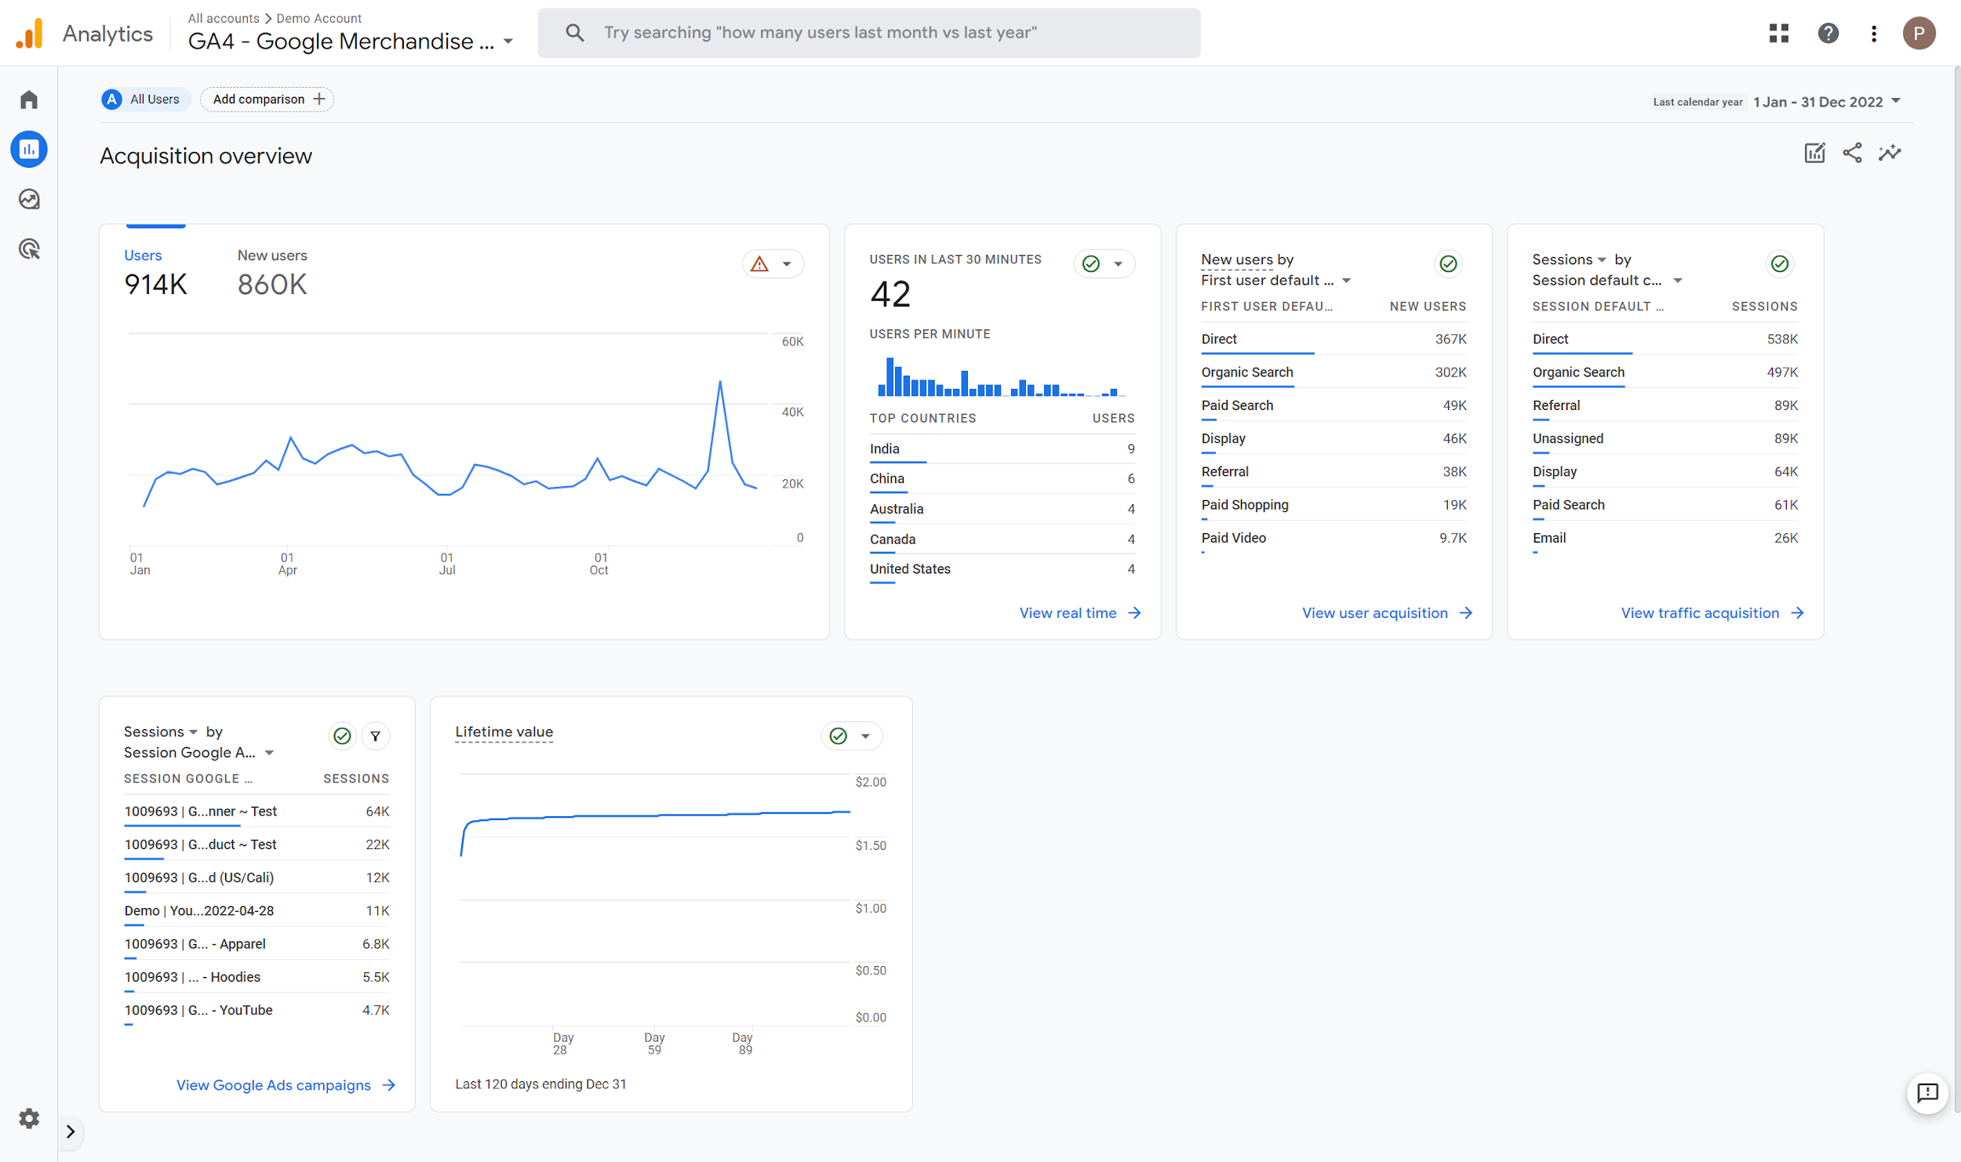


Evaluate Acquisition
Notes:
Audience demographics definition in web analytics refers to the process of grouping website visitors based on their personal characteristics, such as age, gender, income, education, location, and more. This type of segmentation allows businesses to better understand the demographic composition of their target audience, which can inform their marketing and content strategies and help them deliver a more personalized and relevant user experience.
From an expert perspective, audience demographics is one of the most fundamental types of segmentation in web analytics. By identifying the age, gender, income, education, and location of their website visitors, businesses can gain valuable insights into the preferences, interests, and behaviors of their target audience, which can then inform their marketing and content strategies. For example, if a business knows that the majority of its website visitors are millennial females with high incomes, it can create targeted marketing campaigns and content that speaks to this demographic and aligns with their interests and values.
In order to effectively use audience demographics in web analytics, businesses must have access to accurate and up-to-date data. This can be obtained through a variety of sources, such as website analytics tools, customer databases, and third-party data providers. Additionally, businesses must have a clear understanding of the data they collect and the limitations of their sources, as demographic data can be incomplete or inaccurate.
It is also important for businesses to keep in mind that demographic data is only one piece of the puzzle when it comes to understanding their target audience. While demographic data can provide valuable insights into the preferences and interests of a specific group, it does not provide a complete picture of individual behavior or motivations. For this reason, businesses must also consider other types of segmentation, such as behavior and interest-based segmentation, in order to gain a more comprehensive understanding of their target audience.
In conclusion, audience demographics definition in web analytics is a critical tool for businesses looking to understand the personal characteristics of their website visitors. By grouping visitors based on their age, gender, income, education, and location, businesses can gain valuable insights into the preferences, interests, and behaviors of their target audience, which can inform their marketing and content strategies and help them deliver a more personalized and relevant user experience.

Slide 7
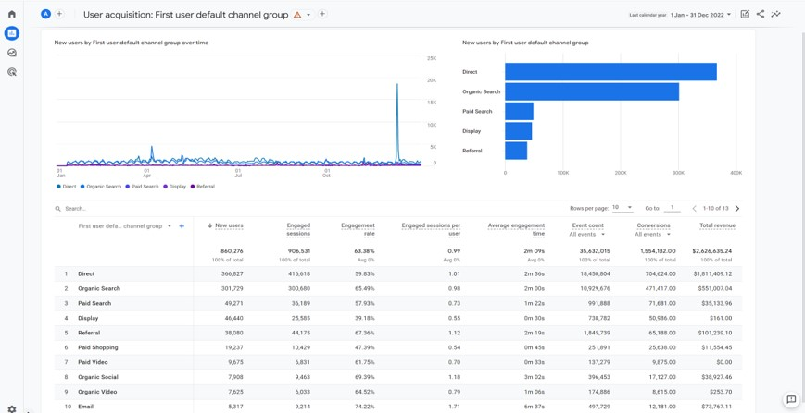
Evaluate Acquisition
Notes:
Audience demographics definition in web analytics refers to the process of grouping website visitors based on their personal characteristics, such as age, gender, income, education, location, and more. This type of segmentation allows businesses to better understand the demographic composition of their target audience, which can inform their marketing and content strategies and help them deliver a more personalized and relevant user experience.
From an expert perspective, audience demographics is one of the most fundamental types of segmentation in web analytics. By identifying the age, gender, income, education, and location of their website visitors, businesses can gain valuable insights into the preferences, interests, and behaviors of their target audience, which can then inform their marketing and content strategies. For example, if a business knows that the majority of its website visitors are millennial females with high incomes, it can create targeted marketing campaigns and content that speaks to this demographic and aligns with their interests and values.
In order to effectively use audience demographics in web analytics, businesses must have access to accurate and up-to-date data. This can be obtained through a variety of sources, such as website analytics tools, customer databases, and third-party data providers. Additionally, businesses must have a clear understanding of the data they collect and the limitations of their sources, as demographic data can be incomplete or inaccurate.
It is also important for businesses to keep in mind that demographic data is only one piece of the puzzle when it comes to understanding their target audience. While demographic data can provide valuable insights into the preferences and interests of a specific group, it does not provide a complete picture of individual behavior or motivations. For this reason, businesses must also consider other types of segmentation, such as behavior and interest-based segmentation, in order to gain a more comprehensive understanding of their target audience.
In conclusion, audience demographics definition in web analytics is a critical tool for businesses looking to understand the personal characteristics of their website visitors. By grouping visitors based on their age, gender, income, education, and location, businesses can gain valuable insights into the preferences, interests, and behaviors of their target audience, which can inform their marketing and content strategies and help them deliver a more personalized and relevant user experience.

Slide 8
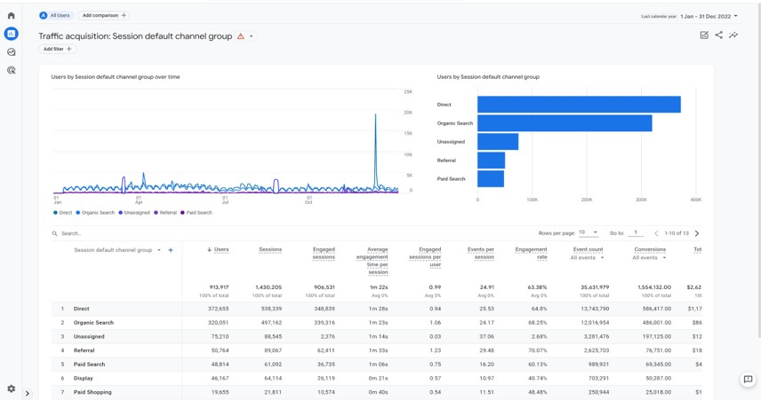
Evaluate Acquisition
Notes:
Audience demographics definition in web analytics refers to the process of grouping website visitors based on their personal characteristics, such as age, gender, income, education, location, and more. This type of segmentation allows businesses to better understand the demographic composition of their target audience, which can inform their marketing and content strategies and help them deliver a more personalized and relevant user experience.
From an expert perspective, audience demographics is one of the most fundamental types of segmentation in web analytics. By identifying the age, gender, income, education, and location of their website visitors, businesses can gain valuable insights into the preferences, interests, and behaviors of their target audience, which can then inform their marketing and content strategies. For example, if a business knows that the majority of its website visitors are millennial females with high incomes, it can create targeted marketing campaigns and content that speaks to this demographic and aligns with their interests and values.
In order to effectively use audience demographics in web analytics, businesses must have access to accurate and up-to-date data. This can be obtained through a variety of sources, such as website analytics tools, customer databases, and third-party data providers. Additionally, businesses must have a clear understanding of the data they collect and the limitations of their sources, as demographic data can be incomplete or inaccurate.
It is also important for businesses to keep in mind that demographic data is only one piece of the puzzle when it comes to understanding their target audience. While demographic data can provide valuable insights into the preferences and interests of a specific group, it does not provide a complete picture of individual behavior or motivations. For this reason, businesses must also consider other types of segmentation, such as behavior and interest-based segmentation, in order to gain a more comprehensive understanding of their target audience.
In conclusion, audience demographics definition in web analytics is a critical tool for businesses looking to understand the personal characteristics of their website visitors. By grouping visitors based on their age, gender, income, education, and location, businesses can gain valuable insights into the preferences, interests, and behaviors of their target audience, which can inform their marketing and content strategies and help them deliver a more personalized and relevant user experience.

Slide 9
Assessment Activity
The groups access the demo google analytics account and choose the Google Analytics 4 property: Google Merchandise Store
Using the data from the platform, answer the following questions:
Identify the different channels that are driving traffic to your website, such as organic search, direct, referral, social, email, and paid search.
Analyse the data to determine which channels are the most effective at acquiring new users.

Slide 10
Topic 1
Understand Behaviour

Slide 11
Understand Behaviour
Metrics definitions in the platform
Popular and engagement pages
  Where they arrive; what they visit
  How much they stay
  Where they leave
Events
Notes:
Understanding behavior in web analytics refers to the process of analyzing and interpreting data on website visitor actions and interactions to gain insights into how they engage with a company's digital presence. This includes tracking metrics such as page views, clicks, form submissions, time on site, and more. By understanding visitor behavior, businesses can optimize their website and marketing strategies to drive more meaningful engagement and conversions.
From an expert perspective, understanding behavior is a crucial component of any comprehensive web analytics strategy. By tracking visitor actions and interactions, businesses can identify trends, patterns, and areas for improvement, which can inform their marketing and content strategies and help them deliver a more personalized and relevant user experience. For example, if a business finds that a significant portion of its website visitors abandon the site after only a few seconds, it may indicate a problem with the website's design or the quality of its content, which can then be addressed to improve the user experience.
There are several methods for tracking visitor behavior in web analytics, including website analytics tools, heat mapping software, and A/B testing. Website analytics tools, such as Google Analytics, provide a comprehensive overview of visitor behavior, including page views, time on site, bounce rate, and more. Heat mapping software, such as Hotjar, allows businesses to visualize how website visitors interact with their site, including where they click, what they hover over, and where they spend the most time. A/B testing is a method of comparing two versions of a website or landing page to determine which version is more effective at driving conversions and engagement.
In order to effectively understand visitor behavior in web analytics, businesses must have a clear understanding of their goals and objectives, as well as the specific metrics they want to track and measure. For example, if a business wants to improve its website's conversion rate, it may track metrics such as form submissions, time on site, and bounce rate. Additionally, businesses must have a plan in place for analyzing and acting on the data they collect, as well as regularly updating and optimizing their web analytics strategy to keep pace with changing visitor behaviors and industry trends.
In conclusion, understanding behavior in web analytics is a critical tool for businesses looking to optimize their website and marketing strategies and deliver a more personalized and relevant user experience. By tracking visitor actions and interactions, businesses can gain valuable insights into how their target audience engages with their digital presence and make informed decisions about their marketing and content strategies.
When analyzing user behavior in a platform, there are several metrics and insights that can provide valuable information. Here are definitions of some key metrics and insights related to popular and engagement pages, where users arrive, what they visit, how much they stay, where they leave, and events:
Popular Pages: Popular pages refer to the pages on your platform that receive the highest number of visits or pageviews. These pages can provide insights into the content or features that are most appealing to your users.
Engagement Pages: Engagement pages are the pages on your platform where users spend a significant amount of time or interact extensively. These pages typically indicate high user interest and involvement. Examples can include articles, interactive tools, forums, or social features.
Referral Sources: Referral sources indicate where users are coming from before arriving on your platform. This data reveals which external sources, such as search engines, social media platforms, referral websites, or specific campaigns, are driving traffic to your platform.
Landing Pages: Landing pages are the first pages that users visit when they arrive on your platform. Understanding which pages serve as entry points can provide insights into the effectiveness of your marketing campaigns, search engine optimization, or referral sources.
Pageviews: Pageviews refer to the total number of times a page is viewed by users. This metric helps determine the popularity and reach of different pages on your platform.
Time on Page: Time on page measures the average amount of time users spend on a specific page. This metric indicates the level of user engagement and interest in the content or features provided on that page.
Exit Pages: Exit pages represent the pages where users leave your platform. Analyzing exit pages can help identify potential issues or bottlenecks that lead to user drop-off. It can also indicate whether users are completing their intended actions or encountering obstacles.
Bounce Rate: Bounce rate indicates the percentage of users who leave your platform after visiting a single page without interacting further. A high bounce rate may suggest that users are not finding what they expected or that the page experience needs improvement.
Events: Events are specific user actions or interactions that you track on your platform. These can include clicking a button, submitting a form, playing a video, or any other predefined actions. Analyzing events helps understand user behavior patterns, conversion funnels, and the effectiveness of certain features or campaigns.
By analyzing these metrics and insights, you can gain a deeper understanding of user behavior within your platform. This knowledge can inform decision-making, content optimization, user experience improvements, and ultimately drive higher user engagement and conversion rates.

Slide 12
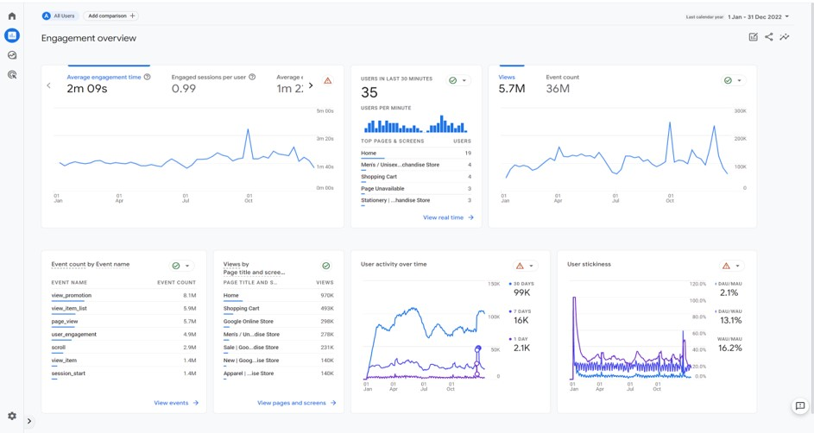
Understand Behaviour
Notes:
Audience demographics definition in web analytics refers to the process of grouping website visitors based on their personal characteristics, such as age, gender, income, education, location, and more. This type of segmentation allows businesses to better understand the demographic composition of their target audience, which can inform their marketing and content strategies and help them deliver a more personalized and relevant user experience.
From an expert perspective, audience demographics is one of the most fundamental types of segmentation in web analytics. By identifying the age, gender, income, education, and location of their website visitors, businesses can gain valuable insights into the preferences, interests, and behaviors of their target audience, which can then inform their marketing and content strategies. For example, if a business knows that the majority of its website visitors are millennial females with high incomes, it can create targeted marketing campaigns and content that speaks to this demographic and aligns with their interests and values.
In order to effectively use audience demographics in web analytics, businesses must have access to accurate and up-to-date data. This can be obtained through a variety of sources, such as website analytics tools, customer databases, and third-party data providers. Additionally, businesses must have a clear understanding of the data they collect and the limitations of their sources, as demographic data can be incomplete or inaccurate.
It is also important for businesses to keep in mind that demographic data is only one piece of the puzzle when it comes to understanding their target audience. While demographic data can provide valuable insights into the preferences and interests of a specific group, it does not provide a complete picture of individual behavior or motivations. For this reason, businesses must also consider other types of segmentation, such as behavior and interest-based segmentation, in order to gain a more comprehensive understanding of their target audience.
In conclusion, audience demographics definition in web analytics is a critical tool for businesses looking to understand the personal characteristics of their website visitors. By grouping visitors based on their age, gender, income, education, and location, businesses can gain valuable insights into the preferences, interests, and behaviors of their target audience, which can inform their marketing and content strategies and help them deliver a more personalized and relevant user experience.

Slide 13
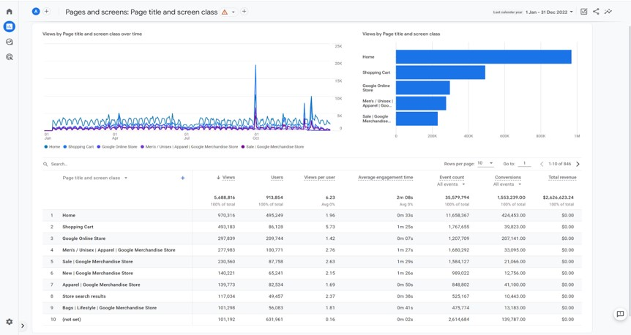
Understand Behaviour
Notes:
Audience demographics definition in web analytics refers to the process of grouping website visitors based on their personal characteristics, such as age, gender, income, education, location, and more. This type of segmentation allows businesses to better understand the demographic composition of their target audience, which can inform their marketing and content strategies and help them deliver a more personalized and relevant user experience.
From an expert perspective, audience demographics is one of the most fundamental types of segmentation in web analytics. By identifying the age, gender, income, education, and location of their website visitors, businesses can gain valuable insights into the preferences, interests, and behaviors of their target audience, which can then inform their marketing and content strategies. For example, if a business knows that the majority of its website visitors are millennial females with high incomes, it can create targeted marketing campaigns and content that speaks to this demographic and aligns with their interests and values.
In order to effectively use audience demographics in web analytics, businesses must have access to accurate and up-to-date data. This can be obtained through a variety of sources, such as website analytics tools, customer databases, and third-party data providers. Additionally, businesses must have a clear understanding of the data they collect and the limitations of their sources, as demographic data can be incomplete or inaccurate.
It is also important for businesses to keep in mind that demographic data is only one piece of the puzzle when it comes to understanding their target audience. While demographic data can provide valuable insights into the preferences and interests of a specific group, it does not provide a complete picture of individual behavior or motivations. For this reason, businesses must also consider other types of segmentation, such as behavior and interest-based segmentation, in order to gain a more comprehensive understanding of their target audience.
In conclusion, audience demographics definition in web analytics is a critical tool for businesses looking to understand the personal characteristics of their website visitors. By grouping visitors based on their age, gender, income, education, and location, businesses can gain valuable insights into the preferences, interests, and behaviors of their target audience, which can inform their marketing and content strategies and help them deliver a more personalized and relevant user experience.

Slide 14
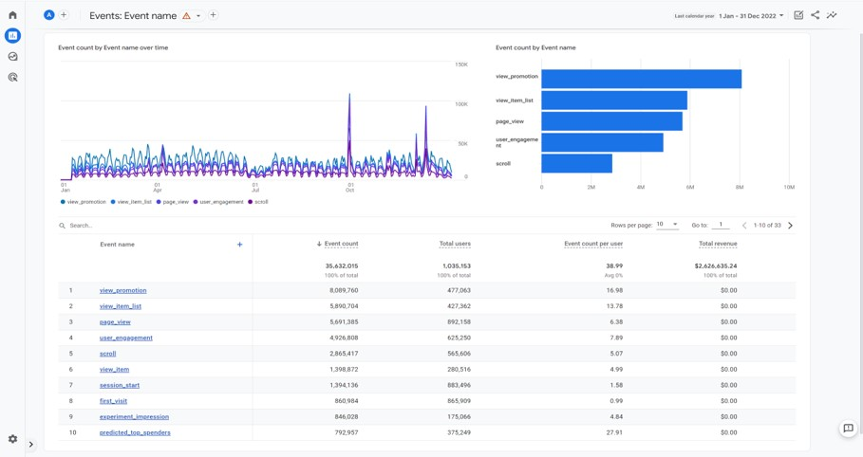
Understand Behaviour
Notes:
Audience demographics definition in web analytics refers to the process of grouping website visitors based on their personal characteristics, such as age, gender, income, education, location, and more. This type of segmentation allows businesses to better understand the demographic composition of their target audience, which can inform their marketing and content strategies and help them deliver a more personalized and relevant user experience.
From an expert perspective, audience demographics is one of the most fundamental types of segmentation in web analytics. By identifying the age, gender, income, education, and location of their website visitors, businesses can gain valuable insights into the preferences, interests, and behaviors of their target audience, which can then inform their marketing and content strategies. For example, if a business knows that the majority of its website visitors are millennial females with high incomes, it can create targeted marketing campaigns and content that speaks to this demographic and aligns with their interests and values.
In order to effectively use audience demographics in web analytics, businesses must have access to accurate and up-to-date data. This can be obtained through a variety of sources, such as website analytics tools, customer databases, and third-party data providers. Additionally, businesses must have a clear understanding of the data they collect and the limitations of their sources, as demographic data can be incomplete or inaccurate.
It is also important for businesses to keep in mind that demographic data is only one piece of the puzzle when it comes to understanding their target audience. While demographic data can provide valuable insights into the preferences and interests of a specific group, it does not provide a complete picture of individual behavior or motivations. For this reason, businesses must also consider other types of segmentation, such as behavior and interest-based segmentation, in order to gain a more comprehensive understanding of their target audience.
In conclusion, audience demographics definition in web analytics is a critical tool for businesses looking to understand the personal characteristics of their website visitors. By grouping visitors based on their age, gender, income, education, and location, businesses can gain valuable insights into the preferences, interests, and behaviors of their target audience, which can inform their marketing and content strategies and help them deliver a more personalized and relevant user experience.

Slide 15
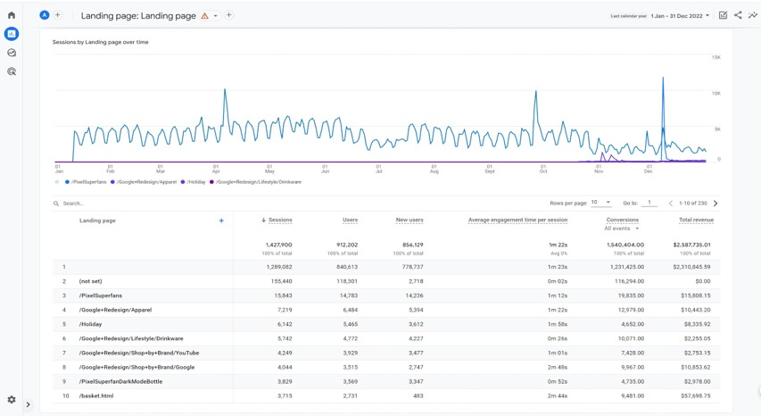
Understand Behaviour
Notes:
Audience demographics definition in web analytics refers to the process of grouping website visitors based on their personal characteristics, such as age, gender, income, education, location, and more. This type of segmentation allows businesses to better understand the demographic composition of their target audience, which can inform their marketing and content strategies and help them deliver a more personalized and relevant user experience.
From an expert perspective, audience demographics is one of the most fundamental types of segmentation in web analytics. By identifying the age, gender, income, education, and location of their website visitors, businesses can gain valuable insights into the preferences, interests, and behaviors of their target audience, which can then inform their marketing and content strategies. For example, if a business knows that the majority of its website visitors are millennial females with high incomes, it can create targeted marketing campaigns and content that speaks to this demographic and aligns with their interests and values.
In order to effectively use audience demographics in web analytics, businesses must have access to accurate and up-to-date data. This can be obtained through a variety of sources, such as website analytics tools, customer databases, and third-party data providers. Additionally, businesses must have a clear understanding of the data they collect and the limitations of their sources, as demographic data can be incomplete or inaccurate.
It is also important for businesses to keep in mind that demographic data is only one piece of the puzzle when it comes to understanding their target audience. While demographic data can provide valuable insights into the preferences and interests of a specific group, it does not provide a complete picture of individual behavior or motivations. For this reason, businesses must also consider other types of segmentation, such as behavior and interest-based segmentation, in order to gain a more comprehensive understanding of their target audience.
In conclusion, audience demographics definition in web analytics is a critical tool for businesses looking to understand the personal characteristics of their website visitors. By grouping visitors based on their age, gender, income, education, and location, businesses can gain valuable insights into the preferences, interests, and behaviors of their target audience, which can inform their marketing and content strategies and help them deliver a more personalized and relevant user experience.

Slide 16
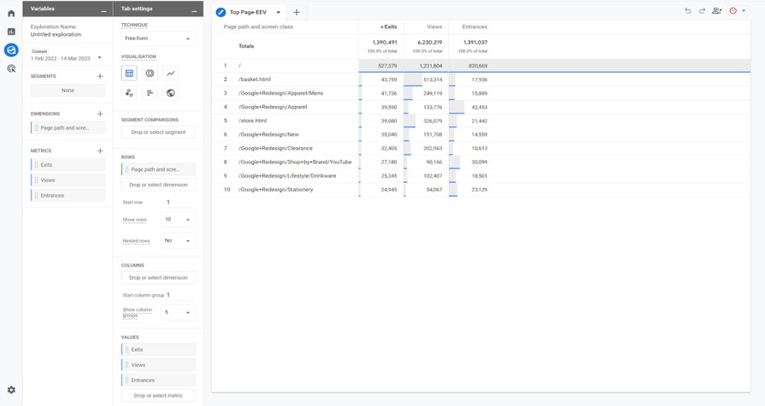
Understand Behaviour
Notes:
Audience demographics definition in web analytics refers to the process of grouping website visitors based on their personal characteristics, such as age, gender, income, education, location, and more. This type of segmentation allows businesses to better understand the demographic composition of their target audience, which can inform their marketing and content strategies and help them deliver a more personalized and relevant user experience.
From an expert perspective, audience demographics is one of the most fundamental types of segmentation in web analytics. By identifying the age, gender, income, education, and location of their website visitors, businesses can gain valuable insights into the preferences, interests, and behaviors of their target audience, which can then inform their marketing and content strategies. For example, if a business knows that the majority of its website visitors are millennial females with high incomes, it can create targeted marketing campaigns and content that speaks to this demographic and aligns with their interests and values.
In order to effectively use audience demographics in web analytics, businesses must have access to accurate and up-to-date data. This can be obtained through a variety of sources, such as website analytics tools, customer databases, and third-party data providers. Additionally, businesses must have a clear understanding of the data they collect and the limitations of their sources, as demographic data can be incomplete or inaccurate.
It is also important for businesses to keep in mind that demographic data is only one piece of the puzzle when it comes to understanding their target audience. While demographic data can provide valuable insights into the preferences and interests of a specific group, it does not provide a complete picture of individual behavior or motivations. For this reason, businesses must also consider other types of segmentation, such as behavior and interest-based segmentation, in order to gain a more comprehensive understanding of their target audience.
In conclusion, audience demographics definition in web analytics is a critical tool for businesses looking to understand the personal characteristics of their website visitors. By grouping visitors based on their age, gender, income, education, and location, businesses can gain valuable insights into the preferences, interests, and behaviors of their target audience, which can inform their marketing and content strategies and help them deliver a more personalized and relevant user experience.

Slide 17
Assessment Activity
The groups access the demo google analytics account and choose the Google Analytics 4 property: Google Merchandise Store.
Using the data from the platform, answer the following questions:
Study the different metrics such as pages per session, bounce rate, session duration, and exit rate.
Analyse the data to understand how users interact with the website, such as which pages are most popular and where users tend to drop off.
Use the navigation summary report to identify the most common path that users take through the website.
Create a report that includes a breakdown of the user behaviour metrics for different sections of the website (e.g., blog, product pages, checkout process)
Using the data from your report, make recommendations on how to improve user engagement and reduce bounce rates by optimizing the most popular pages and addressing issues that cause users to drop off.

Slide 18
Topic 1
Evaluate Conversion
Notes:
Evaluating conversion in web analytics refers to the process of measuring and analyzing the success of a company's efforts to convert website visitors into customers. This involves tracking the percentage of visitors who take a desired action, such as filling out a form, making a purchase, or subscribing to a newsletter, and analyzing the factors that influence conversion rates. By evaluating conversion, businesses can gain insights into the effectiveness of their marketing and advertising efforts and make informed decisions about their website and marketing strategies.
From an expert perspective, evaluating conversion is a key component of any web analytics strategy. Conversion rate is a critical metric that provides insight into how well a company's website is performing in terms of attracting and converting visitors into customers. By tracking and analyzing conversion rates, businesses can identify opportunities for improvement and optimize their website and marketing strategies to drive more meaningful engagement and conversions.
There are several methods for evaluating conversion in web analytics, including conversion rate analysis, A/B testing, and funnels. Conversion rate analysis measures the percentage of website visitors who take a desired action, such as filling out a form, making a purchase, or subscribing to a newsletter. A/B testing is a method of comparing two versions of a website or landing page to determine which version is more effective at driving conversions and engagement. Funnels provide a visual representation of the steps that a website visitor takes to complete a desired action, such as making a purchase, allowing businesses to identify points of friction or drop-off and make improvements to optimize the user experience.
In order to effectively evaluate conversion in web analytics, businesses must have a clear understanding of their goals and objectives, as well as the specific metrics they want to track and measure. For example, if a business wants to improve its website's conversion rate, it may track metrics such as form submissions, time on site, and bounce rate. Additionally, businesses must have a plan in place for analyzing and acting on the data they collect, as well as regularly updating and optimizing their web analytics strategy to keep pace with changing visitor behaviors and industry trends.
In conclusion, evaluating conversion in web analytics is a critical tool for businesses looking to measure the effectiveness of their marketing and advertising efforts and make informed decisions about their website and marketing strategies. By tracking and analyzing conversion rates and other related metrics, businesses can gain valuable insights into the factors that influence conversion and take action to improve their website and marketing performance.

Slide 19
Evaluate Conversion
Conversions and goals
Value of a conversion
Conversion rate
Abandonment rate
Notes:
Conversions and Goals: Conversions refer to the desired actions that users take on your platform, such as making a purchase, filling out a form, signing up for a newsletter, or completing any other predefined goals. Tracking conversions helps measure the success of your business objectives and indicates the effectiveness of your marketing and user experience strategies.
Value of a Conversion: The value of a conversion represents the monetary or non-monetary worth associated with each conversion. It could be the revenue generated from a sale, the lead quality of a form submission, or the potential lifetime value of a customer. Understanding the value of each conversion helps determine the return on investment (ROI) and prioritize marketing efforts and resources accordingly.
Conversion Rate: The conversion rate is the percentage of users who complete a desired action out of the total number of visitors or sessions on your platform. It is a key metric to evaluate the effectiveness of your conversion funnel and marketing campaigns. A higher conversion rate indicates better optimization and alignment between your offerings and user expectations.
Abandonment Rate: The abandonment rate measures the percentage of users who start a conversion process but leave without completing it. This metric is particularly relevant for e-commerce websites, where users may abandon their shopping carts or checkout process. Understanding the reasons behind abandonment and reducing the abandonment rate can help optimize the user experience and improve conversion rates.
To evaluate conversion effectively, it's crucial to set clear goals, track conversions, assign values to them, and analyze conversion rates and abandonment rates. These metrics provide insights into the effectiveness of your conversion strategies, identify areas for improvement, and help optimize your marketing and user experience efforts to drive higher conversion rates and overall business success.
Analyzing conversions in Google Analytics involves utilizing various features and reports available in the platform. Here's how you can analyze conversions and related metrics in Google Analytics:
Conversions and Goals:
Set up Goals: In Google Analytics, set up goals that align with your desired conversions. This can include destination goals (e.g., thank you page after a purchase), duration goals (e.g., time spent on a specific page), pages/screens per session goals, or event goals (e.g., form submission).
Track Goal Completions: Monitor the number of goal completions in the Conversions > Goals section of Google Analytics. This will provide an overview of how many users are converting on your website.
Value of a Conversion:
Assign a Monetary Value: If your conversions have a monetary value (e.g., sales), assign a specific value to each conversion. This can be done when setting up the goal or by assigning a value to specific actions or events using custom metrics.
Analyze Revenue: In the Ecommerce section of Google Analytics, you can track revenue generated from specific conversions, products, or transactions. This will help you understand the value associated with your conversions.
Conversion Rate:
View Conversion Rate: The Conversion Rate metric shows the percentage of sessions that resulted in a conversion. You can find this metric in various reports, such as the Conversions > Goals > Overview report or in custom reports.
Analyze Conversion Funnels: The Funnel Visualization report allows you to track the conversion rates at different stages of your conversion funnel. It helps identify any drop-off points where users are abandoning the conversion process.
Abandonment Rate:
Analyze Behavior Flow: The Behavior Flow report in Google Analytics provides insights into the user journey on your website. By examining this report, you can identify the pages or steps where users tend to drop off or abandon the conversion process.
Use Funnel Visualization: As mentioned earlier, the Funnel Visualization report can also help identify abandonment rates at specific stages of your conversion funnel.
Additionally, you can create custom reports or use segments in Google Analytics to further analyze conversions and related metrics based on specific dimensions or segments of your audience.
By leveraging these features and reports in Google Analytics, you can gain valuable insights into conversions, understand the value associated with each conversion, track conversion rates, and identify abandonment rates. These insights enable you to optimize your website, marketing campaigns, and user experience to improve conversion rates and achieve your business goals.

Slide 20
Evaluate Conversion
Micro and macro conversations
Macro conversation
Micro conversation
Micro conversation
Micro conversation
Micro conversation
Micro conversation
Notes:
In website analytics, micro and macro conversions refer to different types of user actions or goals that are tracked to measure the success of a website or online business. Here's an explanation of each:
Micro Conversions: Micro conversions are smaller, intermediate actions that users take on a website that may indicate progress towards a macro conversion. These actions are typically related to user engagement or interaction and can vary depending on the specific goals of the website. Examples of micro conversions include:
Signing up for a newsletter
Adding items to a shopping cart
Watching a video
Downloading a resource or whitepaper
Clicking on a specific call-to-action button
Spending a certain amount of time on a page or site
Micro conversions are important because they provide insights into user behavior, engagement, and the effectiveness of specific website features or content. While they may not directly lead to a sale or the primary conversion goal, they contribute to the overall user journey and can eventually lead to macro conversions.
Macro Conversions: Macro conversions are the primary, high-value actions or goals that are the main focus of a website or online business. These conversions typically represent the ultimate objectives or desired outcomes. Examples of macro conversions include:
Completing a purchase
Submitting a lead generation form
Signing up for a paid subscription or membership
Requesting a demo or consultation
Making a booking or reservation
Macro conversions are directly tied to the primary business goals and revenue generation. Tracking macro conversions allows businesses to evaluate the success of their overall conversion funnel, marketing campaigns, and user experience.
Both micro and macro conversions are essential for a comprehensive understanding of website performance and user behavior. While macro conversions represent the ultimate goal, micro conversions provide insights into the user journey, engagement, and the effectiveness of various touchpoints and interactions on the website. Analyzing both types of conversions helps businesses identify opportunities for optimization, improve user experience, and increase overall conversion rates.

Slide 21
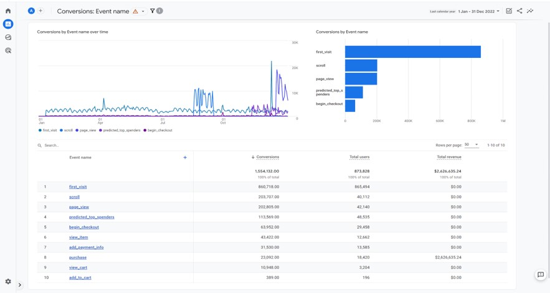
Evaluate Conversion

Slide 22
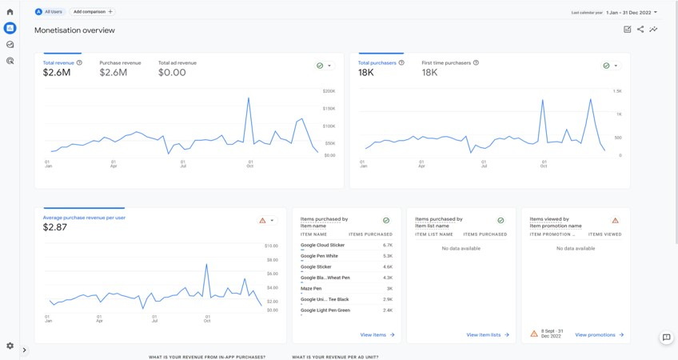
Evaluate Conversion

Slide 23
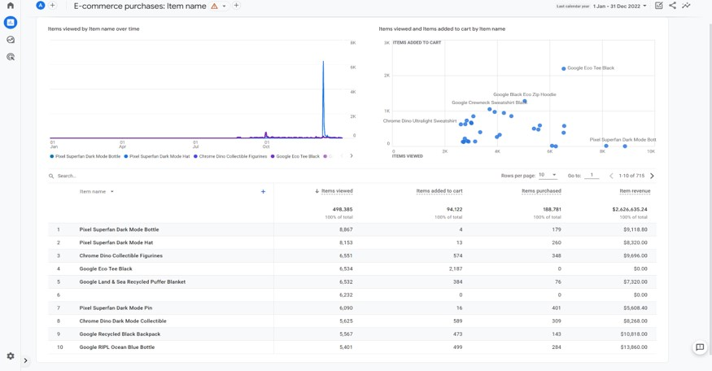
Evaluate Conversion

Slide 24
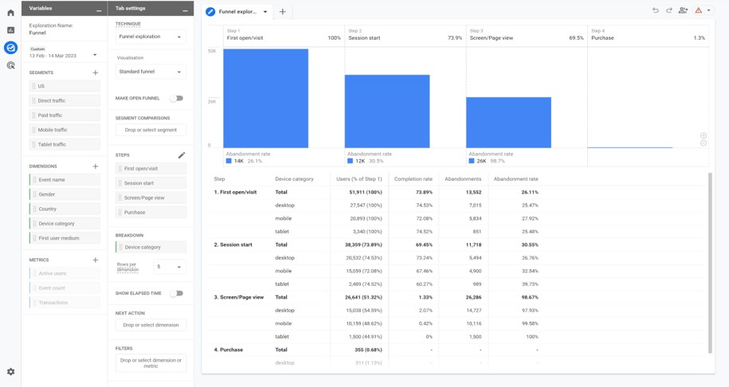
Evaluate Conversion

Slide 25
Assessment Activity
The groups access the demo google analytics account and choose the Google Analytics 4 property: Google Merchandise Store.
Using the data from the platform, answer the following questions:
Identify the goals that you have set up for the website, such as form submissions, product purchases, and account creations.
Analyse the data to understand the conversion rate for each goal and identify any potential bottlenecks in the conversion process.
Use the funnel visualization report to identify where users are dropping off in the conversion process and understand which steps of the process are causing the most friction.
Create a report that includes a breakdown of the conversion rate for different sections of your website (e.g., product pages, checkout process, thank you page)
Using the data from your report, make recommendations on how to improve the conversion rate by addressing issues that cause users to drop off and optimizing the most popular pages.

Slide 26
Topic 1
Evaluate Retention/Loyalty
Notes:
Evaluating retention and loyalty in web analytics refers to the process of measuring and analyzing the likelihood that a customer will return to a company's website and make additional purchases. This is a critical metric for businesses as it can provide valuable insights into the effectiveness of their marketing and customer experience strategies, as well as the overall health of the business.
From an expert perspective, evaluating retention and loyalty is a key component of any web analytics strategy. The ability to retain customers over time is a key indicator of a successful business, as it is often more cost-effective to retain existing customers than to acquire new ones. By tracking and analyzing metrics such as repeat purchase rate, customer lifetime value, and churn rate, businesses can gain a deep understanding of their customers' behavior and identify opportunities for improvement.
There are several methods for evaluating retention and loyalty in web analytics, including cohort analysis, customer segmentation, and customer journey mapping. Cohort analysis is a method of grouping customers based on their behavior, such as the time of their first purchase, and tracking their behavior over time. Customer segmentation is a method of dividing customers into groups based on characteristics such as purchase history, demographics, or location. Customer journey mapping is a method of visualizing the steps that a customer takes to engage with a company, from their first interaction to their final purchase, allowing businesses to identify points of friction and opportunities for improvement.
In order to effectively evaluate retention and loyalty in web analytics, businesses must have a clear understanding of their goals and objectives, as well as the specific metrics they want to track and measure. For example, if a business wants to improve its retention rate, it may track metrics such as repeat purchase rate, customer lifetime value, and churn rate. Additionally, businesses must have a plan in place for analyzing and acting on the data they collect, as well as regularly updating and optimizing their web analytics strategy to keep pace with changing customer behaviors and industry trends.
In conclusion, evaluating retention and loyalty in web analytics is a critical tool for businesses looking to measure the effectiveness of their customer experience strategies and the overall health of their business. By tracking and analyzing key metrics, businesses can gain valuable insights into the factors that influence customer behavior and take action to improve their customer retention and loyalty. By doing so, businesses can increase customer satisfaction, reduce customer churn, and ultimately drive growth and success for their business.

Slide 27
Evaluate Retention/Loyalty
Track of visitor retention and loyalty
  New users vs returning users
Cohort Analysis Report
Tracking id code in the website => login
Notes:
Evaluation of Retention/Loyalty metrics involves tracking visitor retention and loyalty, understanding the behavior of new users versus returning users, utilizing cohort analysis reports, and implementing tracking ID codes on the website. Here's an assessment of each aspect:
Visitor Retention and Loyalty:
Visitor Retention: Tracking visitor retention helps measure the ability of a website to retain users over time. Analyze metrics such as the percentage of returning visitors, the frequency of visits, or the time elapsed between visits to assess visitor retention.
Loyalty Metrics: Loyalty metrics provide insights into user engagement and loyalty. Examples include the number of sessions per user, average session duration, or pages per session. Higher values in these metrics indicate greater user loyalty and engagement.
New Users vs Returning Users:
New Users: Evaluating new users focuses on understanding the number of first-time visitors to your website during a specific period. Analyze metrics like the total number of new users, the source of acquisition, or the effectiveness of marketing campaigns in attracting new users.
Returning Users: Analyzing returning users involves assessing the behavior and engagement of users who have previously visited your website. Understand metrics such as the percentage of returning users, their conversion rates, or their level of activity compared to new users.
Cohort Analysis Report:
Cohort Analysis: Cohort analysis involves grouping users based on specific characteristics or time periods and tracking their behavior over time. Cohort analysis reports provide insights into user retention, engagement, and conversion rates within specific cohorts. This analysis helps identify patterns, trends, and changes in user behavior.
Tracking ID Code in the Website:
Tracking ID: Implementing a tracking ID code, such as the Google Analytics tracking code, on your website is essential for collecting and analyzing user behavior data. The tracking ID enables the tracking of visitor retention, loyalty, and other relevant metrics. Ensure that the tracking code is correctly implemented on all pages of your website for accurate data collection.
To evaluate retention/loyalty effectively, utilize the retention and loyalty metrics provided by your analytics platform. Examine reports on visitor retention, new users, returning users, and cohort analysis. Additionally, verify that the tracking ID code is correctly implemented to collect accurate data on user behavior. These evaluations help in understanding user engagement, optimizing user experience, and implementing strategies to improve retention and loyalty on your website.

Slide 28
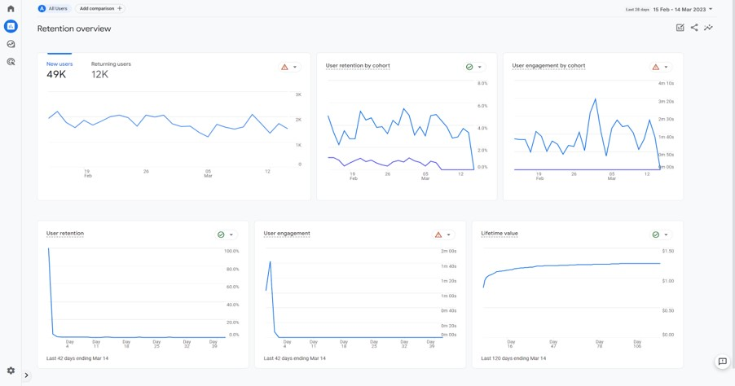
Evaluate Retention/Loyalty

Slide 29
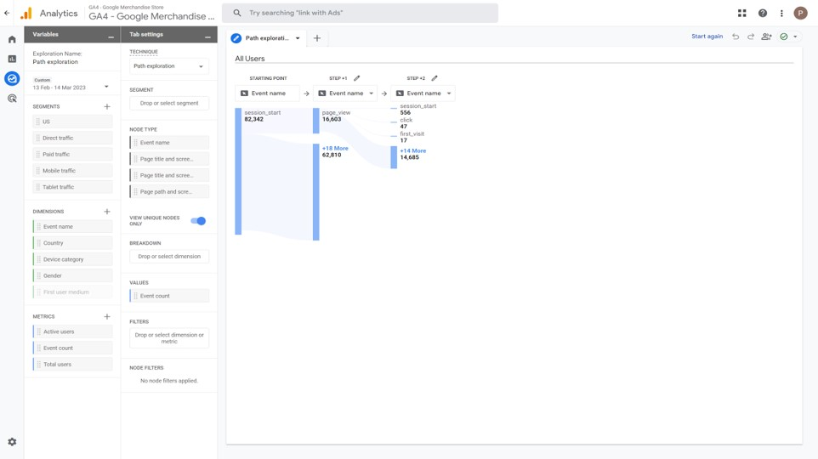
Evaluate Retention/Loyalty

Slide 30
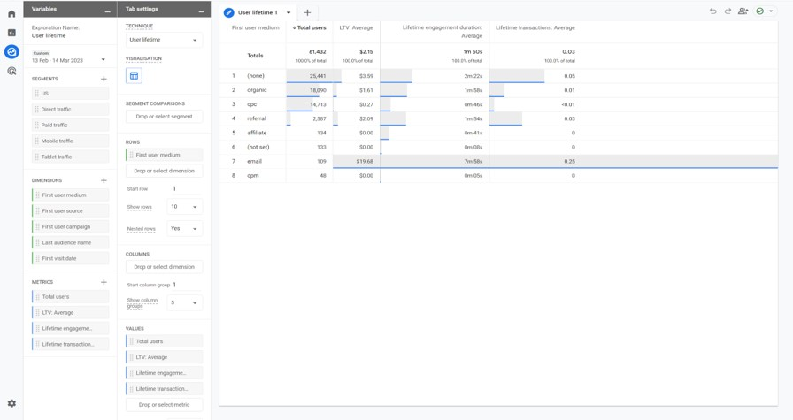
Evaluate Retention/Loyalty

Slide 31
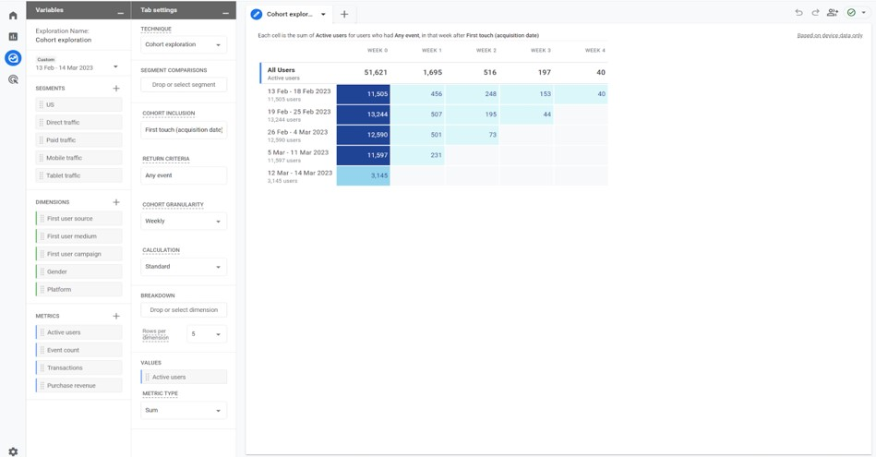
Evaluate Retention/Loyalty

Slide 32
Assessment Activity
The groups access the demo google analytics account and choose the Google Analytics 4 property: Google Merchandise Store.
Using the data from the platform, answer the following questions:
Analyse the data of user engagement over time, such as the number of returning users, frequency and recency of visits, and average session duration.
Use the Cohort Analysis report to understand how user engagement changes over time and identify patterns in the behaviour of different groups of users.
Create a report that includes a breakdown of the retention rate for different sections of the website (e.g., product pages, blog, account pages)
Using the data from your report, make recommendations on how to improve retention rate by addressing issues that cause users to disengage and optimizing the most popular pages.

Slide 33
Consolidation Activity

Slide 34
Consolidation Activity
The groups access the demo google analytics account and choose the Google Analytics 4 property: Google Merchandise Store
Generate a report summarizing your findings and recommendations, including any insights you've gained from analyzing acquisition user behavior.
Generate a report summarizing your findings and recommendations, including any insights you've gained from analyzing user behavior.
Generate a report summarizing your findings and recommendations, including any insights you've gained from analyzing user behavior and conversion data.
Generate a report summarizing your findings and recommendations, including any insights you've gained from analyzing user behavior and retention data.

Slide 35
Recap of Learning Objectives
Now, can you compare the behaviour types of users?
Now, can you assess the behaviour of users?

Slide 36
Recap of Learning
In your opinion, what is the most important thing we learned today?
Describe three things that you learned today, two things you need clarification on and one thing you found interesting.

Slide 37
Questions?

Slide 38
Next class…
Segmentation and filtering

Slide 39
Disclaimer
The DEMS material aims to enhance digital marketing skills in higher education, comprehending the essential needs in organizations. You have access to extensive slide sets with in-class activities and assignments, as well as detailed user instructions for teacher.
Note: The material includes contents and figures retrieved from the internet and is thus subject to changes. The sources have been announced according to the rules of fair use. The publisher´s responsibility is restricted to the original material stored at www.dems.pro. All material is produced for open use and co-funded by Erasmus +.

