Slide 1
Understand your Audience
Professor
School
Digital Analytics and Monitoring

Slide 2
Understand your Audience
User behavior on a website can be compared to a shopper's behavior in a physical store. Just as a shopper may browse different aisles, pick up and examine products, and make purchases, a website visitor may click on different pages, spend varying amounts of time on the site, and complete certain actions (such as making a purchase or filling out a form). Google Analytics allows website owners to track and analyze this "shopper behavior" on their website, giving them insights into how to improve the website and attract more customers. Each page view, click, and conversion is like a word, and by analyzing the patterns and sequences of these "words" website owners can understand the "sentences" and "conversations" that users are having with their website. Just as a linguist can understand the meaning behind a sentence by looking at its structure and context, website owners can use analytics to understand the motivations and needs of their users by analyzing their behavior on the site.

Slide 3
Learning Objectives
Compare the behaviour types of users
Assess the behaviour of users

Slide 4
Topics
Overview of audience
Users behaviours
Evaluate Acquisition
Understand Behaviour
Evaluate Conversion
Evaluate Retention/Loyalty

Slide 5
“Users will never forget how your product or service made them feel.”
Mario Maruffi

Slide 6
“Data are just summaries of thousands of stories – tell a few of those stories to help make the data meaningful.”
Chip & Dan Heath

Slide 7
Topic 1
Overview of audience
Notes:
Audience definition in web analytics refers to the process of grouping website visitors based on shared characteristics such as demographics, behaviors, interests, or location. This helps businesses better understand who their website visitors are, what they are interested in, and how they interact with their website, allowing them to tailor their digital marketing efforts and improve user experiences.
From an expert perspective, audience definition is a crucial step in developing a comprehensive web analytics strategy. By understanding their target audience, businesses can identify the most effective channels to reach them, optimize their website for their specific needs, and make informed decisions about the types of content and messaging that will resonate with them. Additionally, audience definition helps businesses determine which marketing campaigns are performing well and which need improvement, as well as track the progress of their online initiatives over time.
There are several methods for defining audiences in web analytics, including demographic segmentation, behavior segmentation, and interest-based segmentation. Demographic segmentation groups visitors based on factors such as age, gender, income, education, and location. Behavior segmentation groups visitors based on their behavior on the website, such as the pages they visit, the products they purchase, and the length of time they spend on the site. Interest-based segmentation groups visitors based on their interests and hobbies, as determined by their online behavior and search history.
In order to effectively define audiences in web analytics, businesses must have access to accurate and up-to-date data. This can be obtained through various sources, such as website analytics tools, customer databases, and third-party data providers. Businesses must also have a clear understanding of their target audience, including what motivates them, what challenges they face, and what they hope to achieve by visiting their website. This information can be gathered through market research, surveys, and focus groups.
In conclusion, audience definition is a critical component of any successful web analytics strategy. By understanding who their website visitors are, what they are interested in, and how they interact with their website, businesses can tailor their digital marketing efforts to meet the needs and expectations of their target audience, improve user experiences, and drive more meaningful engagement and conversions.

Slide 8


Overview of audience
User vs. Sessions
User
User has sessions
Notes:
In analytics, "users" and "sessions" are two important metrics used to measure and understand user behavior on websites or applications. Here's the difference between these two metrics:
Users: The term "users" refers to the number of unique individuals who visit a website or use an application within a specific timeframe. Each individual is counted as a single user, regardless of how many times they visit or interact with the site or app. Users are typically identified through unique identifiers like cookies or login credentials.
Sessions: A session represents a single visit or interaction by a user within a website or application. It starts when a user initiates their visit and ends after a period of inactivity, such as a specified time of inactivity (e.g., 30 minutes) or when the user closes the browser or app. Sessions are used to measure engagement and track user activities during a specific visit.
Here are a few key points to keep in mind:
Users are counted as unique individuals, while sessions represent individual visits or interactions.
A single user can have multiple sessions. For example, if a user visits a website in the morning, leaves, and then returns later in the day, that would count as two sessions for the same user.
Sessions can provide insights into user engagement, such as the number of pages visited, time spent on the site, or specific actions taken during a visit.
Users are often associated with long-term metrics, such as user acquisition, retention, and overall audience size, while sessions are used to measure short-term engagement and interaction patterns.
Understanding the distinction between users and sessions can help analysts gain insights into user behavior, identify trends, and make data-driven decisions to improve user experience and engagement.

Slide 9
Overview of audience
Audience demographics
Geography and language
Genre and age
Interest
Technology and devices
Notes:
Audience demographics definition in web analytics refers to the process of grouping website visitors based on their personal characteristics, such as age, gender, income, education, location, and more. This type of segmentation allows businesses to better understand the demographic composition of their target audience, which can inform their marketing and content strategies and help them deliver a more personalized and relevant user experience.
From an expert perspective, audience demographics is one of the most fundamental types of segmentation in web analytics. By identifying the age, gender, income, education, and location of their website visitors, businesses can gain valuable insights into the preferences, interests, and behaviors of their target audience, which can then inform their marketing and content strategies. For example, if a business knows that the majority of its website visitors are millennial females with high incomes, it can create targeted marketing campaigns and content that speaks to this demographic and aligns with their interests and values.
In order to effectively use audience demographics in web analytics, businesses must have access to accurate and up-to-date data. This can be obtained through a variety of sources, such as website analytics tools, customer databases, and third-party data providers. Additionally, businesses must have a clear understanding of the data they collect and the limitations of their sources, as demographic data can be incomplete or inaccurate.
It is also important for businesses to keep in mind that demographic data is only one piece of the puzzle when it comes to understanding their target audience. While demographic data can provide valuable insights into the preferences and interests of a specific group, it does not provide a complete picture of individual behavior or motivations. For this reason, businesses must also consider other types of segmentation, such as behavior and interest-based segmentation, in order to gain a more comprehensive understanding of their target audience.
In conclusion, audience demographics definition in web analytics is a critical tool for businesses looking to understand the personal characteristics of their website visitors. By grouping visitors based on their age, gender, income, education, and location, businesses can gain valuable insights into the preferences, interests, and behaviors of their target audience, which can inform their marketing and content strategies and help them deliver a more personalized and relevant user experience.
When analyzing audience demographics in the context of analytics, there are several key factors to consider:
Geography and Language: This refers to the geographical location of your audience and the languages they use. It helps you understand the regions where your audience is concentrated and tailor your content or marketing strategies accordingly. Analytics tools often provide data on the countries, cities, or regions where your users are located, as well as the languages they prefer.
Genre and Age: Understanding the genre preferences and age demographics of your audience can be crucial for content creation and targeting. By analyzing user data, you can identify the genres or categories of content that resonate most with your audience. Additionally, knowing the age range of your users helps you refine your messaging and tailor your offerings to specific age groups.
Interest: Analyzing user interests can provide valuable insights into the topics, products, or services that are of most interest to your audience. This information helps you personalize your content, develop targeted marketing campaigns, and deliver relevant recommendations. It can be derived from user interactions, browsing behavior, or explicit data provided by users.
Technology and Devices: Understanding the technology and devices used by your audience is essential for optimizing the user experience. This includes information about the devices (desktop, mobile, tablet), operating systems, browsers, and screen resolutions. It helps ensure your website or application is compatible with the most popular platforms and provides a seamless experience across different devices.
By analyzing audience demographics across these factors, you can gain a comprehensive understanding of your audience's characteristics, preferences, and behaviors. This knowledge allows you to tailor your marketing strategies, content, and user experiences to better meet their needs and expectations.

Slide 10
Assessment Activity
The groups access the demo google analytics account and choose the Google Analytics 4 property:
Google Merchandise Store
Using the data from the platform, answer the following questions:
What is the demographic profile of the audience (e.g., age, gender, income, etc.)?
What technology do they use?

Slide 11
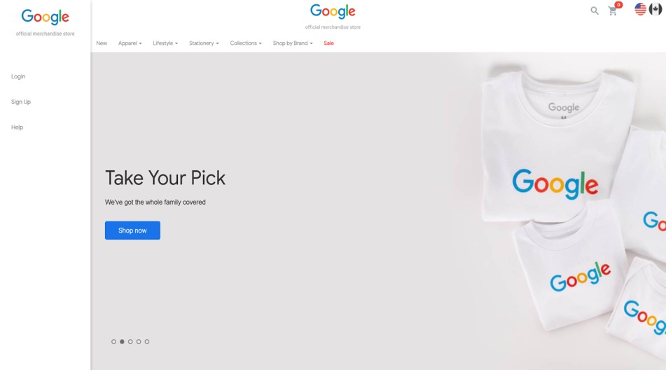



Slide 12
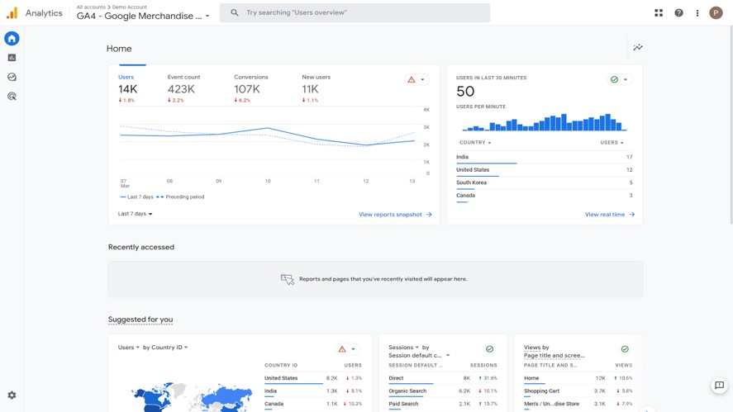
Notes:
In Google Analytics, demographics data provides insights into the characteristics of your website or app users. Google Analytics offers several demographic reports that can help you understand your audience better. Here are some key features and reports related to demographics in Google Analytics:
Age and Gender: Google Analytics provides data on the age and gender distribution of your users. You can analyze the age and gender demographics in the "Audience" section under "Demographics" and "Overview" reports. This information helps you understand the age and gender composition of your audience and tailor your marketing strategies accordingly.
Interests: Google Analytics also provides insights into the interests and affinity categories of your audience. These reports, available under the "Demographics" section, help you understand the topics and categories that interest your users. This information can be valuable for content creation, ad targeting, and refining your marketing messaging.
Geo-Location: The "Geo" reports in Google Analytics provide information on the geographical location of your audience. You can analyze the countries, regions, cities, or even specific languages of your users. This data helps you identify geographic trends, target specific regions, and personalize your content based on user location.
Cross-Device Reporting: Google Analytics offers cross-device reporting, which enables you to understand how users engage with your website or app across different devices. This data can help you optimize your user experience and marketing campaigns across various devices, such as desktops, mobiles, and tablets.
These demographic insights in Google Analytics can be invaluable for understanding your audience, tailoring your content and marketing strategies, and optimizing your user experience. They provide a deeper understanding of who your users are and how to effectively engage with them.

Slide 13
Define the data analysis period
01/01/2022 – 31/12/2022

Slide 14
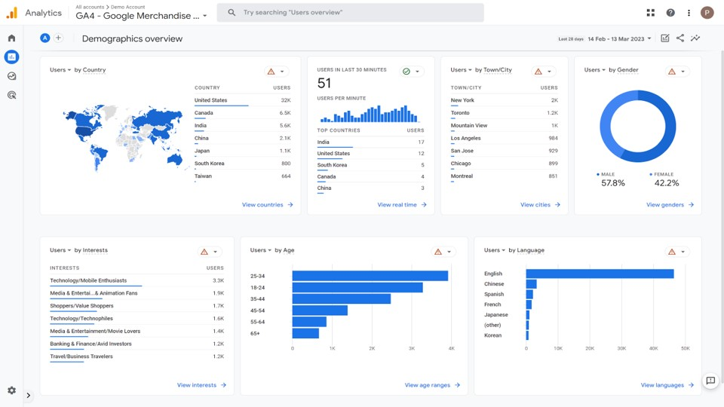

Slide 15
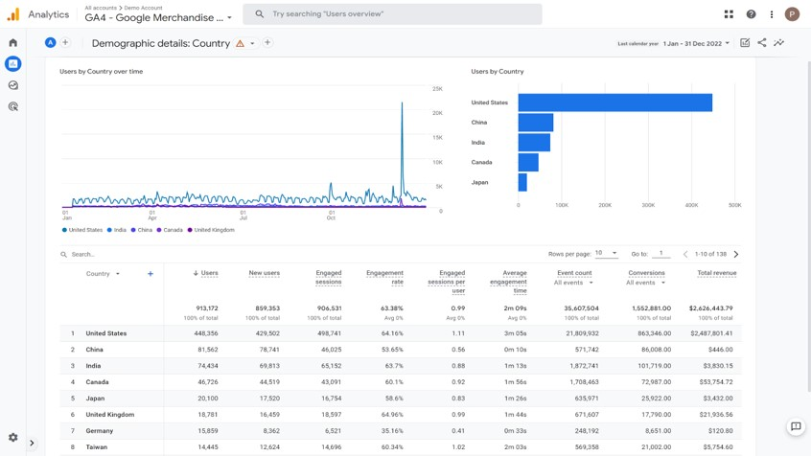

Slide 16
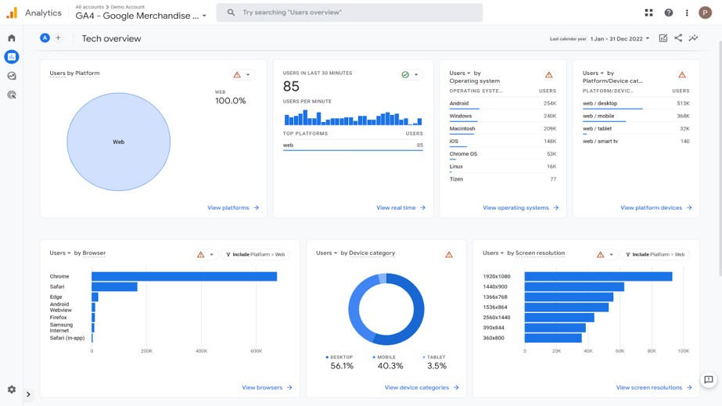

Slide 17
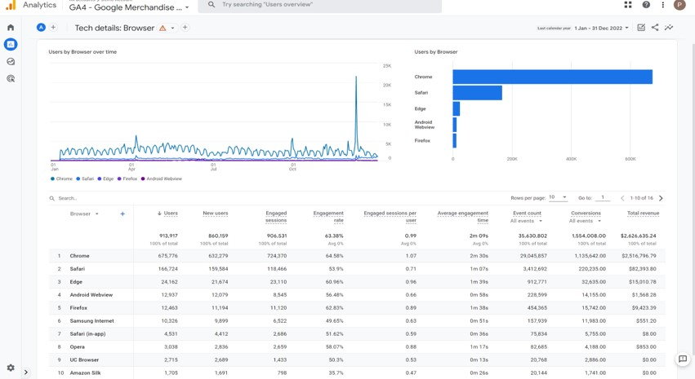

Slide 18
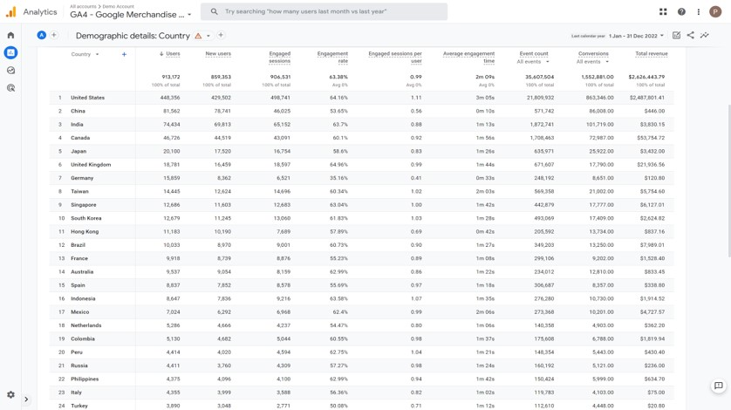
Geography

Slide 19
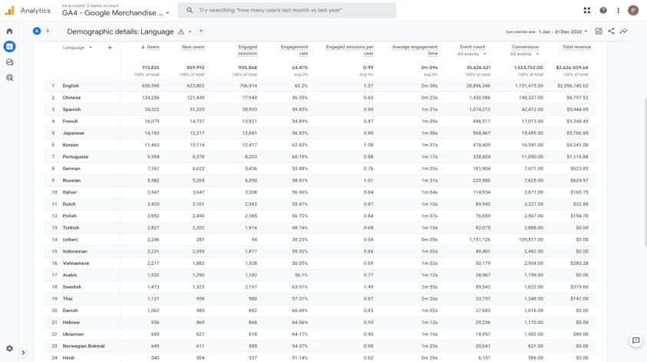
Language

Slide 20
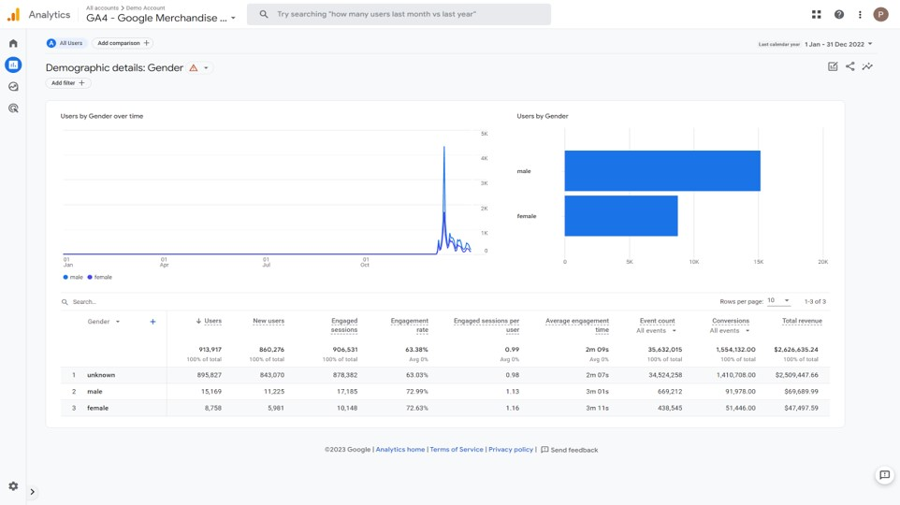
Gender and Age

Slide 21
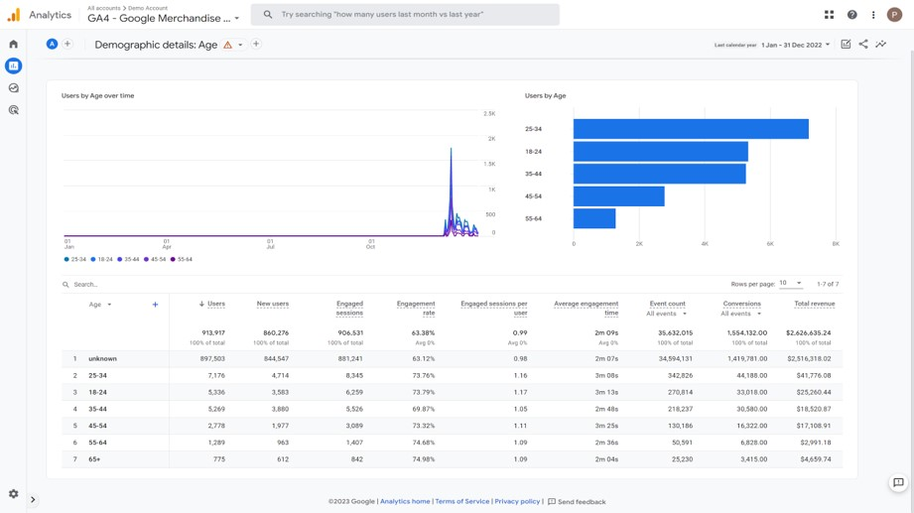
Gender and Age

Slide 22
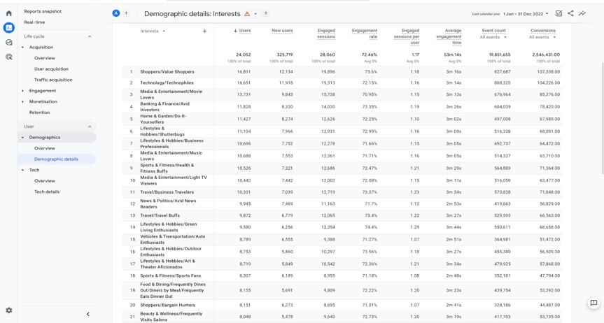
Interest

Slide 23
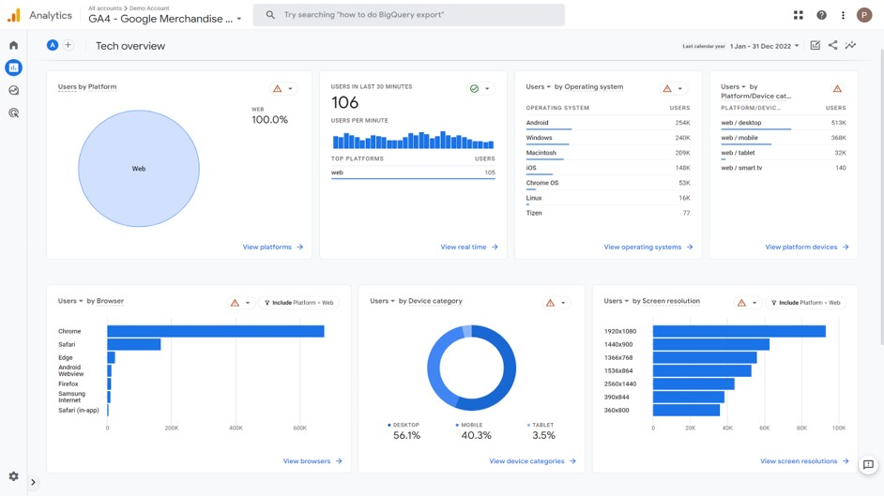
Technology and devices

