Slide 1
Metrics
Professor
School
Digital Analytics and Monitoring

Slide 2

“The importance of choosing proper metrics”
Metrics (have different meanings for people)
Km or Miles
Kg or Ounces
Cm or Inches
Marathon? How should it be measured?
A professional wants to finish the marathon in less than 2 hours.
An amateur wants to run and finish the 42 km.
Notes:
Choosing the proper metrics is important because it ensures the validity of data analysis and helps in making informed decisions. It also helps to measure progress towards goals, understand the impact of changes and allocate resources effectively. Incorrect metrics can lead to misinterpretation of data and flawed decision-making. Here are some reasons why choosing proper metrics is important:
Clarity of objectives: Proper metrics help clarify the objectives or goals you want to achieve. By defining specific and measurable metrics, you can ensure that everyone involved understands what needs to be accomplished and how success will be determined. Clear metrics align efforts and focus attention on key areas.
Measurement of progress: Metrics provide a means to track progress over time. They enable you to assess whether you are moving in the right direction, identify areas of improvement, and make necessary adjustments. Without proper metrics, it becomes difficult to evaluate progress objectively and make data-driven decisions.
Performance evaluation: Metrics play a crucial role in evaluating performance, whether it's an individual, a team, a project, or an entire organization. By selecting relevant metrics, you can assess the effectiveness and efficiency of processes, identify strengths and weaknesses, and identify areas for improvement. Properly chosen metrics provide a basis for fair and objective performance evaluations.
Data-driven decision-making: Metrics provide empirical data that can guide decision-making. They help you identify trends, patterns, and correlations in data, which in turn inform strategic choices. Proper metrics enable you to make informed decisions based on evidence rather than relying on intuition or subjective opinions.
Accountability and transparency: Well-defined metrics foster accountability and transparency. When metrics are clearly communicated and understood, it becomes easier to hold individuals or entities responsible for their performance. Transparent metrics enable stakeholders to assess and compare performance fairly, enhancing trust and credibility.
Optimization and efficiency: Metrics help identify areas where optimization and efficiency gains can be made. By measuring and analyzing relevant data, you can identify bottlenecks, inefficiencies, or areas of waste. Proper metrics highlight opportunities for improvement and guide resource allocation for maximum impact.
Alignment with strategic goals: Proper metrics ensure alignment between activities and strategic goals. By choosing metrics that directly reflect the desired outcomes, you can monitor progress towards strategic objectives and ensure that efforts are focused on the right priorities. This alignment enhances the effectiveness and relevance of initiatives.
Comparison and benchmarking: Well-chosen metrics allow for meaningful comparisons and benchmarking. By selecting industry-standard or best-practice metrics, you can compare performance against peers or competitors, identify gaps, and set ambitious but achievable targets. Proper metrics enable you to assess relative performance and drive continuous improvement.
In summary, selecting proper metrics is essential for clarity, measurement, evaluation, decision-making, accountability, optimization, alignment, and benchmarking. Properly chosen metrics provide a foundation for effective management, strategic planning, and achieving desired outcomes.

Slide 3


“The importance of choosing proper metrics”
The wrong choice of metric for the two runners causes unintended consequences

Slide 4
Learning Objectives
Determine what metrics should be used
Categorize metrics into groups of websites

Slide 5
Topics
Defining Your Measurement Strategy
Key goal performance measures
Metrics That Matter

Slide 6
“Not everything that can be counted counts, and not everything that counts can be counted.”
Albert Einstein

Slide 7
Topic 1
Measuring
Defining Your Measurement Strategy
Notes:
A measurement strategy in web analytics typically consists of the following phases:
Define Goals: Establish clear and measurable goals for your website or digital marketing campaigns, such as increasing conversions, improving user experience, or increasing brand awareness.
Identify Key Performance Indicators (KPIs): Select metrics that align with your goals and help to track progress towards them. These metrics become your KPIs.
Data Collection: Implement tracking and measurement tools, such as Google Analytics, to collect data on your website and digital marketing campaigns.
Data Analysis: Use tools and techniques, such as segmentation and funnel analysis, to make sense of the data you have collected and identify patterns, trends, and opportunities for improvement.
Insights and Recommendations: Draw insights from the data analysis and make recommendations for optimization based on the insights.
Implementation and Optimization: Implement the recommendations and make ongoing optimizations to improve performance and achieve your goals.
Continuous Monitoring and Reporting: Regularly monitor and report on the KPIs to track progress and ensure the continued success of your digital marketing efforts.
These phases form a cycle of continuous improvement, allowing you to continuously monitor and optimize your digital marketing efforts to achieve your goals.
Note that there are quite a few models and theories, proposed by various authors, and in the following pages we present some of them.

Slide 8
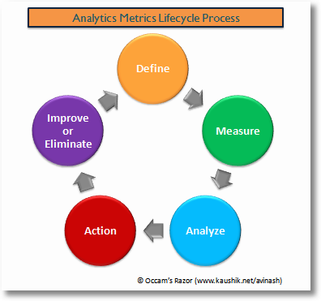
Measuring - Defining a Measurement Strategy
Notes:
Another framework

Slide 9
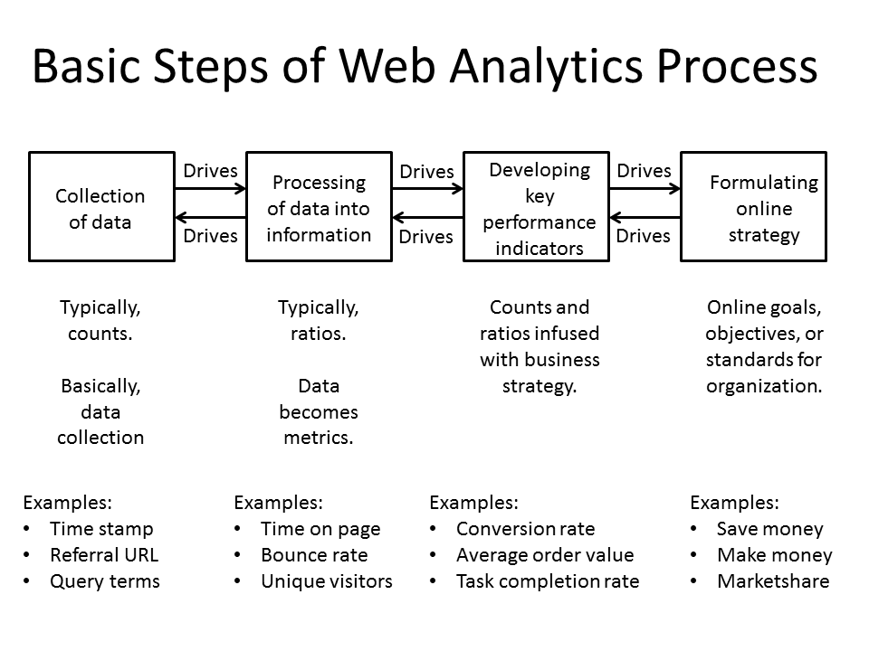
Measuring - Defining a Measurement Strategy
Notes:
Another framework

Slide 10
Measuring - Defining a Measurement Strategy
Describe the phases of web analytics process
Planning and strategy
Data collection
Data processing and analysis
Reporting
Action and optimization
  Setting goals and objectives for web analytics efforts, as well as determining which metrics and data points are most important to track.
  Setting up web analytics tools and tracking codes on the website or app to collect data on user behavior and interactions.
  Cleaning and organizing the collected data and using tools and techniques to analyze and interpret it.
  Creating and sharing reports that summarize and visualize the findings from the data analysis phase.
  Using the insights gained from the data analysis to make improvements to your website or app, and to inform future planning and strategy.
Notes:
Another framework

Slide 11
Measuring - Defining a Measurement Strategy
Setting goals
Collecting data
Reporting
  Resources
  Structure
  Planning
  Choose KPI
  Relate KPI to business objectives
  Transform data into knowledge
  Improve what is not working
  Define objectives
  Collect and storage of data
  Synthesizing information and knowledge into management actions
Identifying key performance indicators
Developing a strategy
Processing data
Optimization
Notes:
Another framework

Slide 12

Measuring - Defining a Measurement Strategy
Stage
Steps
Example for a small online store
Developing a strategy
Resources; Structure; Planning
One data analyst; Reports to Digital Marketing Manager; Reports weekly to the manager
Setting goals
Define objectives
Increase sales and profit; retain customers
Identifying key performance indicators
Choose KPI; Relate KPI to business objectives
Sales growth; Sales by Customer; New customers; Lost customers; CPA
Collecting data
Collect and storage of data
Move data from Analytics to Excel or Analytics Software
Processing data
Transform data into knowledge
Perform Analysis about KPI
Reporting
Synthesizing information and knowledge into management actions
Weekly report
Optimization
Improve what is not working
Checkout process has a 90% bounce rate; Sales by Customer are decreasing

Slide 13
Assessment Activity
For the next list, choose an organization and its website:
Online store.
Online brand presence.
Information repository (e.g., news)
Define the measurement strategy for each organization

Slide 14
Topic 2
Measuring
Key goal performance measures
Notes:
Key Performance Indicators (KPIs) are critical to the success of a digital marketing strategy. KPIs provide a way to measure the effectiveness of marketing efforts, identify areas for improvement, and track progress towards goals.
KPIs help to:
Focus efforts on what matters most: By selecting the right KPIs, marketers can prioritize their efforts and focus on what is most important for achieving their goals.
Make data-driven decisions: KPIs provide a way to measure progress and performance, which allows marketers to make data-driven decisions rather than relying on intuition or assumptions.
Monitor progress and measure success: Regularly tracking and monitoring KPIs helps marketers to understand if their efforts are paying off and if they are on track to achieving their goals.
Continuously optimize efforts: KPIs provide insights into areas for improvement and help marketers to continuously optimize their efforts to achieve better results.
In summary, KPIs are a crucial part of a successful digital marketing strategy. They provide a way to measure the impact of marketing efforts, identify areas for improvement, and continuously optimize efforts to achieve better results.

Slide 15
Measuring - Key goal performance measures
Key Performance Indicators (KPIs) are the crucial (key) quantifiable indicators of improvement toward an envisioned result. They provide a focal point for strategic and operational improvement, producing an analytical foundation for decision making and directing attention on what matters.
Notes:
Key Performance Indicators (KPIs) are metrics that help organizations measure progress towards specific business goals and objectives. KPIs are a crucial component of data-driven decision making and play a vital role in tracking the performance of a business.
KPIs are used to measure progress towards specific objectives, such as increasing sales, improving customer satisfaction, or reducing costs. By tracking and analyzing KPIs, organizations can gain a better understanding of their performance, identify areas for improvement, and make informed decisions to optimize their efforts and achieve their objectives.
Choosing the right KPIs is important, as the KPIs selected will impact the data that is collected and analyzed, and inform decision-making. In order to be effective, KPIs must be relevant, measurable, and actionable, and must provide insights that are useful for optimizing the performance of the business towards achieving its objectives.
For example, if a business objective is to increase sales, the relevant KPIs could be conversion rate, average order value, and revenue. By tracking these metrics, the business can monitor their progress towards the objective of increasing sales and make informed decisions to improve performance.
In order to be effective, KPIs must be regularly monitored and updated. As the business evolves and new objectives are established, KPIs may need to be adjusted or replaced to ensure that they remain relevant and useful for tracking progress towards business goals and objectives.
In conclusion, KPIs are a critical component of any successful business strategy. They provide a way to measure progress, identify areas for improvement, and make informed decisions to optimize performance and achieve objectives. By regularly monitoring and updating KPIs, organizations can ensure that they are continuously aligned with their goals and objectives and making the best use of their resources.

Slide 16
Measuring - Key goal performance measures
Best metrics: small, medium large business
Acquisition
Behaviour
Outcomes
Cost per acquisition
Bounce rate
Macro Conversion Rate
S
CK Abondonment rate
M
Click-through rate
Page depht
Micro Conversion Rate
Loyalty
Per visit Goal Value
L
Events per visit
Days to Conversion
% of new visits
% Assisted Conversions
https://www.kaushik.net/avinash/best-web-metrics-digital-companies/
Notes:
Key Performance Indicators (KPIs) are directly related to the objectives of a business company. KPIs are metrics that help to measure progress towards specific business goals and objectives. By tracking and analyzing KPIs, businesses can gain a better understanding of their performance and make informed decisions to optimize their efforts and achieve their objectives.
For example, if a business objective is to increase sales, the relevant KPIs could be conversion rate, average order value, and revenue. By tracking these metrics, the business can monitor their progress towards the objective of increasing sales and make informed decisions to improve performance.
It is important to choose the right KPIs to align with business objectives, as the KPIs selected will impact the data that is collected and analyzed, and inform decision-making. In order to be effective, KPIs must be relevant, measurable, and actionable, and must provide insights that are useful for optimizing the business's performance towards achieving its objectives.
Here's another example:
Objective: Improve website user experience
Relevant KPIs: Bounce rate, page load time, time on site, and pages per session.
By tracking these KPIs, a business can monitor their progress towards improving user experience on their website. For example, if bounce rate is high, it may indicate that users are not finding the content they are looking for or that the website is slow to load. Time on site and pages per session can provide insight into how engaged users are with the website and its content. By optimizing these KPIs, the business can improve the overall user experience on their website and achieve its objective of improving user experience.

Slide 17
Measuring - Key goal performance measures
KPIs for an online store
Revenue: This metric tracks the total amount of revenue generated by the online store. It can be broken down further by product, region, or other dimensions.
Conversion Rate: This metric measures the percentage of visitors who complete a desired action.
Average Order Value (AOV): This metric calculates the average value of each transaction on the online store.
Cart Abandonment Rate: This metric measures the percentage of visitors who add items to their shopping cart but do not complete the checkout process.
Traffic Sources: This metric tracks where visitors to the online store are coming from, such as organic search, paid search, social media, or referral traffic.
Customer Lifetime Value (CLV): This metric estimates the total value of a customer over the entire course of their relationship with the online store. It can be used to identify high-value customers and to tailor marketing strategies accordingly.
Return on investment (ROI): This is a measure of the profitability of the store's marketing efforts, calculated by dividing the revenue generated by the marketing spend.

Slide 18
Measuring - Key goal performance measures
KPIs for a newspaper website
Pageviews: This metric tracks the total number of pages viewed on the website.
Unique Visitors: This metric measures the number of individual visitors to the website.
Time on Page: This metric measures the average amount of time that visitors spend on each page of the website.
Session Duration: This metric measures the average amount of time users spend on the website during a session.
Referral Sources: This metric tracks where visitors to the website are coming from, such as search engines, social media, or other websites.
Engagement Metrics: These include metrics such as scroll depth, video views, and social shares, which can provide insight into how visitors are interacting with the website's content.
Ad Performance: This metric measures the revenue generated by advertising on the website.
Content Performance: This includes metrics such as top pages, top content, and exit pages, which can help you understand which pages and content are performing well and which may need improvement.

Slide 19
Measuring - Key goal performance measures
KPIs for an online brand presence
Sessions: This metric measures the number of sessions on your website, which represents the total number of times visitors interacted with your website during a specific time period.
Users: This metric measures the number of unique users who visited your website during a specific period.
Pageviews: This metric measures the total number of pages viewed on your website during a specific period.
Average Session Duration: This metric measures the average length of a session on your website during a specific time period.
Bounce Rate: Bounce rate measures the percentage of visitors who leave your website after only viewing one page (Although bounce rate is not a default metric in Google Analytics 4, you can create a custom calculation to measure it).
Engagement Rate: Shows the percentage of engaged sessions (engaged session is a session that lasts longer than 10 seconds, has a conversion event, or has at least 2 pageviews or screen views).
Traffic Sources: This metric measures the sources that drive traffic to your website, such as organic search, paid search, social media, or referrals.

Slide 20
Topic 3
Measuring
Metrics That Matter

Slide 21
Measuring - Metrics That Matter
What are the basic metrics that a website analysis tool provides?

Slide 22
Measuring - Metrics That Matter
Acquisition
Events
Conversions
Pages
Landing pages
Retention
Customer value
Engagement Rate
Site Search
Notes:
Acquisition: Acquisition refers to the metric that measures the number of new customers or users that a business or website attracts within a specific time period. It provides insights into the effectiveness of marketing and advertising efforts in bringing in new prospects or customers. Acquisition metrics often include metrics such as the number of new sign-ups, downloads, registrations, or website visits.
Events: Events are metrics that track specific actions or interactions taken by users on a website or application. These actions can include clicks, downloads, form submissions, video views, or any other predefined user engagement. Events provide data on user behavior, engagement levels, and can help evaluate the effectiveness of marketing campaigns or user experience.
Conversions: Conversions are metrics that measure the number of desired actions taken by users or customers that align with specific goals. These goals could be making a purchase, subscribing to a service, filling out a form, or any other action that represents a successful outcome for the business. Conversion metrics help assess the effectiveness of sales funnels, marketing campaigns, or website optimization efforts.
Pages: Pages refer to metrics related to the performance and engagement of specific webpages within a website or application. These metrics can include page views, unique page views, time spent on a page, bounce rate, or exit rate. Page metrics help analyze user engagement, identify popular content, and evaluate the performance of individual pages in achieving their intended objectives.
Landing Pages: Landing pages are specific webpages designed with the purpose of capturing visitor's attention and encouraging a specific action or conversion. Landing page metrics typically measure the effectiveness of these pages in terms of conversion rate, bounce rate, click-through rate, or engagement metrics. They help assess the success of marketing campaigns, optimize landing page design, and improve conversion rates.
Retention: Retention metrics measure the ability of a business or product to retain its customers over a specific period. These metrics typically include customer churn rate (the rate at which customers stop using a product or service), customer lifetime value (the total value a customer brings to a business over their lifetime), or repeat purchase rate. Retention metrics are crucial for assessing customer loyalty, evaluating the effectiveness of customer retention strategies, and identifying opportunities to increase customer lifetime value.
Customer Value: Customer value metrics quantify the economic value that a customer brings to a business over their relationship. These metrics can include average order value, customer lifetime value (mentioned earlier), customer profitability, or customer acquisition cost. Customer value metrics help businesses understand the financial impact of their customer relationships, identify high-value customers, and inform marketing and sales strategies.

Slide 23
Assessment Activity
What is web analytics?
  The process of analyzing data from a website to understand how users interact with it
  The process of creating and designing a website
  The process of optimizing a website for search engines
Which of the following is NOT a common metric tracked in web analytics?
  Page views
  Time on site
  Age of website visitor
What is the purpose of A/B testing in web analytics?
  To compare the performance of two different versions of a website or web page
  To track the number of clicks on a particular link or button
  To measure the effectiveness of a marketing campaign
Which of the following is NOT a common tool used for web analytics?
  Google Analytics
  Adobe Analytics
  Microsoft Word
True or False: Web analytics is only useful for e-commerce websites.
  True
  False
Select the following statements
that are true:

Slide 24
Consolidation Activity

Slide 25
Consolidation Activity
For the next list, choose an organization and its website:
Online store.
Online brand presence.
Information repository (e.g., news)
Define the measurement strategy for each organization
Define the Key Performance Indicators for each organization

Slide 26
Recap of Learning Objectives
Now, can you describe the phases of web analytics process?
Now, can you determine what metrics should be used for a specific website?
Now, can you list the key metrics associated with website analytics?

Slide 27
Recap of Learning
What is something you need further clarification on?
Based on what I learned today, what do I want to learn in the next class?

Slide 28
Questions?

Slide 29
Next class…
Understand your audience
Segmentation and filtering

Slide 30
Disclaimer
The DEMS material aims to enhance digital marketing skills in higher education, comprehending the essential needs in organizations. You have access to extensive slide sets with in-class activities and assignments, as well as detailed user instructions for teacher.
Note: The material includes contents and figures retrieved from the internet and is thus subject to changes. The sources have been announced according to the rules of fair use. The publisher´s responsibility is restricted to the original material stored at www.dems.pro. All material is produced for open use and co-funded by Erasmus +.

