Slide 1
How Analytics Work
Professor
School
Digital Analytics and Monitoring

Slide 2
“Pre-historic Analytics”
How did companies collect information about consumers before the advent of the Internet and the Web?
Marketing Research
Customer transactions
Notes:
Before the advent of the Internet and the web, companies collected information about consumers through various methods. Here are some common techniques used:
Surveys and questionnaires: Companies conducted surveys and distributed questionnaires to gather information about consumers' preferences, buying habits, and demographics. These surveys were often conducted through mail, phone calls, or in-person interviews.
Market research: Companies employed market research firms to conduct studies and gather data on consumer behavior, market trends, and product preferences. These studies often involved focus groups, interviews, and observational research.
Purchase data: Companies collected information through point-of-sale systems, where customers' purchasing data was recorded. This data included the products purchased, transaction amounts, and frequency of purchases. Loyalty programs were also used to track customer purchases and preferences.
Public records and directories: Companies accessed public records, such as census data, property records, and professional directories, to gather demographic information about consumers. This helped them understand the target audience and tailor their marketing strategies accordingly.
Direct mail campaigns: Direct mail campaigns involved sending promotional materials, catalogs, and surveys directly to consumers' mailboxes. Companies used the responses received to gather data and better understand their customers.
Retail store observations: Companies observed consumer behavior and preferences by physically monitoring customers in retail stores. This involved tracking customer movements, noting product interactions, and analyzing purchase decisions.
Customer feedback: Companies encouraged customers to provide feedback through suggestion boxes, customer service hotlines, or comment cards. This feedback provided valuable insights into consumer satisfaction, complaints, and suggestions for improvement.
Third-party data sources: Companies collaborated with data brokers and other third-party sources to access information such as mailing lists, magazine subscriptions, and public records. These sources provided additional consumer data for targeted marketing efforts.
Customer transactions were an essential source of information for companies before the Internet and the web. Here's how companies collected information related to customer transactions:
Point-of-sale systems: Retail stores and businesses used point-of-sale (POS) systems to record customer transactions. These systems tracked details such as the items purchased, quantities, prices, and transaction dates and times. This data provided insights into customer buying patterns, popular products, and sales trends.
Receipts and invoices: Companies issued receipts and invoices to customers for their purchases. These documents contained information about the purchased products or services, prices, and sometimes customer details. By analyzing these documents, companies could gather transaction-related data and monitor customer preferences.
Loyalty programs: Many companies implemented loyalty programs where customers could sign up and receive a unique identifier, such as a membership card or number. Customers would present these identifiers during transactions, allowing companies to link the purchases to specific individuals. This enabled companies to track individual buying behavior, offer personalized promotions, and analyze customer spending habits.
Manual records: Before the digital era, businesses maintained manual records of customer transactions. They used ledgers, logbooks, or computer systems without internet connectivity to manually record sales data. These records included details like customer names, purchased items, and transaction amounts. Although this method was more time-consuming and prone to human error, it served as a valuable source of transaction information.
Credit card and check payments: When customers made purchases using credit cards or checks, companies had access to transaction data through payment processing systems. These systems recorded the payment method, card or check details, transaction amounts, and sometimes customer information. This information helped companies analyze payment trends and better understand customer preferences.
Subscription and membership services: Companies offering subscription or membership-based services maintained records of customer subscriptions, renewals, and cancellations. This data provided insights into customer loyalty, retention rates, and subscription preferences.
By analyzing customer transaction data, companies could identify popular products, understand consumer behavior, refine inventory management, and tailor their marketing and sales strategies to target specific customer segments.

Slide 3
“Pre-historic Analytics”
Compare the resources that were needed before and the resources that are needed now
Compare the timing, the quality and quantity of information available to organizations to make decisions
Notes:
Before the advent of the Internet and the web, collecting information about consumers required different resources compared to the present digital age. Here's a comparison of the resources required then and now:
Before the Internet and the web:
Physical Infrastructure: Companies needed physical infrastructure such as retail stores, offices, call centers, and data storage facilities to conduct business operations, store customer data, and maintain records.
Paper-based Communication: Surveys, questionnaires, and feedback forms were printed on paper and distributed through mail or conducted in-person. This required printing and mailing resources, as well as manual data entry to process the responses.
Manual Data Storage and Management: Data collected from various sources, such as transactions and surveys, were typically stored manually in ledgers, logbooks, and filing cabinets. Managing and retrieving this data involved physical effort and space.
Market Research Firms: Conducting comprehensive market research often required outsourcing to specialized market research firms, which involved additional costs and coordination.
Manual Data Analysis: Analyzing consumer data involved manual processing, calculations, and statistical analysis. This required trained personnel and significant time and effort.
Limited Reach and Speed: Collecting consumer information was slower and limited in scope due to the physical nature of data collection and communication. It often took longer to gather and process data, resulting in delayed insights.
Now, with the Internet and the web:
Digital Infrastructure: Companies require digital infrastructure such as websites, online platforms, and cloud storage to conduct business, collect and store consumer data, and communicate with customers.
Online Surveys and Forms: Surveys and questionnaires can be created and distributed online, reducing the need for physical printing and manual data entry. Responses are automatically collected and stored digitally.
Digital Data Storage and Management: Consumer data can be stored digitally, eliminating the need for physical storage space and allowing for easier data management, retrieval, and analysis.
Data Analytics Tools: Advanced data analytics tools and software are available for efficient processing, analysis, and visualization of consumer data. These tools provide faster and more accurate insights, enabling data-driven decision-making.
Online Market Research: Companies can conduct online market research using digital platforms, reaching a larger audience and collecting data more quickly and cost-effectively.
Automation and AI: Automation and artificial intelligence technologies enable automated data collection, analysis, and personalized marketing efforts. Machine learning algorithms can process large volumes of data and provide targeted insights.
Global Reach and Real-time Insights: With the internet's global reach, companies can collect data from consumers worldwide and receive real-time insights, allowing for quicker response to market trends and consumer demands.
Overall, the resources required in the digital age are more focused on digital infrastructure, online tools, and data-driven technologies, enabling faster, more efficient, and broader data collection, analysis, and decision-making processes compared to the physical and manual methods of the past.
In comparing the timing, quality, and quantity of information available to organizations for decision-making, there are significant differences between the pre-digital era and the present digital age:
Timing: Before the Internet and the web:
The timing of information gathering and processing was relatively slow. Companies relied on physical methods of data collection, such as surveys, manual record-keeping, and market research studies conducted over extended periods.
The time required to distribute surveys, receive responses, manually process data, and conduct analysis often resulted in delayed insights.
Decision-making was based on historical data, and real-time information was challenging to obtain.
Now, with the Internet and the web:
Information can be collected, shared, and accessed in real-time. Companies can gather data rapidly through online surveys, social media monitoring, and real-time analytics.
Real-time insights enable organizations to make quicker decisions, respond to market trends promptly, and adapt their strategies dynamically.
Quality: Before the Internet and the web:
Data quality was dependent on manual data entry, which carried the risk of human error.
Data collection methods, such as surveys and questionnaires, were limited by respondents' accuracy, recall biases, and interpretation errors.
Market research studies provided valuable insights, but the quality of data depended on the methodology, sample size, and researcher expertise.
Now, with the Internet and the web:
Advanced data collection technologies and automated systems reduce the chances of human error in data entry.
Real-time analytics tools and machine learning algorithms can process large volumes of data, uncover patterns, and provide accurate insights.
Companies have access to a wealth of diverse data sources, including online customer interactions, social media conversations, and digital footprints, contributing to richer and more comprehensive information.
Quantity: Before the Internet and the web:
The quantity of available information was limited due to the constraints of physical data collection methods.
Market research studies had sample sizes based on budget and logistical considerations.
Customer feedback was primarily obtained through direct interactions or limited response rates to surveys.
Now, with the Internet and the web:
The quantity of data available to organizations has increased exponentially.
Digital interactions, social media platforms, online transactions, and IoT devices generate vast amounts of data.
Big data technologies enable organizations to collect, store, and analyze large datasets, providing a deeper understanding of consumer behavior and market trends.
In summary, the digital age has revolutionized the timing, quality, and quantity of information available to organizations for decision-making. Real-time data, advanced analytics, and a wealth of diverse data sources allow for faster insights, higher data quality, and more extensive datasets, empowering organizations to make more informed and timely decisions.

Slide 4
Learning Objectives
Describe how Website Analytics Works

Slide 5
Topic
How websites gather information

Slide 6
“Without data, you’re just another person with an opinion”
W. Edwards Deming
Notes:
The quote "Without data, you're just another person with an opinion" emphasizes the importance of using data and evidence to support arguments and decisions rather than relying solely on personal beliefs or subjective opinions. Here's an explanation of the quote:
Data as a basis for informed decisions: Data provides factual information that can support and validate arguments or decisions. It brings objectivity and reliability to the decision-making process, as it is grounded in evidence rather than personal biases or assumptions.
Data-driven decision-making: Making decisions based on data helps reduce the potential for errors, biases, and guesswork. By analyzing relevant data, organizations can identify patterns, trends, and correlations, enabling them to make more accurate predictions and informed choices.
Enhancing credibility: Data adds credibility to arguments and decisions by demonstrating that they are backed by empirical evidence. When presenting data-supported findings, individuals are more likely to be perceived as knowledgeable and trustworthy, strengthening their positions.
Challenging subjective opinions: Without data, opinions are subjective and can be influenced by personal biases, limited experiences, or anecdotal evidence. Data provides a more objective perspective and helps challenge or refine opinions that may not align with the available evidence.
Driving innovation and improvement: Data allows organizations to identify areas for improvement, uncover emerging trends, and identify new opportunities. By basing decisions on data-driven insights, organizations can optimize processes, enhance products or services, and stay competitive in a rapidly evolving landscape.
However, it's worth noting that data should be interpreted and applied with care. It's important to consider the quality of data, potential biases, and the context in which it was collected. Data should be analyzed critically and in conjunction with other factors such as domain expertise and qualitative insights to make well-rounded decisions.

Slide 7
Topic 1
How websites gather information

Slide 8
How websites gather information
The four key data sources for web analytics are as follows:
Hypertext transfer protocol (HTTP) requests (via javascript code snippets or cookies)
Data from the server that isn’t part of the HTTP request
Data from website applications, such as JavaScript or hypertext preprocessor (PHP) plug-ins
Third-party or external data from linked software and applications, such as email marketing or social media platforms
Notes:
Websites gather information from various sources, such as user input, cookies, and server logs, in order to provide a personalized experience and track user behavior. As a professional in digital marketing, it is important to understand the methods used for gathering this information.
One common method is through user input, such as forms and surveys, which allow websites to collect information directly from users. This information can be used to tailor the user's experience, personalize marketing efforts, and improve the website's functionality.
Another method is through the use of cookies, small text files stored on users' devices that track their activity on the website. Cookies can be used to remember user preferences, store login information, and track user behavior for analytics and advertising purposes.
Additionally, websites gather information from server logs, which record information about each user's request, such as their IP address, browser type, and page visited. This information is used to track website traffic and improve website performance, as well as for security purposes, such as detecting malicious activity.
Finally, websites can also gather information from third-party sources, such as social media platforms and analytics tools. This information can provide a more comprehensive view of the user, allowing websites to personalize their experience and improve marketing efforts.
In conclusion, websites gather information from various sources, including user input, cookies, server logs, and third-party sources. As a professional in digital marketing, understanding the methods used for gathering information is essential for tailoring the user experience, tracking user behavior, and improving marketing efforts.

Slide 9
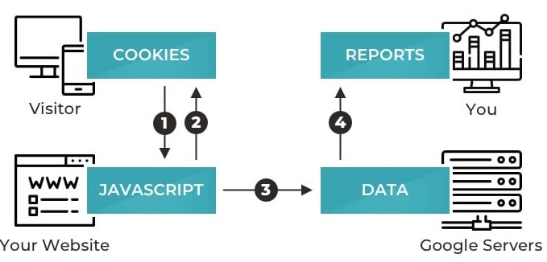
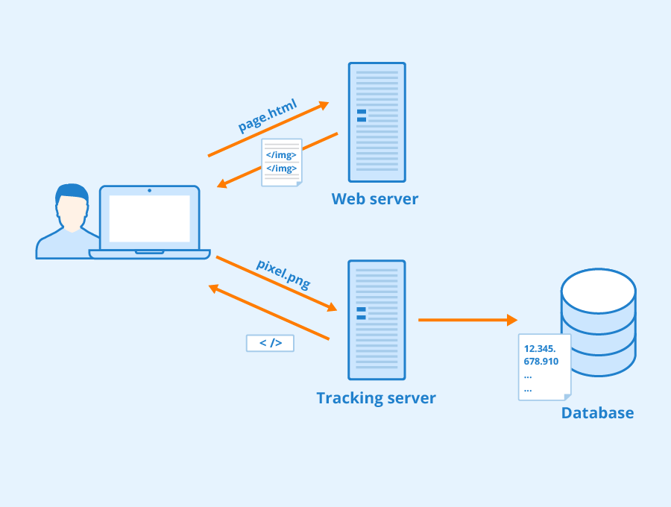
How websites gather information
https://www.rawsoft.com/blog/how-does-google-analytics-work/
https://www.seobility.net/en/wiki/Tracking_Pixels

Slide 10
Assessment Activity
Mark the statements that are true:
To know how website gather information a highly technical knowledge of the process is indispensable
Website analytics uses only one method to track data
Website analysis tools insert JavaScript code into HTML text on website pages so they can capture data and store it in database tables

Slide 11
Consolidation Activity

Slide 12
Consolidation Activity
What factors can lead to data collection by analytics tools being performed with errors?
Meet with your working group
Each group member conducts research to identify factors that can lead to errors in data collection
Discuss with colleagues and construct a list containing the main factors

Slide 13
Recap of Learning Objectives
Now, can you describe how analytics works on websites?

Slide 14
Recap of Learning
What big ideas did you take away from today’s topic?
Describe three things that you learned, two things you need clarification on and one thing you found interesting.

Slide 15
Questions?

Slide 16
Next class…
Metrics, KPI, etc.
Understand your audience

Slide 17
Disclaimer
The DEMS material aims to enhance digital marketing skills in higher education, comprehending the essential needs in organizations. You have access to extensive slide sets with in-class activities and assignments, as well as detailed user instructions for teacher.
Note: The material includes contents and figures retrieved from the internet and is thus subject to changes. The sources have been announced according to the rules of fair use. The publisher´s responsibility is restricted to the original material stored at www.dems.pro. All material is produced for open use and co-funded by Erasmus +.

