Slide 1
How online listening works
Professor
School
Digital Analytics and Monitoring
Notes:
Hey there, fearless teacher! You're about to embark on a journey of knowledge dissemination and inspiration! Your passion and expertise are sure to captivate your students and leave them with a thirst for more. So, go out there and make them fall in love with your subject of online listening as much as you have!

Slide 2
Learning Objectives
Understanding what online listening is.
Knowing what to use online listening for.
Learning to use the tools to use online listening yourself.
Notes:
Understanding what online listening is will enable you to gain valuable insights into your audience's preferences, opinions, and behaviors, helping you to tailor your marketing efforts for maximum impact.
Knowing what to use online listening for can help you to identify new opportunities for your business, stay on top of industry trends, and manage your brand's reputation online.
Learning to use the tools to use online listening yourself will give you the skills and knowledge to effectively monitor and analyze online conversations about your brand, competitors, and industry, allowing you to make informed decisions and stay ahead of the curve.

Slide 3
Topics
Online Listening
Example
Coosto
Talkwalker
Google Alerts
Google Trends
Closure

Slide 4
As a junior marketer students often start listening. Online listening that is. Students will investigate what is going on in the market or in society when it comes to a certain theme. Students can do this at a PR agency, but it is also relevant at an advertising agency or the government.

Slide 5
Topic 1
What is it all about?

Slide 6
What is online listening?
Measure your brand image or corporate reputation via social media sentiment and analyse the underlying feelings, problems and needs. With real-time alerting, push notifications and automatic analyses you can prevent and solve any crisis easily.

Slide 7
Online Listening
Research social media messages about a specific theme or topic and filter them on different characteristics. Analyse data from social networking sites, blogs, forums, (online and offline) news sites, radio and television easily.

Slide 8
Online Listening
Important note: listen within the business/club/organisation!

Slide 9
Example:
Theme: Give money to charities
Trendresearch:
More elderly people give to charities. This has an impact on donating behavior (legacies donations)
Communication about large financial gifts benefits giving money to charities
Approaching young people: respond to emotion. But fact material is very important for this group. Make it easy to donate.
Crowdfunding
Notes:
Case Study Objectives:
Through effective online listening, NGO’s can improve their bottom line and achieve sustainable growth.
To illustrate the importance of online listening in marketing.
To demonstrate how online listening can help companies improve their brand reputation and attract new customers.

Slide 10

Coosto example (Coosto, 2023)
https://www.coosto.com/en/platform/social-listening
Notes:
Coosto is a social media management and monitoring tool that allows users to manage their social media accounts, engage with their followers, and analyze their social media performance. It offers a range of features, including social media scheduling, social media listening, and social media reporting. Coosto is used by businesses of all sizes to improve their social media presence and connect with their target audience.
SHOW VIDEO
We hope that this instructional video has provided you with a solid understanding of how to use Coosto for social media management and monitoring. Whether you're new to social media marketing or looking to improve your existing efforts, Coosto can help you achieve your goals. Remember to experiment with Coosto's features and follow best practices to get the most out of this powerful tool.

Slide 11
Talkwalker
Talkwalker is a social media and web monitoring tool that allows businesses and organizations to track and analyze their online presence. It provides real-time insights into online conversations and trends, allowing users to make data-driven decisions and take proactive steps to manage their online reputation.
The platform uses advanced AI-powered technology to monitor millions of sources, including social media platforms, news sites, forums, and blogs, in over 187 languages. It can track brand mentions, sentiment analysis, and competitor insights, as well as provide customizable reports and alerts.
Notes:
Intro:
Talkwalker is relevant when it comes to online listening because it provides a comprehensive social media listening and analytics platform that allows users to monitor and analyze conversations about their brand, competitors, and industry in real-time. Its AI-powered features enable users to gain actionable insights, identify trends, and make data-driven decisions to improve their online presence and customer engagement.

Slide 12
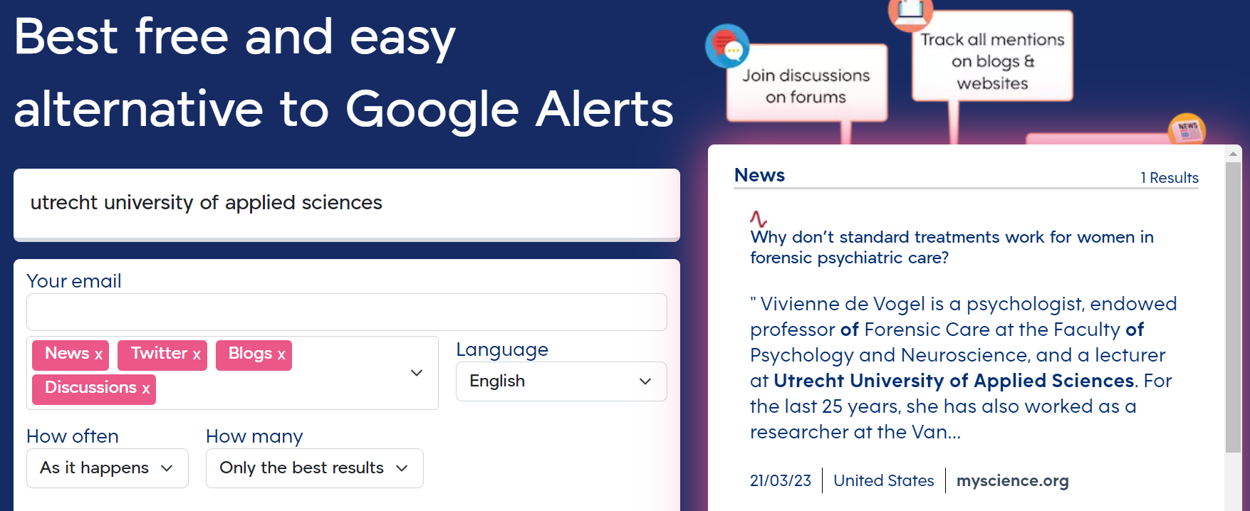
Talkwalker alerts
Type in your company or product and know where it will be discussed. Blogs, Twitter, websites are viewed.
Student example: Type in your own name. Receive notifications when you are being talked about.
Notes:
Talkwalker alerts is a free online tool that allows users to monitor mentions of their brand, competitors, and industry keywords across the web and social media.

Slide 13
Google Alerts
Google Alerts is a free service offered by Google that sends email notifications to users when new content appears online that matches their selected search queries. These search queries can be based on keywords, phrases, or topics of interest to the user.
Users can create multiple alerts for different search queries, and can choose the frequency of email notifications (e.g. as-it-happens, once a day, or once a week). Google Alerts can be used to monitor brand mentions, track industry news, follow competitors, and stay up-to-date on a variety of topics.
Notes:
Why Google Alert is relevant for online listening:
Google Alerts is a free and easy-to-use tool that allows users to monitor mentions of their brand, competitors, and industry keywords across the web.
It provides timely notifications whenever there are new mentions of the specified keywords, helping users stay on top of their online reputation and industry trends.
Google Alerts also allows users to track their competitors' online activities, gain insights into their strategies, and identify opportunities for improvement in their own online presence.

Slide 14
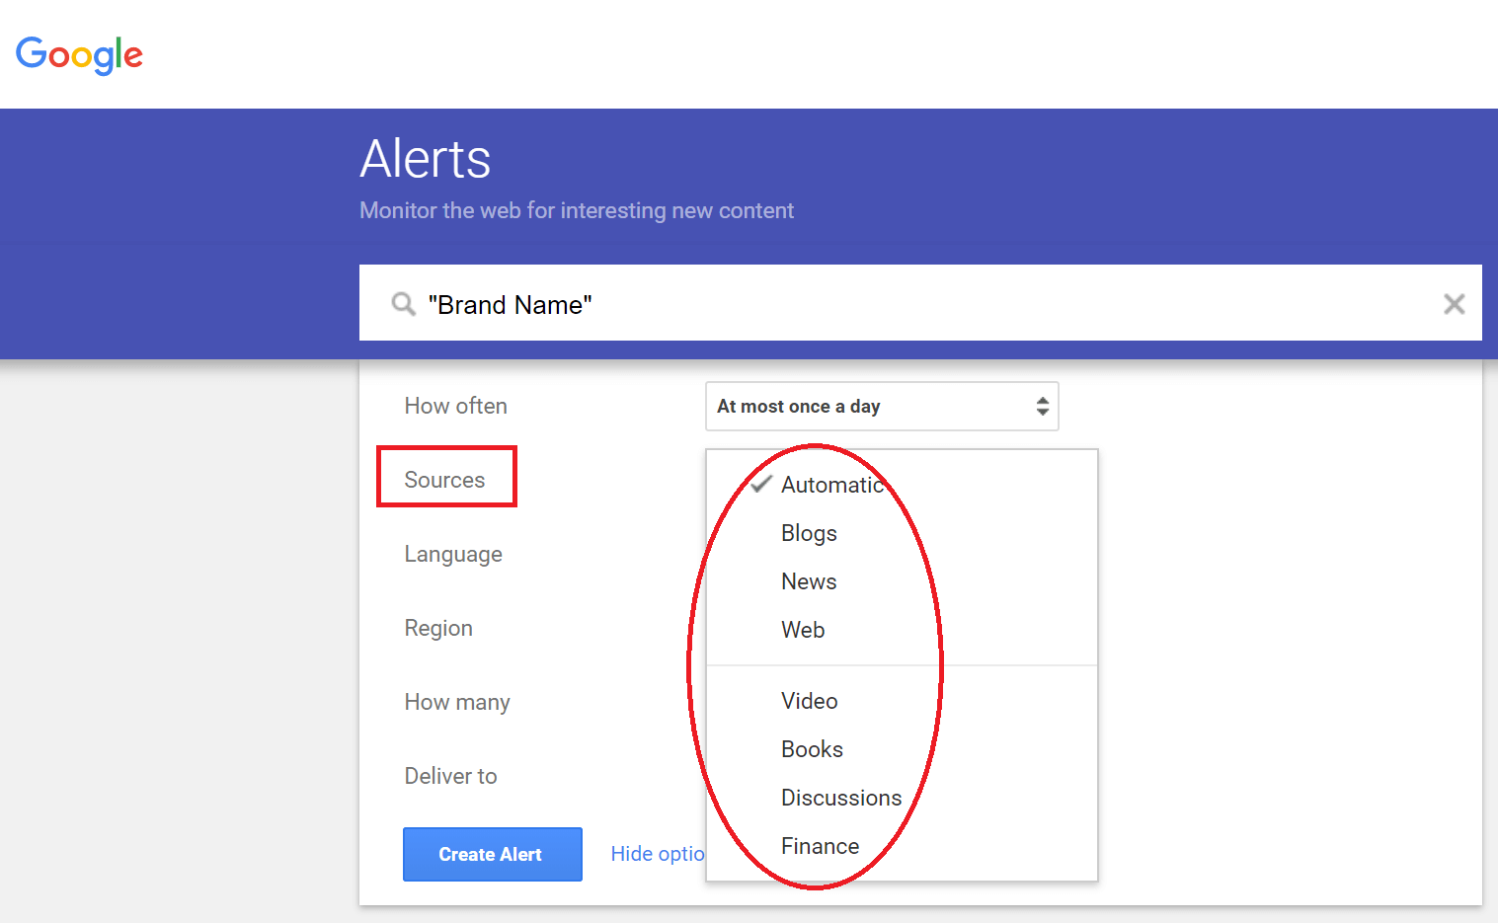
Type in your topic and know where it will be discussed
Learn more how to do it via: https://reputationup.com/google-alerts-guide/
Notes:
Example of how it works.
You can ask students to try it themselves for a couple of minutes.

Slide 15
Google Trends
Google Trends is a free tool offered by Google that allows users to explore and analyze the popularity of search queries over time and across geographic locations. It provides insights into the relative popularity of different search terms, as well as related topics and queries.
Users can enter search terms and filter by location, time range, and category to see how search interest has changed over time. The tool can also generate visualizations of the data, such as line charts, maps, and bar graphs, to help users better understand trends and patterns.
Notes:
Introduction: Google Trends is a free tool that allows users to explore the popularity of search terms and topics on Google.
Why Google Trends is relevant for online listening in three points:
Google Trends can help users identify popular search terms and topics related to their brand, industry, or competitors, providing valuable insights into what their target audience is interested in.
It can also help users track changes in search volume over time, giving them a better understanding of how their brand or industry is trending and how they can adjust their online strategy accordingly.
Google Trends allows users to compare the popularity of different search terms and topics, helping them to identify emerging trends and stay ahead of the curve in their online presence.

Slide 16

Year in search 2022
This year, the world searched “can i change” more than ever before. From changing careers to seeking new outlooks on life, people are finding ways to reimagine themselves and reshape the world around them.
Explore more trends from the year at yearinsearch.google.
Notes:
Google's Year in Search is an annual report that summarizes the top trending searches and topics of the year across various categories, such as news events, people, movies, TV shows, sports, and more. It provides insights into what people around the world were interested in and what dominated the cultural conversation over the course of the year.

Slide 17
Questions?

Slide 18

For next week:
Prepare a personal pitch presentation about the topic for your assignment, max. 2 minutes.
What is your topic?
Why is your topic important to today’s marketers?
Notes:
Students are going to write a listening report themselves, using the tools. For next week they can prepare the following:

Slide 19
Disclaimer
The DEMS material aims to enhance digital marketing skills in higher education, comprehending the essential needs in organizations. You have access to extensive slide sets with in-class activities and assignments, as well as detailed user instructions for teacher.
Note: The material includes contents and figures retrieved from the internet and is thus subject to changes. The sources have been announced according to the rules of fair use. The publisher´s responsibility is restricted to the original material stored at www.dems.pro. All material is produced for open use and co-funded by Erasmus +.

