Slide 1
Digital advertising
Executing digital campaigns

Slide 2
Learning objectives
Apply and put in action instructions given on ad platforms
Plan and execute a campaign on Google and/or Meta platforms
Design ads
Set budget
Follow impact and improve the campaign
Plan and set budget on a display ad campaign

Slide 3
Topics
Creating campaign on Google platform
Creating campaign on Facebook & Instagram platform
Plan digital campaign in media
Notes:
5-6 lessions á 2h

Slide 4


How to get started?
In this part, you will get acquainted with the Facebook ad platform (a.k.a. Meta Business Suite) and Google ad platforms
Both of them offer detailed instructions in your language*
Most of the other platforms have quite a similar logic in creating ads and campaigns.
Note: You will probably need a business profile for creating real campaigns.
Notes:
Most advertising platforms provide you with instructions how to start campaigns, even in your own language (use search words ’Create campaign on Facebook/Google’ etc.). *These can be found by using the search words ‘google ads instructions’ or ‘Meta/Facebook ad instructions’

Slide 5
Creating campaigns on the Google platform

Slide 6
Pre-assignment (in small groups)
Get familiar with instructions on Google support for Ads.
By means of them, your task is to create a concise instruction ‘How to create a campaign on Google Ads’ for ‘someone in the marketing team who never used the platform before.
What can be reached with the ads?
What are the steps for creating an ad? Be concrete, use screenshots.
Add special remarks and advice to conduct a successful campaign.
The instruction is expected to cover all steps of a campaign and to be easy to understand and put into practice. Use 12-15 ppt slides. Time needed 3-6 hours.
Notes:
This assignment encourages students to apply Google´s original instructions and get them familiar with using them. This is useful especially because the parameters in the campaign platforms are continuously being developed, and so the instructions. When creating instruction for someone else, the students have first to study the material, pick the essential and then present it in and understandable form.
You can choose 1-2 best

Slide 7
In-class activity (individual or group work)
Use a search engine (Google or similar) and make some searches for products/services. Among results, you will probably see search ads, shopping ads and local ads.
Analyze a few different search ads for similar product.
Would you click the ad? Why?
Which elements are good in it?
Do the same for other types of ads.
Which elements make them appealing?
Present your findings by a ppt show. Time needed 20-30 minutes.
Notes:
This activity is a warm-up for creating an appealing ad. Use also learnings taken from the previous section. If you feel that it´s not needed, you can jump over to the next step.

Slide 8
After fulfilling the pre-assignment, your students have the theoretical knowledge needed in creating a Google Ad campaign.
The next step will be to make this happen in real Google environment. For this, you or your students need a Google Ads account*.
Notes:
* This means that you can associate the campaign with an organization with a URL address. You also need a credit card. Hint: as a higher education teacher, you may have the possibility to do advertising for a development project that you or your colleagues run.

Slide 9

How to get to Google Ads:
Write ‘Google Ads’ in the URL field
Click ‘start now’
Fill in organizational data (URL, field of business, etc.)
Start from step 1
Notes:
Note: The first step is much easier if you have become familiar with Google´s support presented in previous slides.

Slide 10
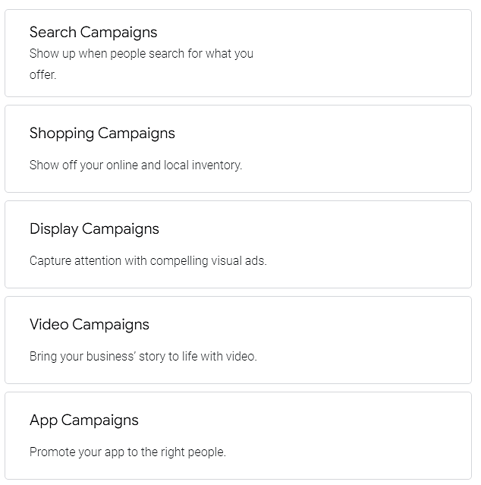
Step 1 – Select campaign type
Despite Search engine ads, you can buy other ads (see picture)
The ads are displayed when people search for products or services like yours.
Despite Google Search and Maps, your ads appear across the Google display network, reaching up to 90% of internet users.
You’ll pay for results, like when people click your ad to call your business, visit your website or get directions to your shop.
Notes:
The campaign types offered by Google Ads in August 2023.

Slide 11
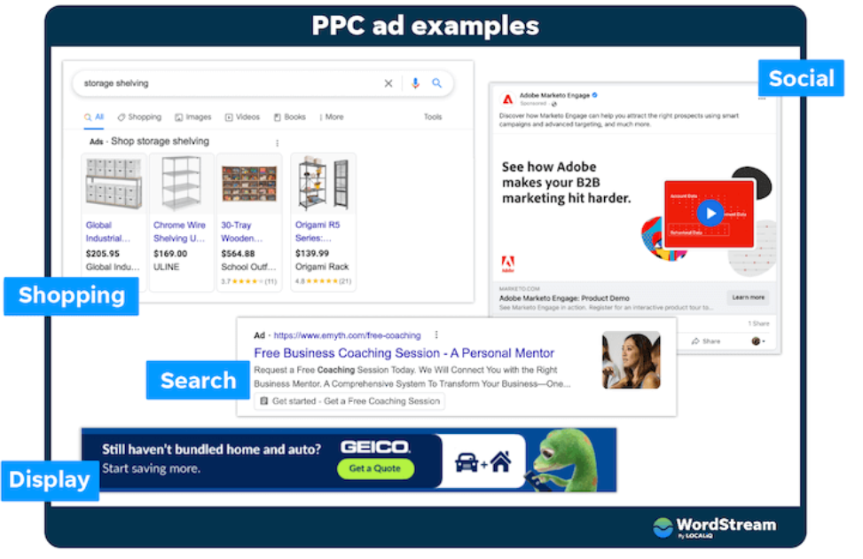
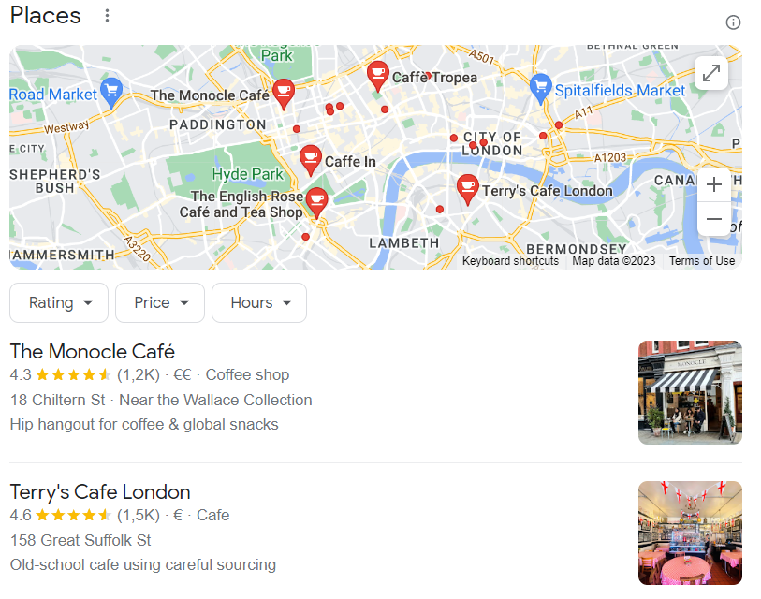
This is how they look:
Local
Source: Wordstream
Notes:
This is how the ads look like.

Slide 12
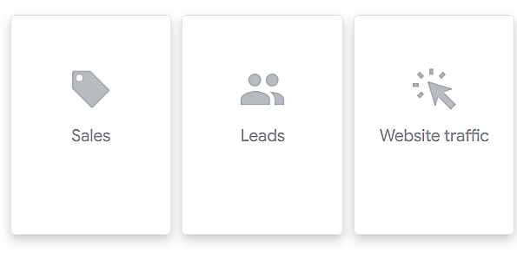
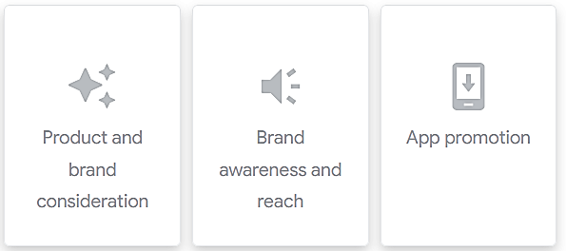
Step 2 – Set your goals
The ad will be tailored based on the results you want.
Get more calls to your business
Increase visits to your shop
Drive people to your website
Notes:
The alternative goals offered by Google Ads in August 2023. Usually ‘website traffic’ is the main goal.

Slide 13
Step 3 - Define your key words
Key words are essential as your ad appears connected to respective searches.
you should define at least 5-8 key words
Once you have named some, the ‘key word planner’ function will suggest you more key words
Notes:
The google key word planner is using AI, may suggest relevant, unexpected key words.

Slide 14
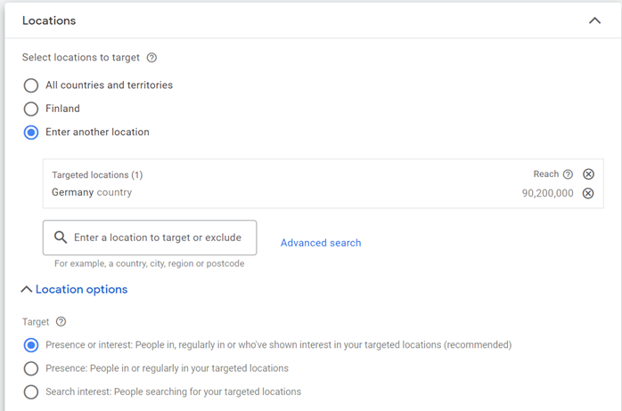
Step 4 – Decide where to advertise
For your ad to perform well, it has to find the right audience.
You can choose the geographical location where your ad will appear
Ex. within a certain radius of your store, or even covering entire regions and countries.

Slide 15
Step 5 – Create your message
The message is essential – people will click on ads that appeal to them.
Google Ads makes it easy to write a structured ad.
While writing, you will see how the ad will look like.
Notes:
How does a good ad look like? Which elements does it include? Your students can check back to the previous sections.

Slide 16
Step 6 – Set your budget
You decide how much to spend, and never pay more than the money set.
No minimum spend and the campaign can be cut any time.
A budget based on businesses similar to yours is recommended.
The platform will estimate the potential results (impressions, clicks) according to your budget.
Most ads start seeing results in some days.

Slide 17
Assignment (in small groups)
By using the material and the Google Ads instructions, create a real campaign in Google Ads. For this you need an organization (and URL address to promote) possessing a website.
set goals for the ad
create an ad (version 1)
publish it on Google Ads, 3-7 days in order to get sufficiently impressions
assess the results (amount of clicks and conversion on the landing page)
If necessary, improve the ad and/or the landing page
create an improved ad (version 2) and publish it (3-7 days)
follow-up and assess the campaign
Make a short report with your own evaluation (What did work well in the ad - picture, text, CTA button? Where you happy with the conversion? What could have been improved additionally?)
Notes:
*Without a Google Ad account and credit card inclined, it is unfortunately not possible to create and publish a real ad. Options to solve this: 1. You as teacher could create an own account which you can connect with an RDI project you are involved in, or your university´s account if possible. One more option is that some of your students have an account available (their familiars´ company).
Once an account is available and the ‘financer’ is agreed, the person in charge can publish different ads from various groups using the same target group. The money needed is not too big as some 10€ per ad/week will give enough impressions to judge the impact of the campaign.
Assessment: working process of the group 75% (Did they fulfill the entire process, according to Google instructions? How was their work division? Did they give 100% to the assignment? Were they creative/did they focus on the target audience when writing the ad?, Results of the campaign 25%.

Slide 18
Creating campaigns on Facebook & Instagram

Slide 19
Pre-assignment (in small group)
Get familiar with Meta Business (=Facebook) help center
By means of the instructions there, your task is to create a concise instruction for ‘someone in the marketing team who never used Facebook ads before’.
What can be reached with the ads
What are the steps for creating an ad
Special remarks and advice to succeed
The instruction is expected to cover all steps of a campaign and to be easy to understand and put in practice. Use 12-15 ppt slides, you can also include illustration (ex. screenshots).
Time needed: 3-6 hours.
Notes:
This assignment utilizes Meta (Facebook) original instructions and makes the students familiar with them. This is useful especially because the parameters in the campaign platforms are continuously being developed, and so the instructions. When creating instruction for someone else, the students have first to study the material, pick the essential and then present it in and understandable form.
You can have 1-2 best presented by the groups.

Slide 20
After doing the pre-assignment, your group has already a basic knowledge of creating a Facebook campaign.
The next step will be to make this happen in real Meta (Facebook/Instagram) environment. For this, you or your students need a Meta business account*.
Notes:
* This means that you can associate a business Facbook/Instagram account to Meta business platform. You also need a credit card. Hint: as a higher education teacher, you may have the possibility to do advertising for an RDI project that you or your colleagues run. Another option would be that your students do this as assignment for a business client.

Slide 21
Advice & instruction
Meta Business Suite is the advertising platform to reach Facebook and Instagram
It allows small businesses and content creators to manage all their combined Facebook and Instagram accounts in one place.
To start, you must have access to an organizational Facebook account that can be associated with Meta business suite.
This is easy: Meta BS will suggest associating upon entering their site (below).
Instructions: https://www.facebook.com/business/ads
Notes:
Note: This step should already be familiar as it was already delt with in the pre-assignment.

Slide 22
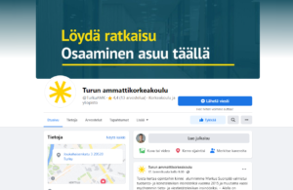
Why have a Facebook business account
As usual on Facebook, also the company account collects likes, comment and shares.
These likers are people who consciously want to follow the company's posts.
The likers can easily find current information and offers in one place.
The business’ Facebook page displays the latest publications, contact information and profile picture
Notes:
Note: Having an existing Facebook profile, you can create new accounts and edit them with your own personal user, without logging out and in inbetween.

Slide 23
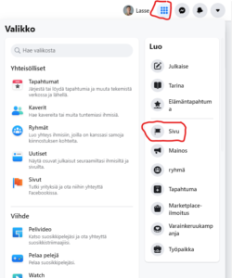
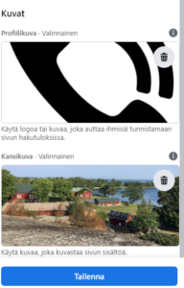
How-to?
The first step is to log in and go to the “Menu”. This means the nine balls in the upper left corner of the Facebook homepage. After clicking on the menu, select "Page" under the "Create“.
Next, to choose a name, description and "category" for the page, and specify the type of your page in the category (for instance, you can choose a property, an association, or even a brick-and-mortar store.
Finally, you can add a profile picture on the page.

Slide 24
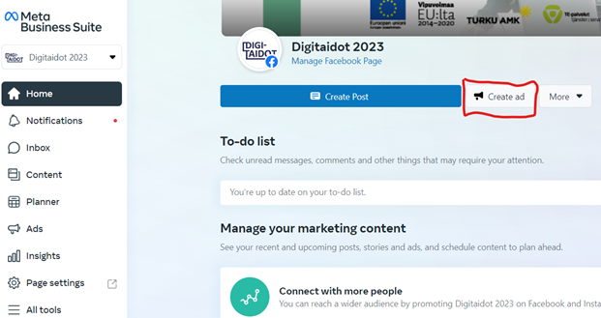
Step 1 – create campaign
When on your account associated to Meta, click “Create ad”
Enter a descriptive name in the ad name text box.
Select a Facebook Page and Instagram account to represent your business (all ads are required to have an associated Facebook Page).
Source: Facebook, campaign instruction video
Notes:
Note: When operating with ads, be sure you log in to your account through meta.business (not ‘normal’ Facebook)

Slide 25

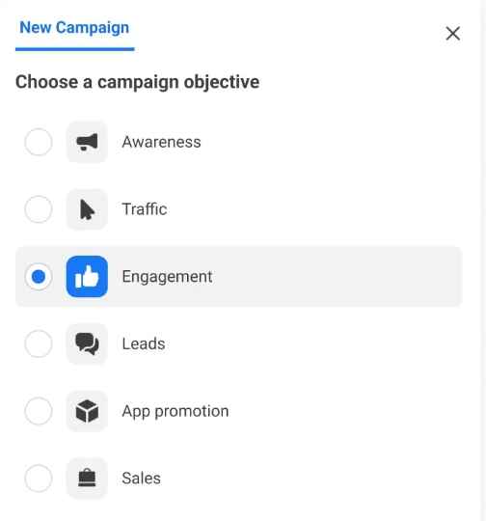
Step 2 – set objective
Choose the ad objective that best supports your business goal Meta will look for
people across Facebook and Instagram, likely to take actions related to your ad objective:
Awareness = show your ads to people who are most likely to remember them.
Traffic = send people to a destination, such as your website, app or Facebook event
Leads = reach potential buyers
App promotion = find new people to install your app and continue using it
Engagement = get more video views, page likes or event responses
Sales = find people likely to purchase your product or service
Notes:
The objective you set will affect the target audience your ad is shown to, as Meta has data on how different users react on ads.

Slide 26
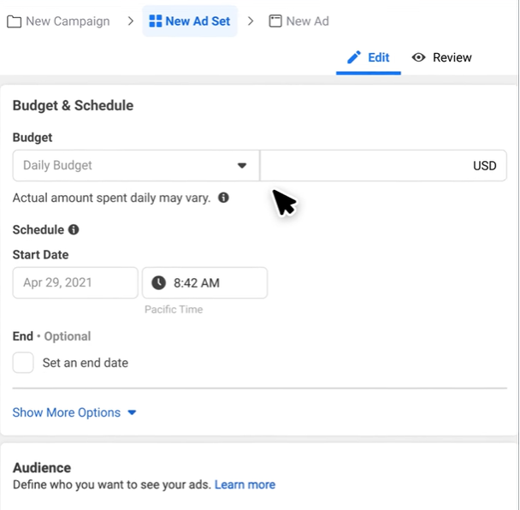
Step 3 – set budget and schedule
Set your ad budget – a total amount that you want to spend daily or over the course of the campaign.
Meta will show you at once the estimated result (impressions, clicks) reached with this budget
You also set a bid – the maximum amount that you're willing to pay when someone sees your ad or takes your desired action.
You pay for the results (impressions, clicks, conversions)
The budget can be changed/added any time.
Notes:
In case of a SME, budgets around 5-20€ a day are feasible. This means that with one hundred € several thousands of persons that belong to the target audience can be reached, and several hundreds of visits to the website can be achieved.

Slide 27
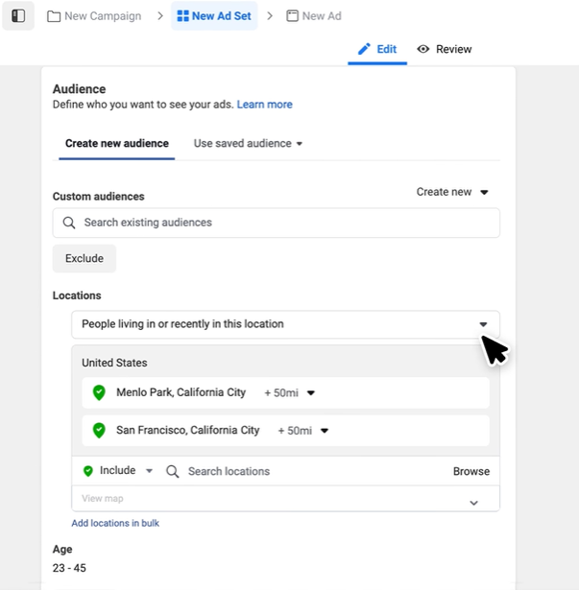
Step 4 – define audience
You decide who sees your ad and where.
Create the online audience based on the traits of who you want to see your ad, and narrow down your ad's audience by interests, gender or location
Use ad targeting to find the people who are most likely to take action. Once your ad starts running, Meta will learn who is engaging with it and, over time, narrow your audience so you reach more of the right people
Notes:
Note: With the Meta targeting options you can define your target audience by many factors (demographic, educational, likings and lifestyle, Facebook behaviour, etc.).

Slide 28
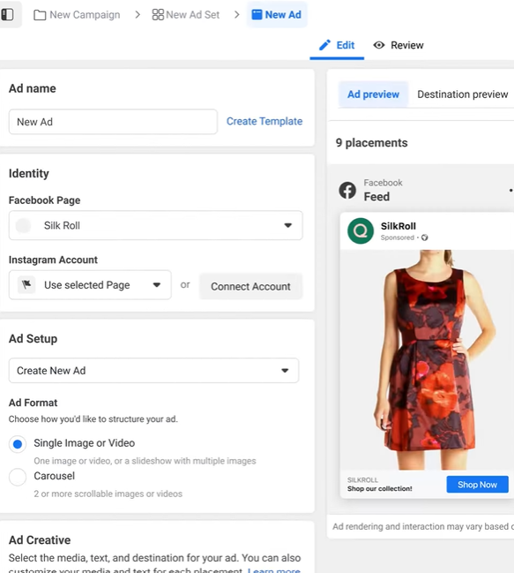
Step 5 – upload your creative assets
Now, you decide how you want your ad to look.
You can use text, images and videos to capture people's attention.
Select an ad format (either a single image or video, carousel or collection).
Choose your respective media and upload it in the media archive.

Slide 29
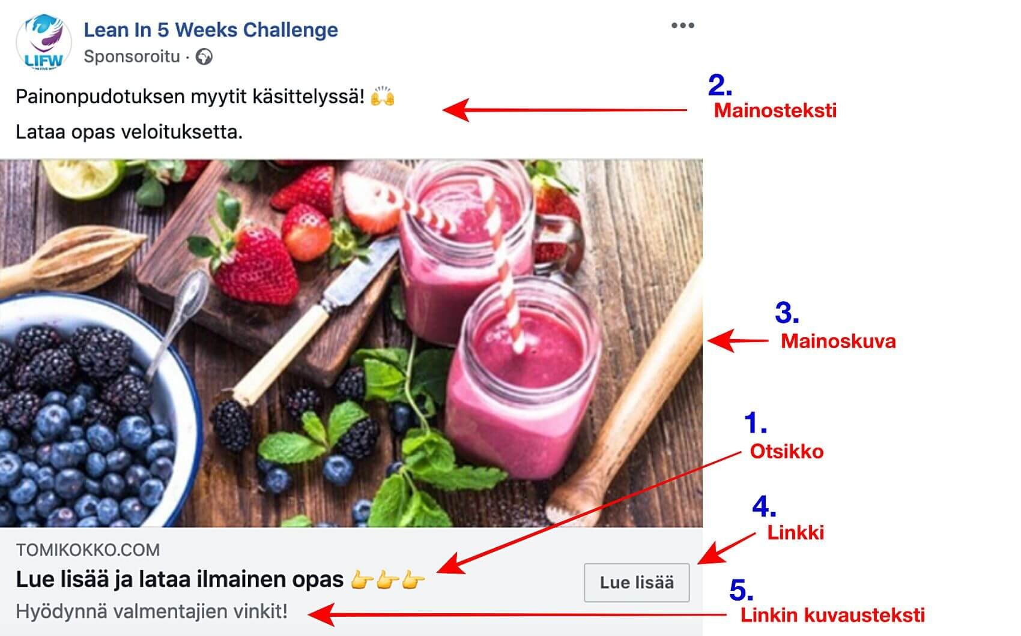
Elements of a Facebook-ad
1. Title - refer to the benefits and advantages received by the client!
2. Ad text - describe the benefits of your service – to the customer!
3. Image - the image has a big impact on the functionality of the ad and the Facebook ad generally performs better if your image has a human face facing the "camera“
4. Link - choose attractive and short text for the link to your site
5. Link description - for the link you can additionally give a description and tell a little more about the additional benefits
2. Ad text
3. Image
1. Title
4. Link
5. Link
description

Slide 30
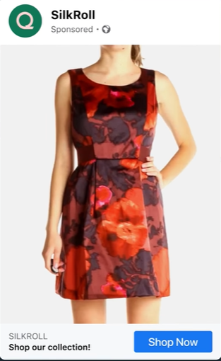
Step 6 – publish
By confirming the ad, it will be processed by Meta AI and auction systems
In few hours, it will be shown to the target audiences you selected
You can follow results and money spent online

Slide 31
Assignment (in small groups)
By using the materials in this whole module, create a real campaign in Facebook following the respective steps:
set goals for the ad
create an ad (version 1)
publish it on Facebook (Meta business), 3-7 days in order to get sufficiently impressions
assess the results (amount of clicks, conversion on the landing page)
do changes on the landing page if necessary/possible
create an improved ad (version 2) and publish it (3-7 days)
follow-up and assess the campaign
Make a short report with your own evaluation (What did work well in the ad - picture, text, CTA button? Where you happy with the conversion? What could have been improved additionally?)
Notes:
*Without a Business account and credit card inclined, it is unfortunately not possible to create and publish a real ad. Options to solve this: 1. You as teacher could create an own account which you can connect with a project you are involved in, or your university´s account if possible. One more option is that some of your students have an account available and allow them conduct a limited campaign (their relatives/familiars).
Once an account is available and the ‘financer’ is agreed, the person in charge can publish different ads from various groups using the same target group. The money needed is not too big as some 10€ per ad/week will give enough impressions to judge the ad.
Assessment: working process of the group 75% (Did they fulfill the entire process, according to Google instructions? How was their work division? Did they give 100% to the assignment? Were they creative/did they focus on the target audience when writing the ad?, Results of the campaign 25%.

Slide 32
Buy a display ad campaign in media
Notes:
The third practical exercise is to buy a display ad on right media. This assignment lets the students to apply topics learned in the previous section.

Slide 33
Where to buy display advertising?
Display advertising (banners) can be bought in your national media
All necessary information can be found in their media cards (search on the internet by using media name + media card)
The pricing is CPM (cost per mille), meaning that you pay for impressions (not for clicks)
Usually, a media plan is created, covering 2-4 essential media and messages in each of them to reach the desired target audiences
Notes:
For

Slide 34
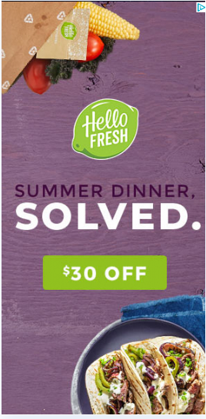
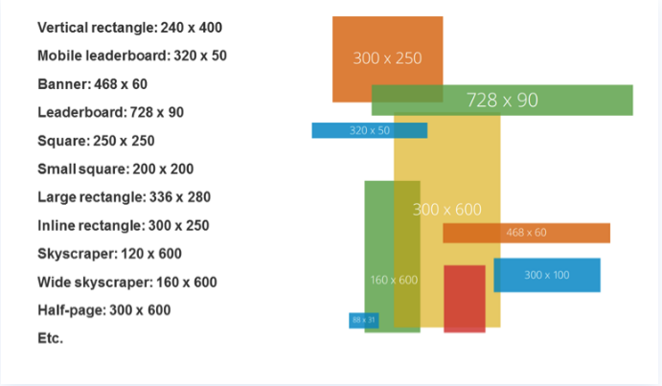
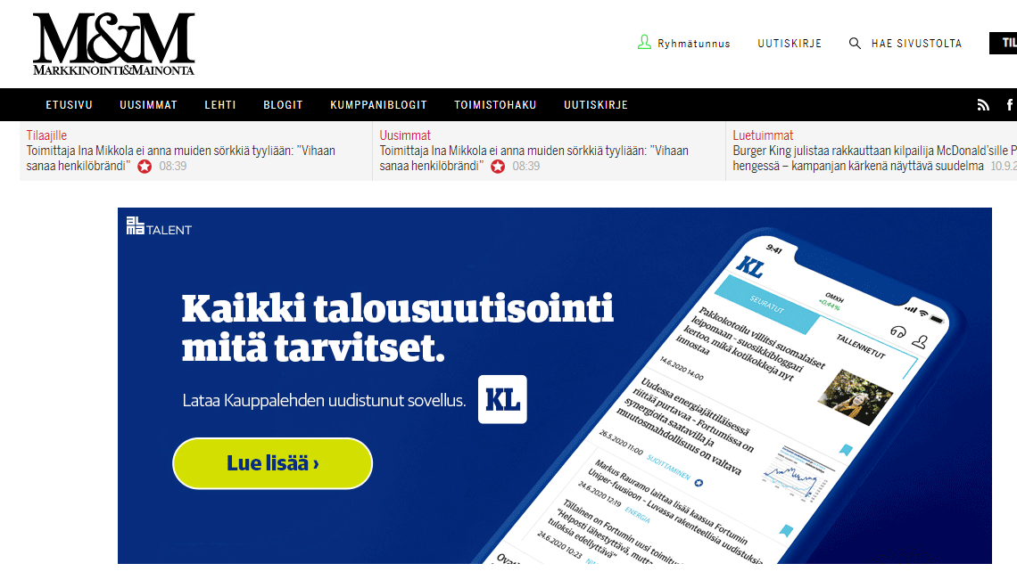
Banner Sizes and Formats
Banner sizes are defined in pixels, below some examples.
Mobile: growing fast. At least 2/3 of display advertising in mobile
Parade: 980x400 (dt) or 300x300 (mobile) quite popular in Finland. Big size draws attention.
Notes:
You will find this kind of specific information regarding particular media on their media cards.

Slide 35
Display Campaign Media Plan
 |  |  |  |  |  | Week
Media | Ad format | Impressions | cpm | Cost | Duration | 42 | 43 | 44 | 45 | 46 | 47
media y | Desktop parade 980x400 | 375000 | 40 | 15000 | 15.-27.10.
media z | Desktop parade 980x400 | 400000 | 37 | 14800 | 15.-29.10.
media x | Mobile parade 300x300 | 425000 | 24 | 10200 | 23.10.-3.11.
Total |  | 1200000 |  | 40000
 | Average CTR 1,5%= 1 200 000 x 1,5% =>
 | 18000 visitors to the landing page
Easy way to calculate: 425 x 24= 10 200 (leave 000’s out)
Notes:
To tell the students: If you end up working with digital marketing, you will need to understand this logic. This was partly explained in the previous section. Impressions = to how many viewers the ad was shown.

Slide 36
You are a media planner at a media expected to plan a campaign for your client.
Assignment ‘buy a banner campaign in media’
Decide who your client is:
  What product/service? (can be real or made-up)
  For example: btoc: new hotel, online footwear store, new car, new baby food brand, new bar…
  Btob: seminar for marketing and sales executives (btob). Feel free to choose yourself.
What is/are your client’s target group(s).
Choose your media, and plan a campaign, which optimally reaches your client’s target audience. At least two different media.
Media budget: 20 000 €, campaign period 1 month.
Advertising formats: Display ads. For desktop and mobile. You need to use both (or cross screen). Real, existing formats with correct prices. Pricing method in all media: CPM
Notes:
Note: You will find information about different medias´ websites and media cards.

Slide 37
Present the media plan in excel:
  impressions and cost per media and ad format
  campaign period
  budget allocation per media and ad format.
In Word.doc:
  tell the product/service + target group
  justify your suggestion: why you chose these media, campaign structure and ad formats.
  give an estimate of number of visitors landing on the landing page, CTR 1,5%. Max 150 words.
Provide screen captures of media cards / CPM-rates you have used.
Time needed: 6-8 hours
Be prepared to discuss and present in class

Slide 38
Assessment criteria
0: The assignment hasn’t been returned in time. The campaign mathematics (the correct cpm price, the correct cpm x impressions calculation, nr of visitors) are wrong or inadequate. The campaign period per media is missing. Pricing method is not CPM.
1-2: Pricing method is CPM, and mathematics are correct, but campaign consists of only one media. No argumentation why the media is chosen. Screen captures of media cards / rates are missing.
3-4: The campaign includes two or more media, mathematics are correct and the campaign has been built according to instructions. Student provides arguments for his/her solutions.
5: The campaign includes two or more media, mathematics are correct and campaign has been built according to instructions. Student provides arguments for his/her solutions, which demonstrate expertise.
Notes:
Purkupohdintaa:
Ryhmässä esittelevät ensin toisilleen: 20 min + kommentointi
6 esitystä koko luokalle? Vapaaehtoisuuden perusteella? Kommentointi perään. Määrää kommentoijat tunnilla?

Slide 39
The DEMS material aims to enhance digital marketing skills in higher education, responding to the needs in business and organizations. You have access to extensive slide sets with in-class activities and assignments, as well as detailed user instructions for teacher. You are free to use part or whole of the material available.
The material includes contents and figures retrieved from the internet and is thus subject to changes. The sources have been announced according to the rules of fair use. The material as a whole can be viewed and downloaded from www.dems.pro. All material is produced for open use and co-funded by Erasmus +.

