Slide 1
Digital advertising
2. Preparing for campaigns

Slide 2
Learning objectives
Set goals for digital campaigns
Define and identify target audiences
Apply key word research
Plan elements of a good landing page
Understand and apply campaign analytics
Suggest elements to improve conversion

Slide 3
Topics
Strategy-based advertising
Defining target audience
Digital advertising formats
Digital advertising platforms
Key words research
Landing page
Measure the impact
Conversion
Notes:
3-5 lessons á 2h

Slide 4
Strategy-based advertising
“Creative without strategy is called ‘art.’ Creative with strategy is called ‘advertising.”
– Jef I. Richards
Notes:
For any business, doing advertising without integrating it to strategic goals, implies a risk. For instance, conducting advertising just in order to achieve ‘visibility’ or ‘awareness’, is likely not to increase sales. The role of strategy was presented in detail in Bases of Digital marketing, submodule 2.

Slide 5
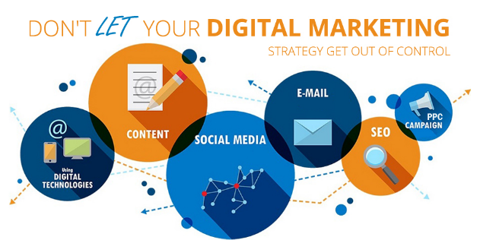
Advertising must be in line with organizational strategy
Which are our overall goals?
What do we want to achieve with our (digital) marketing?
Who are our target groups?
What is our message and where do we transmit ?
Notes:
Digital marketing and advertising activities must be in line with the holistic strategy of the organization.The strategy is a future-oriented plan, that tries to anticipate circumstances that influence the conduct of an organization. Most organizations have a strategy, yet smaller ones may miss one.

Slide 6
Goals and objectives for advertising
Increase in revenue
Improve customer loyalty and satisfaction
Recruiting and retaining the best talent
Innovation and product development
Improving brand awareness and perception
Building a strong brand
Drive traffic to the website and/or blog
Getting new customers
Encouraging existing customers to write positive
reviews
Interacting with customers to get feedback from the market
A goal is an achievable outcome in broad and long-term sense
An objective defines measurable short-term actions to achieve an overall goal.
Notes:
The slide presents the difference between goals and objectives. Each advertising campaign should cover one or more of these goals.

Slide 7
‘Features of a well-set objective – the SMART model
Specific: They must clearly describe what it is you want to achieve.
Measurable: They should have clear metrics that can be measured before and after and objective is met.
Achievable: They should be realistic for your business to achieve by a certain time.
Relevant: They should relate to the overall business or individual objectives. Remember: you get what you measure / what your objectives are. Relevance is important!
Timed: They should have a target date for completion to encourage action to be taken to complete the objective.
Further reading: https://www.mindtools.com/pages/article/smart-goals.htm
Notes:
Marketing and advertising objectives must be integrated with larger strategic business goals and objectives. SMART covers general ’must-be’ objectives. For instance, an objective must be ‘measurable’. If not, what happens? At least you won´t know whether you have achieved it or not. And if it´s not ‘specific’, it is likely that your people understand it in different ways.

Slide 8
Why SMART?
They direct your marketing to the right direction, aligned with business goals.
They are measurable. If objectives are not measurable, they’re not worth much.
Good and useful for all objectives in digital marketing
  Specific
  Measurable
  Achievable
  Relevant
  Timed
EXAMPLE/ In-class activity:
A local garden company (sells plants, garden equipment, etc.) is expanding their services. Next year’s focus is on a new service, garden planning.
Which of the following is/are SMART objectives?
Our objective is to grow our turnover by 20%.
We want to offer a fantastic product sortment.
Our objective is to sell garden planning service worth 10 000 € in year 2025.
Our objective is to be the biggest garden planning company in the region.
Notes:
Right answers: 1 and 3. 2 and 4 need to be precised in figures.

Slide 9
In-class activity
Practicing SMART
‘SMART’ can be applied in many fields, such as developing one´s personal health or physical fitness, or any personal or professional skill.
Choose a goal you want to develop
Create a statement for developing this (first, without applying SMART
Then, formulate the statement by applying SMART
Time needed: 15-20 minutes. Individual task.
Discussion: What becomes different when using SMART? Advantages? Disadvantages?
Notes:
This activity can be conducted with any kinds of student groups, as it can be applied to multiple fields of personal or professional life.

Slide 10
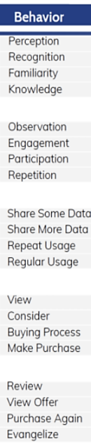
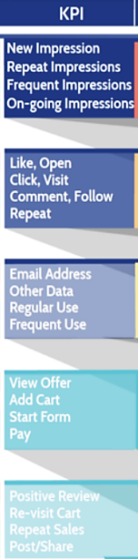
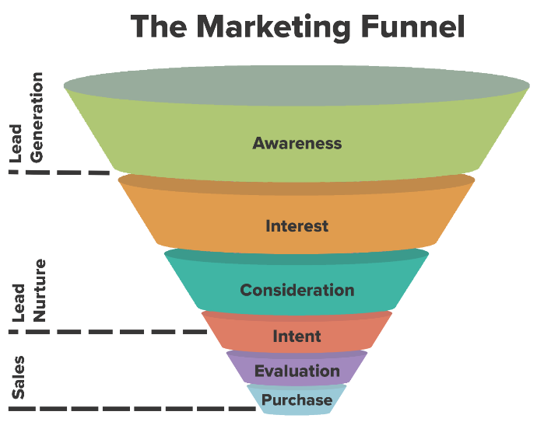
The goals must match with the marketing funnel
Source:Skyword
Modiefied from TCSuccess
Notes:
Advertising belongs normally to the upper part of the funnel (stages ‘awareness’ and ‘interest’. In the further stages we often have contact data of the person (email address, phone number, personal contact) and thus a possibility to communicate on a more individual level.

Slide 11

Objectives and metrics related to the funnel
How many impressions did the ad get? (Awareness)
How many clicked the ad? (Awareness, Interest)
Did we get new followers? (Awareness)
What kinds of reactions did the ad get? (Awareness, Interest)
Do the visitors return on our site (Interest)
Do they ask further questions? (Consideration)
How to create a digital advertising funnel? Video 13 minutes
Notes:
The video will be used as a trigger in the following assignment.

Slide 12
Assignment
See the video How to create a digital marketing funnel.
Use the search words also for finding additional sources.
What is the difference between ‘strategies’ and ‘tactics’?
Explain the role and importance of the digital marketing funnel (what does it mean, what is different, why is it important)
The author names six steps - what are they (as you can notice, they correspond to the funnel seen in our slide) ?
What does ‘nurture’ mean in terms of marketing and advertising?
Notes:
This assignment can be used as a home task and assessed.

Slide 13
Defining target audiences

Slide 14
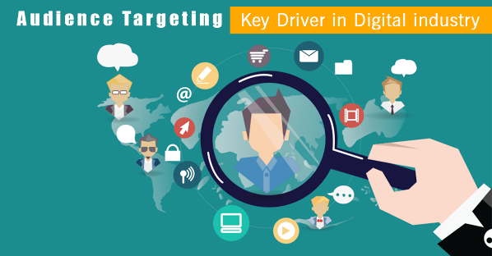
A target audience
  For a business, it is essential to know their customers and which stage of the marketing funnel they are in.
  Target audiences must be defined for two important reasons
  To be able to appeal to them by message
  To find them in the platforms and media they are likely to be in
  Criteria used when defining target audience
Age,income level, hobbies, location, budget (demographic)
Internet device used
Internet search history, prior purchases, prior encounters with
your business (behaviour)
Their needs and questions they have (marketing funnel stage)
Their interests; their purchase intentions
The challenge: Where can this kind of data be found?
source: Digital Floats
Notes:
All marketing actions cost money, thus targeting is a key principle in marketing. When you don´t know your target audience, you won´t be able to a)state messages that appeal them, nor b)select the right channels where they can be reached. All this would mean that a lot of money would wasted. The better you can identify your target audience and their needs, the better you can state clear messages, reach them, and thus get impact for your marketing activities. The challenge is that ready-to-use data does not exist, and each business has to define their target audiences step by step. The following slides present useful methods for digital platforms.

Slide 15
How to discover your target audiences?
1. Analyze your customer base
Look at who already buys your product or service. How old are they, where do they live, what are their interests?
This could be carried out e.g. through engaging on social or distributing customer surveys.
2. Conduct market research and identify industry trends
Look at the market research for your industry to determine where there are holes in service that your product can fill.
Review trends for similar products (google trends, keyword research) to see where they are focusing efforts, then hone in further on your products unique value
3. Analyze Competitors
Review their websites –what key words do they use? What can you learn from them? Who seem to be their target audiences? How does this show?
Marketers can learn a lot by looking at competitors to see who they are commonly selling to. Are they using online or offline channels? Are they focusing on the decision maker or the supporter?
4. Create ‘Personas’*
Especially helpful if your business appeals to a wide range of consumers.
‘Personas’ allow you to determine the general demographics, personalities and needs of your target consumers.
Personas are created based on our customer knowledge and their needs, completed by other available data.
5. Exclusion: Define Who Your Target Audience Isn’t
Try to be specific in determining who your audience is and who it isn’t.
Is your demographic women, or women between the ages of 20 and 40?
Knowing this will keep your teams from devoting ad dollars to segments that will not yield returns
6. Make use of the existing data and targeting criteria of the platforms
Google Ads, Display, Meta and such ad platforms use extensive databases, utilizing artificial intelligence.
This data is organized to target audiences according to their profile, behaviour and interests
When launching a campaign on these platforms, you get access to these audiences.
These platforms also form advertising networks (such as GDN)
*the topic was covered in the previous submodule
Modified from Marketingevolution
Notes:
How to discover target audiences in digital platforms ..? There are various options. You can start by analyzing your existing customer base (1), your field of industry (2), competitors and their customers (3). The steps 4-6 tell how you can elaborate and develop this data. Creating ‘personas’ was explained in the previous submodule. In addition, the platforms (Google, Facebook, etc.) help advertisers to find target audiences, by means of their user profiles (see next slides).

Slide 16
In-class activity
Exploring target audiences by digital means.
The steps 2 (bullet 2 in special) and 3 can be conducted over internet for any business, following the guidance and links given in the previous slide.
Choose a business. Define 5-8 essential key words that the ideal customers use.
Conduct google trends searches with these words - you will get trends, alternative search words, requests and geographical areas related to the search words)
Conduct step 3 (define competitors and review their websites, key words used etc.)
List all the of data you could retrieve by these (key words, potential users, high/low periods, geographical areas) on a PPT presentation.
Notes:
This activity fits ideally for pair or small group use, in-class or at home. Time needed; appx. 60-90 minutes. While students are working, you can visit the groups and spot groups that work well and get extensive results. It is recommended to have these groups present their findings for the whole class.

Slide 17
Advertising networks – Google Display Network (GDN)
Advertisers and content producers (e.g. newspapers, media sites) have created networks with win-win for all partners
You have access to these networks when starting a campaign with adv.platforms that belong to the network
As an example, Google has a vast network of websites for publishing ads, from the New York Times down to the smallest blogs on the Web.
These networks offer various targeting options for advertisers:
Contextual Targeting - based on the content that is consumed in the media
Placement Targeting - advertiser chooses the websites or websites the ad serves on
Remarketing - users who visit a website are then shown advertisements for that website as they browse other areas of the display network.
Interest Categories - based on interests revealed by web users
Topic Targeting - ads published according to a specific topic
Geographic and Language - within a specified region or language of audience.
Demographic Targeting - age, gender, etc.
Further reading: Bigcommerce
Notes:
The example refers to Google, however, most national and international media houses are members of advertising networks and thus able to offer similar kind of targeting options than this slide shows.

Slide 18
Bases for user profilation
User data collected by Google
(Ads, Display ads)
User data collected by Meta
(Facebook, Instagram)
User demographic profile
Gender
Age
Location
The current search
Key words
Your previous activity on Google sites and apps
Searches
Your activities while inscribed in Google
Your reactions to ads
Your activity on other devices
Contents created by user
Contents & pics published
Contents followed (from others)
Purchases made
Keywords used
Time spent in Meta platforms
Contacts and communication in Meta platforms
With whom
Type of communication
Frequency of communication
Devices used
mobile; laptop
Information gathered from third partners
Types of sites followed (interests)
Purchases made
Source: Google support and My Ad center
Source: Facebook privacy policy
Notes:
Obviously, advertising platforms, such as Google and Meta, gather extensive data of their users. As they must follow the agreed privacy policy rules, this data is openly available (sources). The slides base on this data.
For an advertiser, this data becomes useful when creating your Google Ad (or other PPC) or Meta campaign, helping you to define focused target groups.

Slide 19
Digital advertising formats
Notes:
In this section, features and advantages of the essential formats will be presented. The next section presents the most essential platforms (Search engine adverts, social media adverts, different types of Pay Per Click = PPC adverts in advertising networks). The operative part is demonstrated in the next section.

Slide 20
Digital media
Basically equal to traditional newspaper ads but published on digital platforms
These cover a wide range of digital platforms with big visitor numbers: digital newspapers, magazines, other densely visited platforms, search engines, social media platforms, video publishing platforms, blogs, etc.
The media and advertising business is run by a big number of media houses and a few transnational giants such as Alphabet (Google, Youtube, etc.) and Meta (Facebook, Instagram, etc.)
Their business is to publish contents (news, entertainment, living, placement, special interests and hobbies, etc.), attractive to larger and smaller, general and specific audiences, and by means of this,
offer specific media for advertising purposes
Notes:
Prior to talking about advertising, it is essential to understand the role and character of media. Their business (also Google, Facebook and other giants) essentially builds on their users, their experience and happiness with the contents. If not, the volumes drop, which is a disadvantage for the advertisers. In addition, the advertisers expect media to know their users, and be able to classify them for different advertising purposes.

Slide 21
In-class activity
Explore the range of your national media houses
They can be detected in internet by searching for instance ‘media houses’ or ‘buying digital advertising’
In most European countries there are 3-5 prominent media houses and a few smaller ones
List five most important national media houses
Explore their websites and list particular media (newspapers, magazines, special media, other platforms) owned by them. See also their ’media chart’.
Choose 2-3 of the particular media. List which kinds of target groups you could reach via them.
Time needed: 30-45 minutes.
Notes:
This activity can also be done as individual or group work, also at home. It is usual that this kind of examination gives new insights to digital media and digital advertising. Students come to understand that most media exist for commercial reasons and aim to provide advertisers with an attractive selection of media. One more objective is that students start looking on different media in a more professional way, ‘which kinds of target groups could I reach in media N.N.’

Slide 22
Pros and cons of digital advertising
PROS
Offers superior possibilities for any size of business to increase awareness and drive traffic to website
Flexibility - easy to start and change
Advanced options to define target audiences
Low-cost (specially when run in-house)
CONS
Click-through-rates and conversion remain quite low
-> large volume usually needed
Competition may be fierce (depends on business field)
This may lead to high CPC pricing
Web users may feel overwhelmed by ads
Further reading: https://www.wordstream.com/ppc
Notes:
This section will present the different types of digital advertising and their main conditions and advantages.

Slide 23
Advantages of digital advertising
Quickness - adverts go public immediately and start creating traffic
Reach and targeting:
  you reach big numbers of new, unknown audiences
  targeting options allow you to focus on quality audiences
Flexibility
  The elements of an ad (e.g. text, target audience, budget) can be
  changed/adjusted at once
Measurability
  All ad platforms offer analytics
  The impact can be seen easily
Easy to set-up
  Further reading: https://metricswatch.com/advantages-and-disadvantages-of-pay-per-click
  Introductory video (5.26): https://www.youtube.com/watch?v=A37YIpTU9Z0
Notes:
Digital advertising has remarkable advantages when compared to traditional marketing. As for disadvantages, the competition might be fierce. In addition, paid ads usually have smaller impact than organic visits.

Slide 24
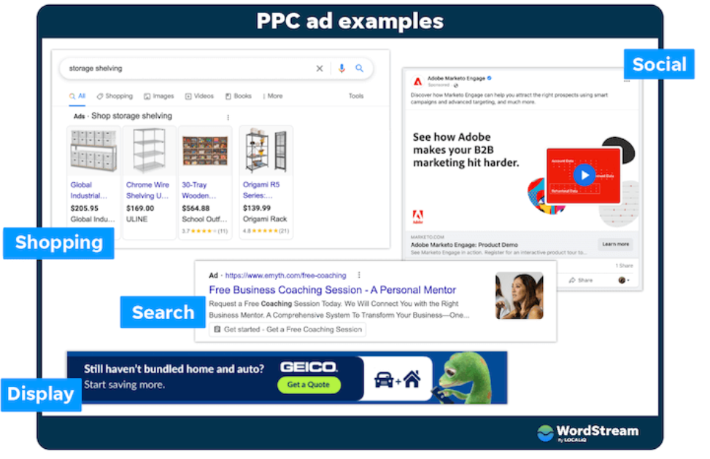
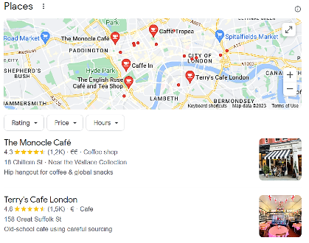
Examples of digital ads
Local
Source Wordstream
Notes:
PPC (pay per click) adverts can appear a.o. in search results (‘shopping’, ‘search’, ‘local), on social media (e.g. Facebook, Instagram, Youtube, etc.) and in a wide range of website banners via advertising networks (‘display’).

Slide 25
Platforms for digital advertising
SEARCH ENGINE ADVERTISING
Google ; Bing, DuckDuckGo, etc.
SOCIAL MEDIA ADVERTISING
Facebook, Instagram (Meta)
Youtube, LinkedIn, blogs, TikTok etc.
WEBSITE
DISPLAY ADVERTISING
NATIVE ADVERTISING
Further readings:
The 14 best ad platforms (2023)
More extensive introduction
Notes:
The main objective of digital advertising is to drive traffic to the business´website. The website is the main operating instrument, as it is apt to offer useful content and data to visitors, as well as elements for them to take further steps (upload, leave contact information, purchase, etc.), called ‘conversion’. The slide displays the essential platforms for digital advertising.

Slide 26
How to get started?
Step 1
Step 2
Step 3
Define your target audience
Identify stage of their buying process
Select the digital platform* where you can meet them
Define your goals and KPIs
Create the ad
Define the budget
Publish the ad
Follow the impact via analytics from the platform
Apply A/B testing
Adjust and tune your adverts to get better results
Notes:
The process of running digital ads is similar to any advertising campaign. The essential difference is that the digital advertising platforms (named previously) offer remarkable help and support for creating ads and following their impact.

Slide 27
Assignment
Read three sources related to digital advertising and respond:
What are the platforms where you can run your ad?
Analyze by objective and audience, things make differences between them?
Name steps to be taken when starting PPC campaigns
Identify the different types of digital ads and find out how they work. Make a list.

Slide 28
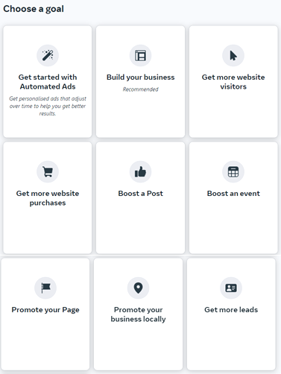
Goal-setting in PPC campaigns
The advertising platforms (Google Ads, Youtube, Facebook, Instagram) help to align your campaign to your main objectives by suggesting campaign-specific goals
The conduct of your ad will be tuned according to the chosen goal
To the right you see goals suggested by Facebook (Jan 2023)
Other platforms suggest similar types of goals
Further reading:
  Instructions provided by these platforms themselves will be easily found on local languages by google search (Facebook/Instagram advertising, Google ad advertising, Youtube advertising, etc.)
Notes:
The example comes from Meta Business Suite (the ads center of Facebook/Instagram)

Slide 29
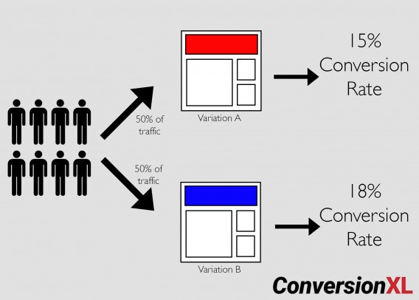
A/B testing of ads
Purpose: to define the best ad, to improve ads
How:
Two or more versions of an ad are shown to visitors at the same time to determine which version is clicked most and/or leads to highest conversion (picture)
‘A’ refers to ‘control’/original variable, ‘B’ refers to ‘variation’ or a new version
Can be varied: pictures/colours/headlines/body text (one or several variables)
Advantages:
Gives quick and reliable indication on which ad is best
Allows the advertiser to detect elements that will usually work
Improves conversion
Further reading: vwo.com
Source & further reading: CXL
Notes:
Even smaller advertiser can utilize A/b testing simply by creating various versions of an ad and comparing their results. The differences can be seen already in some hours, depending on the size of the target audience.

Slide 30
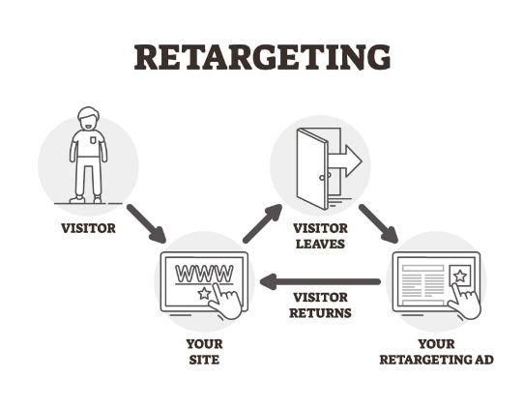
Retargeting
allows your business to show targeted ads to the users who visited your website and didn’t complete a conversion – purchase an item, fill in a contact form, download a file, etc.
Retargeting is effective because it focuses on people who are already familiar with your brand and have recently demonstrated interest.
can be connected to ads on most platforms (for instance Google ads)
Source & further reading: Unbounce
Notes:
We all have experience of ‘retargeting’ - ads that ‘appear again’. Most people agree it gives good results for reasons mentioned in the slide. Consequently, it is a good option to any marketer.

Slide 31
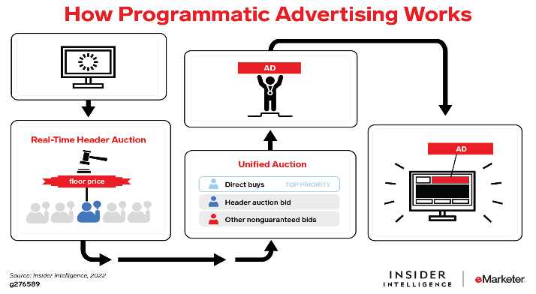
Programmatic advertising
Applies automated technology and algorithmic tools for optimizing advertising media and budget
Serves the ads to visitors in the right place at the right time
Makes an extensive media space available by the use of SSPs (sell-side platforms) and DSPs (demand-side platforms)
Is increasingly used by marketers
Further reading: DMI Digitalmarketinginstitute
Source: Insiderintelligence
Notes:
Programmatic marketing is a new mainstream in digital advertising, increasingly used by big marketers especially, as it needs specific software. In some time it will probably be available also for small advertisers.

Slide 32
Digital advertising - about costs
Digital ad pricing depend on whether you decide to manage your campaigns in-house (less expensive but knowledge needed) or hire an agency
Each of the platforms has its pricing model
The advert itself and the website are classified by their quality (higher quality usually contributes to a lower price)
CPC (Cost per Click) or PPC (Pay per Click) pricing is based on how many clicks the ads receive. The price per click can range from as low as $0.01 to more than $10.
CPM (Cost per Mille) pricing is based on the number of impressions. Each time a visitor sees an ad, the advertiser is charged a pre-determined amount. As an example, an average price for 1000 impressions in Facebook is 10€.
PPC or PPA (Pay per Click/Action) - you pay for the wished action of visitor (purchase, phone call, leave contact info)
Further reading: WebFX 1 WebFX 2
Notes:
Some general principles regarding to pricing. Note: All the platforms show clearly the pricing while creating the ad. More about pricing principles in the two links, as well as examples on them.

Slide 33
Digital advertising platforms
Notes:
In this section, features and advantages of the essential platforms (Search engine adverts, social media adverts, different types of display adverts) will be presented. The operative part ‘How to run campaigns on these platforms’ is demonstrated in the next section.

Slide 34
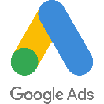



Search engine advertising
The most important ads space
Ads are triggered by the search words defined by the advertiser
Locates your ad on top of search results in the search engine as ‘Ad’
Makes your business available to users with an exact and immediate need
Apt to generate traffic for new companies or recently started websites
Notes:
Search engine advertising can be bought and positioned in any search engine, in order to obtain visibility on the search engine results pages.

Slide 35
Conditions:
Benefits:
Your products/services are searched with a search engine = your potential customers can be found there
You are able to name the critical keywords
The ad links to a landing page to match and respond to your ad
Accelerates traffic to websites/businesses/products/services
that are still unknown, or
The search engine is ’a hot market’ with users who have an obvious need
Even when not clicked, the ads get impressions in the search engine results and increase awareness
Further readings:
https://instapage.com/blog/search-engine-advertising
https://support.google.com/google-ads/answer/10560737?hl=en&ref_topic=3121941
Notes:
The main conditions and benefits of search engine advertising is presented here. In the further reading you can examine the these questions more in detail.

Slide 36
Placing and Pricing of Google Ads
Google Ads platform gives each ad a quality score that is affected by:
  The quality of your website - the higher quality score for your keywords and ads.
  This leads to better placing and lower CPC price of your ads.
  Keywords - highly competed -> higher price
  The match of your ad with your site content
  Landing page user experience
  Expected CTR of your ad
  The price you are willing to pay
Further reading, a Neil Patel blog:
https://neilpatel.com/blog/profitable-google-adwords-campaign/
Notes:
As we can see, Google has a versatile criteria for pricing ads. For this, they deploy a high rate of artificial intelligence. Their interest is not just to earn money, but also maintain good user experience among the ones who use Google search. Read more in the link!

Slide 37
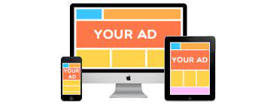
Display ads
(banners)
Display ads can be bought in all media
network (covering thousand of commercial websites with high visitor rates)
Video (Youtube)
Location based ads (for locally searched services such as Cafées, shops, etc)
Shopping ads (product pics in google search results)
Apps (Spotify, Match-apps, games,etc)
See all options on google Ads
Notes:
Display ads can be made/bought on google ads, or platforms of media houses. The title covers different types of ads, aimed to reach customers in a wide range of digital environments, matching with their stage of buyer funnel. PPC ads work in a similar way, but their forms may be versatile. The next slide presents some examples.

Slide 38
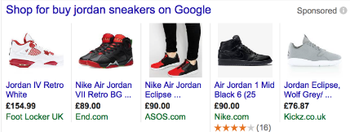

Purposes and objectives
Display ad:
Reach people in specific publications
Display advertising network covers worldwide 35 million websites
Shopping ad:
Reach people with high buying intention
Related to search and search words
Video ad:
Broad reach in the selected audience
Video has been proven to be a very good eye-catcher
Youtube, the Google Network, and apps
Local ads:
Promotes your locations across Google networks
Navigational ads increase your on-site customer flow
App ad:
When you want to increase the number of app downloads
In search results, Youtube, app stores
shopping ad
local ad
Notes:
Display ads are undergoing continuous evolution. In big picture, their purpose is to reach internet users in favorable contexts and at the same time, be ever more attractive for advertisers.

Slide 39
Conditions:
Benefits:
You know your target audience and where it can be found
Your objective is to increase awareness to larger audiences
….and drive traffic to your website (=upper part of the marketing funnel)
The clicks can be directed to a proper website (landing page) that guides them onwards
they are easy and quick to set-up and run
they can quickly create remarkable visitor volumes to your website
they can be targeted on multiple and specific criteria
they are likely to widen your target audiences

Slide 40

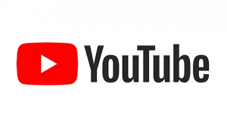
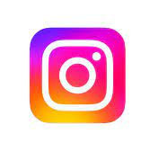

Social media advertising
The second biggest ads space after Search engines
Social media ads allow you to reach a wide range of social media users
Good way to focus specific target audiences
Apt for promoting your brand (visual ads)
In addition to granulated targeting, retargeting and look-alike audiences can be created
Low-cost, easy to conduct

Slide 41
Conditions:
Benefits:
Your target audiences are active social media users
You are able to define features of target profiles
A business account on Facebook/Instagram/Youtube/LinkedIn
Being able to manage Facebook (Meta) business suite yourself will give better yield
Big new audiences can be reached immediately - also regionally and locally
Cost-effective: specific targeting options enable you to focus on exactly right audiences
Engagement: In addition to ad clicks, users can interact with social media ads by liking, sharing, and commenting.
Social media look similar to posts -> less ‘as disruption’ for viewers
Further reading: Wordstream

Slide 42
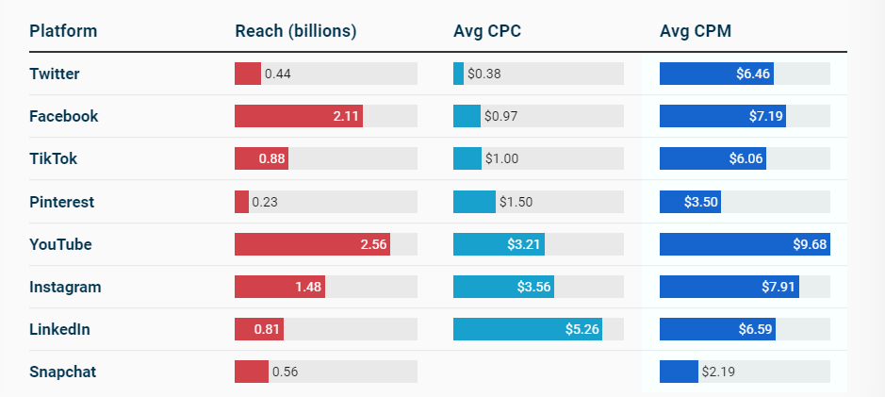
Features of social media platforms
CPC= advertise cost per click
CPM= advertise cost per 1000 impressions
Source: Wordstream
Notes:
The figure displays clear differences between social media platforms. The click price is highest on LinkedIn, whereas Youtube has the highest CPM prices. Facebook has the largest reach.

Slide 43
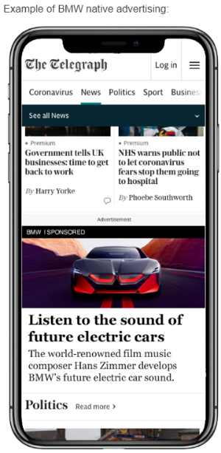
Native advertising
Growing form of advertising
Unlike display ads, native ads include informative content fitting to the media context and format
Offers advertiser the option to reach content-oriented audience
As they do not look like ads, they don't disrupt the user's interaction with the page
-> their CTRs are usually higher than other PPC
Native ads can be bought from the media houses, Read Peak, or via programmatic buying
Both CPM and CPC pricing possible
Further reading: ReadPeak Outbrain
Notes:
Native advertising is a novel advertising form, allowing the advertiser to reach audiences based on content and media format familiar to them. The topic can be explored in the further readings suggested.

Slide 44

Email marketing
Digital newsletters sent to your customer register (or parts of it)
A good way to maintain customer awareness of your business
An apt way to share good contents and drive traffic to your website
A newsletter should be useful for the recipient
Picture: Forbes
Notes:
Although generally not classified as ‘advertising’, email marketing is useful for many businesses as it is likely to reach right target groups and it can be conducted with low costs.

Slide 45
Conditions:
Benefits:
You need email addresses (customer data base) and allowance from the recipients
You must have something to tell about
Someone in your business must have ability to write appealing texts
A software (e.g. Mailchimp) is recommendable as it saves work and money in the creation and dispatching process
Very low-cost way of reaching targeted customers that you know
You can send specific information to specific recipients
Helps to drive traffic to your website/store
Email is a powerful marketing channel for your content
Email marketing is easy to test and develop
Further reading: Mailchimp Sendinblue

Slide 46
Key words research
Notes:
As we have noticed in the material, key words are centric elements in finding adequate information on internet. For this reason it is essential to know the key words related to your business. Key word research can also offer new insights on your business, or its target audiences.

Slide 47

Why keywords are essential?
Key words are real doorkeepers for all online information
If you don´t know which key words your business should be found with, you risk to not to be found in searches!
Key words are essential in most advertising platforms, especially in Google Ads and Display ads
In addition, key word research is likely to offer you new insights on your business, or its target audiences
Further reading: Moz
Notes:
In addition to advertising, key words are essential also when building a website, in terms of search engine optimization and good content.

Slide 48
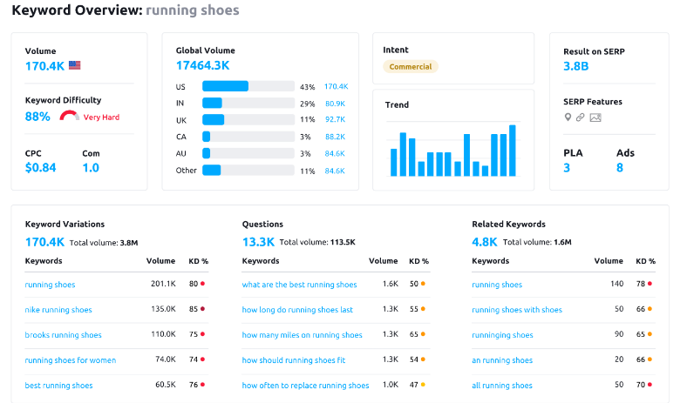
Key words research
Objective: to detect key words that describe your product or service.
Useful in planning your website content and your ads.
Allows you to detect new key words for your business.
Provides you with
Historical statistics - how many searches users have made on a particular keyword or how competitive that keyword is.
Alternative key words used
Traffic estimates, such as how many clicks and impressions your keyword could receive with a specific bid or budget.
Source: Semrush
Further reading: Hubspot
      Free keyword tools
Notes:
The slide presents key words research in short . The topic can be studied more in depth through further reading. Two sources suggested.

Slide 49
Assignment ’Key words’
Choose an organization of your interest
Find out which keywords their target audiences use?
(official, everyday expressions, multi-word expression <-> Google's semantic search...)
Outline 3-4 buyer personas -> what words/expressions they use
Explore your own and your competitors' websites – what words are used on them?
Brainstorm with your team – more people find more key words
After this, conduct keyword research (search for suitable slide title words or 'keyword research’ first. GoogleAdsin't, Semrush, ubersuggest -> Neil Patel, keywordtool.io, or https://ahrefs.com/blog/free-keyword-research-tools/
Which new key words / other ideas did the research provide, regarding the target groups..?
Notes:
This assignment makes the role of key word much more concrete. It offers also a practical approach to the diverse key word research tools. Note: most of the tools are licensed, yet many ofthem offer free trials.

Slide 50
Landing page

Slide 51
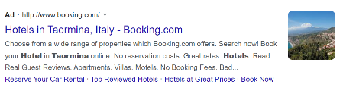
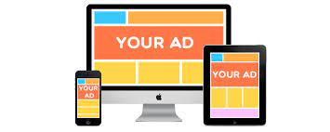
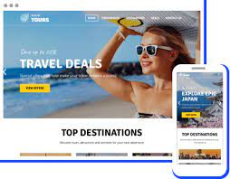
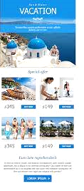
Web traffic and conversion
click
Google search engine Ad
click
Display Ad
Conversion on the website, towards KPIs set
click
The landing page on a business website
Newsletter
Notes:
The goal of ads is to get the maximum rate of clicks, leading the visitor to a landing page. From landing page the visitors are guided to fulfil the main objectives set to the campaign. It could be for instance leave their contact information, load content, fill a request or make a purchase. This process is called ‘conversion’.

Slide 52
Essential on landing page
It´s purpose:
  It must correspond with the ad leading to it*
  It leads the visitor further to fulfill wished activities
What should be included on a landing page:
  Its general outlook should create confidence and be in line with the business
  The correct contents in regard to the ad. (If the ad was about special offers to Spain, then the landing page is expected to tell more about them!)
How to assess a landing page:
  The analytics show the immediate (<5 sec.) exit rate ‘bounce rate’
  The bounce rate should be low (<50%)
  How long did the visitors stay? Did they take the next step?
Improve the landing page
  How to improve conversion? (will be presented in next section)
Further reading: Structure of a good landing page (video 5 minutes); Assess a landing page (video 8 minutes)
*in some cases, the landing page could also be the main website
Notes:
Why the landing page is so important..? The aim of advertising is to have visitors fulfil certain actions. The landing page is decisive in as it must both make the visitor get interested of the business and take further steps. If he landing page fails, the immediate exit will grow (bounce rate).

Slide 53
In-class activity
Landing pages
The internet is full of ads and landing pages, so it is easy to observe and assess them.
Review three different types of ads (search word, social media, display ads) and click them, to enter to the respective landing pages.
Assess each of these landing pages in terms of
  clarity and focus (1-3)
  responsiveness to the ad clicked (1-3)
  conversion: does the landing page suggest clear steps ahead? (1-3)
Make a report on PPT
Time needed: 30 minutes. Can be done individually or in pairs.
Notes:
This activity makes the topics ‘conversion’ and ‘landing page’ more comprehensible. It also underlines the role of ‘landing pages’ and how they could improved.

Slide 54
Measure the impact
“Most organizations do not fail because they lack qualified personnel, but because they do not monitor the success and performance of their digital marketing campaigns.”
Notes:
One of the advantages is that digital platforms are able to track a lot of useful data about the traffic (impressions, click rates, behaviour on website etc.). Note: You will find profound information in the module ‘Metrics and analytics’ .

Slide 55
Measuring the impact of digital ads:
What is needed :
  ‘analytics’, or ‘metrics’ software (note: most advertising platforms entail free analytics tools)
  cookies installed on the websites you want to track
The outcomes:
  Metrics on how visitors behaviour on your website
    Who your users are – Demographics (gender, age range, interests, etc).
    What they do – Session duration, how many interactions they have with your website, and site search terms.
    Where they come from – the sites they’re visiting from, including social media
    Why they leave – the order of pages they visited, the first and last pages they saw, and bounce rate.
Understanding how users interact with your website provides data and insights help you to improve the user experience and maximize conversions and optimize your content.
Notes:
In the following slides some examples on metrics will be demonstrated.

Slide 56
Relevant metrics for digital ads (examples)
How many impressions did the ad get?
How many unique visitors were there?
Was the landing page working well?( measured by ‘bounce rate’)
Were the objectives reached? (measured by ‘conversion’)
Do the visitors return on our site – have they become our ‘users’?
What kinds of reactions did the ad get? (social media ads)
Did we get new followers? (social media ads)
Did we get new contact data = leads? (email addresses or similar)
Further reading on metrics: Instapage
Notes:
Which metrics is most relevant to an ad ..? This depends on the goal-setting. If your objective is ‘creating awareness’, then the number of impressions is a relevant metrics. For ‘improving brand’, reactions on social media, or returners to your website might be relevant.

Slide 57
Metrics to follow up the performance of ads
1. How well does the ad text work - the CTR (click through rate) of the ad
      Indicates how have clicked of those who have seen the ad
<1% low; 1-5% normal; >5% high
2. How well is the landing page performing?
How many visitors stay on the landing page?
‘Bounce rate’ is the share of immediate exits (<5 sec.)
<50% normal; <50% fair
3. How many fulfil a wished action - conversion rate
How many of the visitors fulfilled desired actions?
This data can be obtained from the analytics of the ad platforms (Google Ads, Facebook/Instagram)

Slide 58
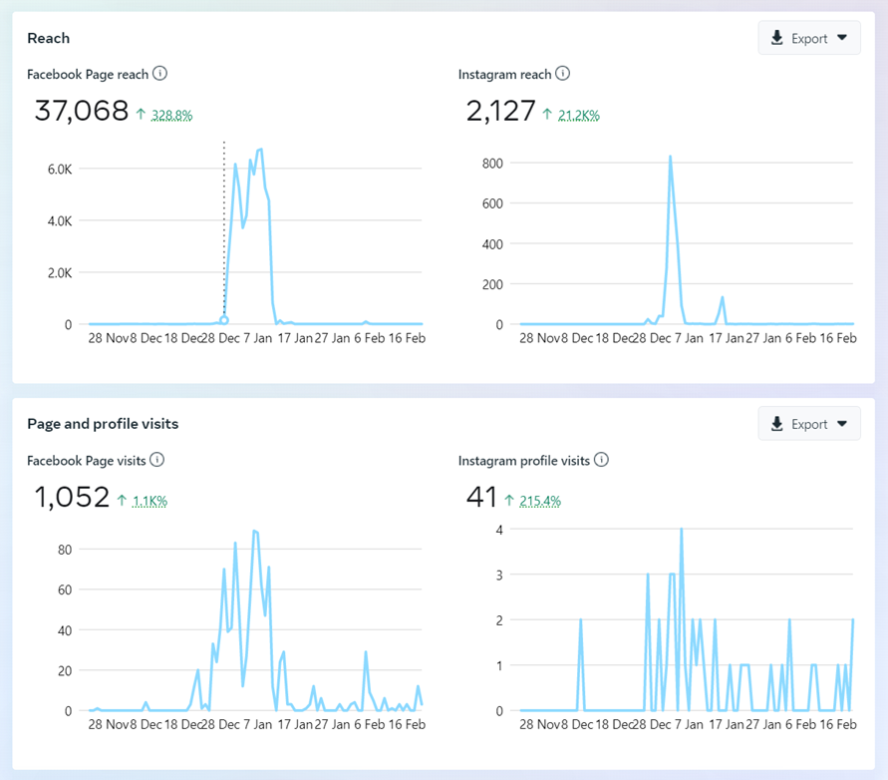

Campaign run in 28.12. - 17.1.:
37.000+ impressions on Fb
2000+ impressions on IG
Page visits (=CTR)
Fb 1000+ (~2,7%)
IG 41 (~2%)
Budget total 100€ (80€ Fb, 20€ IG)
-> spend:
CPM Fb: ~2,1€
CPM IG: ~10€
per click Fb: 8 c
per click IG: 50c
Metrics from
Facebook/IG
Notes:
The example graphic shows the results of a campaign ran on Facebook and Instagram from 28.12. to 17.1. For 100 euros 37.000 impressions on Fb and more than 2000 on IG were reached. These led to 1000+ visits from FB, meaning a CTR of 2.7%. The cost of 1,000 impressions (=CPM) was €2.1 on FB and €10 on IG. IG is therefore a more expensive advertising platform.

Slide 59
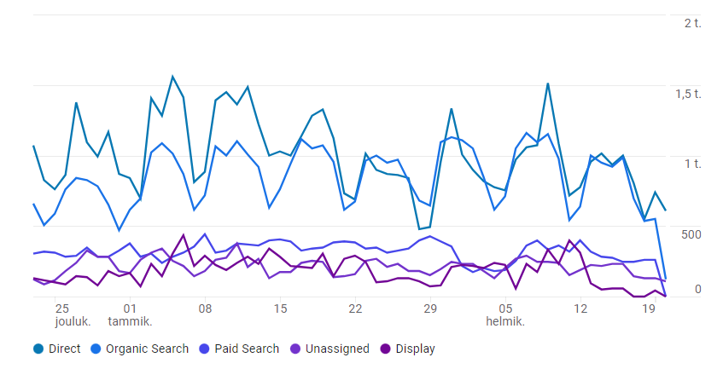
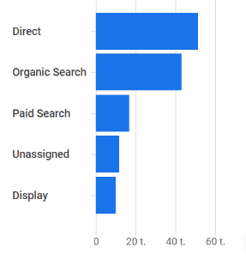

Example metrics
from Google ads 1/2 (data from the Google demo account*)
timeline 23.12. - 20.2.
display sources and rates of traffic
most important source is ‘direct traffic’ (user knows the URL address)
appx. 50k ‘direct’ visitors in the timeline
second ‘organic search’ (site found through search engine)
third is advertising (‘paid search’)
*Google demo account shows visitor data from Google Merchandise store
Notes:
Google campaigns provide even more information than social media campaigns. Here you can see, for example, the sources of traffic. Note! Google's demo account (link below the title) is linked to a real product site (Google merchanise store) and is a great way to illustrate analytics. It requires the teacher to familiarize him/herself with it a little beforehand.

Slide 60
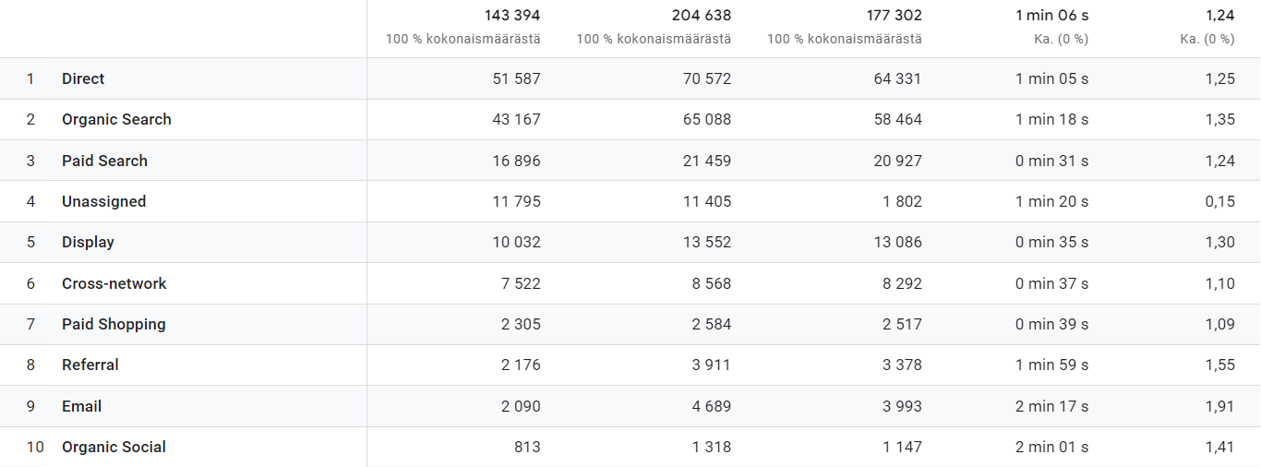
Source of traffic Users Sessions Active sessions Avg time spent Act.ses.per user
Example metrics from Google ads 2/2
This metrics display active sessions* and differences in their length
Ads (paid and display) seem to have shorter sessions than direct and organic visits
Longest sessions by email-adverts and organic social (followers on Google´s own social media accounts)
Notes:
This data confirms that ads usually have lower impact/conversion than organic visits. Why? Because those who already know a website/business/product (=returning visitors) are more advanced in their buying stage and that is why their interest is more focused and bigger.
*active sessions refer to sessions with duration > 5 seconds.

Slide 61
Conversion

Slide 62
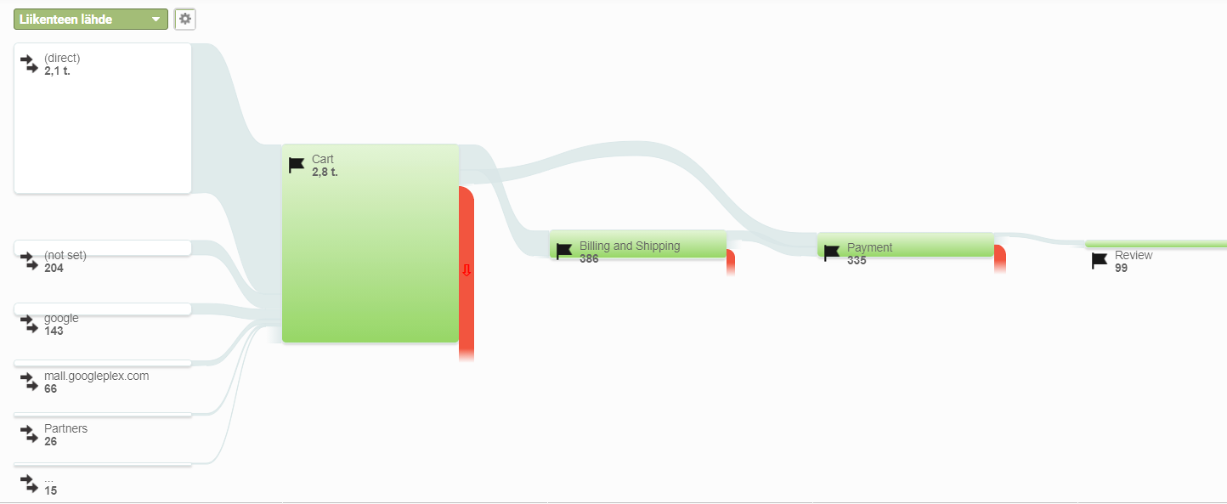
Conversion – illustration
The Google analytics figure displays quite a typical conversion process on a webshop (the data comes from Google´s demo webshop Google merchandise).
We can see the sources of traffic, the number of shop-enterer and so on.
The final conversion rate would be 99/2800 x100 = 3,53%
Notes:
‘Conversion’ is an important indicator for the success of digital advertising. It refers to the rate of those who have done desired actions, in proportion to all visitors, or those who have seen an ad. In a way, it refers to the funnel. Conversion is essential for many reasons - in addition to a measure , it also indicates to points in the ‘funnel’ where improvements can be made.

Slide 63
A good conversion rate?
Conversion rate is calculated as the percentage of fulfilled actions among all visitors.
For instance, if an online store had 2000 daily visitors and a total of 30 purchases, the conversion rate will be 30 / 2000 x 100, that is, 1.5%.
In general, a 1-4% conversion rate is considered good.
For a B2B company with high-price products, a conversion of a few per mil can bring a monthly trade of hundreds of thousands of euros.
On the other hand, even a conversion rate of > 20% can be unprofitable in case of low-value products.
Notes:
Conversion calculations help to develop good advertising and a profitable business.

Slide 64
Overall tips for improving your conversion
Create confidence
Enable facile navigation
Write appealing titles and texts
Guide in the right direction: Call to Action
Apply A/B testing
Modified from source: www.salescommunications.fi
Trigger video on the topic Conversion (6 minutes)
Notes:
The topic ‘How to improve conversion’ is one of the hottest topics in digital advertising. In these slides some hints are presented. You will find more profound instructions in the module ‘Website and SEO’.

Slide 65

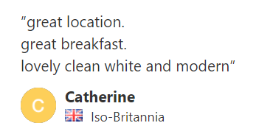
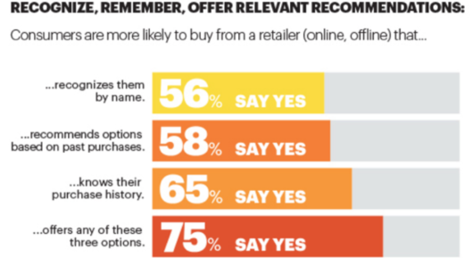
1. Create confidence
Recommendations and testimonials reflect positively past experiences and thus create confidence.
Any reference to visitor´s person or past behaviour creates confidence (see picture)
Knowing your target audiences and buyer personas enables you to resonate with them with the type and tone of voice of your website content.
By website personalization the visitor perceives the content as the most relevant and the visit more meaningful.
Source: Neil Patel
Notes:
These are basic guidelines for creating trust on a website. Note: The three first ones are feasible for any business and and size of company, whereas the fourth one normally needs specific software with artificial intelligence.

Slide 66
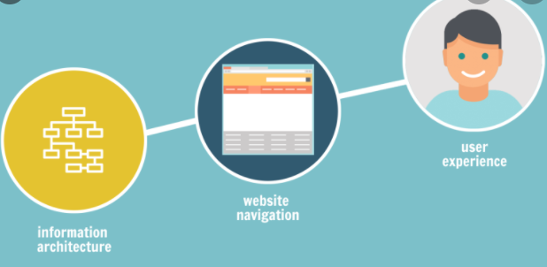
2. Ensure facile navigation
Clear site structure: main levels, sublevels, site map
Seamless longitudinal navigation (the visitor is supposed to find by maximum three clicks)
Visual clarity, clear descriptions of products and services
Sufficient instructions for moving forward - 'tell the visitors what you want them to do’
Notes:
Note: In businesses, the customer experience is a major concern of the marketing&sales staff, whereas the website navigation belongs to technical staff. It is important that the former give feedback and suggestions to the latter, in order to improve the customer experience and conversion on the website.

Slide 67
3. Write appealing titles and texts
By tuning the headlines and text, you can quickly get results in conversion optimization.
The visitor has clicked your link with an offer - does
your content offers added value to your customer:
  Is your content responding to this need?
  Does your content help a customer solve
  their problems?
  Does your content guide the customer to
  take action?
Note: Any size of company is able to produce
content related to their expertise.
Some examples:
“Get here the Top-five tips for finishing your garden”
“Want to hear how experts repair their car breaks?”
“Would you hope stop freezing outside in the winter?”
“Three advantages of having your hair treated by nn”
Notes:
In the section of ‘landing page’, it was stated that landing pages should offer immediate interest and motivation to stay on the website and proceed further. This topic is closely related to the module ‘Content marketing’.

Slide 68
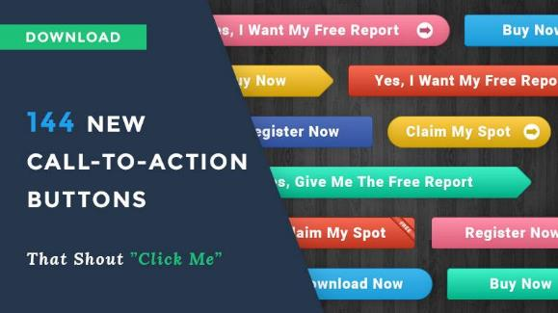
4. Call to Action
Website visitors may often need help ‘to take the next step’ -> they should be encouraged in many ways.
The website owner should tell the visitor clearly ‘what I want you to do’.
Call-to-action (CTA) buttons lower the threshold for action.
They should include fair and positive suggestions.
Read more about CTA

Slide 69

Congratulations for finishing this module!
1.Bases for
advertising
2. Preparing for
campaigns
The next module will show how campaigns are created in the main digital platforms.
3. Execution of
campaigns

Slide 70
The DEMS material aims to enhance digital marketing skills in higher education, responding to the needs in business and organizations. You have access to extensive slide sets with in-class activities and assignments, as well as detailed user instructions for teacher. You are free to use part or whole of the material available.
The material includes contents and figures retrieved from the internet and is thus subject to changes. The sources have been announced according to the rules of fair use. The material as a whole can be viewed and downloaded from www.dems.pro. All material is produced for open use and co-funded by Erasmus +.

