Slide 1
Digital advertising
Bases for advertising

Slide 2
Learning objectives
The student is able to
Describe features and elements of modern advertising
Explain features and advantages of digital advertising
Understand and apply the sales funnel model
Determine target groups
Create marketing messages with impact
Identify and describe the most essential digital media and channels

Slide 3
Topics
Digital advertising
Features of modern advertising
The message is essential
Customer oriented marketing and advertising
Trends and prospects
Main forms of digital advertising
Notes:
3-4 lessions á 2h

Slide 4

Refers to marketing through online channels, such as websites, mobile phones, social media
Covers various media formats and consist of text, image, audio, and video.
Helps to achieve similar types of goals than traditional advertising (raise awareness, boost sales, drive repeat sales, increase brand awareness)
Digital advertising?
Notes:
This is just to give short introduction to what ‘digital advertising’ is for those users that are not familiar with the module “Introduction to digital marketing”. The named module covers features and advantages of Digital Marketing in details..

Slide 5
In-class activity
Can be done individually or in pairs.
Purpose: to make students aware of the wide range of digital advertising we face daily, and to orientate towards the media and channels.
What types of digital advertising do you see daily? Search on different sites and media (10 minutes). Name 3 examples and paste them on a ppt-slide.
How do they differ? What seems to be their purpose?
Present to the group.
Notes:
This activity helps you as teacher to see how well the students can identify ads as such and different types of them. The main formats are: 1. banner/display ads, 2. search engine ads, 3. social media ads, 4. native ads, 5. newsletters

Slide 6
Special for digital advertising
Flexibility
Creation of ads is technically simple and ads show up almost immediately
Ad elements and contents can be changed and adjusted any time while campaign is live
Campaigns can be adjusted based on how they are performing.
You may adjust the creative content, target audiences, timing and frequency and budget.
Digital ads are also accessible to smaller businesses without significant budgets
Precision
can be shown in a great variety of media and channels
allows you to specify your target audiences very precisely
Notes:
Compared to traditional media (newspapers, magazines, printed brochures, direct ads, TV, billboards, etc.) digital media is much more flexible. Traditional media aims to reach anyone who sees them, whereas in digital media you can target precisely. For instance, if you sell outdoors equipment, you may choose to reach audiences who are interested in hiking, or reengage shoppers who have browsed your products but not yet purchased. Depending on the format, you may also choose to limit your ad to certain times of day, or exclude audiences who have already viewed your ad once from seeing it again.

Slide 7
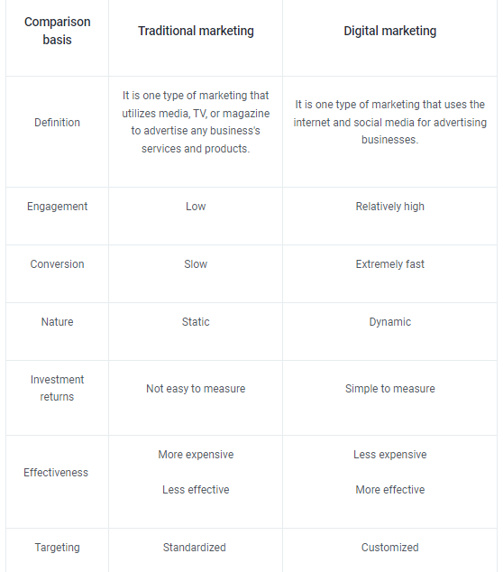
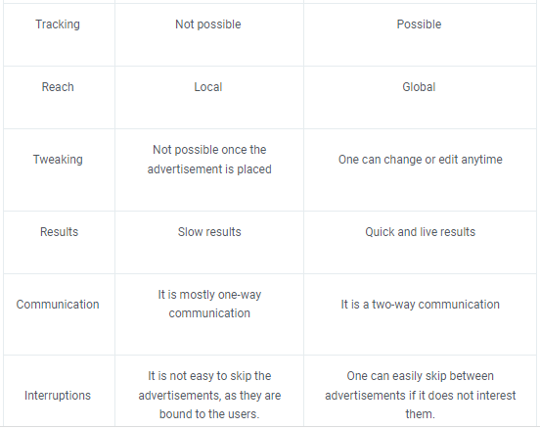
Notes:
Comparison between traditional and digital marketing Source: Simplilearn

Slide 8
“Stopping advertising to save money is like stopping your watch to save time.”
– Henry Ford
Notes:
Most businesses are in the need of new customers and increased sales. Advertising is one of the feasible ways to achieve this. Yet, as advertising and marketing mean expenses, the question ‘where do we get the best result for our marketing/advertising efforts’ is always present.

Slide 9
Features of modern advertising
Notes:
There are some main features characterizing modern advertising. Advertising should complete the other marketing activities of the business. It should always be planned in advance and have certain goals, also numeric ones. In addition, it should be adjusted according to the stage of the buying process.

Slide 10
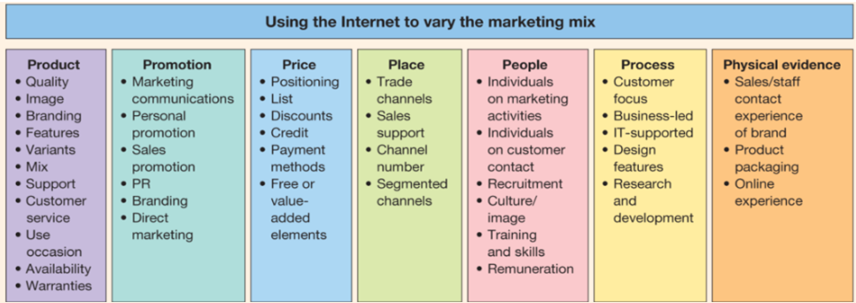
Advertising in the digital Marketing mix
‘7P’ in digital
Chaffey (2012):Digital Marketing - Strategy, Implementation and Practice
See Dave Chaffey´s video on the topic
Notes:
Quite often, ‘marketing’ and ‘advertising’ are seen as synonyms. The picture ‘Marketing Mix’ shows that marketing covers much more. Advertising is part of ‘Promotion’, a synonym to ‘marketing communication’.

Slide 11

Advertising - characteristics
Advertising is the most vital and generally used tool of marketing communication.
Most organizations need to do advertising in order to make themselves known in the market and to promote their products or services.
Advertising and visibility usually cost money-> optimization is needed.
Advertising is directed in channels and media where target audiences can be reached optimally.
These media can be classified as
    own - paid - earned
    traditional - digital
Notes:
It is important to recognize that advertising has expenses and must thus have goals. One essential question is ‘In which media/channels can we meet our customers?’

Slide 12
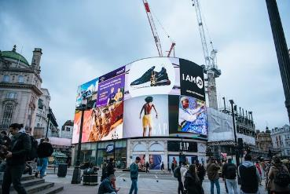
Tasks of advertising
inform, create awareness
build or reinforce attitudes in the minds of target audience
persuade to buy - ‘to be aware’ is not enough!
remind - ‘we still exist’
increase demand - ‘did you know about this additional feature’
increase sales
popularize and improve organizational brand
Notes:
A good way to concretize the topic is to let your students analyze advertising themselves - see next slide ‘In-class activity’

Slide 13
In-class activity
Referring to the previous slide - search for examples for the different types of ads. Use various internet websites as sources.
Time needed: 15-20 minutes.
Can be done individually or in pairs.
Take captures and present to class.

Slide 14
Advertising must be adjusted to the sales funnel
How can a marketer know where to meet the customer and what to message? The so called sales funnel (due to most products and services with value) helps to understand this.
  Each customer process starts from becoming aware of a need (this may happen through various triggers: seeing an ad, listening to a friend, reading social media or news.)
  Getting additional signals and information may raise interest. At this stage there is readiness to receive more information regarding the product or service.
  The next step is called consideration, where the need is specified and the process is considered critically.
  If the need still seems real and the solutions realistic, the intent emerges
  … leading to comparison of alternatives
  next, a decision or purchase will follow
  Still after the purchase the customer is interested in the product, and may become an advocate
Notes:
Sometimes we buy things instantly (usually inexpensive product for daily use, or products we have used before). Yet, in case of unknown products and services, there is usually a process that can take days, weeks or even months (a car, an apartment, a surgeon operation).
The marketing funnel is a useful tool for structuring and displaying this process. From the business´point of view, the different phases need different kinds of messages and ads.

Slide 15
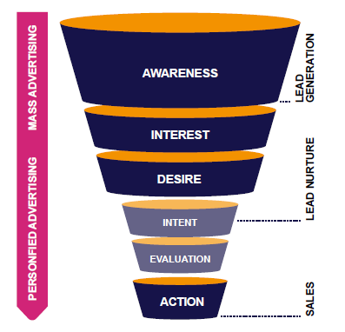
Sales Funnel and buyer stage
The potential buyer:
Becomes aware of own need, or becomes affected by a certain brand
Wants to know more, searches information of brand/product/service
Knowledge has risen; overweighs best solutions
Does comparison; evaluation; intends to be convinced
Has selected most appropriate solution; makes decision
Video 13 min
Notes:
Anyone of us has experience of buyer processes. Think about how it was when you planned the purchase of your car or setting a new garden … . For a marketer it is highly valuable to identify the character of buyer stages, and especially the thoughts, doubts and questions that potential buyers have. The video opens the course of the funnel.

Slide 16
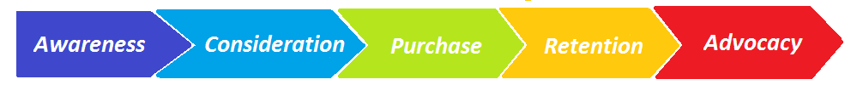
Different types of advertising
Different stages of buying process need different type of advertising.
Here the sales funnel is presented horizontally, often called the ‘customer journey’.
‘advertising for masses’ ->
targeted & personalized advertising
create awareness
reminders
increase demand
‘call to action’ messages
increase sales
reminders
persuade
brand promotion
support
content
brand promotion
Notes:
When the company or its product is new or unknown, investments are needed in creating awareness, often by mass media (TV, display ads, search engine ads). In the consideration stage, people often contact the company. After this they are identified and can be contacted personally.

Slide 17
The message is essential
“The real fact of the matter is that nobody reads ads.
People read what interests them, and sometimes it’s an ad.”
– Howard Luck Gossage
Notes:
In digital advertising, the goal is often to achieve a high click-through-rate (CTR), i.e. not just to have impressions to the ad but also to encourage to further steps such as enter a website.

Slide 18
“On the average, five times as many people read the headline as read the body copy. When you have written your headline, you have spent eighty cents out of your dollar.”
– David Ogilvy
Notes:
Is this true ..? What do we think affects people …? This topic can be discussed in class. In advertising, the ads that work well (=earn high click through rates), are good ads. How to write and design appealing ads...?

Slide 19
Good advertising
consistent in look and message
  aligned with company total strategy
  this creates resonance
targeted to right audiences and relevant for them.
  meet right persons at right time
trustworth and valuable
  present evidence on relevance
accessible on relevant customer touch points
  know where your customers move!
measurable for its impact
Best advertisements of all times: https://www.wyzowl.com/best-commercials/
https://blog.hubspot.com/marketing/best-advertisements
Notes:
Before going to ‘how to create good ads’, it is useful to inspect general conditions for ‘good advertising’. The videos offer additional background knowledge.

Slide 20
The process of creating ads
Start from the core message:
”What do you want to say”
(=Value proposition, USP)
Create the ad, adapted to the media
Publish it
Targeting:
Define target audience
->identify stage of buyer process
> detect channel to meet buyer
Notes:
The process can start either from message (‘We just started a new business’, ‘We have a new product’) or from the target audience (‘Our business has existed for nn years, and now we want to reach new audiences’). Whatsoever, you must know your message and your target audience (sometimes the audience is known first and then the core message is created) , in order to create appealing ads.

Slide 21

Value proposition and USP
Overflow of advertising -> customers want to quickly capture what makes one product/service different from another
-> important to position and define your company in order to stand out in competition (define your value proposition)
USP (unique selling proposition) refers to a marketing statement that differentiates a product or brand from its competitors
-> to be used in advertising and marketing
video examples on well-stated USPs
Notes:
To see more on this topic, please see module 1 Introduction to digital marketing.

Slide 22
In-class activity
In all marketing activities and advertising in particular, it is essential to state the value proposition and the unique selling proposition. They should express ‘Who we are and what we stand for?’
Watch the video on the previous slide as a trigger.
Let students first remind themself of compelling value propositions. Ask them to express some.
Next, let your students to choose a brand and then state a USP for it.
Notes:
Usually, we are more used to see Value propositions (in ads) than to invent ones by ourselves. Students might be a bit shy - you get better results if you let them work in pairs. In point 3, remember, the most important thing is that every pair invent something. You can pick the best for presentation, in order to raise good examples and encourage the students to good USPs. And remember - there are no right or wrong answers - the number one criteria is ‘does it sound good and convincing’

Slide 23
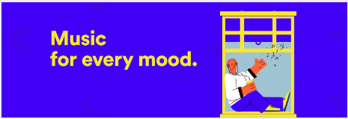

Elements of good marketing communication?
Respond to your customer´s needs, values and style
Describe your solutions and benefits (in order to differentiate from competitors when possible)
Try to say something original
Keep it clear and concise
More examples and further reading on ‘How to create a marketing message’
Notes:
The slide presents some features of good marketing communication over all. The link (on bottom) highlights the issue by presenting a variety of examples.

Slide 24
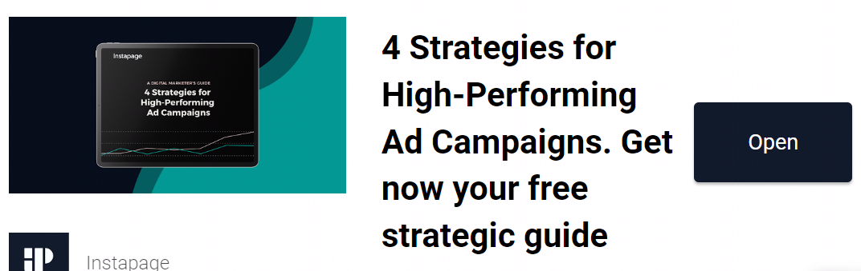
Notes:
What do good adverts include …? Picture, appealing text, call to action (‘open’).

Slide 25
Goal-oriented advertising
“Creative without strategy is called ‘art.’
Creative with strategy is called ‘advertising.”
– Jef I. Richards

Slide 26
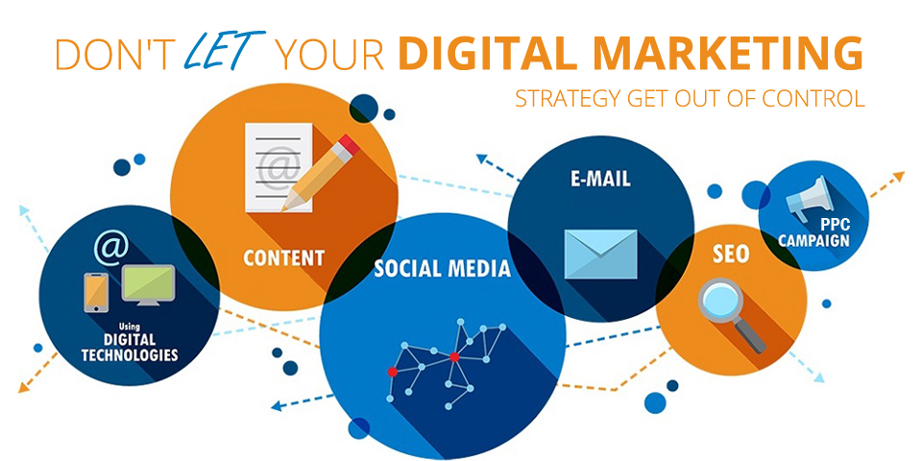
Advertising must fulfill strategy
Which are our overall goals?
What do we want to achieve with our (digital) marketing?
Who are our target groups?
What is our message and where do we transmit ?
Notes:
Digital marketing activities must be in line with the holistic strategy of the organization.The strategy is a future-oriented plan, that tries to anticipate circumstances that influence the conduct of an organization. Most organizations have a strategy, yet smaller ones may miss one. You will find detailed presentations of Strategy in module one, part 2.

Slide 27
Goals and objectives for advertising
Increase in revenue
Improve customer loyalty and satisfaction
Recruiting and retaining the best talent
Innovation and product development
Improving brand awareness and perception
Building a strong brand
Drive traffic to the website and/or blog
Getting new customers
Encouraging existing customers to write positive
reviews
Interacting with customers to get feedback from the market
Goal
can include more than one objective
Objective
must be measurable and framed in time
Notes:
Each advertising campaign should have goals and objectives determined.

Slide 28
Example of goals and their KPIs*
provide product information
increase awareness
drive traffic to website
create sales
build community
engage customers to return
reinforce expertise profile
strengthen company brand
number of customer contacts
awareness %
visitor rates on website
sales €
members in social media communities
rates of returning visitors, time spent on site
brand & loyalty polls, NPS
Notes:
*’Key Performance Indicator’ is a quantified form of a goal. The importance of integrating all marketing operations and setting objectives and goals was expressed in the first section of this presentation. Note: the goals are alternative, they derive from the strategy. For instance, if an organization is new and seeks to grow, the first ones may rule. If the company wants to sharpen its brand, the two last ones may be relevant.

Slide 29
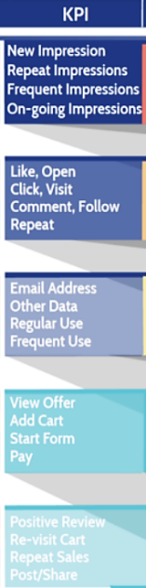
Goals and KPIs can be set by the sales funnel
Source:Skyword
Modiefied from TCSuccess

Slide 30
Customer oriented advertising
"We aren't in the coffee business, serving people. We are in the people business, serving coffee"
– Howard Schultz, Starbucks
Notes:
Recently, a few businesses have chosen ‘Customer orientation’ as their strategy. No wonder that they are successful (e.g. Starbucks, Amazon, Apple)

Slide 31
Customer oriented marketing and advertising
Customer orientation is a business approach that puts the needs of the customer over the needs of the business.
Customer-oriented companies understand that the business won't thrive unless it consistently improves customer focus.
Insight into the expectations and satisfaction of customers enables an organization to improve its processes and distinguish from competition
WHY - BECAUSE:
Satisfied customers are potential advocats who ‘spread the word’
It is far more expensive to reach new customers than main the current ones.
Further reading on topic::
What it is about
Definitions and examples
Notes:
‘Customer orientation’ is a mainstream that underlies all marketing theories in the recent years.

Slide 32
In-class activity
Many businesses aim to be ‘customer oriented’, yet quite few really succeed in it.
How do you assess whether a business is customer oriented? In which functions can it be seen?
Name some difference between ‘customer oriented’ - ‘not customer oriented’.
What do customer-oriented digital ads look like? Can you name some examples?
Notes:
You can apply this activity in the start of the topic ‘customer oriented marketing and advertising’. It gives a good orientation to the topic.

Slide 33
Steps how to grow your customer orientation
Make sure you get regular customer feedback
  ‘How was the interaction/customer service?’ 🙂
  Use surveys and metrics
Use the feedback to set goals and improve customer experience
Monitor social media feedback and react
  e.g. FAQs, common complaints, discussion
  Correctly identify the issue -> offer links to additional information -> thank the customer, apologize for inconvenience
Nurture compassion and win-win spirit in your customer interface
  attend with empathy and patience
  focus on customer experience
Get sales and customer service to collaborate
Read more on
the topic
Notes:
Note: More tools and instruments in the module ‘Analytics and monitoring’.

Slide 34
Practical instruments for improving customer experience
The main objective behind customer oriented philosophy is to improve the Customer experience.
In addition to the steps previously presented, any business should focus on ‘knowing our customer’
Next, two instruments for this purpose will be presented:
‘the buyer persona’
‘the customer journey’

Slide 35

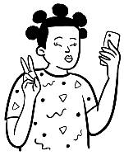
Buyer Personas
Do audience research
  Who is already buying from you? Interview some of them.
  Study your website and social analytics. For example
  Facebook Audience Insights.
  See what the competition is up to
Identify customer pain points
  Social listening
Identify customer goals
Understand how your brand can help
How can you reach him/her? What news and
social media channel s/he uses?
Turn your research into buyer personas
Templates:
https://docs.google.com/document/d/1LjXUD2T80m9abqmqQRgJva5Xds3OxLqtmEOXkTX_wpI/edit
https://www.impactplus.com/blog/great-buyer-persona-examples-free-template
Further reading: https://blog.hootsuite.com/buyer-persona/

Slide 36
Why?
How to apply?
Know your audience in detail allows you to create targeted, interesting and meaningful content
Customers expect personalized content
Buyer persona is a model – a fictional persona – who describes your typical customer
NOTE! Buyer persona is NOT ”a 30-50 year old man”.
Talk to your persona in his/her own tone of voice.
When producing content, always keep in mind, what is important for your customer (and not to your company)
When sharing content in social media, you can target more precisely, when you target to your persona (f. ex. according to his/her interests)
Notes:
The topics ´Buyer persona´ and ´How to apply them´ in advertising was presented in the sources named in the previous slide.

Slide 37
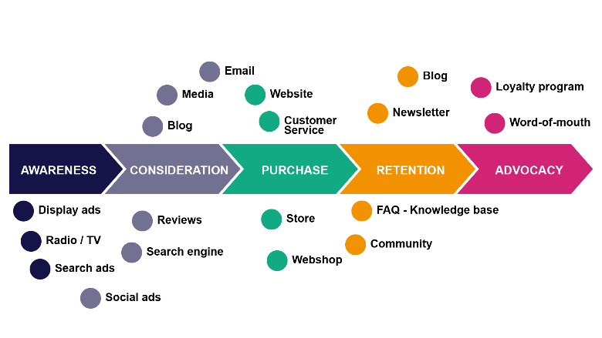
The Customer journey
The Customer journey is closely related to the previously presented Sales funnel
By using CJ, we can identify the stages of the buying process with the touch points where the customer gets in contact with the business
This helps essentially to plan the advertising messages and select the media to reach the target audience optimally
Source: Roberta Cinus
Notes:
The customer journey was presented previously. Here we can see that the model offers an excellent tool for understanding our customers.

Slide 38
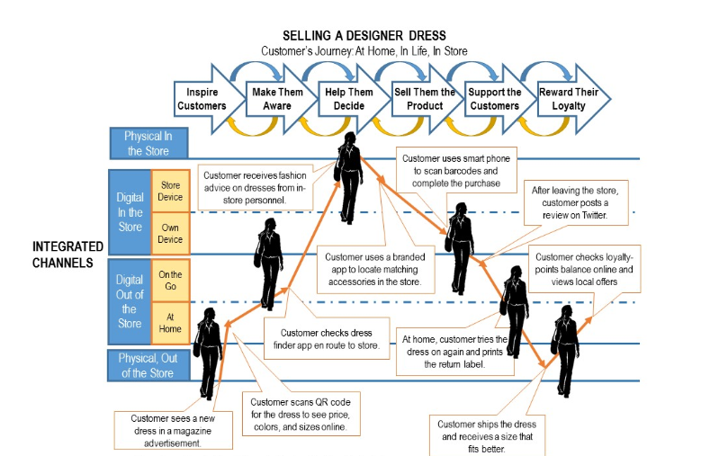
Example on ‘customer journey’
Source: Chaffey, 2020 (original:Boston Consulting Group)
Notes:
This illustration, related to ‘buying a designer dress’, depicts the channels and customer touch points and the type of signals that are involved in the process. In such way, it is possible to draft a ‘customer journey’ for any product or service.

Slide 39
In-class activity
‘Digital customer journey’
In the process of planning ‘what kinds of ads’ and ‘in which media/platforms to publish them’, it is highly useful to figure out the customer journey and the customer touch points for the respective business.
Think out a business and product or service
Figure out a certain buyer persona
How could the journey look like? Which steps are involved?
Name the digital touch points, ideal for the business to meet the customer
Notes:
This activity applies for individual or pair activity. You could also use it as a pre-assignment, in order to orient to the lecture.
Hints: in this activity the previous slides and internets sources are very useful and worth applying. Regarding point 1 (choice), please suggest your students to choose a consumer durable, as these typically involve a longer and multi-step process (for instance: a holiday trip, a car, an apartment, a hobby)

Slide 40
Trends and perspectives

Slide 41

The share of digital media is increasing in advertising
Due to competition, advertising expenditures of organizations keep rising, ever since 2017
The share of digital media is rising, although traditional media still used
The graph shows an average of all advertisers
Note: huge variations between different types of organizations
Source: Statista (2022)
Notes:
Which types of organizations use traditional media channels? For instance: local stores and service businesses.
Who distincts in digital media? For instance: eCommerce businesses.
Of course, most organizations use both traditional AND digital media (multichannel marketing)

Slide 42
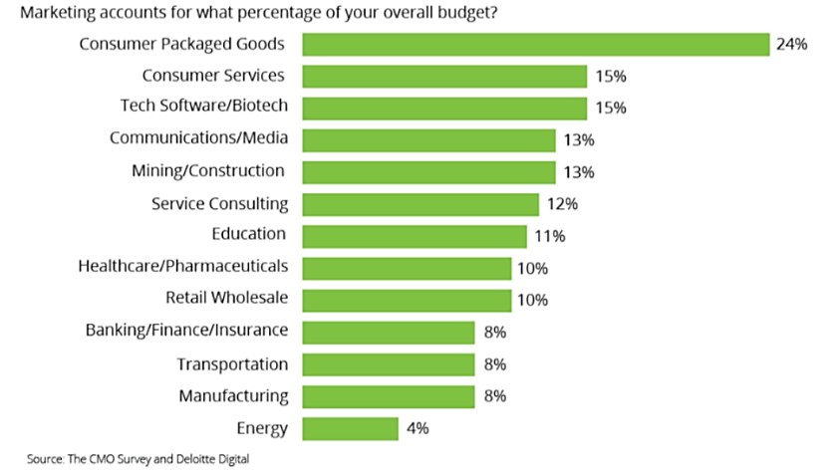
Some businesses promote more than others
The need for promotion is vital when there is much competition (such as alimentary stuff, consumer electronics etc.)
Larger companies tend to use higher share of their total budget in marketing
In general, B2C companies spend higher budgets than B2B companies
Source: Merehead, 2021
Notes:
This phenomena is evident also when following different media. Certain companies seem to invest a lot in advertising (e.g. national alimentary companies, big travel agencies, car retailers, retailers of special goods), whereas others ivest less, focusing on certain target-audience related media and channels. B2B businesses are examples of this.

Slide 43
Trends and future perspectives
Trend:
As digital marketing skills become ‘everyone´s skills’, the competitive edge decreases and all competitors are doing the same thing.
Questions arising:
How to stand out among competition? Will new ad platforms offer improved targeting options?
Trend:
Search engine use is transforming from word search to video based search and location based search. At the same time, increasingly AI is used to structure databases.
Questions arising:
Which customer touch points will grow/reduce in importance? Which website content will rule?
Trend:
Regulation increasing -> Cookieless future ..?
-> How can advertisers reach target audiences without this data?
Questions arising:
Alternative methods to define identities of potential ad receivers?
Further readings:
https://www.theperspective.com/debates/businessandtechnology/the-perspective-on-digital-marketing/
Notes:
Digital advertising is under continuous change deriving from technical inventions, progress of media and channels, legislation etc. Thus the slide presents only a few takes and examples. More can be found in the further reading link, also using the search words ‘progress/changes in digital advertising’

Slide 44
Main formats of digital advertising

Slide 45
SEARCH ENGINE ADVERTISING (SEA)
SOCIAL MEDIA ADVERTISING
  Facebook, Instagram (Meta)
  Youtube, LinkedIn, blogs, TikTok etc.
DISPLAY AND PPC ADVERTISING
WEBSITE
In different media and channels a wide range of target groups can be reached.
Different forms of advertising allow to achieve various goals.
In digital advertising, the primary objective is often to lead visitors to the business website.
Notes:
Finally in this submodule, an overview on the main digital advertising platforms is given. You will get more detailed view and hands-on instructions in the next submodules.

Slide 46
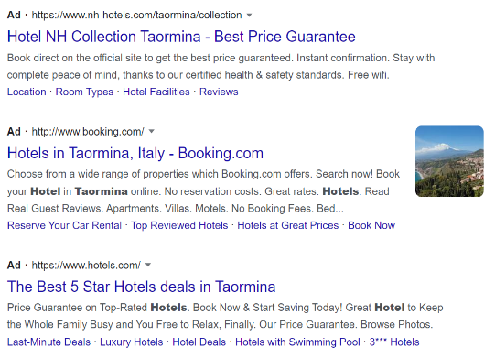
Search engine advertising
Allows your business to position on top of a search result page as ‘Ad’ in search engine results.
Connects your ad to search results that relate to key words you have chosen.
Benefit: a newcomer website or product can obtain position on first result page (theTop10 results).
Available with a low budget.
Easily manageable.
search engine ads
Notes:
The role of search engine ads are vital as they enable you to meet the customer at the point of buying intention.

Slide 47

Display and PPC advertising
They cover various advertising forms, allowing your business to obtain visibility in a wide range of digital media
Display (banner) ads, Video ads, App ads, Shopping ads, etc.
Can reach specified audiences by targeting
A potential means to increase brand awareness, by getting in front of potential customers that don't yet know your brand.
Available with low budget.
Easily manageable.
Notes:
Display and PPC (Pay per Click) ads cover a variety of ads in different media and channels. They can be located on websites, publications, media, videos and applications, enabling your business to reach specific target audiences. Most of them can be managed via Google. They are presented in the next submodule.

Slide 48

Social media advertising
Can be conducted on all social media platforms*.
Allows you to get in contact with previously unknown audiences
Permits to reach carefully selected target audiences, based on their personal profiles, behaviors, and interests
Available with low budgets.
Easily manageable.
*in this module we focus on Meta platforms (Facebook, Instagram); yet, the advertising practice is very similar in all social media platforms
Notes:
Social media covers a changing variety of platforms. Common for them is that different groups and types of people publish, comment and follow stories, pictures, videos and other content for public visibility. ‘Social media’ offer versatile media and channels for a wide range of interests, including hobbies, personal topics and work&business issues. This means that groups and individuals with specific interests can be found there.

Slide 49


In this submodule the bases for advertising and digital advertising platforms were introduced.
In the next two modules you get acquainted in preparations that most campaigns need, as well as how to create ads on Google and Meta platforms and newsletters.
1.Bases for
advertising
2. Preparing for
campaigns
3. Execution of
campaigns

Slide 50
The DEMS material aims to enhance digital marketing skills in higher education, responding to the needs in business and organizations. You have access to extensive slide sets with in-class activities and assignments, as well as detailed user instructions for teacher. You are free to use part or whole of the material available.
The material includes contents and figures retrieved from the internet and is thus subject to changes. The sources have been announced according to the rules of fair use. The material as a whole can be viewed and downloaded from www.dems.pro. All material is produced for open use and co-funded by Erasmus +.

