Slide 1

Content Marketing:
Email Marketing

Slide 2

Learning Objectives
Pre-requisite for student: Introduction to digital marketing is recommended.
The student is able to
• describe what email marketing is
• understand the benefits of email marketing
• assess the effectiveness of the email marketing campaigns
• design a newsletter example and email campaign plan

Slide 3

•
•
•
•
•
•
What is email marketing?
•
Customer segmentation in email
marketing
Email marketing objectives
Benefits of email marketing
• Newsletter structure
Topics
How to get started with email marketing?
How to build an email marketing list?
GDPR in email marketing
• Tips for designing an email
campaign
• Email marketing KPI’s
• Email marketing platform example:
Mailchimp
• How to get started with Mailchimp?
• Assignments

Slide 4

What is email marketing?
What and why?
•A marketing form where you can send focused messages to registered
customers in mass quantities
•It has low expenses and the mails reach the recipients without any
‘algorithm filter’
•Email marketing campaigns can be used for promoting special offers,
new product releases, publications or your brand at large
•A way of reinforcing brand and customer loyalty
How?
•The presentation text and pics of the emails should be personal and attractive
•When useful and appealing, the recipients become engaged and continue opening your emails

Slide 5
Email marketing objectives
What does email marketing aim to achieve?
● New customer acquisition?
● Waking up old customers?
● Brand visibility?
● Campaign communication?
● DIrect sales growth?
Clearly measurable objectives should also be SMART (=specific, measurable, achievable,
relevant, and time-bound), e.g. “In one year the email marketing list will have increased by
20 %.

Slide 6
Benefits of email marketing
• One of the oldest forms of digital communication — but also one of the most effective digital marketing
strategies out there: email marketing has an ROI of 40 € for every euro spent (Data & Marketing
Association’s research, 2019)
• Email is an effective content marketing channel → traffic to website/e-com
• Easy to test and develop
• Way to interact with customers and create (personalized) value for customers at the right moment
(segmentation & purchase path)
• Channel that customers use everyday
• Reach customers in real-time (smartphones)
• Easy to measure & optimize
• Increases brand awareness
• Scalable: use the same contents elsewhere e.g. in social media, vice versa

Slide 7

How to get started with email marketing?
1. Choose an email marketing platform (e.g. MailChimp)
2. Establish your goals and target group(s)
3. Build your marketing list
4. Build your basic email template/use ready made templates
5. Design and send your first email
6. Test (e.g. A/B testing), measure results & develop further

Slide 8
How to build an email marketing list?
● Website forms: Add opt-in forms to your website, allowing visitors to
subscribe to your email list.
● Social media: Use social media to promote your email list and
encourage followers to sign up, or use social media lead ads to generate
new subscribers (=leads)
● Events: Collect email addresses from attendees of your own event, and
ask if they would like to receive your newsletter or promotional emails.
● Lead magnets: Offer a valuable lead magnet, such as an e-book,
whitepaper, or webinar, in exchange for a visitor's email address.
● In-store signups: If you have a brick-and-mortar store, encourage
customers to sign up for your email list in-store. You can offer incentives,
such as a discount on their next purchase, to encourage sign-ups.

Slide 9
GDPR in email marketing
● The GDPR (General Data Protection Regulation) became applicable in EU member
states in May 2018
● It applies to all organisations in the EU that collect, store and process personal data,
where they are large listed companies, foundations, associations or public sector
organisations.
● GDPR has a significant impact on email marketing, as it requires businesses to obtain
explicit consent from individuals before sending them marketing emails or newsletters
● Under GDPR individuals have the right to know what personal data is being collected
about them and how it will be used.
● They also have the right to opt-out of the email marketing at any time.
● Businesses must provide clear and concise information about the data they collect and
the purpose for it is used, and they must obtain consent from individuals before adding
them to an email marketing list

Slide 10
Customer segmentation in email
marketing
Customer segmentation in email marketing refers to the practice of dividing a
business’s email subscribers into smaller groups or segments based on specific
characteristics or behaviours.
● Helps to send more targeted and relevant email campaigns that are tailored to the
needs and interests of each segment.
● Can be done e.g. based on demographic info (age, gender, degree etc.),
psychographic info (interests, values etc.) or behavioral info (purchase history,
website activity, email engagement etc.)
By sending more relevant and targeted emails, businesses can improve their open
rates, click-through rates, conversions, as well as customer satisfaction and loyalty.

Slide 11
Newsletter structure
Newsletter structure can be divided to envelope content and
body content.
● Envelope content refers to the information that appears in the
recipient's email inbox before they even open the email.
● The body content refers to the actual content of the email that the
recipient sees when they open the email.

Slide 12
Newsletter structure: Envelope
content
● Sender Name: The name that appears as the sender of the email. It's
important to use a recognizable name that the recipient will associate
with your brand or business.
● Sender Email Address: The email address that appears as the sender
of the email. It's important to use a professional-looking email address
that the recipient can easily identify as coming from your brand.
● Subject Line: The line that appears in the recipient's inbox and gives
them a preview of what the email is about. It's important to make the
subject line clear and attention-grabbing, while also accurately reflecting
the content of the email.

Slide 13
Newsletter structure: Elements of the
body content
Most common elements of the body content:
1. Header: Typically includes the name of the newsletter, the date of issue, and a logo or
image.
2. Introduction: A brief section that welcomes the reader and sets the tone for the rest of the
newsletter. It may include a summary of the content to follow or a teaser for a featured
article.
3. Featured article: The main content of the newsletter and may include an in-depth article,
an interview, or a product showcase. It's often accompanied by images or graphics to make
it visually appealing.
4. Secondary articles: Additional articles or content that support the main theme of the
newsletter. They may be shorter in length and cover a variety of topics.
5. Call-to-action: A section that encourages the reader to take action, such as visiting the
company's website, signing up for a service, or following the company on social media.
6. Footer: Typically includes contact information, such as the company's address, phone
number, and email address. It may also include unsubscribe instructions and social media
links.

Slide 14
Email marketing KPI’s
Some of the most important KPIs to track:
1. Open rate: measures the percentage of subscribers who open your email. It’s a good indicator of the
effectiveness of your subject line and sender name.
2. Click-through rate (CTR): measures the percentage of subscribers who clicked on a link within your
email. It indicates the level of interest in your content and the effectiveness of your call-to-action.
3. Conversion rate: measures the percentage of subscribers who completed the desired action, such as
making a purchase, after clicking through from your email.
4. Bounce rate: measures the percentage of emails that were not delivered to the recipient’s inbox. A
high bounce rate could indicate issues with your email list or content.
5. List growth rate: measures the rate at which your email list is growing. A healthy list growth rate
indicates that you’re attracting new subscribers and retaining existing ones.
6. Unsubscribe rate: measures the percentage of subscribers who opt-out of your email list. A high
unsubscribe rate could indicate that your content is not relevant or engaging enough for your audience.
7. Revenue generated: measures the amount of revenue generated from your email marketing
campaigns. It’s the ultimate indicator of the success of your campaigns.

Slide 15
Tips for designing an email campaign
1. Set Campaign Goals: Determine the objectives of your email campaign, such as
increasing sales, promoting a new product, or building brand awareness.
2. Define Target Audience: Identify your target audience and segment them based
on demographics, behavior, or other relevant factors.
3. Design the Email Template: Choose a pre-designed template or create a custom
template that aligns with your brand's visual identity and messaging.
4. Write the Email Copy: Craft compelling copy that resonates with your audience
and motivates them to take action.
5. Add Visual Content: Include images, videos, and graphics that support your
message and engage your audience.
6. Send the Campaign: Send your email campaign to your segmented list and track
the performance metrics, such as open rate, click-through rate, and conversion
rate.
7. Analyze Results and Refine Strategy: Review your campaign's performance and
refine your strategy for future campaigns based on the data collected.

Slide 16
Tips for designing an email campaign
● Design your email based on your objectives.
● Decide the content theme (educational, engaging, promotional
etc.) you are using.
● What is the segment you are targeting?
● How can you tailor the message to the target audience?
● When will the message be sent, and why is this a good time to
send it? (E.g. “on Tuesday at 1PM”)
● Remember to preview and test the email before sending it.

Slide 17
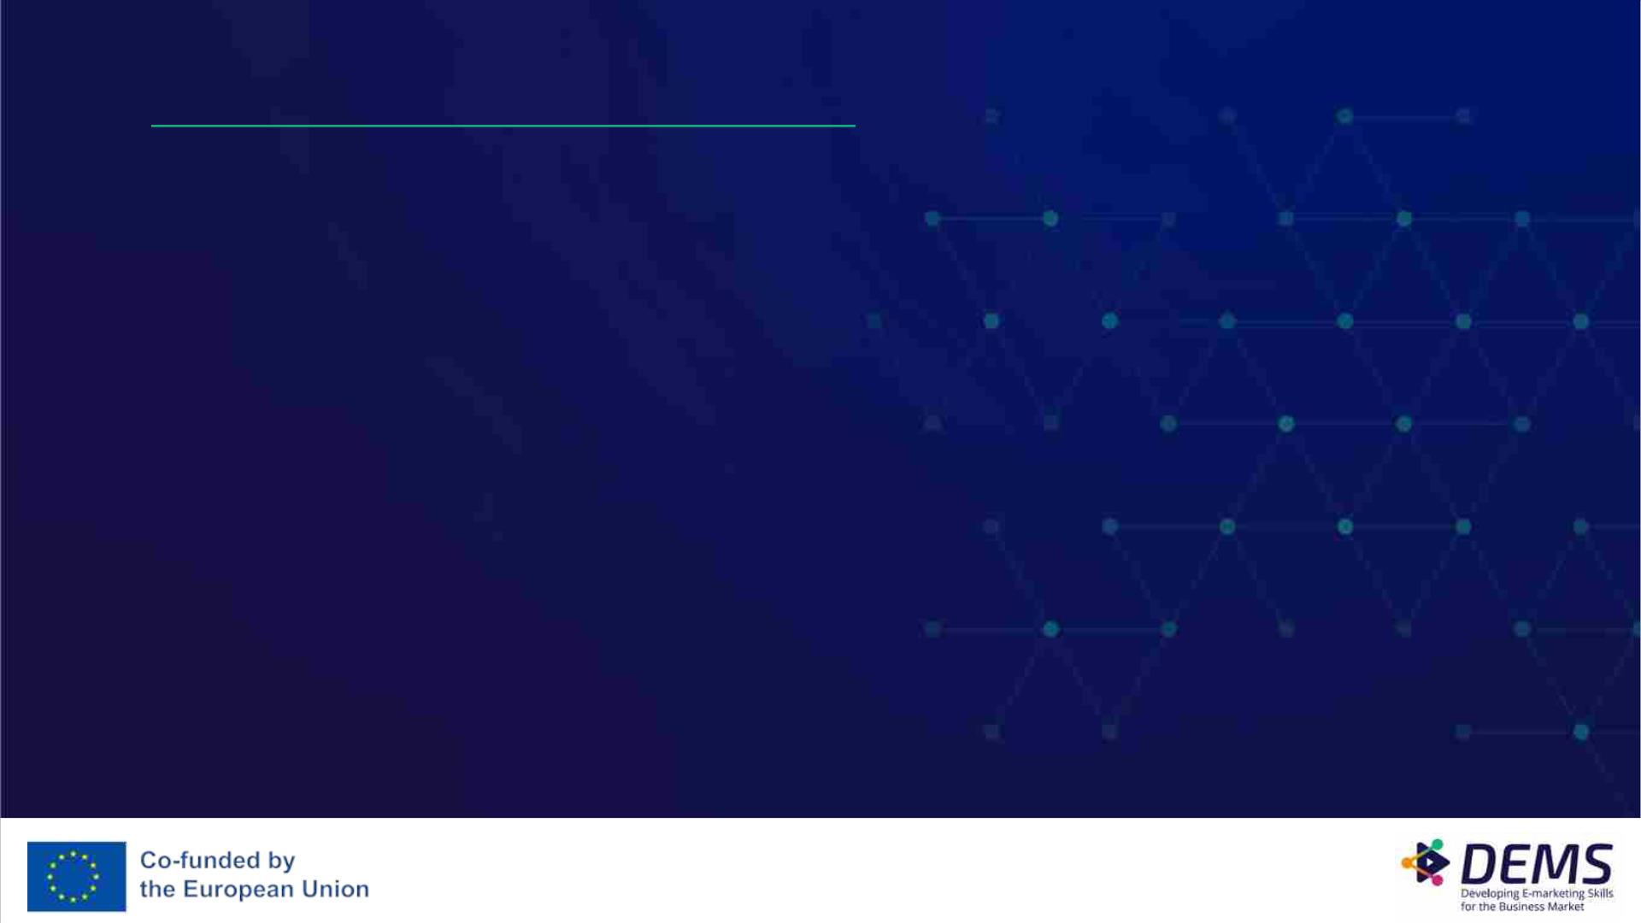
In-class activity: Design a newsletter
Can be done individually or as a pair/group work.
Design a newsletter for an imaginary company or a company you select.
Include a draft about the layout (you can use some suitable stock pictures if you
wish) of the newsletter and the envelope and body content.
Design the newsletter to a text document or to some other suitable
template. You can use for example MailChimp’s free version as
well. Send the newsletter to a peer student/peer student group and
discuss about output in pairs/groups.

Slide 18
In-class activity: Email marketing KPIs
Can be done individually or as a pair/group work.
Key Performance Indicators (KPIs) are metrics that help measure the success of
email marketing campaigns.
Go online to find five or more important email marketing KPIs, which you
think should be tracked.
List your findings and explain what they mean and why they are
important. Discuss and compare your findings in small groups.

Slide 19
Email marketing platform example:
Mailchimp
• An all-in-one marketing platform for small businesses
• Its heavy users are e-commerce store owners, digital businesses, freelancers, and marketing
agencies
• Mailchimp’s goal is to “help small businesses market smarter so they can grow faster”
• User-friendly → designed to put the audience at the center so users can send marketing emails and
automated messages, create targeted ad campaigns, build landing pages, facilitate reporting and
analytics etc.
• Founded in 2001, based in Atlanta, GA, has 1000+ employees and is privately held
• Plans from Free to Premium
• Features e.g. A/B testing, pre-built email templates, basic/enhanced automated customer journeys,
landing pages, list management etc. (depending from the plan)

Slide 20
How to get started with Mailchimp?
1. Start by creating an account and choose the most suitable
plan for your business
2. Add or collect contacts to create an audience
3. Create a signup form to your website/e-commerce
4. Determine your target audience
5. Write and design your first email
6. Send the campaign
7. Monitor your performance

Slide 21

Assignments

Slide 22

Individual / Group assignment
ꢀ Can be done individually or as a pair/group work.
Make a plan for an email marketing campaign for a specific company or product.
The plan should include at least the following points:
• Objectives: what do you want to achieve with the campaign?
• Target group: who is the target group for the campaign, and what are their characteristics?
• Plan: how often will emails be sent? What content will they contain?
• Metrics: how will the success of the campaign be measured? What KPIs are used?
• Message: what kind of message/messages are you sending to the target audience? How can the message/messages
be tailored to them?
Provide a .ppt presentation about your insights. Remember to mention your sources. Present the plan to the class.
Assessment:
Fail:
The work is missing most of the required elements. The use of sources is limited. The work does not show understanding of the use of email marketing.
Pass:
The group has studied email marketing but only superficially, and the use of sources is limited. They have some understanding about the possibilities of
using email marketing in marketing.
Outstanding:
The group has studied email marketing thoroughly from different angles. Their work demonstrated profound understanding of the possibilities of using
email marketing.

Slide 23

Important Notice
The DEMS material aims to enhance digital marketing skills in higher education,
comprehending the essential needs in organizations. You have access to
extensive slide sets with in-class activities and assignments, as well as detailed
user instructions for teacher.
Note: The material includes contents and figures retrieved from the internet and
is thus subject to changes. The sources have been announced according to the
rules of fair use. The publisher´s responsibility is restricted to the original
material stored at www.dems.pro. All material is produced for open use and co-
funded by Erasmus +.

