Slide 1

Content Marketing
Definition & Strategy

Slide 2

Learning objectives
Pre-requisite for student: Introduction to Digital Marketing is recommended.
The student is able to / understands
• what content marketing is
• the ‘WHY’ of content marketing.
• the benefits of content marketing
• the connection of content marketing strategy to company’s business
strategy
• the essentials of effective content marketing strategy
• set up an effective content marketing strategy

Slide 3

1. Content Marketing Definition
2. Content Marketing types and channels
3. Benefits of Content Marketing
4. Content Marketing Strategy
○ relation to Business and Marketing
Strategy
Contents
○ objectives and metrics
○ target group, ie. Buyer Personas
○ Customer Journey
5. Assignments

Slide 4

In-Class Activity: recap and discussion on
pre-course assignment
•What is content marketing? Rely on sources.
•Students need to think an example of their own prior to the
course; come up with an example for content marketing which
you found interesting/successful and argue for your choice
Discussion in pairs / groups of 3-4 for 10 minutes
1. Is content marketing inbound or outbound marketing
2. In which channels can one do content marketing
3. Share your findings about the brands / companies (re: pre-
course assignment)

Slide 5

1.Content Marketing Definition
What Is Content Marketing?
What Is Not Content Marketing?
“Content marketing is a strategic
marketing approach focused on creating
and distributing valuable, relevant, and
consistent content to attract and retain a
clearly defined audience — and, ultimately,
to drive profitable customer action.”
https://contentmarketinginstitute.com/what-is-content-
marketing/
• Advertising
• Pushing through own message
• Non-measurable
• Easy
• Relevant only to big brands
• Free
• Appreciated by target group
• Useful - target group typically searches
for content
• Continuous
• Planned and measurable
• It raises awareness, not sales
• Results come quickly

Slide 6
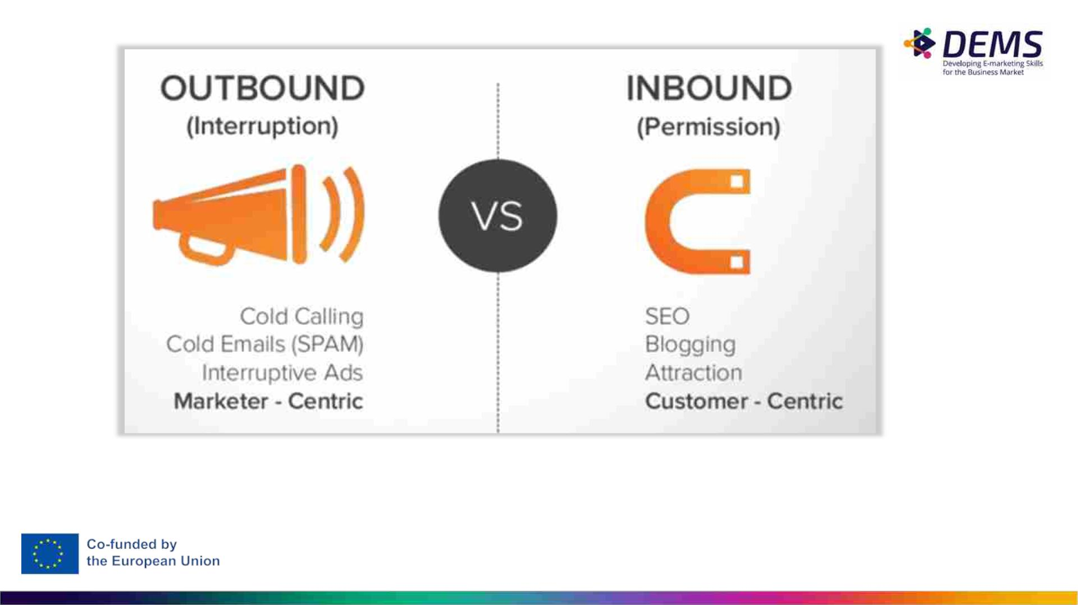
Read further: https://blog.hubspot.com/blog/tabid/6307/bid/2989/inbound-marketing
-vs-outbound-marketing.aspx

Slide 7

What content does
Content increases brand visibility
Instead of reading a sales pitch, customers or potential customers may be reading an article that provides advice or guidance,
promoting the brand in different areas outside its corporate website or traditional locations.
Content helps create backlinks for search engine optimisation (SEO)
Good articles are often recycled by other people online. Have you ever quoted an article or added a link back to a page about a
certain subject? By adding someone else’s article to your web page, you are creating a backlink that Google sees and it
acknowledges that the original content must have value to be added to another website.
Content encourages conversion rate optimisation (CRO)
Clever content such as buying guides can convert browsers into buyers. If you are visiting online retailers such as Sears in the
United States or John Lewis in the UK, you will notice with more expensive goods, such as those in their large appliance category,
they offer ‘buying guides’. This free online advice offers useful information before a purchase takes place. A well-written guide can
convert browsers into buyers and offer greater reassurance about the company’s expertise.
Content inspires social shares
Have you ever shared an article on Twitter? Retweeted, liked or commented on content created by someone else? Content can
inspire social shares, especially where the contentis vivid and interactive Digital tools make it easy to share content across social
channels.

Slide 8

2. Content Marketing Types And
Channels
• Blogs
• Reports, articles, guides
• Whitepapers
• Videos
• Social media posts
• Print media (eg. customer magazines)
• Webinars, e-books
• Podcasts
• Infographs
• Newsletters
• Influencer marketing
• Native advertising
• Events
“A father” of content marketing.
The Furrow magazine by John Deere, est. in 1895.
Still going strong - now online, too, of course.

Slide 9

A tip: Content Curation
You don’t need to create content from the scratch.
Curated content or the process of content curation has been described by researchers Aristea
Fotopoulou and Nick Couldry from Goldsmiths College, University of London, as ‘finding,
categorizing and organizing relevant online content on specific issues’
Content curation can be a useful way of creating content on specific themes such as product
reviews, where you are telling the story about the story. As an example, you may curate content by
gathering up a series of articles written about Snapchat Specs, assessing the different perspectives
and range of advice provided and turning this into a post for your blog.
Fotopoulou, A. and Couldry, N. (2015) ‘Telling the story of the stories: Online content curation and digital engagement’,
Information Communication and Society, 18 (2), pp. 235–49.

Slide 10

3. Benefits of Content Marketing
Image source: https://thepointsguy.com/news/i-spent-24-hours-
in-times-square-and-i-had-an-awesome-time/

Slide 11
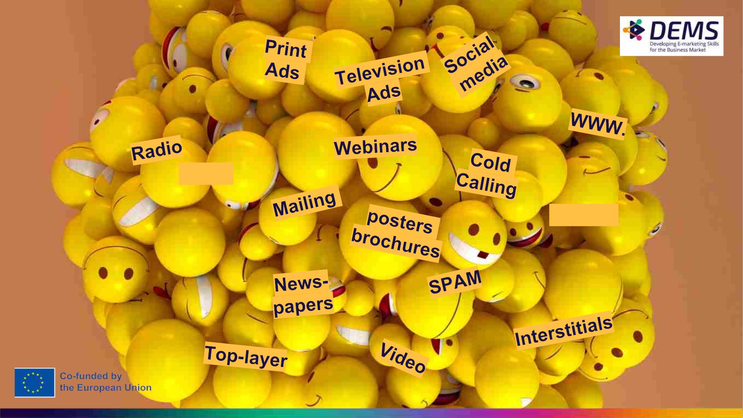
Trade
shows
Banner
advertising

Slide 12
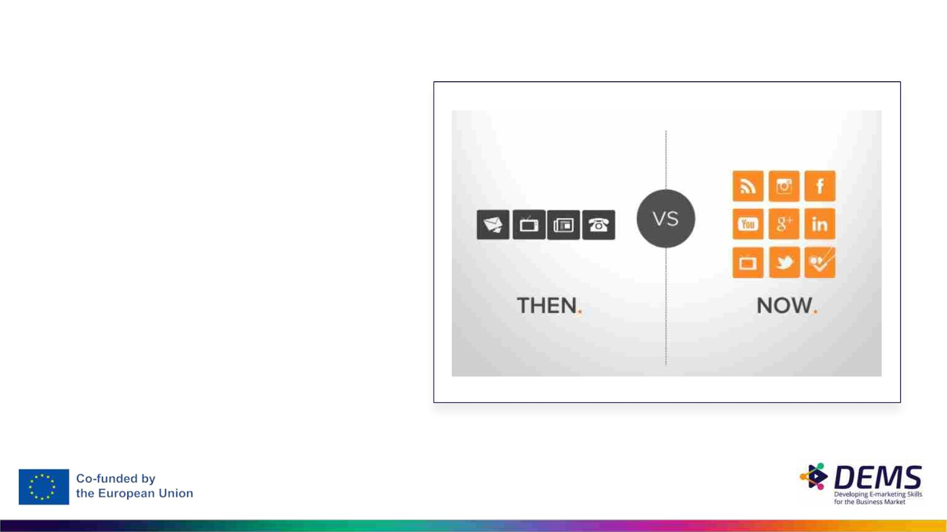
Changes in
Consumer
Attention
The customer is in control.

Slide 13
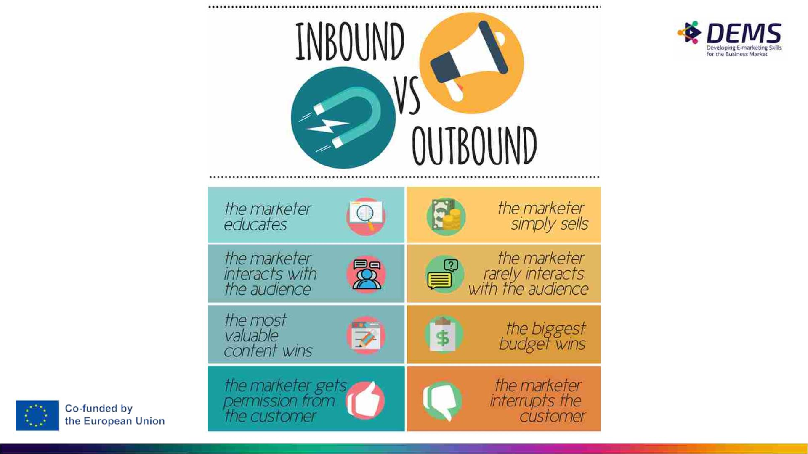

Slide 14
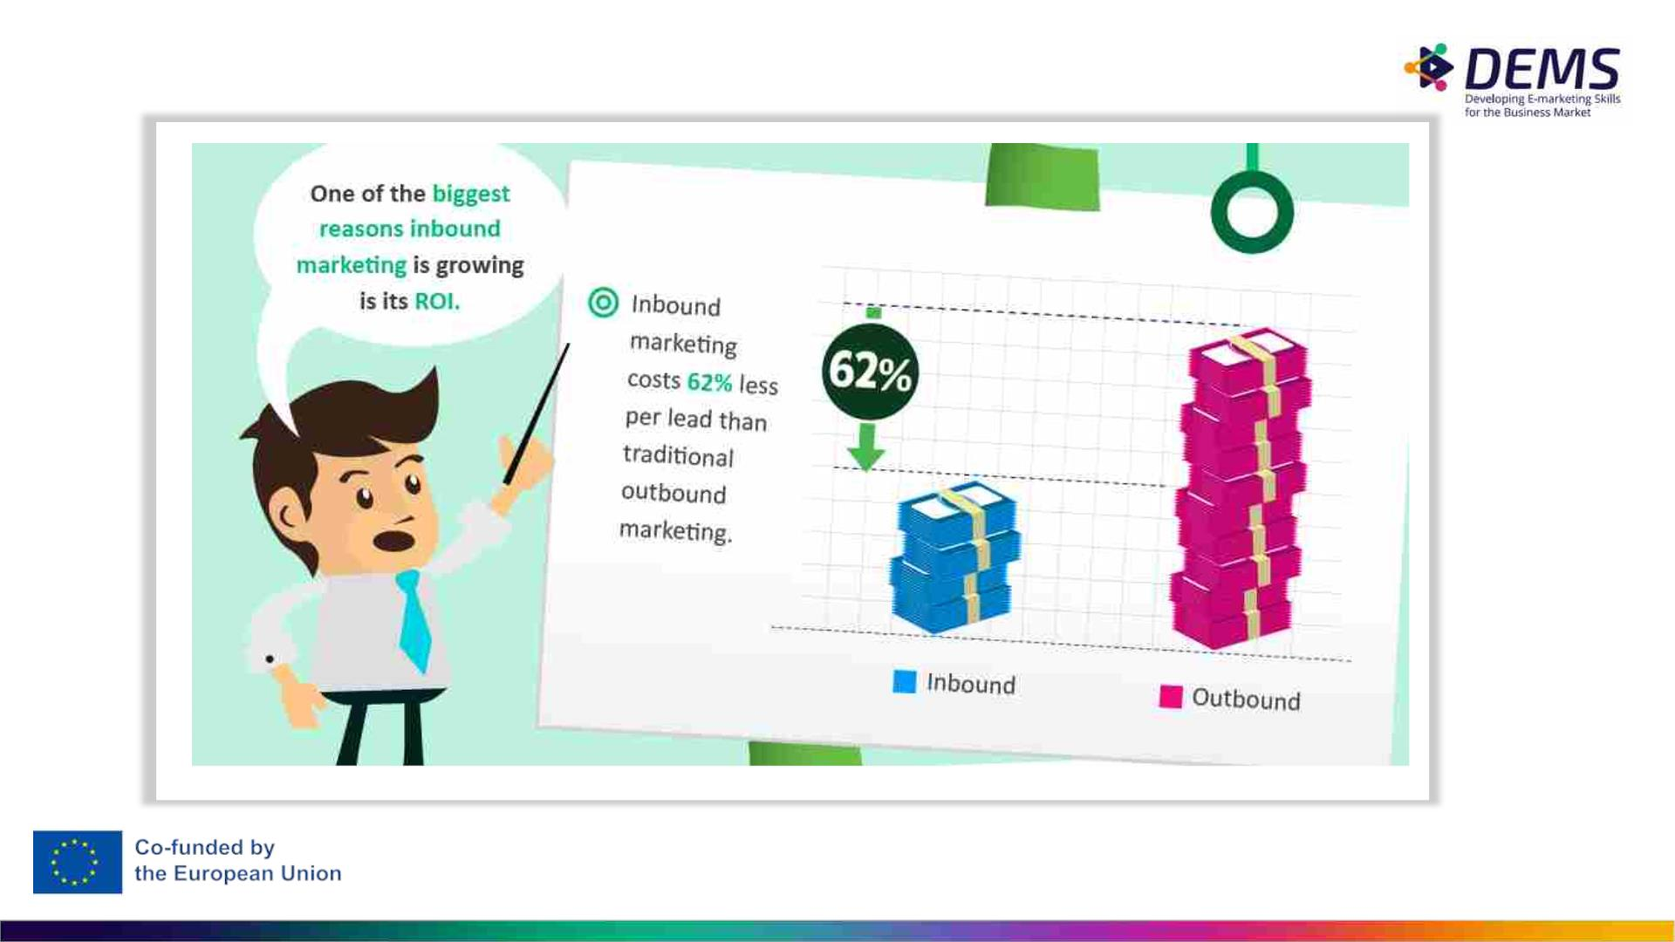

Slide 15
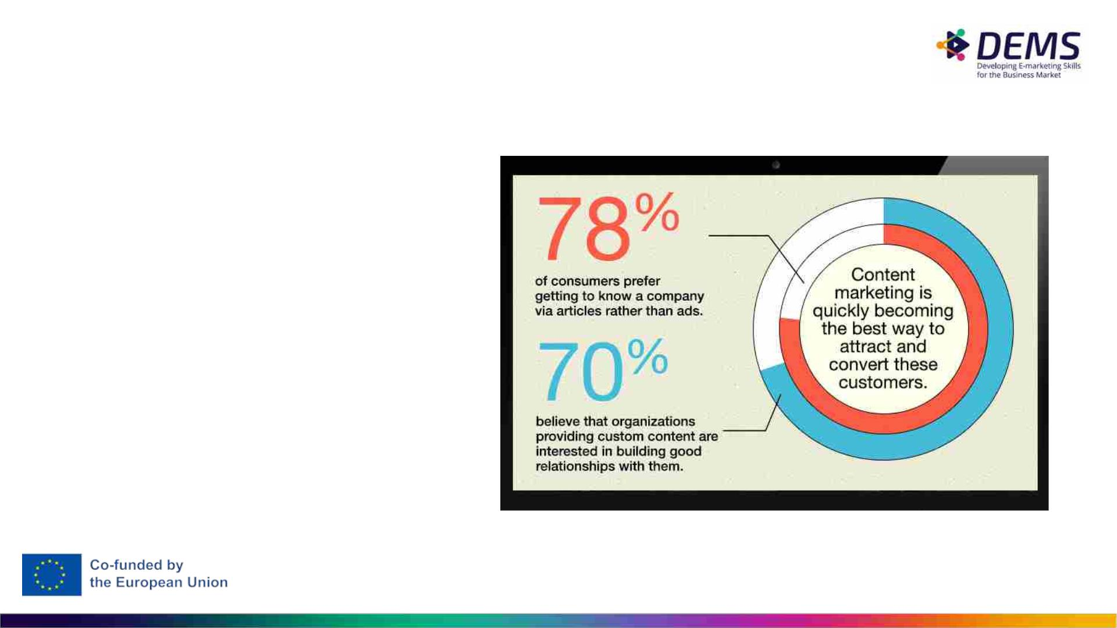
Content Marketing – WHY?
• According to Demand Metric,
content marketing costs 62% less
than traditional marketing and
generates 3 times as many
leads.
• It’s no surprise that 90% of
organizations use content
marketing as part of their marketing
efforts and that it continues to grow
in popularity.
Source: Lyfemarketing
Futher reading: https://www.thehoth.com/blog/boring-niche-content/

Slide 16
Benefits of content marketing
● Increase website traffic.
● Establish authority and trust.
● Create brand awareness.
● Develop brand personality.
● Connect with your audience.
● Fuel social media and PR.
● Support the conversion funnel.
● Improve conversion rates.

Slide 17
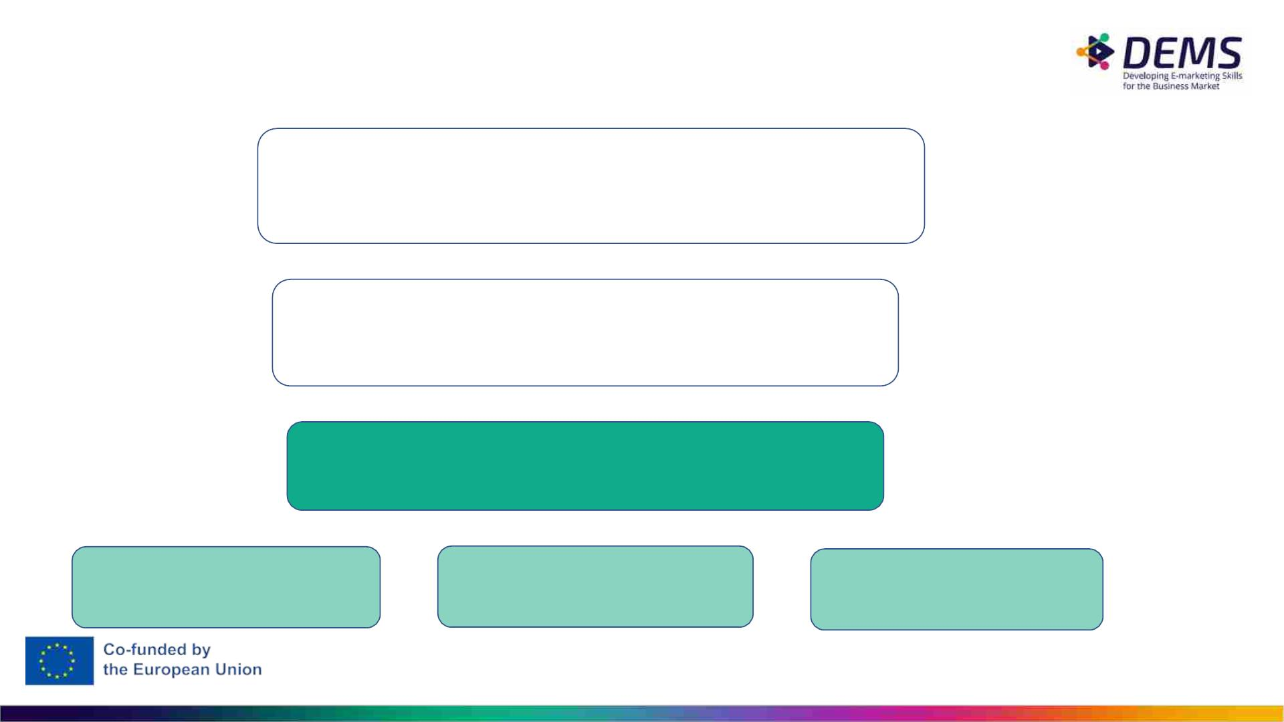
4. Content Marketing Strategy
Business Strategy
Marketing Strategy
Content Marketing Strategy
Social Media Strategy
Video Strategy
etc.

Slide 18
Quiz! (this is in-class activation)
True or false?
• content marketing = advertising
• content marketing can be applied in small companies, too
• content marketing brings results quickly
• content marketing doesn’t cost anything

Slide 19

Content Marketing Strategy
– what is it?
• Set goals, a) objectives and b) relevant metrics and c) KPI’s
• Ie. a) Increase awareness, sales, customer service, employer brand. Remember
SMART
• Ie. b) # of returning visitors, best converting content, # of returning customers
• Target = know your (potential) customers
• Buyer personas
• Their buying behavior - customer journey
• Create a Content Mission
• How – by creating content - to help your buyer personas to reach their goals.
And to become your customers.
• Resource realistically
• People, budget

Slide 20
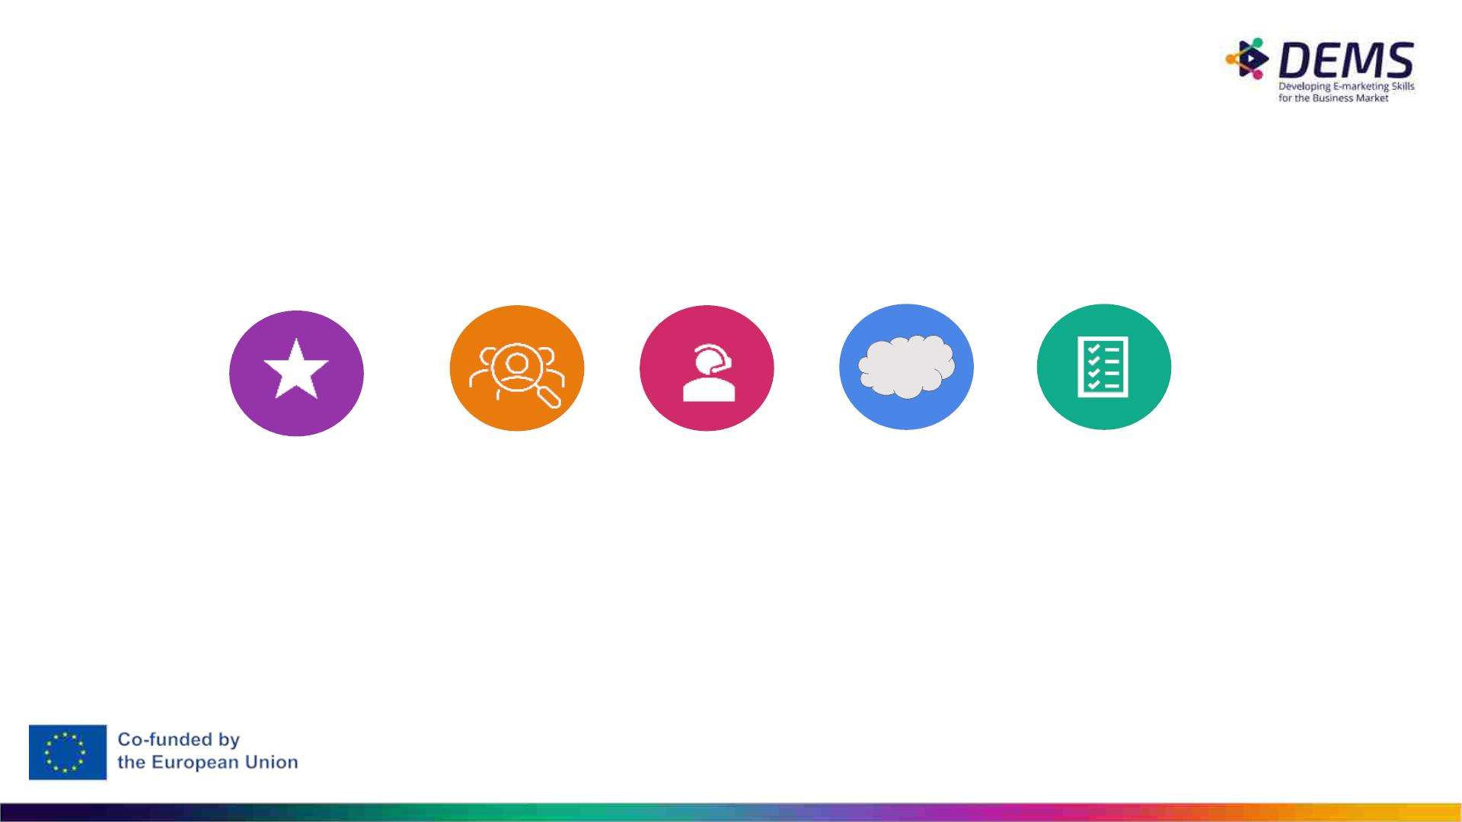
Content Marketing Strategy:
Closer Look at the Following Strategy Parts
GOALS,
OBJECTIVES &
METRICS
WHY AND HOW CUSTOMER
CONTENT
MISSION
ASSIGNMENTS
TO BUILD A
JOURNEY
BUYER PERSONA

Slide 21

GOALS,
OBJECTIVES &
METRICS

Slide 22
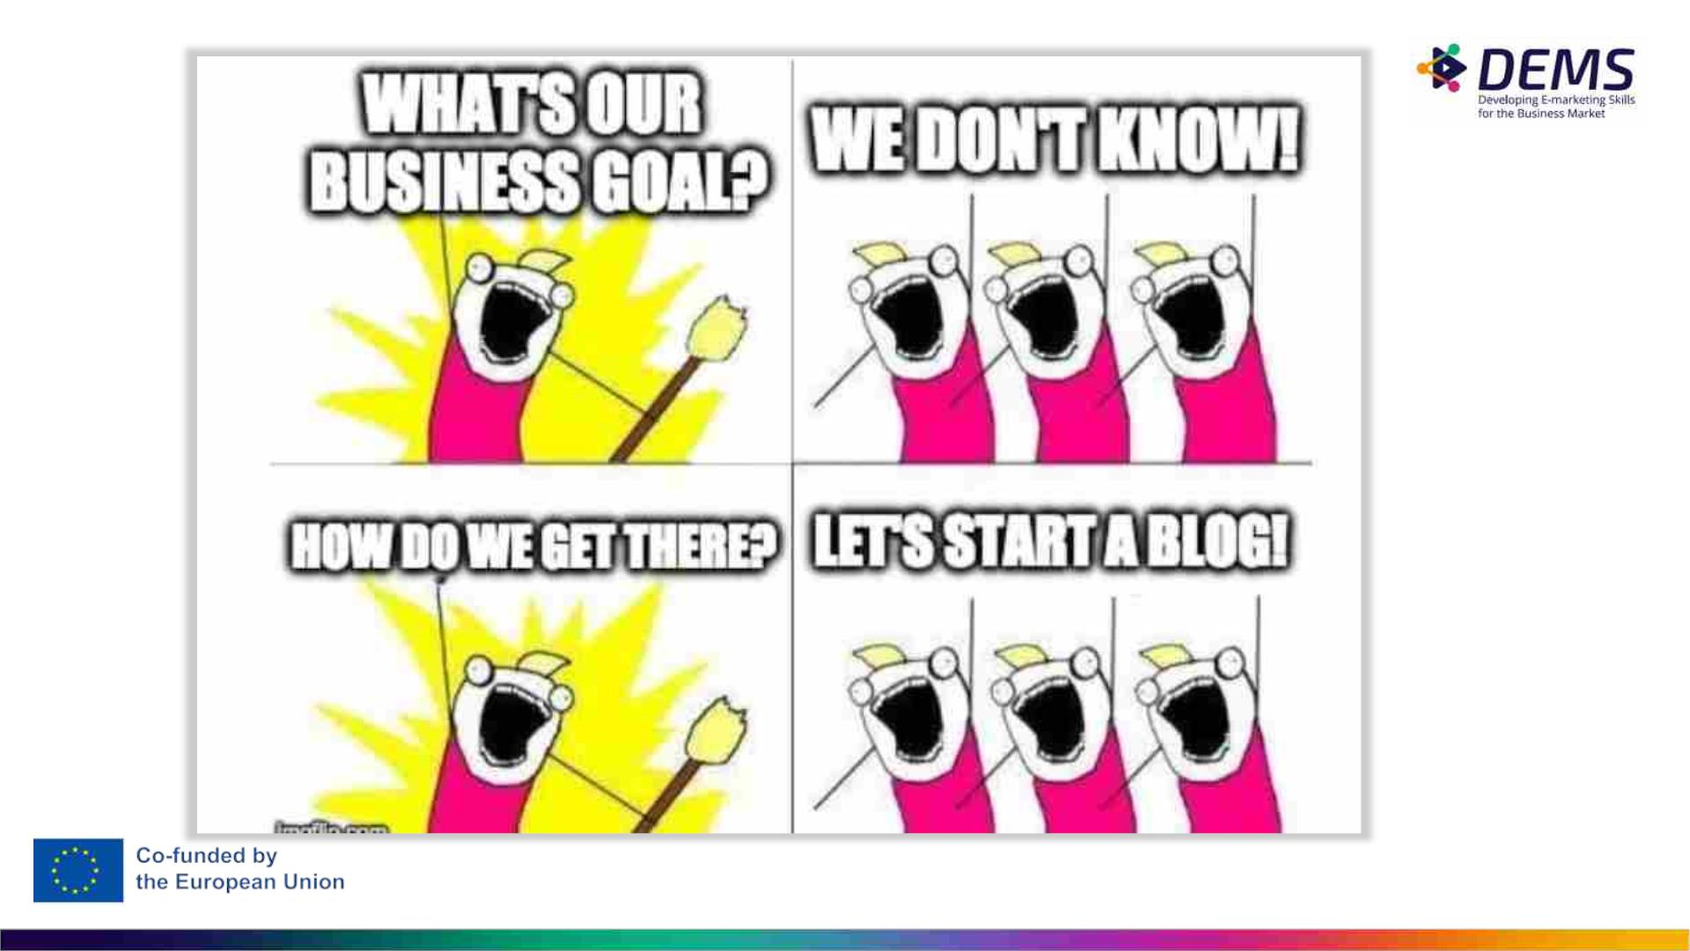

Slide 23
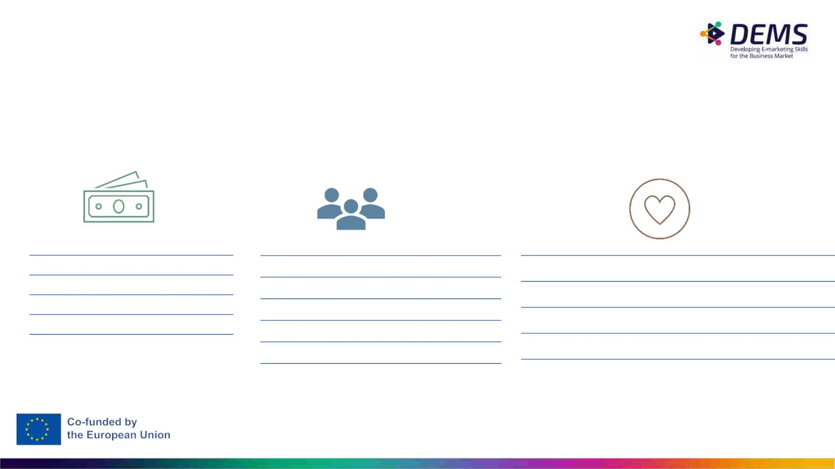
What is the difference between a business,
marketing or content strategy
What do you want
to achieve with
your target audience?
Business goals
Sales forecast
Profit
Content Marketing goals
Brand awareness
Content goals
Increase conversation rates
Engaging with customers
Educating current and potential customers
Fostering brand loyalty
Brand knowledge
Market share
Brand attitude
Brand action (buying) intention
Brand loyalty

Slide 24
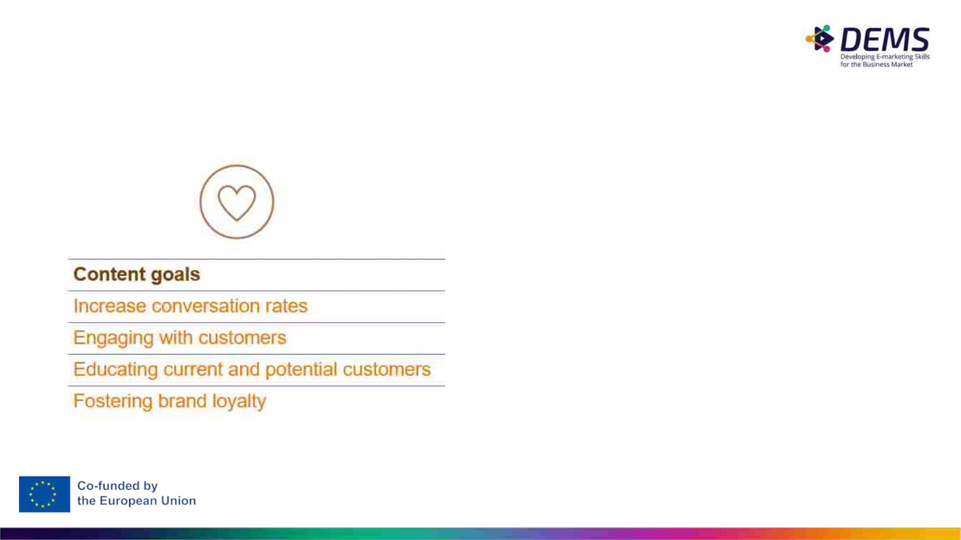
Content Metrics
Goals
Metrics
• set relevant conversion goals for different
stages of customer journey: newsletter and
blog subscription, video views, content
downloads, purchase
• engagement: number of shares and
comments in social media, analytics metrics:
nr of pages per session, time on page,
sessions per user, etc
• educating customers: content downloads,
users on site
• fostering brand loyalty: nr of returning users

Slide 25
SMART Objectives
Specific: They must clearly describe what it is you want to achieve.
Measurable: They should have clear metrics that can be measured before and after and
objective is met.
Achievable: They should be realistic for your business to achieve by a certain time.
Relevant: They should relate to the overall business or individual objectives. Remember: you
get what you measure / what your objectives are. Relevance is important!
Timed: They should have a target date for completion to encourage action to be taken to
complete the objective.
Further reading (tip: useful in the group assignment):
https://www.mindtools.com/pages/article/smart-goals.html

Slide 26
Why SMART?
• They direct your marketing to the right direction.
Ie. align with business goals.
EXAMPLE:
• They are measurable. If objectives are not
measurable, they’re not worth much.
A local garden company (sells plants, garden
equipment, etc.) from Turku is expanding their
services. Next year’s focus is on a new service,
garden planning.
• Good and useful for all objectives in digital
marketing
Specific
Which of the following is/are SMART objectives?
Measurable
Achievable:
Relevant
Timed
• Our objective is to grow by 20%.
• Our objective is to sell garden planning service
worth 10 000 € in 2023.
• Our objective is to be the biggest garden
planning company in Finland during 2023.

Slide 27

WHY AND HOW TO
BUILD A BUYER
PERSONA

Slide 28
Buyer persona
• Fictional character that is created to represent a type of customer.
• Personas are used in conjunction with segmentation, where the personas represent the
different segments.
• Personas are represented through their demographics, history, personality, ambitions and
goals, frustrations, preferred brands and other characteristics that are important to the
company.
• When the buyer is not the same as user/consumer important to create buyer persona and
user persona

Slide 29
WHY?
HOW TO USE?
• You can draw the attention of potential
• Talk to your persona in his/her own
customers by offering them interesting
tone of voice.
content or helping them.
• Excellent way to create targeted,
•
When making content, always keep in
mind, what is important for your
interesting and meaningful content
customer (and not to your company)
• Customers expect personalized
• Better results in SEO and SEA, when
content
• Buyer persona is a model – a fictional
you plan your keywords for your
persona (f. ex. painpoints)
persona – who describes your typical
• When sharing content in social media,
you can target more precisely, when
you target to your persona (f. ex.
according to his/her interests)
customer.
• NOTE! Buyer persona is NOT ”a 30-
50 year old man”.

Slide 30

Buyer Personas
How to build?
1. Do audience research
● Who is already buying from you? Interview some of them.
● Study your website and social analytics. For example Facebook Audience
Insights.
● See what the competition is up to
2. Identify customer pain points
• Social listening
3. Identify customer goals
4. Understand how your brand can help
5. How can you reach him/her? What news and social media
channel s/he uses?
6. Turn your research into buyer personas
Templates:
• https://docs.google.com/document/d/1LjXUD2T80m9abqmqQRgJva5Xds3OxLqtm
EOXkTX_wpI/edit
• https://www.impactplus.com/blog/great-buyer-persona-examples-free-template
(see Student Sarah, Rachel Stay at Home Mom
• Further reading: https://blog.hootsuite.com/buyer-persona/

Slide 31
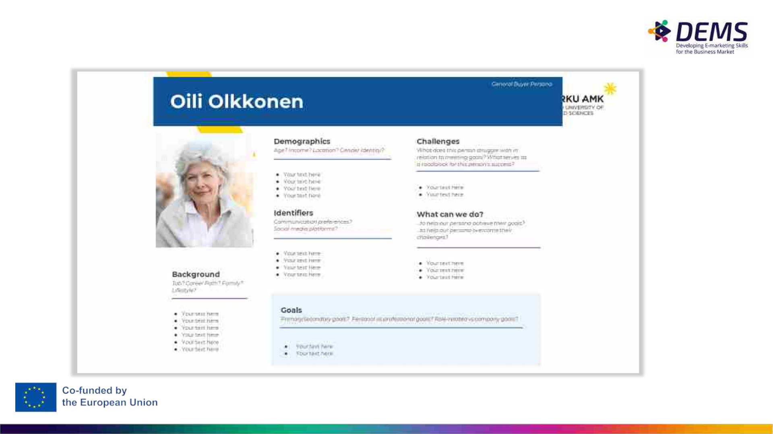
Good, editable template
How to Create Detailed Buyer Personas for
Your Business [Free Persona Template]

Slide 32
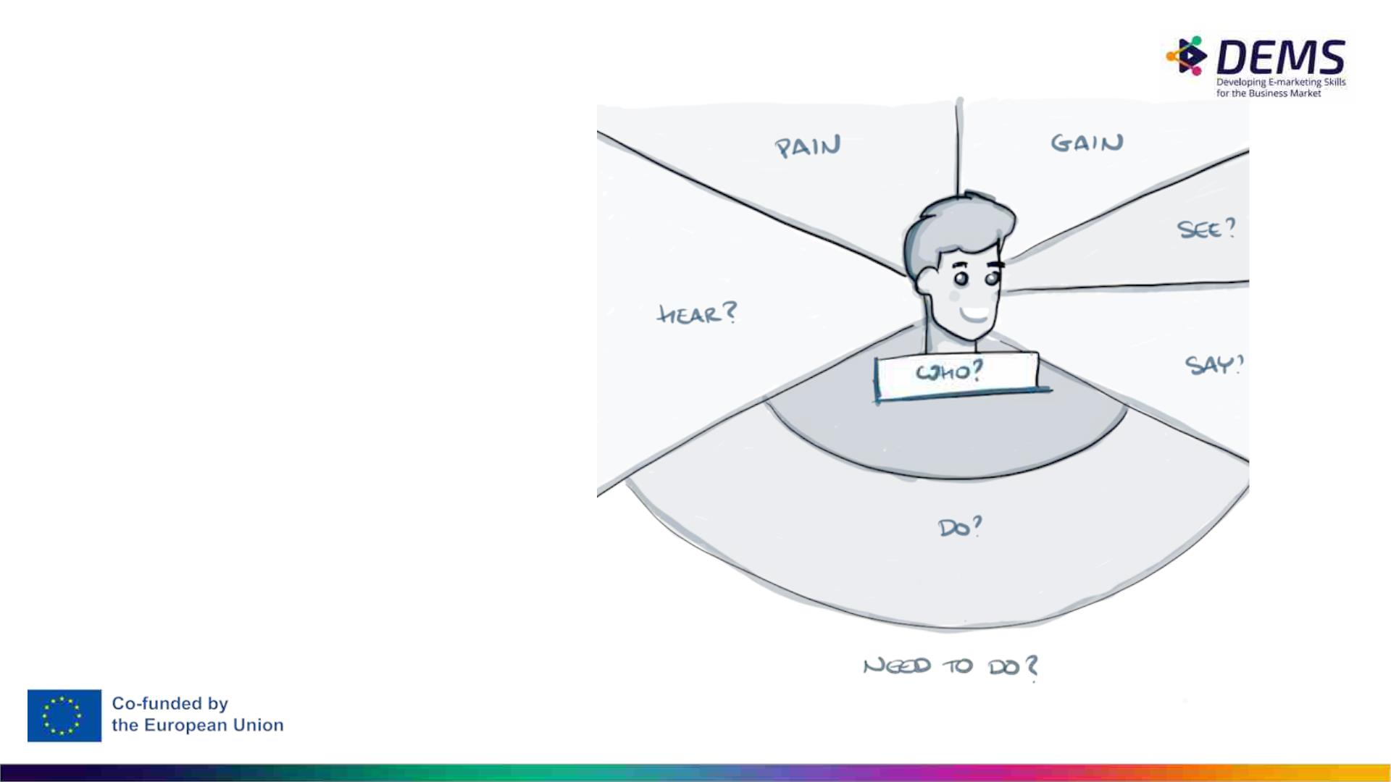
Empathy map
An empathy map is a
collaborative tool that we can
be used to gain a deeper
insight into our customers.
Much like a buyer persona,
an empathy map can
represent a group of users,
such as a customer segment.

Slide 33
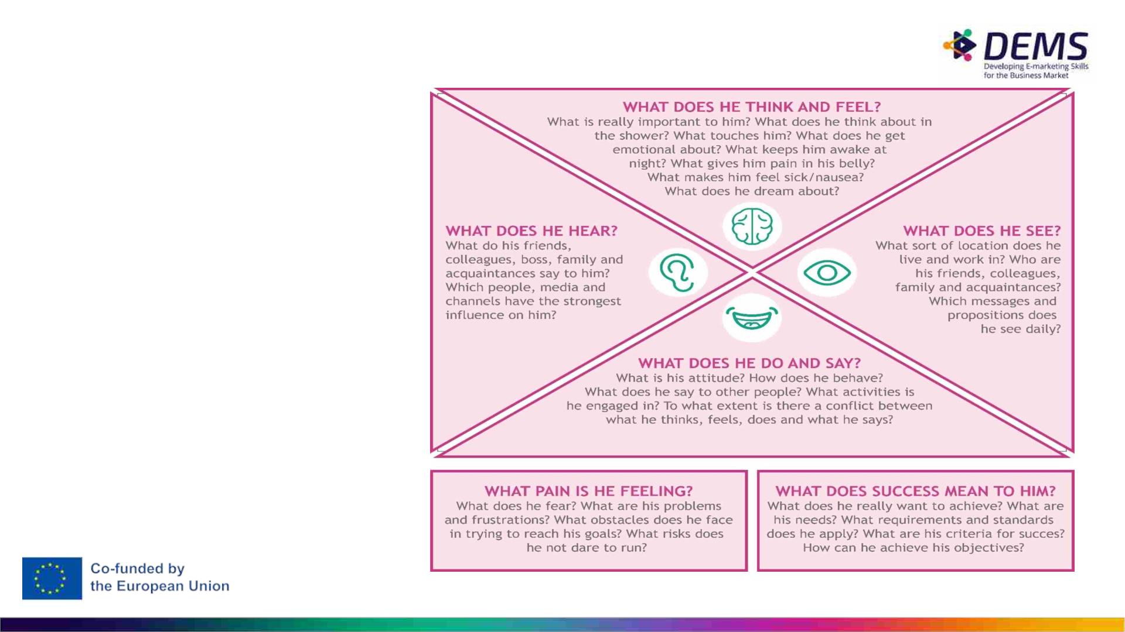
Empathy map
A tool to gain deeper insight into
the needs / experience of the
target group you work for.
Use this to identify your
persona’s goals and painpoints.
Bron: Basisboek customer journey © 2018 Noordhoff uitgevers b.v.

Slide 34
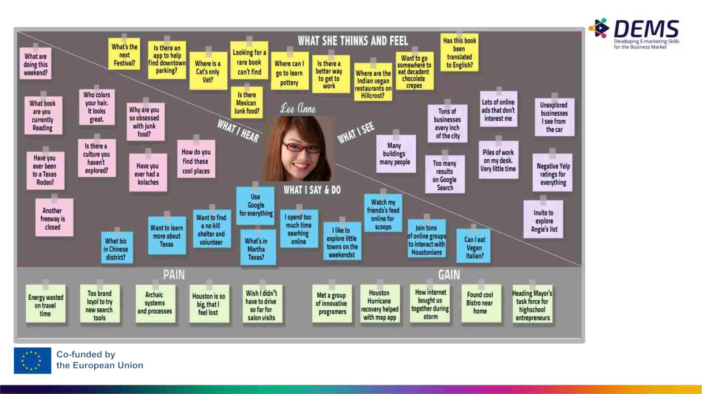

Slide 35
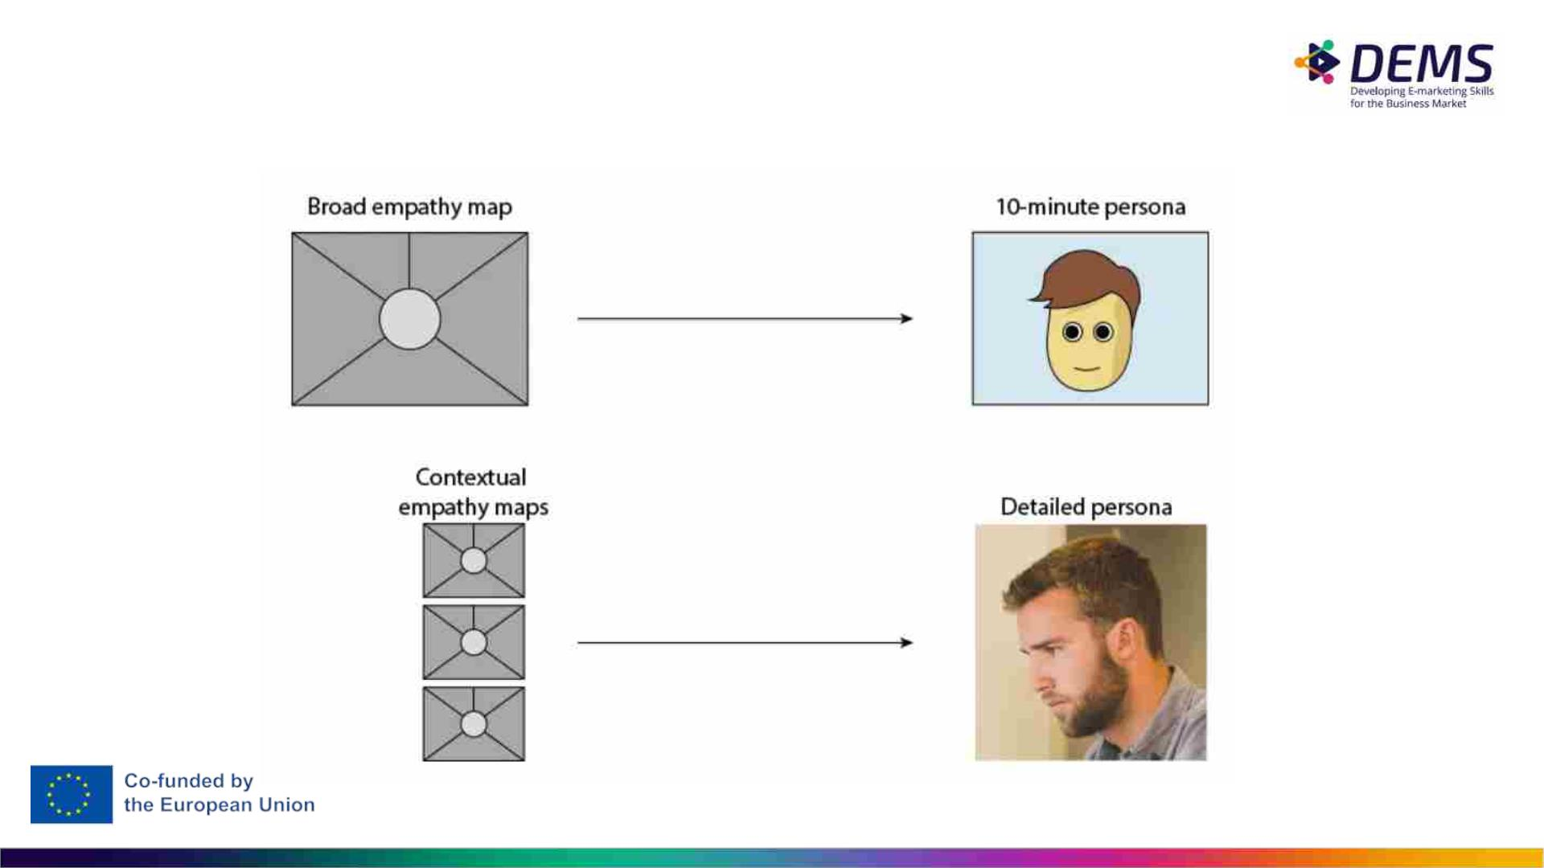
Empathy Map – The Creation Process

Slide 36
In-Class Group Activity: create a broad empathy map
Managerial problem to solve: “Why would somebody buy a new iPhone?”
Before you start the exercise, you will need at least basic understanding of your user segments (e.g. Sally
the College Student, Sean the Young Professional).
You can use this template:https://www.ijlan.nl/wp-content/uploads/2012/04/empathy-map-poster.pdf
Encourage everyone to write down their thoughts regarding each of the empathy map’s quadrants. Review
the completed empathy map and discuss any patterns and outliers.
Choose a moderator, who will posing questions like these to help team members better visualize their
users:
What environment are the users in when using your product?
Are they having fun, or do they want to get it over with?
What’s their life like outside of using the product?
What kind of day are they having?
If all else fails, try a bit of role-playing, where one person “plays” the user, and ask them questions or play
the role of the product, eliciting responses.
At the end of the session, wrap up what was learned. Did anyone’s opinions change? Is there a better
direction to go with the product design? Were any of the responses based on data, or pure assumption?
These answers are partly why you made an empathy map in the first place.

Slide 37

CUSTOMER JOURNEY

Slide 38
Customer Journey
• There are many different illustrations – and even terms – in customer
journey description
• Common to them all is that their purpose is to describe the path which
potential customer takes when searching solution to his/her needs.
• In content marketing the marketer’s task is to provide content which
takes the potential customer through different stages of the customer
journey towards purchase and brand loyalty
• In the following slides you see four different illustrations, each
emphasizing a different point of view.
• Do you see the same logic in all of them?

Slide 39
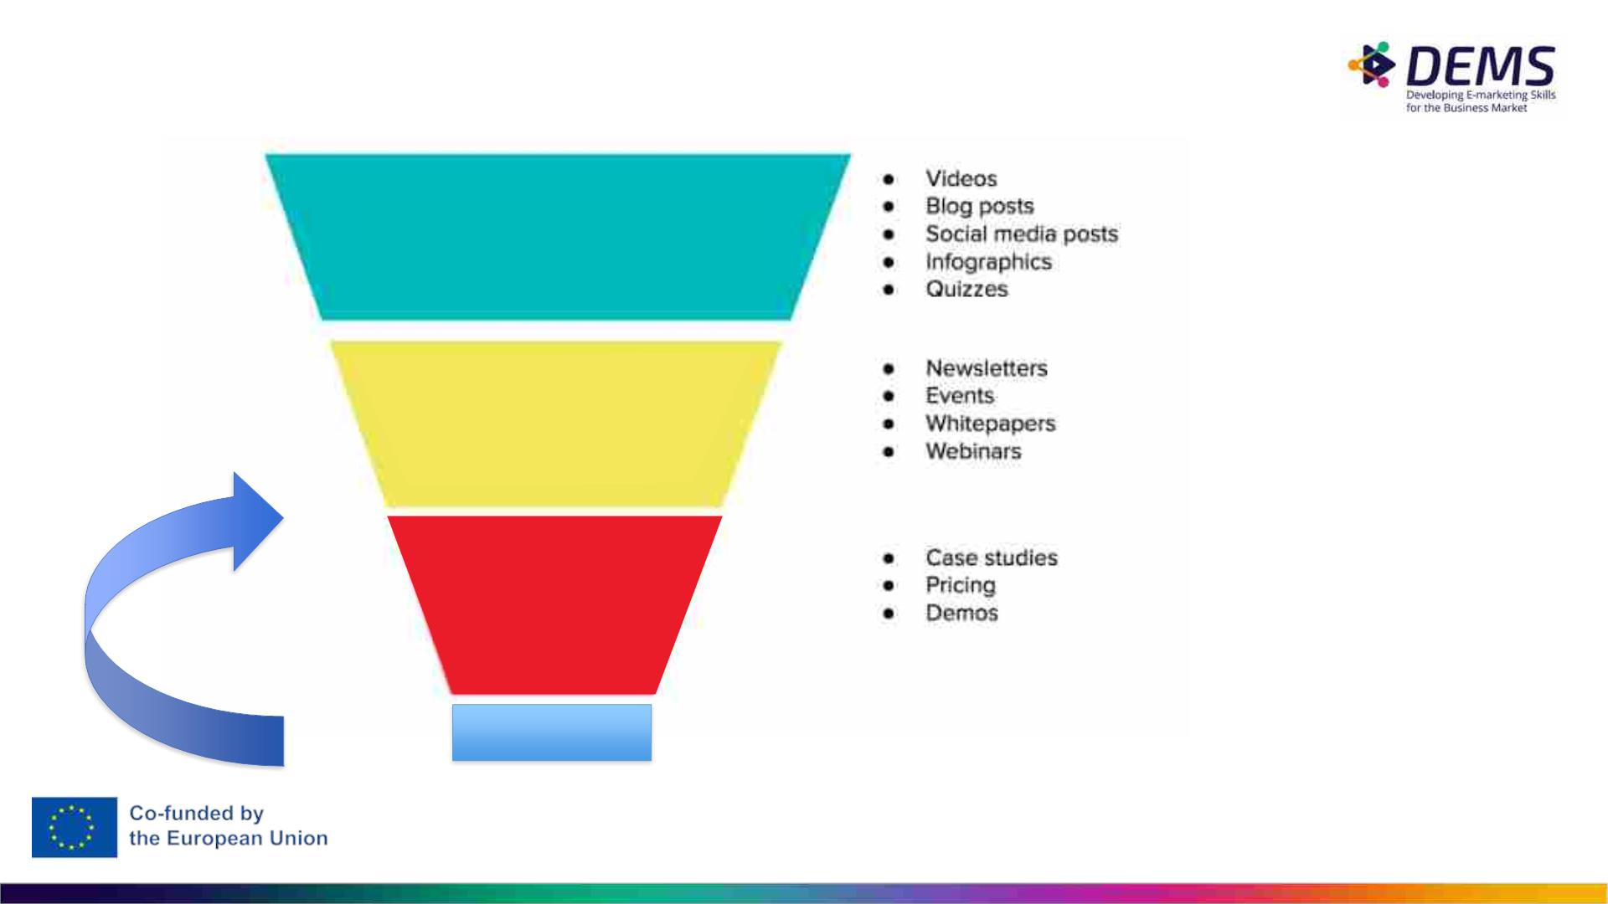
Buyer’s Journey (= Customer Journey)
= Process buyers go through to become aware of, consider, and decide to purchase a new product or
service.
Awereness
Potential customer becomes aware of
the problem s/he needs to solve.
• Outbound advertising – traditional media, too!
Consideration
Potential customer is aware of what
the problem is – now s/he’s looking
for solution.
• SEO, SEM
• Native advertising, influencer marketing
Decision
Potential customer
is looking for the
best
product/service,
with the best deal.
• Website
• Customer service
• Social networks ~word of mouth
Advocacy
• Blogs
Graphics source: https://insights.newscred.com/
Further reading:
https://www.crazyegg.com/blog/guides/buyers-journey/

Slide 40
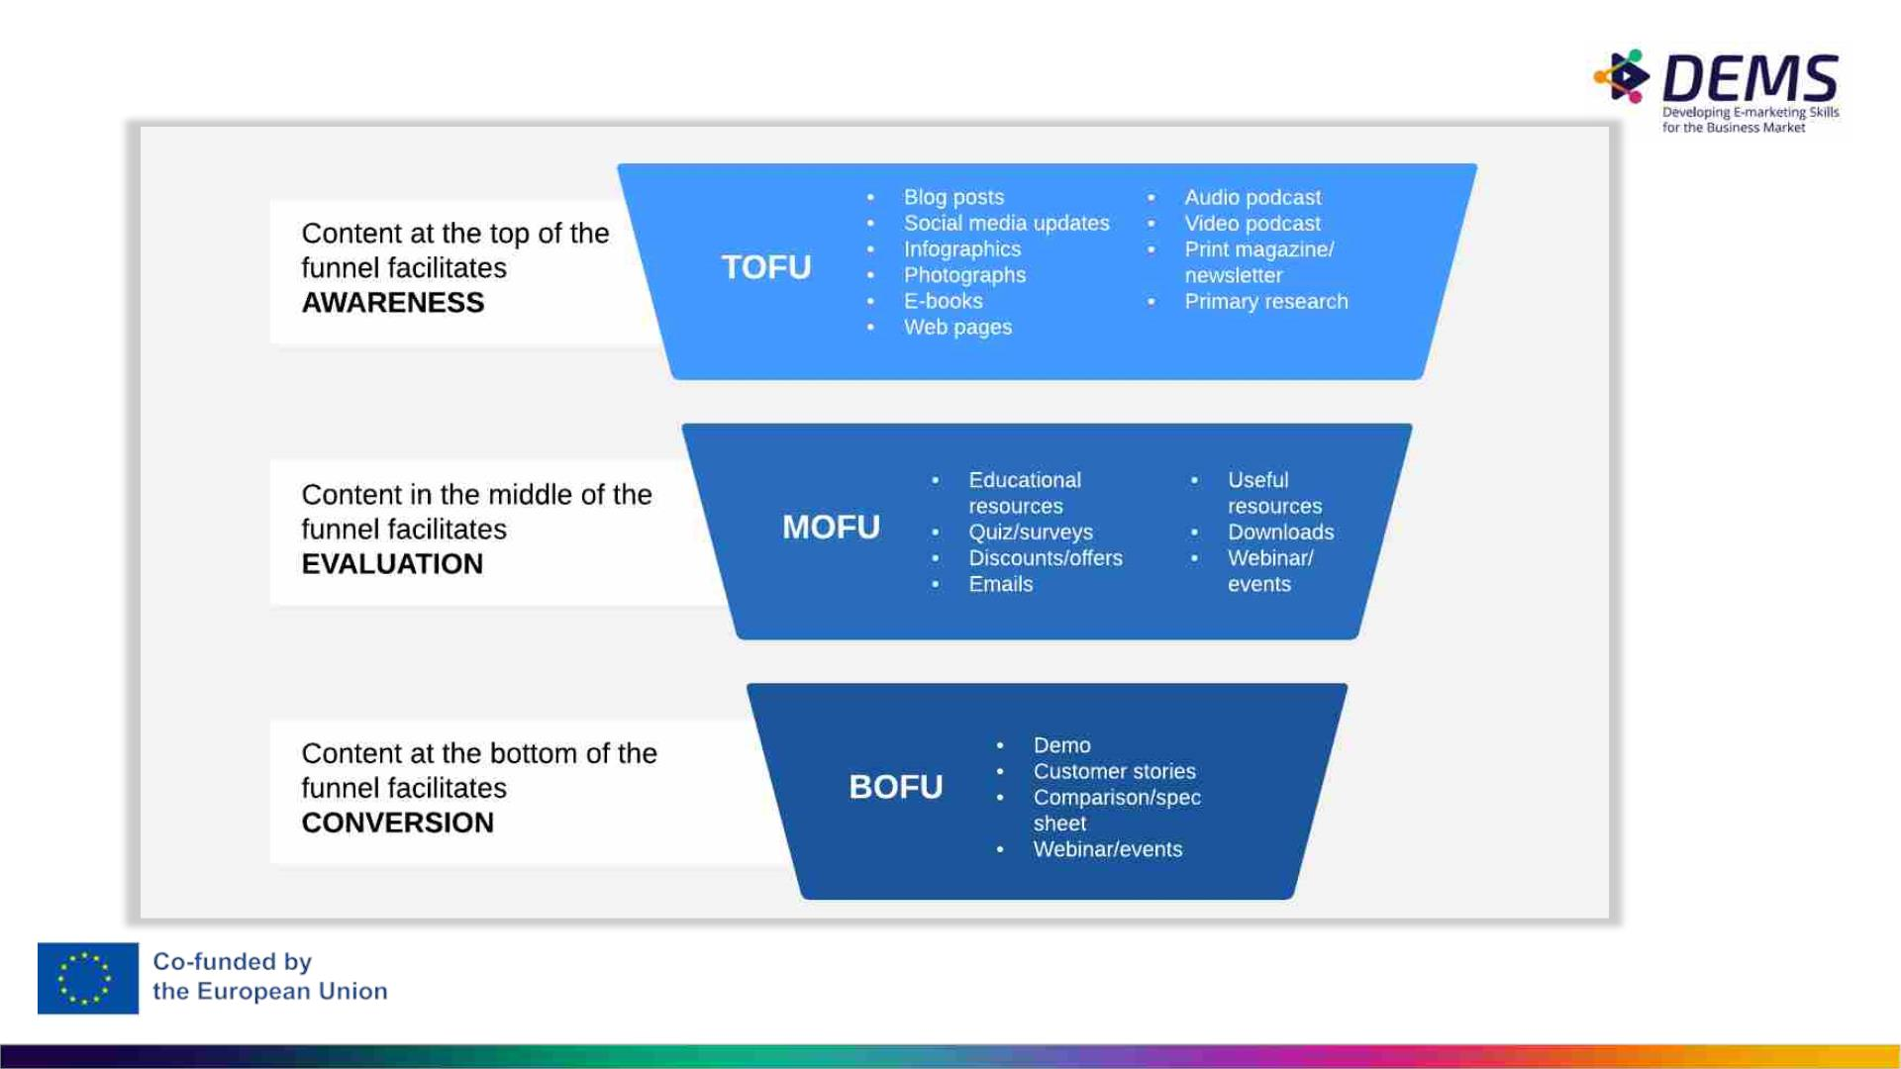

Slide 41
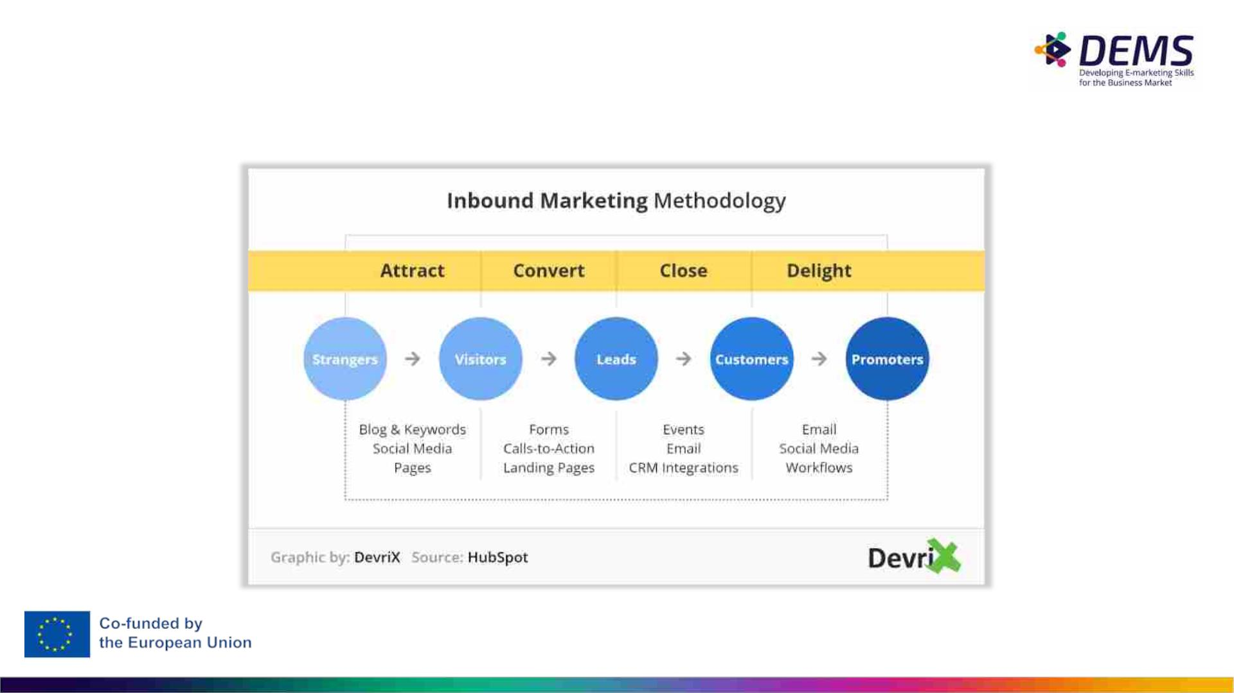
INBOUND MARKETING METHODOLOGY
From a stranger to a loyal promoter

Slide 42

Successful inbound
marketing strategy
that engages in
conversation with
potential customers
Engagement builds connections with
a client.
Image source: Campaign Creators on Unsplash

Slide 43

CONTENT MISSION

Slide 44
Content Mission
● when creating content mission, you need to think how you can help your buyer persona
with your content
● what are his/her problems / painpoints?
● what are his/her goals, and how your content can help him/her to achieve those?
● make first a keyword analysis, and and include those keywords in your content mission
For example:
Our content mission is to ease our buyer personas in their recruiting challenges. We provide
useful tips, information and content in how to succeed in finding and hiring the best people
to open positions.
keywords: recruiting, how to find best workers

Slide 45

But remember!
Inbound marketing does not
exclude outbound marketing
activities. Only a combination of
these two strategies will be a key
advantage in building
competitiveness of companies.

Slide 46

5. Assignments
is section includes also the in-class
tivities, which are presented earlier

Slide 47

Inidividual assignment
difference between in- and outbound marketing
STEP 1
Look for two organizations or brands.
STEP 2
And use social content marketing examples to show how
a brand uses inbound or outbound marketing, respectively.
STEP 3
Show these examples (screenshots) in a Powerpoint
presentation (maximum 6 slides) Substantiate your choices
in the notes below and don’t forget to mention the sources.
STEP 4
On the final slide mention your learning outcome, what
insight(s) do you take along after this assignment?

Slide 48
Pre-Course Assignment
•What is content marketing? Rely on sources.
•Students need to think an example of their own prior to the
course; come up with an example for content marketing which
you found interesting/successful and argue for your choice
•use .pptx or .word in reporting
•be prepared to discuss in class

Slide 49
Group Assignment: Build Content Marketing
Strategy for your company
1. Decide a company which you build a strategy for. It can be BtoC or BtoB
company. The key elements (1-4) of the strategy are mentioned on slide 25.
2. Build a content marketing strategy for your company. . When building buyer
personas, think through and answer to these questions:
Get into the minds of your buyer persona
• what is his/her pain point or objective for which s/he seeks help?
• what are steps in his/her journey, and what kind of content could you offer?
• how do you (channels) reach him/her in different stages
• how would you help conversion in different stages
Make a customer journey for your persona
1. Utilize these slides and trustworthy sources.
1. Format: .doc or .pptx. Quality over quantity.

Slide 50
Assessment
Build Content Marketing Strategy for your company
Fail:
Strategy is inferior; missing most elements and not content marketing related.
Pass:
Strategy contains some elements, but is not quite logical nor realistic. Use of
sources is limited.
Outstanding:
Strategy demonstrates expertise and profound understanding of content
marketing strategy

Slide 51
Important Notice
The DEMS material aims to enhance digital marketing skills in higher education,
comprehending the essential needs in organizations. You have access to
extensive slide sets with in-class activities and assignments, as well as detailed
user instructions for teacher.
Note: The material includes contents and figures retrieved from the internet and
is thus subject to changes. The sources have been announced according to the
rules of fair use. The publisher´s responsibility is restricted to the original
material stored at www.dems.pro. All material is produced for open use and co-
funded by Erasmus +.

