Slide 1
Websites
4. Keeping the attention of your audience

Slide 2
Learning objectives
Pre-requisite for student: Basics in marketing is recommended.
The student is able to
Understand why monitoring and the evaluation of the user experience experience and web analytics are important for digital business
Know how to monitor and evaluate the performance and usability of a website
Start learning to use usability surveys (top task and cardsort sessions)
Start learning Google Analytics 4

Slide 3
Summary of this course
(what where the steps covered in the teaching material)
Set objectives to your site (business objectives)
Set targets (analytics)
Plan your content accordingly (i.e. SEO, conversion, targeting, tone of voice, graphics, etc.) (coverd in module creating content)
Create your site (setting up the site)
Work the social media and advertise (not covered in this sub -module)
Monitor your website:
  Measure the performance of your website (analytics)
  Measure the userfriendlyness of your website(usability test)
Set up Google Analytics (analytics)
React (covered during in-class discussions)

Slide 4
Topics
Why monitoring your website
Why do we need web analytics?
Why do we need user surveys
Exercise with two usability tests
Briefly about Google Analytics 4

Slide 5
Why monitoring your website?
Performance Tracking:
Web analytics allows you to measure and track the performance of your website.
It provides valuable insights into visitor behavior, such as the number of visitors, their demographics, the pages they visit, and the actions they take.
→ helps you understand how well your website is performing and identify areas for improvement.
User Experience Optimization:
Web analytics helps you gain insights into how users navigate your website, what content they find valuable, and where they may encounter issues.
Usability tests and website engagement metrics helps you analyse user behavior. You can identify opportunities to enhance the user experience, improve website navigation, and optimize content placement.
Conversion Rate Optimization:
Provides data on conversion rates, such as the percentage of visitors who take desired actions like making a purchase, filling out a form, or subscribing to a newsletter.
By analyzing conversion funnels, identifying bottlenecks, and conducting usability testing, you can make data-driven optimizations to increase your conversion rates and improve overall business outcomes.
Marketing Campaign Effectiveness:
Web analytics helps measure the effectiveness of your marketing campaigns.
By tracking referral sources, keywords, and landing page performance, you can determine which marketing channels and strategies are driving the most traffic and conversions.
→ allows you to allocate resources more effectively and optimize your marketing efforts.
Data-Driven Decision Making:
It provides quantitative data that informs your decision-making process.
Helps you identify trends, patterns, and opportunities for growth.
→ you can make informed decisions about website improvements, content strategies, marketing initiatives, and resource allocation.
Notes:
Web analytics provides valuable insights that help you understand your audience, optimize your website, improve conversion rates, and make data-driven decisions. It is a crucial tool for measuring and improving the performance and effectiveness of your online presence.
Conversion rate optimization (CRO) refers to the systematic process of increasing the percentage of website visitors who take a desired action, such as making a purchase, filling out a form, subscribing to a newsletter, or engaging with a specific element on the website. The goal of CRO is to maximize the effectiveness of a website by improving its conversion rate and ultimately driving more valuable actions from its visitors.

Slide 6
“Anything that you do without measuring the results is merely a hobby”

Slide 7
Without measuring the traffic on your site, you really don’t know how well it is performing.
  Because you never get it right anyway the first time you launch your site.
  Internet marketing requires constant interaction and iteration
  The tastes and behavior of the markets change constantly
  Your own objectives change.
  .....

Slide 8
Why do we need web analytics?
Notes:
Learn more about analytics from Module 5. Digital analytics & Monitoring

Slide 9
Possible insights you are looking for
What are the target audiences of the company?
Age, location, interests
Which channels should be used to reach this target audience?
e.g. Facebook, Google
What kind of content should be created on the website to attract users?
blog posts, information about services, buying guides etc.
What are the goals of the company and the website, and what actions do users need to take on the website?
e.g. making a purchase in an online store, contacting the company, reading content
What marketing strategies drive traffic to the website?
e.g. video ads, Instagram advertising, influencer collaborations
Notes:
Do we need this sheet

Slide 10
Some examples
Objectives for your site & how to measure
Objective
Measure
Let people know you exist?
  Attract to your site
Make sure people know what your company does?
  Micro conversion
Make sure people know about your new product?
  Macro conversion
Collect email addresses from potential customer?
  Loyal clients
The number of people who visited your site
How long people stayed on the page where you explained your business
The number of people who visited the page where you displayed your new product
Returning visitors, subscribes to newsletter
Notes:
Web analytics helps you measure whether your objectives are being achieved.

Slide 11
What do you measure
How many people have visited your site?
From where did they come to you site?
    Search engine
    Social Media
    A link from another site
    Etc.
Which pages did they visit?
How long did they stay on a pages?
Did they scroll down on your pages?
Which page did they leave from?
Was there conversion?
Are they returning visitors?

Slide 12

Is 200 visitors a lot?
Source: Unsplash - Magnet.me https://unsplash.com/photos/LDcC7aCWVlo

Slide 13
Example – you want 20 new orders per month
 | To reach the objective of | 20 new orders per month
Assuming 50% of your offers are accepted | You need | 40 new qualified offers
Assuming 40% of new contacts want an offer | You need | 100 new contacts (email addresses)
Assuming a 50% conversion rate | You need | 200 new visitors to your site
Notes:
This is the logic you must use when setting objectives for you site/pages.

Slide 14
Why do we need user surveys?
Notes:
Learn more about analytics from Module 5. Digital analytics & Monitoring

Slide 15
Analytics tells you what is happening on your website, but it is up to humans to analyze why, what actions to take, and how to leverage the data obtained.

Slide 16
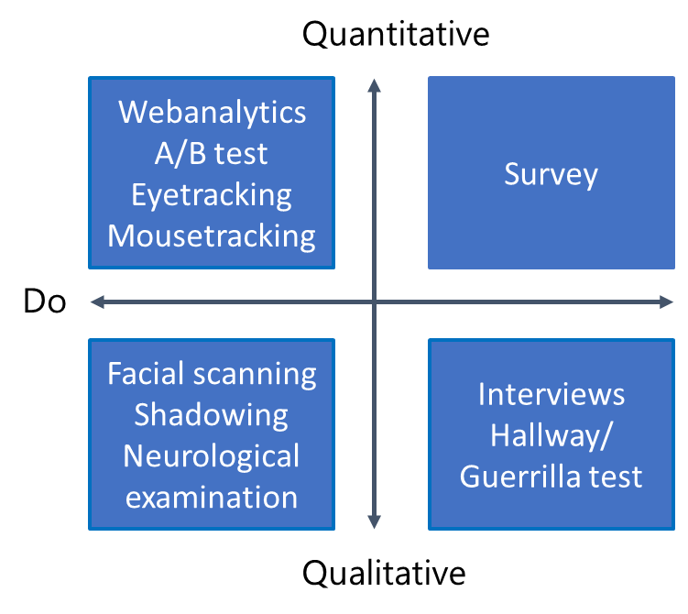
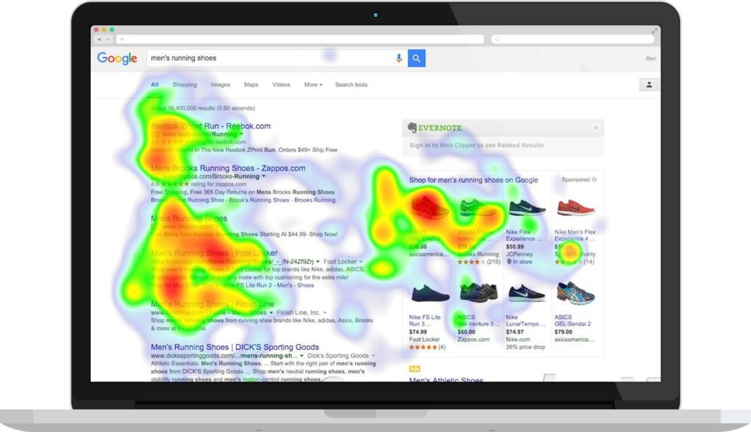
Folluw up on analytics: investigate the quality of your website
Say
Notes:
Here you can see examples for different kind of methods to investigate
In addition, you see an example of a heat map.
For example, the program Hotjar creates these types of heatmaps.
What can you see:
How far do visitors scroll down a page
What visitors click on
What non-clickable content do visitors click on
What attracts attention or what distracts the visitor

Slide 17
Focus on Top tasks
Gerry McGovern:
Every web site has a small set of tasks that deliver a huge amount of value. These are the top tasks
Every website has a large range of tiny tasks. Carefully managed, these tasks have the potential to deliver value, but they also have real potential to destroy value by getting in the way of the top tasks.
Manage the top tasks, not the content or the technology. Focus relentlessly on helping your customer complete the top tasks as quickly and easily as possible
Notes:
Source Gerry McGovern the strangers’s long neck

Slide 18
Top task survey
Top tasks are the most important tasks that a visitor wants to perform on a website.
→ Why does a visitor come to your website?
According to Gerry McGovern, of the 100 tasks on a website, 5 tasks get 25% of the attention.
→ These are the most crucial tasks on the website according to the visitors.
Method of investigating top tasks:
Usability test (how easy are tasks to perform?)
Surveys (what was the purpose of the visit?)

Slide 19

Usability testing
Usability test is a qualitative research method to assess the user-friendliness of a digital product (e.g. website or app).
In this test, participants perform assignments on a (prototype of) website. These assignments are in line with the goals of your website.
In the assignments the participants perform the most important (top)tasks on the site.
How it works:
During a test, a participant performs several tasks behind a PC.
Often video recordings are made, and the eye movement might also be recorded (eye tracking).
When performing the tasks, the participants mention aloud their frustrations, comments or questions.
In this way, in addition to their behavior, the underlying thoughts and any frustrations become transparent.
The test ends with a short questionnaire.

Slide 20
Usability test Example
Take, for example, a website of a travel agency or airline company.
In order to arrive at a set of suitable assignments, it is important to first determine, based on the goals of the website, what the most important tasks are that a visitor must be able to perform.
For the website of a travel agency or airline: What are the most important tasks that a visitor would like to perform?
Top tasks include: Searching for destinations and prices, ordering tickets, changing or cancelling a reservation
Possible assignments that connect to this are:
1. Book the cheapest trip from Amsterdam to Milan around May 21, 2024
2. Find out how you can take out travel insurance after purchasing the tickets
3. Find out which London airports you can fly to from Amsterdam
4. Find out how to change your trip to Milan with a departure date of around June 21 instead of May 21
5. Contact customer service

Slide 21

Video explaining usability testing
https://www.youtube.com/watch?v=0YL0xoSmyZI

Slide 22

In-class activity: usability test
Continue with assignment from lecture 1 (homework 1)
(alternative: the teacher selects websites)
Each group:
  defines the most important tasks of their website
  Creates a list of short assignments related to these tasks.
Put two groups together.
Students from one group perform the top tasks of the other group and than the groups switch
The group that has developed the tasks:
  Observe and make notes during the test.
  Evaluates at the end: How easy did it go, what did the test group run into?

Slide 23
The base of a good website:
Navigation structure
On a website you want the target group to be able to find information quickly and easily. But in practice it turns out to be quite difficult to develop an intuitive navigation.
If website visitors cannot find the information they are looking for, insufficient thought has been given to the navigation structure during the design.
The result is annoyed visitors and many visitors who quickly leave the website.

Slide 24
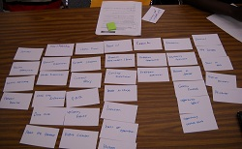
Cardsorting
Often, during a usability test, it turns out that users get lost in main and sub-navigation menus, because content is not in a 'logical place' or has a 'strange name' for them.
Cardsorting can be used if previous user tests show that the website layout is not perceived as logical by the user.
Card sorting is a method to determine an optimal layout of your website.
Notes:
One of the reasons for this is that a navigation is often only designed from an internal perspective and knowledge of the employees within a company

Slide 25
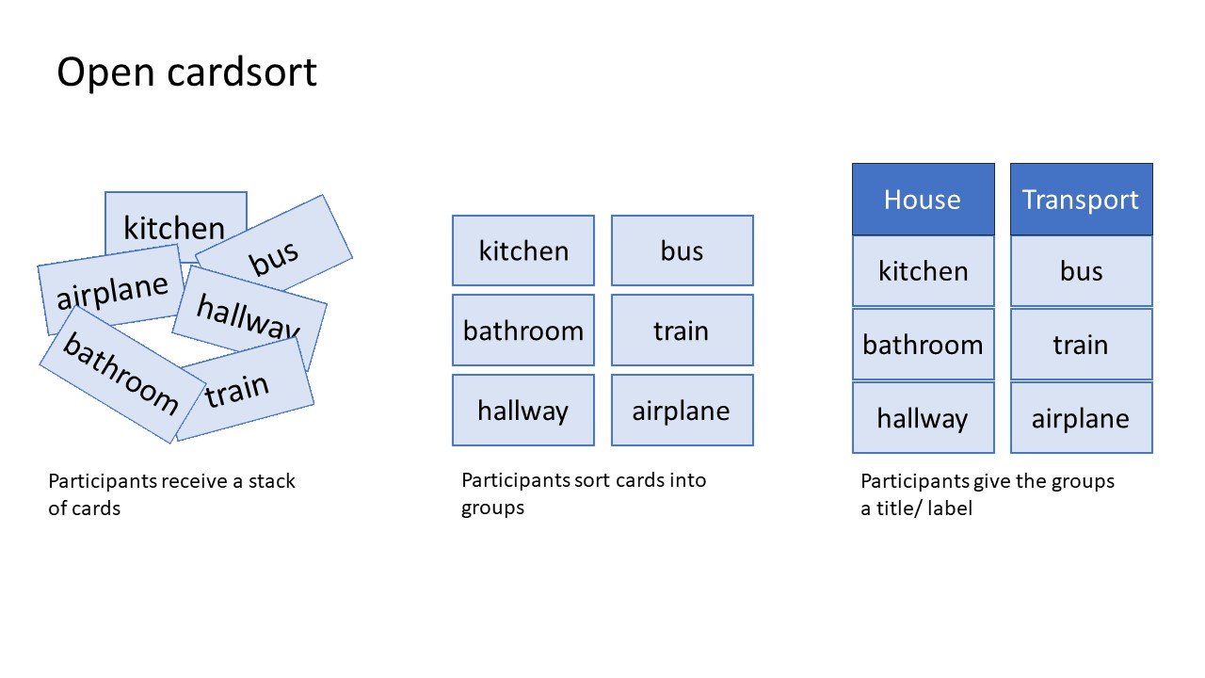
Cardsorting: how it works
Note:
Open means that the users also determine the titles for the groups and thus for the layout of the main navigation.
With a closed card sorting, the main navigation is already fixed.

Slide 26

In-class activity:Cardsorting
Create cards for every part, web page, or topic of your website
Asks two other groups to execute a cardsort session with the stack of cards, by organizing the cards into groups that they think make sense.
If necessary, the participants may also change the name of the cards. The goal is that by grouping the cards, a navigation structure / layout comes out that they find useful.
The participants can work individually or in pairs.

Slide 27
Assignement 5
1. Usability survey summary
Process the results of your usability test. Try to answer the following questions
How easy is it for the visitor to achieve the goals?
What is the customer experience like?
Is the visit to the website positive?
Work out a list of improvement for the website based on the usability test.
2. Card sort
Process the results of your cardsort session.
Work out a new navigation for your website

Slide 28
Briefly about Google Analytics 4

Slide 29
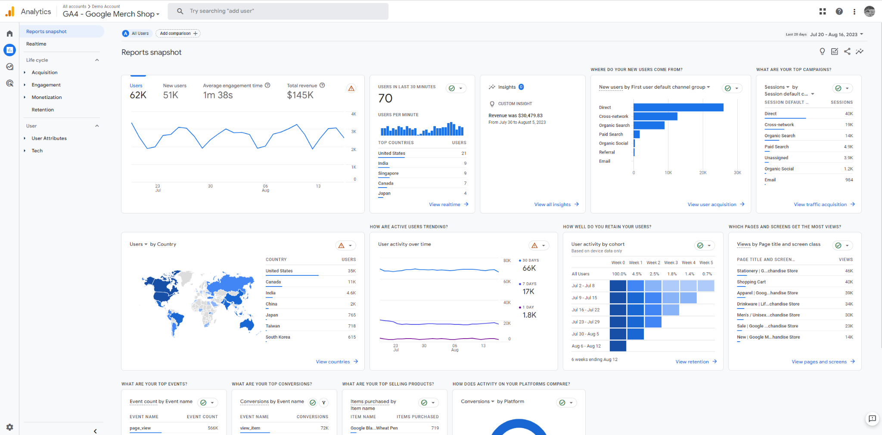
What is Google Analytics?
Google Analytics is a free web analytics tool provided by Google that helps website owners and marketers track the performance of their website and understand visitor behavior.
With Analytics, you can track e.g.:
Website traffic and visitor numbers
User behavior on the website
Website performance across different platforms
The impact of marketing efforts on website visitors

Slide 30

Google Analytics Demo Account
Start learning Google Analytics 4 with Google’s Demo Account:
“The Google Analytics demo account is a fully functional Google Analytics account that any Google user can access. It contains one Universal Analytics property and two Google Analytics 4 properties. The demo account is a great way to look at real business data and experiment with Google Analytics features.”
Notes:
You will need a Google account to access the demo account.

Slide 31
Disclaimer
The DEMS material aims to enhance digital marketing skills in higher education, comprehending the essential needs in organizations. You have access to extensive slide sets with in-class activities and assignments, as well as detailed user instructions for teacher.
Note: The material includes contents and figures retrieved from the internet and is thus subject to changes. The sources have been announced according to the rules of fair use. The publisher´s responsibility is restricted to the original material stored at www.dems.pro. All material is produced for open use and co-funded by Erasmus +.

