Slide 1
Websites
3. Attracting visitors to your website

Slide 2
Learning objectives
Pre-requisite for student: Basics in marketing is recommended.
The student is able to
Recognize the types of content in a website
Understand the basics of Search Engine Optimization
Design and create SEO content for a website

Slide 3
Topics
Why SEO?
What is SEO?
Why SEO is important?
Attractive website
Why do we need content to the website?
Different types of content in a website
Basic rules for writing SEO content

Slide 4
Why SEO?
To help your customers find you!
Notes:
SEO is essential for businesses and website owners who want to improve their online visibility, attract targeted traffic, build credibility, and ultimately drive business growth.

Slide 5
What is SEO?

Slide 6
What is SEO?
Search engine optimization (SEO) means the process of improving website or e-commerce to increase its visibility in search engines when people search for products or services related to your business.
Search engines such as Google and Bing use bots or “spiders” to crawl pages on the web, going from site to site, collecting information about those pages and putting them in an index (like a giant library).
Next, algorithms analyze pages in the index, taking into account hundreds of ranking factors or signals, to determine the order pages should appear in the search results for a given query.
Notes:
Deepen your SEO knowledge with this module’s SEO materials: 2.1-2.7.

Slide 7
Why SEO is important?
It boosts site’s credibility
A site that ranks high on search engine results pages is typically considered high-quality and trustworthy by search engines boosts the credibility of your business.
It’s “free”
After you have published content or made some technical SEO improvements, search engines keeps promoting useful content and helping you find your customers organically
It supports content marketing
By creating helpful SEO content for visitors, including text, images and videos, your site will rank better in search results and supports your content marketing goals.
It maximizes PPC campaigns
Unpaid (SEO) and paid marketing strategies (PPC) work well together.
PPC helps your site appear at the top of paid search results, while SEO does the same thing organically.
With SEO you can save in your PPC budget (good content better quality score cheaper ads)
Notes:
Learn more about Content marketing from Module 3, and more about PPS campaigns from module 4.

Slide 8
Why SEO is important?
It gives you a competitive advantage:
If you consider that results on the first page of a Google search get over 90% of traffic, you cannot afford not to be there
Start by identifying your competitors, analyzing their strengths and weaknesses, and creating and managing your online reputation.
Then, ensure that your site loads fast and is mobile-friendly, make the best content possible, and focus on providing the best user experience.
It can help you reach more people
While many marketing campaigns tend to focus on a defined target audience, SEO can help you attract anyone with intent at a given point in time, no matter what stage of the sales funnel they are in.
Notes:
The sales funnel or purchase funnel, is a concept that illustrates the customer's journey from the initial awareness stage to the final purchase decision. It is a model used by marketers to understand and analyze the steps a consumer goes through before making a purchase. Learn more from the Module 3.

Slide 9
Why SEO is important?
It helps you rank better in local searches
Local searches such as “restaurants near me" are becoming more common.
Nearly 80% of local searches on mobile lead to conversions.
Local SEO strategies can help you attract these searchers who are often ready to buy.
It improves website usability
SEO is about making your site search engine-friendly, but it also can improve the experience a customer has when visiting your website.
If you put the work in to generate useful and high-quality content, make your site faster and more responsive, add backlinks and enhance every page, you typically get an excellent website in addition to one that's optimized for search engines.
You can measure the results
With SEO, you can track changes in rankings, conversions and website traffic.
For example, with Google Analytics you can see every website user's buying journey — including the pages they engaged with, the keywords they used to search and whether they completed specific actions.

Slide 10
Why SEO is important?
It improves user engagement rates
An optimized site brings in quality traffic.
If you have a site with useful content that matches the searcher's intent, they will likely spend more time browsing, which ultimately can lead to more conversions and increased ROI.
Customers who engage longer with a website tend to connect to the brand more.
Long-term results
Unlike some paid advertising methods, SEO provides long-term benefits.
Once you establish a strong organic presence and maintain good SEO practices, your website can continue to attract organic traffic and deliver results over time without incurring ongoing advertising costs.

Slide 11
Why SEO is important?
Overall, SEO is important because it helps your website rank higher in search results, attract targeted traffic, build trust and credibility, provide a better user experience, and achieve sustainable long-term results for your online presence.

Slide 12
Attractive website

Slide 13
What is an attractive website like?
An attractive website is:
visually appealing
user-friendly
engaging
Attractiveness is subjective!
It's important to consider your target audience, their preferences, and the goals of your website when designing an attractive website.

Slide 14
Key elements that contribute to an attractive website:
Visual Design:
A visually appealing website incorporates an attractive color scheme, high-quality images, and balanced layouts.
A clean and modern design that aligns with your brand identity → use the brand colors, logo, typography, and visual elements consistently throughout the site.
User-Friendly Navigation:
Intuitive navigation that allows users to easily find the information they need.
Clear and well-organized menus, logical page hierarchy, and a search function can enhance user experience and keep visitors engaged.
Responsive Design:
Optimized for various devices and screen sizes.
Adapts and displeys properly on desktops, laptops, tablets, and mobile devices.
Responsive design ensures that your website looks great and functions well regardless of the device being used.
Compelling Content:
Engaging and well-written content is crucial for attracting and retaining visitors.
Use clear and concise language, compelling headlines, and relevant images or videos to communicate your message effectively.
Incorporate storytelling and compelling calls-to-action to encourage user interaction.

Slide 15
Key elements that contribute to an attractive website:
Eye-Catching Call-to-Action (CTA):
Including visually appealing and strategically placed CTAs helps guide visitors to take desired actions, such as making a purchase, signing up for a newsletter, or contacting you.
Fast Loading Speed:
Slow-loading websites can frustrate visitors and lead to high bounce rates.
Optimized page loading speed provides a smooth and seamless browsing experience.
Engaging Multimedia:
Incorporating engaging multimedia elements, such as videos, animations, or interactive features, can make your website more visually appealing and interactive.
Use multimedia strategically to enhance the user experience and convey your message effectively.
Social Proof:
Displaying testimonials, reviews, or case studies can help build trust and credibility with visitors.
Positive social proof can make your website more attractive and encourage users to take action.
Regular Updates:
An attractive website is one that is regularly updated with fresh content, new features, and relevant information.
Regular updates show that your website is active, current, and cared for.

Slide 16
Why do we need content to the website?

Slide 17
Why do we need content to the website?
Inform and educate
Content provides valuable information and educates visitors about your products, services, industry, or specific topics of interest.
It helps to answer their questions, address their needs, and establish your expertise.
Engage and entertain:
Compelling and engaging content keeps visitors on your website for longer periods.
It captivates their attention, sparks their interest, and encourages them to explore further. Interactive and entertaining content can also enhance the user experience.
Build trust and credibility:
Well-crafted content helps to build trust and credibility with your audience.
It demonstrates your knowledge, expertise, and authority in your industry. High-quality, accurate, and reliable content establishes your brand as a trustworthy source of information.
Notes:
Content is crucial for attracting, engaging, and converting visitors on your website. It helps to establish your brand's authority, build relationships with your audience, and drive business growth.

Slide 18
Why do we need content to the website?
Enhance SEO and organic visibility:
Search engines value fresh, relevant, and high-quality content.
Regularly updating your website with valuable content can improve your search engine rankings, drive organic traffic, and increase your website's visibility to potential visitors.
Drive conversions and sales:
Effective content can guide visitors through the customer journey and influence their purchasing decisions.
It can showcase your products or services, highlight their benefits, address common objections, and provide persuasive calls-to-action, ultimately driving conversions and sales.
Support customer service and support:
Content can serve as a resource for customer support, providing FAQs, troubleshooting guides, tutorials, and instructional materials.
It helps customers find solutions to their problems and enhances their overall experience with your brand.

Slide 19
Why do we need content to the website?
Foster brand loyalty and engagement:
Compelling and valuable content keeps your audience engaged and connected to your brand.
It encourages repeat visits, social sharing, and user-generated content.
By consistently delivering valuable content, you can foster brand loyalty and build a community around your brand.
Differentiate from competitors:
Well-crafted content sets your website apart from competitors.
It allows you to showcase your unique value proposition, express your brand's personality, and create a distinctive voice and tone that resonates with your target audience.

Slide 20
Different types of content in a website

Slide 21
Different types of content in a website
There are various types of content that can be included on a website, depending on the
goals
target audience
and nature of the website.
Notes:
Learn more about content planning and e.g. the goals from The Module 3. Content marketing & Social media, part. 6.

Slide 22
Different types of content in a website
Here are some common types of content:
Text-based content: inc.written articles, blog posts, product descriptions, guides, whitepapers, case studies, FAQs, and any other text-based information that provides valuable and informative content to visitors.
Visual content: inc. images, infographics, charts, graphs, illustrations, and videos. Visuals help to enhance the user experience, convey information in a more engaging way, and make the content more shareable and memorable.
Multimedia content: inc.audio content such as podcasts, interviews, and music tracks that can be consumed directly on the website or through downloadable files or embedded players.
Notes:
Learn more about Content marketing from Module 3., this is just an overview!

Slide 23
Different types of content in a website
User-generated content (UGC): refers to content created by users or customers. It can include product reviews, testimonials, comments, forum discussions, social media posts, and any other content that users contribute to the website.
Interactive content: Interactive content engages users and encourages their active participation. E.g. quizzes, surveys, polls, calculators, interactive maps, games, and interactive infographics.
Social media content: Integration of social media content allows users to view and engage with social media posts, share buttons, and social media feeds directly on the website.
Notes:
Social media integrations helps to foster social engagement and user-generated conversations.

Slide 24
Different types of content in a website
E-commerce content: In the case of e-commerce websites, product listings, product descriptions, pricing information, customer reviews, ratings, and shopping cart functionality are crucial types of content.
Landing pages: Landing pages are specific pages designed to capture visitor attention and drive a particular action, such as signing up for a newsletter, downloading a resource, or making a purchase. They are typically focused on a single offer or conversion goal.
News and updates: Websites often include a section for news, press releases, company updates, or blog posts to keep visitors informed about the latest developments, industry trends, or company announcements.
About and contact information: It is essential to have content that introduces the company or organization, provides information about its mission, values, team, and contact details. This helps to establish credibility and facilitates communication with visitors.

Slide 25
In-class activity
Form a group of 4-5 people.
Discuss in groups:
  What kind of content do you consume?
  Why do you think you find it interesting?
  Try to think the business goals behind the content? What is the content aiming you to do as a customer?
  How the content is related to the firm’s website?
Provide a .ppt presentation about your insights. Each group will present their own, and other groups can comment.

Slide 26
Basic rules for writing SEO content

Slide 27
Basic rules for writing SEO content
1. Write for humans
Know your audience and write for them answer their questions & provide help those problems they are struggling with
Attract backlinks: The content you write must attract backlinks from other sites in order to improve its SEO.

Slide 28
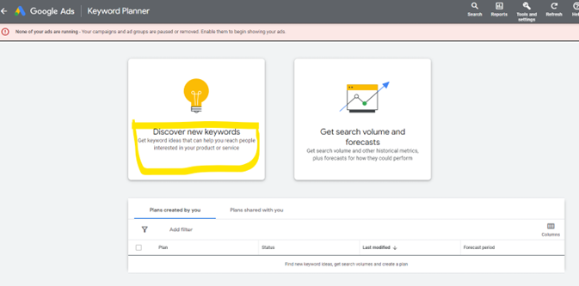
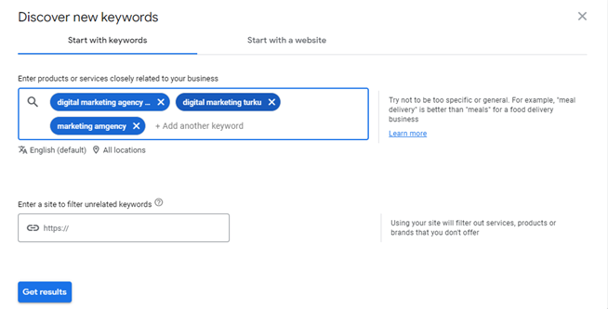
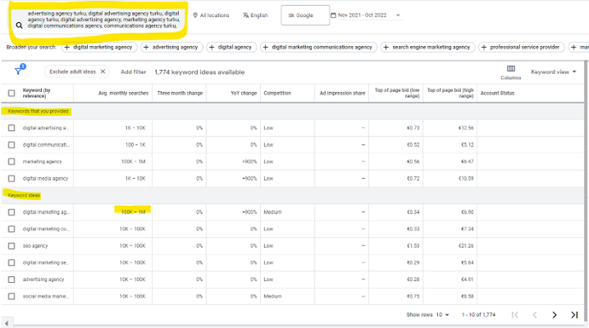
Basic rules for writing SEO content
2. Know how to find the right keywords
Conduct a keyword research with Google Keyword Planner (in order to use the Google Keyword Planner, you need to have a Google Ads account, see instructions here)
Discover new keywords (example: digital marketing agency in Turku)
Enter products or services closely related to your business (use commas to separate the keywords or click Enter) & click “get results”
Choose the best ideas (=the highest amount of searches with reasonable amount of competition) and use them in your content
Read detailed instructions from Hubspot

Slide 29
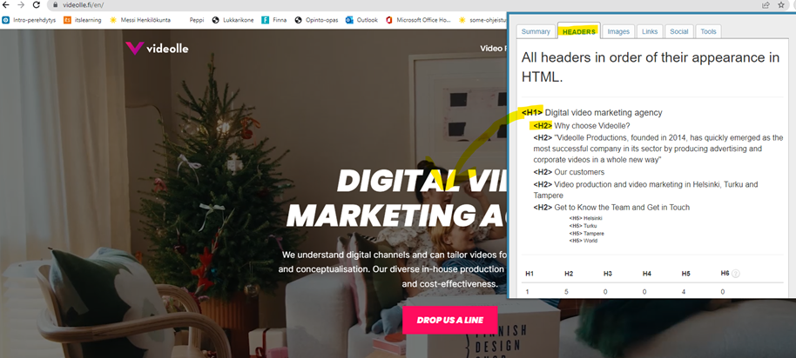
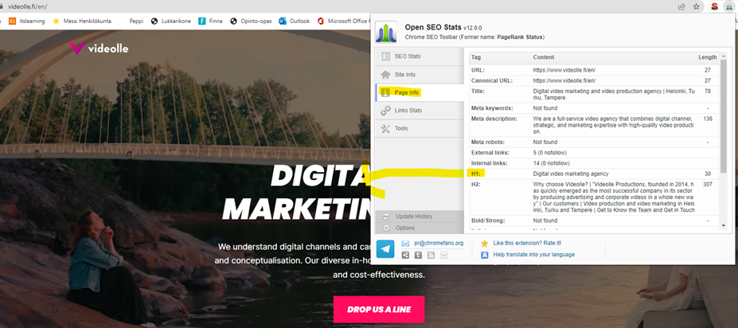
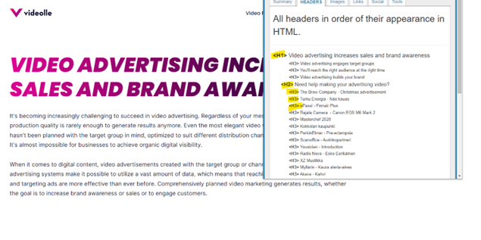
Basic rules for writing SEO content
3. Optimize headers
Utilize the best keywords in headers and main content
  no keyword stuffing! → always write to humans
Headers (H1, H2, H3...)
Only one H1 per page as the main title of the page!
Use other headers systematically like in thesis à first subtitle is H2 and under the same subject after that comes H3 and maybe H4 etc.
Research sites with chrome extensions:
  SEO meta in 1 click
  Open SEO Stats
Notes:
Keyword stuffing refers to the practice of overloading a webpage or website content with an excessive number of keywords or phrases in an attempt to manipulate search engine rankings. Keyword stuffing was a common tactic used in early search engine optimization (SEO) strategies, aiming to increase a webpage's visibility in search results by including a high density of keywords. However, search engines have evolved and become more sophisticated, and they now penalize websites that engage in keyword stuffing.

Slide 30
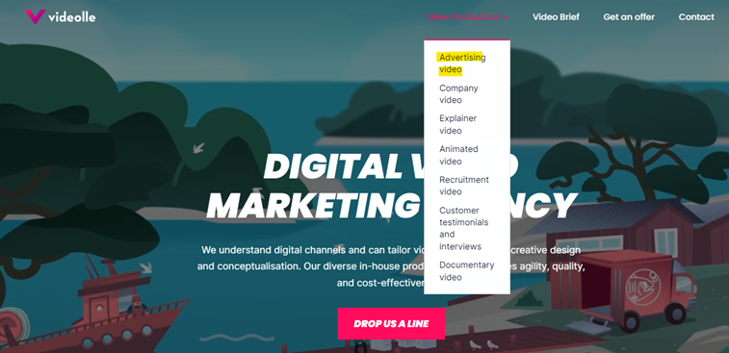
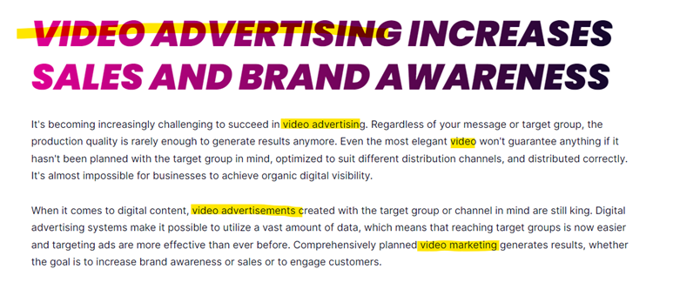
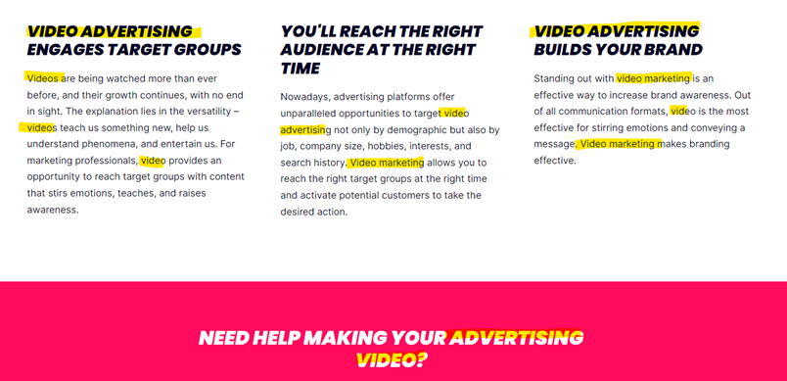
Basic rules for writing SEO content
4. High-quality content
Write long, informative, unique, high-quality content for your target audience
  How you can help them?
  What are they looking for?
  What are their pain points?
  Use your own text, don’t copy-paste anything!
500 – 1000 words per page → make it scannable and reader-friendly
  use headers, anchor tags and inner links, lists, pictures, videos, tables etc.
Remember to add the most important keyword about the subject to headers and somewhere in the text
  use also other related keywords (e.g. video advertising à video marketing, video, video advertisements)
  optimize every page for one subject, don’t use your business’s every possible keyword on every page (design the structure of the site so that each service/product is on its own page, see first picture on right)
https://www.videolle.fi/en/video-production/advertising-video

Slide 31
Basic rules for writing SEO content
5. Link to high-quality sites
Use links to show where the information came from
Use only high-quality sites (the leading experts on the subject)
  If you link to a spammy site, Google sees your site as spammy too
The overall goal of search engines is to make good information universally available.
  When you link to good sites, you show search engines that you are connected to other sites and that you get your information from useful sites.

Slide 32
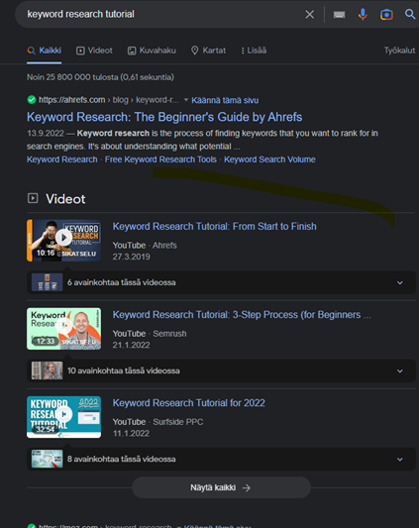
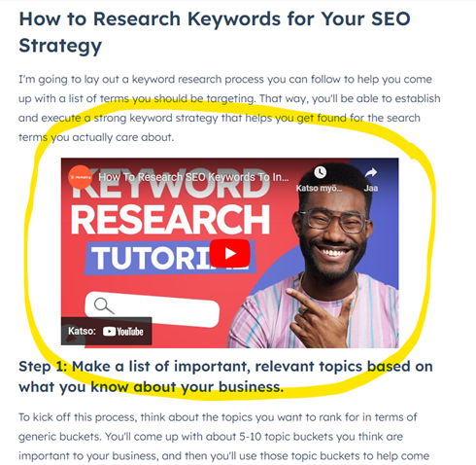
Basic rules for writing SEO content
6. Use Varied Content Types
Use other types of media (videos, pictures, infographics) to back up and expand on the information in the text and to maximize the ranking also in image & video search results.

Slide 33
Basic rules for writing SEO content
7. Write Meta Title & Description
Title tags and meta descriptions are bits of HTML code in the header of a web page.
They help search engines understand the content on a page.
A page’s title tag and meta description are usually shown whenever that page appears in search engine results.
Well written and compelling meta tags can attract more users to click to your website from the search engine results.
Title length: 55–60 characters
  Choose a title that reads naturally and effectively communicates the topic of the page’s content.
  Create unique titles for each page. This helps Google know how the page is distinct from the others on your site.
  Titles should be both short and informative. If it is too long or less relevant, Google may only show a portion of it or one that’s automatically generated in the Google search result.
  The most crucial step is to make sure you carry out keyword research to ensure you use high-value keywords in your title tag
Description length: 150–160 characters
  Accurately summarize the page content.
  Use unique descriptions for each page.
  Include your primary keyword and related keywords naturally
Notes:
See examples on next slide

Slide 34
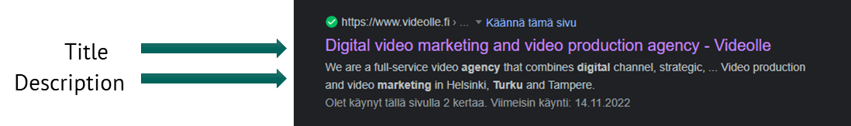
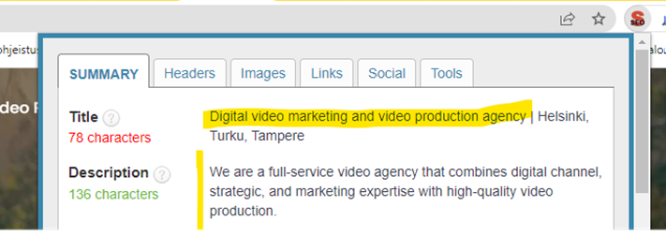
Basic rules for writing SEO content

Slide 35
Basic rules for writing SEO content
8. Remember to optimize your images
Without proper image optimization, you’re wasting a valuable SEO asset.
Best practices in image SEO:
1. Choose the right format
PNG, JPEG, WebP
2. Compress your images
Compress your images before uploading to your site.
You can do this in Photoshop or you can use a tool like TinyPNG.
Too large images lengthens the page loading time

Slide 36
Basic rules for writing SEO content
Best practices in image SEO continues:
3. Customize image file names
Change the file name from the default to help the search engines understand your image and improve your SEO value, e.g. IMG_722019 → dark_blue_shirt
4. Write SEO-friendly alt text
Alt tags are a text alternative to images when a browser can’t properly render them.
Similar to the title, the alt attribute is used to describe the contents of an image file.
  When the image won’t load, you’ll get an image box with the alt tag present in the top left corner.
  Make sure they fit with the image and make the picture relevant.
Adding appropriate alt tags to the images on your website can help your website achieve better rankings in the search engines by associating keywords with image
It provides Google with useful information about the subject matter of the image.
The purpose of alt text is to improve accessibility by describing what an image is showing to visitors who do not have the ability to see them. However, it also helps search engine crawlers and so improves SEO.

Slide 37
Assignment 4
Content. What kind of content do you want to use on your website?
Make a list different content types you want to add to your website (see sheets 22-24)
Add some of the different content types you selected in your website prototype
SEO
Write a title ans description for your website
Execute a SEO key word analysis and make a list of Key words which are relevant for your website
Add the keyword list on an appendix sheet at the end of your website powerpoint

Slide 38
Disclaimer
The DEMS material aims to enhance digital marketing skills in higher education, comprehending the essential needs in organizations. You have access to extensive slide sets with in-class activities and assignments, as well as detailed user instructions for teacher.
Note: The material includes contents and figures retrieved from the internet and is thus subject to changes. The sources have been announced according to the rules of fair use. The publisher´s responsibility is restricted to the original material stored at www.dems.pro. All material is produced for open use and co-funded by Erasmus +.

