Slide 1

Websites
2. Insights in conversions and your target groups

Slide 2

Learning objectives
Pre-requisite for student: Basics in marketing is recommended.
The student is able to
• Identify different kinds of web conversions
• Understand the role of website in a customer journey
• Understand the role of Usability in supporting the customer to reach
conversion
• Elaborate the target groups of a webiste by describing persona’s and
segmentation

Slide 3

The role of websites in a customer journey
Defining conversions
Topics
Conversion and the customer experience
Insights in your customers
Customer Segmentations and Buyer persona

Slide 4
The role of websites in the
customer journey

Slide 5
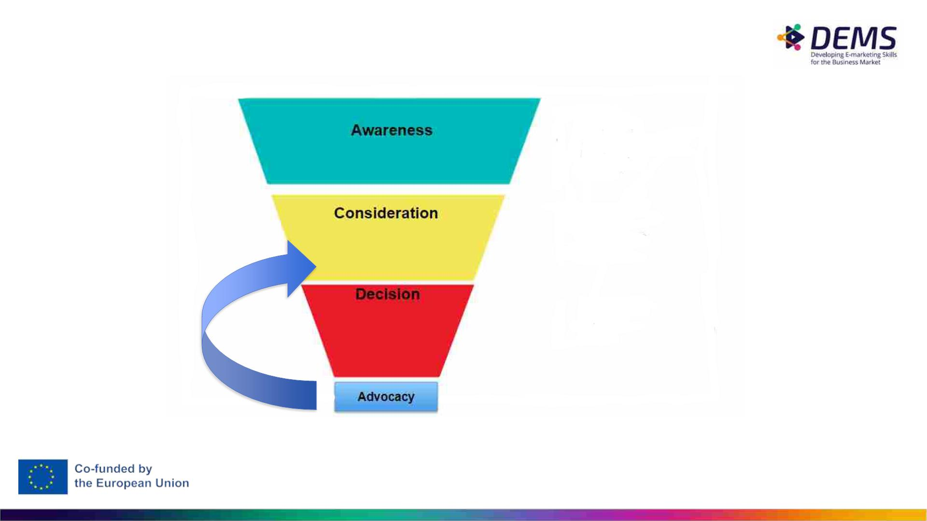
Buyer’s Journey (= Customer Journey)
= Process buyers go through to become aware of, consider, and decide to purchase a new product or
service.
Further reading:
Graphics source: https://insights.newscred.com/
https://www.crazyegg.com/blog/guides/buyers-journey/

Slide 6
The website is involved in each step
of the customer journey
Awareness:
●
●
Websites help create awareness by providing relevant and engaging content that attracts potential customers.
They introduce the business, its products or services, and establish an initial connection.
Consideration:
●
●
In the consideration stage, websites provide detailed information about the business offerings, features, benefits, and unique selling
propositions.
They showcase testimonials, reviews, case studies, and comparisons to help customers make informed decisions.
Conversion:
●
●
Websites play a vital role in converting prospects into customers.
They provide clear calls-to-action (CTAs) that prompt visitors to take desired actions such as making a purchase, filling out a form, subscribing
to a newsletter, or requesting a demo.
Engagement and Relationship Building:
●
●
●
Websites facilitate ongoing engagement with customers.
They provide valuable content, blog articles, resources, and interactive features to keep customers engaged and build a relationship over time.
E.g. personalized recommendations, loyalty programs, or customer portals.
Support and Retention:
●
●
Websites also serve as a support channel, offering FAQs, knowledge bases, chatbots, or contact forms for customers to seek assistance.
They provide a seamless experience for existing customers, enabling them to access account information, track orders, or seek help when
needed.

Slide 7
The main goal of a website
You want CONVERSION
• Each web page MUST have an objective
• If some of your web pages do not have an objective –
DELETE it

Slide 8
Defining conversions

Slide 9
What is a website conversion?
● A website conversion happens when a user completes a desired action on your website, e.g.
○ make a purchase
○ fill out a contact form.
● Every business website is built to generate conversions.
● Micro-conversions
○ A micro-conversion happens when a step toward your end goal is achieved, like
subscribing to a newsletter, downloading an e-book, or watching a product video.
○ Micro-conversions are events that occur before a macro-conversion.
● Macro-conversions
○ A macro-conversion happens when your end goal is achieved, such as a sale, a new paid
subscriber, or a completed contact form.

Slide 10
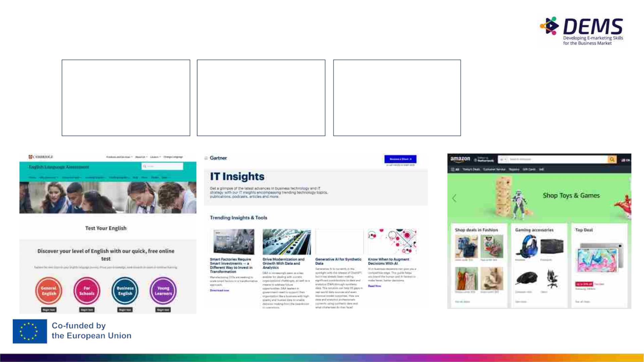
Possible conversions
Interaction:
• Take a test
• Visit contact page
• Time on the website
• Watch video
Leads:
Sales:
• Download whitepaper
• Email results
• Quotation request
• Sign petition
• Purchase
• Subscription
• Sign-up
• Register course
1
0

Slide 11
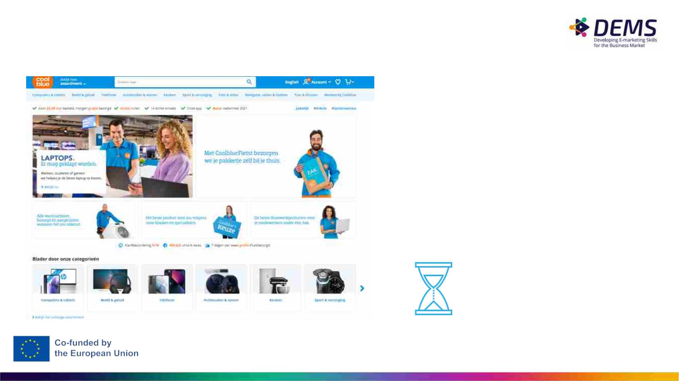
Assignment: website
What are the conversions
on this website?
Discuss with your group
Write them down.
10 minutes
11

Slide 12
Conversions and the customer
experience

Slide 13

The importance of customer
experience
It's not just Conversion that's important.
To be effective, the customer must have a
positive experience while visiting a website.
Customer experience is the sum of what a
customer experiences during the interaction
with an organization and the feeling that that
experience evokes.
The more pleasant an experience, the greater
the effect on the conversion and customer
experience.

Slide 14
Website Usability
for a user centric design of your
website

Slide 15
Website Usability
Defintion of Usability:
A thing is usable if a person of average (or even below average)
ability can figure out how to use the thing for its intended
purpose, without it being more trouble than it’s worth
Website usability:
The overall experience that a user has while interacting with a
website, especially in terms of how easy or enjoyable it is to use

Slide 16
Website Usabilty where to look at
Easy to use
Appearance
Trust
•
•
•
•
•
•
•
•
Bread crumb navigation
Clickable text indicated with
color or underline
Reviews and feedback
Navigation buttons at the top
•
•
•
Domain name
Authority
Call-to-Action buttons and
buttons on the right
Video
Mobile first
•
•
Up-to-date content
Search bar
Multilingual
Structure of the site and
navigation

Slide 17
Know your customer:
Persona’s and segmentations

Slide 18
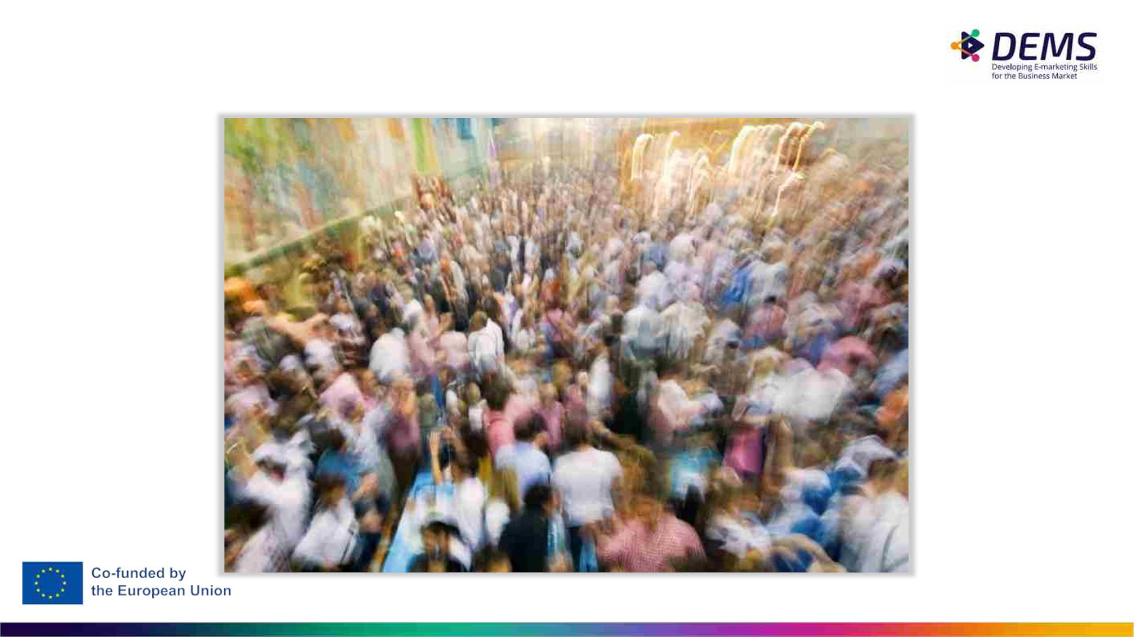
Who are you targeting?

Slide 19
Buyer persona
A buyer persona is a fictional representation of your ideal
customer based on market research and real data about your
existing customers.
Data, insights and research results are given a human face by
linking pesona’s to them.

Slide 20

Buyer persona
Why using persona’s:
Why persona’s are not enough:
● It helps you to better
understand your target
audience and tailor your
marketing strategies to their
specific needs, behaviors,
and preferences.
● Good personas are not
composed from behind a desk!
● Data analysis don't give insights
on the motivations of your
visitors behavior.
● That’s why it is also important to
gain qualitative insights, for
example through surveys and
interviews.
● It triggers the empathy so
that a website is developed
more from the perspective
of the user.

Slide 21
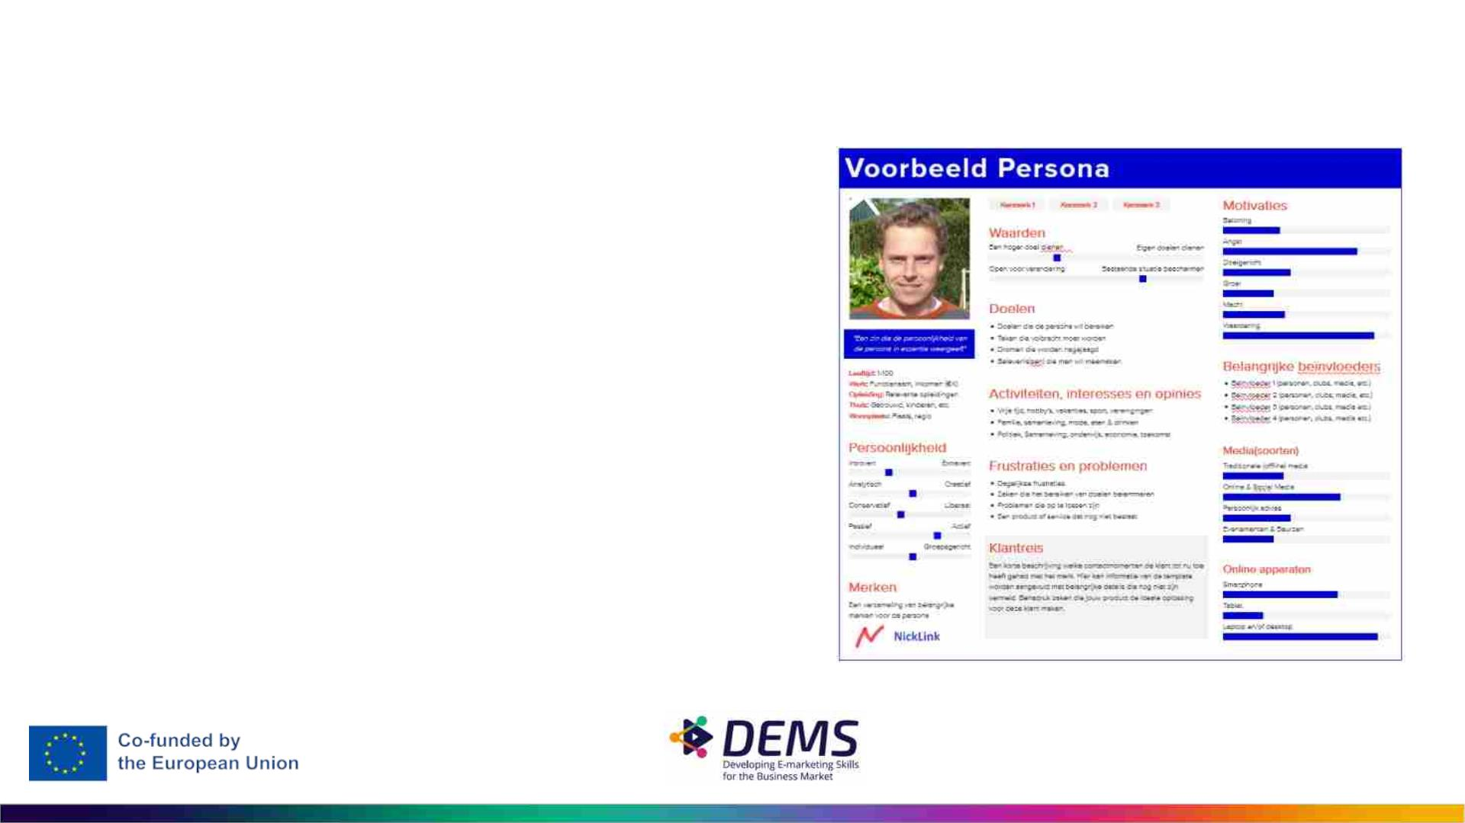
Buyer persona
example
A Buyer Persona often provides the
following information:
- Name & photo
- Persona demographics
- Interests
- Channels used
- Needs / Gains
- Frustrations / pains
- Current solutions used

Slide 22
Customer segmentation
Every customer is unique.
By clustering customers into different groups/segments, we can split the target group and use a
different persona for each segment
Customers in one segment have common needs, problems, attitude or other issues.
These needs makes it necessary to provide different offers.
Based on this, you can differ per segment in:
● Product offerings
● Value proposition
● Communication (channels / tone of voice / ...)
Always define customer segments and use them in analytics

Slide 23
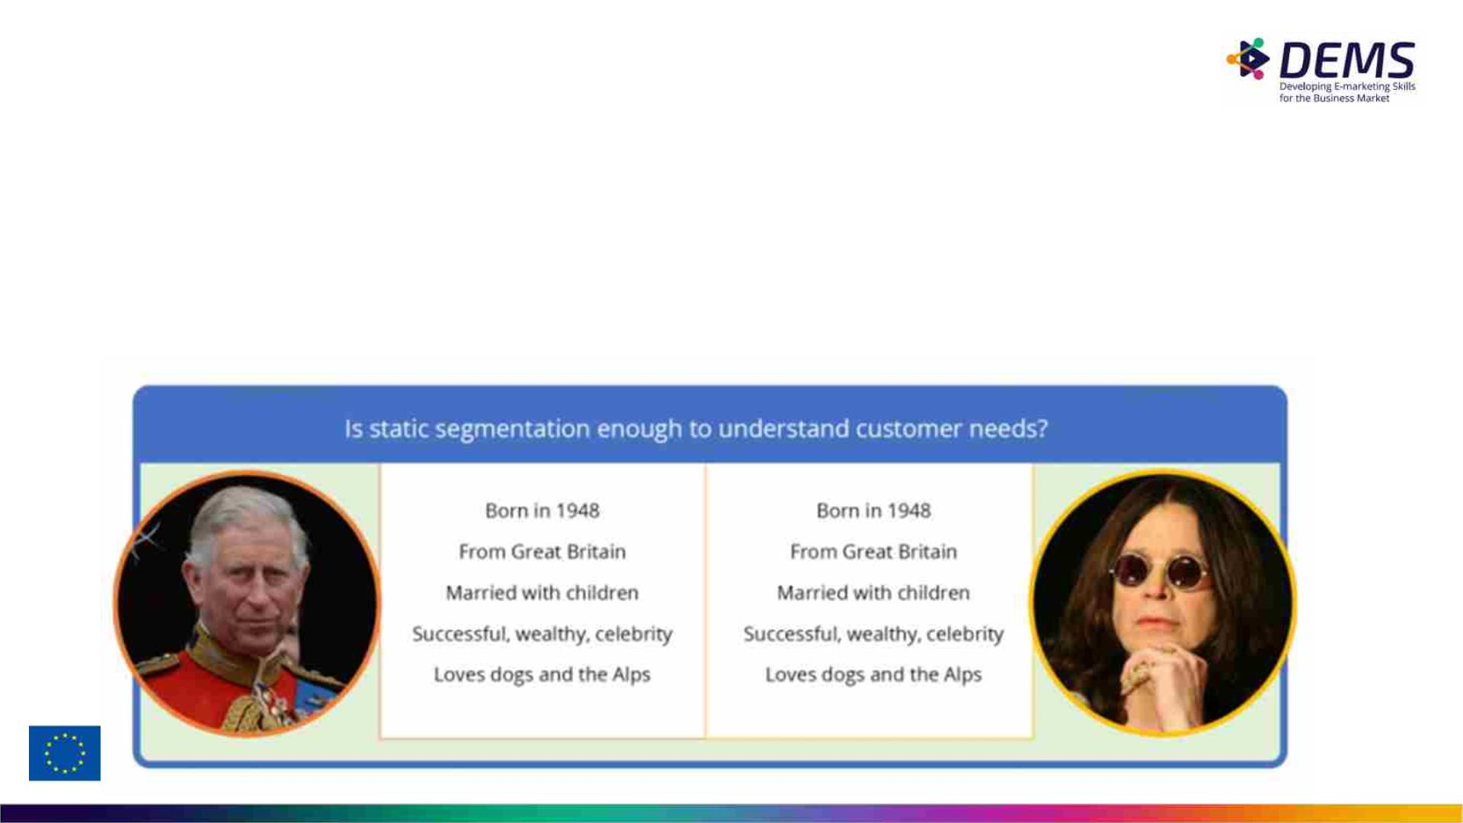
Customer segmentation
A Buyer Persona Helps you to empathize with the customer.
And this in turn helps you with better customer segmentation... Sometimes 2 people do not
look alike from the outside but can fall into the same segmentation.
Think, for example, of exclusive food for dogs.

Slide 24
How to use segmentation in
website design?
Identify key characteristics:
● Start by defining the key demographics, interests, goals, challenges, and
pain points of your target audience.
User experience (UX) design:
● Use buyer personas to inform the design and layout of your website.
● Consider factors such as user flow, navigation, and content organization
to ensure a seamless and intuitive experience for your target audience.
Content creation:
● Develop content that resonates with your buyer personas. Understand
their needs, questions, and motivations, and create relevant and
engaging content that addresses their pain points and provides solutions.

Slide 25
How to use segmentation in
website design?
Tailor messaging and tone of voice:
● Use the language, tone of voice, and messaging that aligns with your buyer personas.
● Speak to their interests, concerns, and aspirations to establish a connection and build
trust.
Personalization and customization:
● Leverage buyer personas to offer personalized experiences on your website.
● This could include personalized recommendations, targeted offers, or customized
landing pages based on specific buyer personas.
Test and iterate:
● Continuously monitor and analyze user behavior and feedback to refine your website
design and content based on the insights gained from your buyer personas.
● Regularly update and optimize your website to meet the evolving needs of your target
audience.

Slide 26

Example:
The use of segmentation in navigation design
Whose problem are you addressing?
Graduate student:
“I’m looking for a job”
Professional user:
”I need new equipment”
Customer:
”I have an issue with
my purchase
New Customer:
”I want to learn more
about a specific
product”

Slide 27
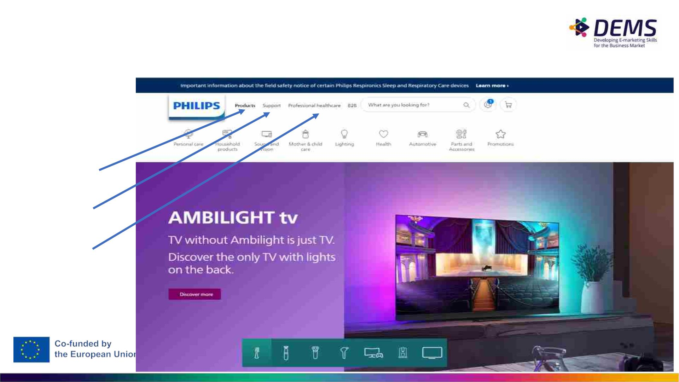
Use the menu structure to address different people/needs
New Customer
Customer
Professional
Graduate student ?

Slide 28
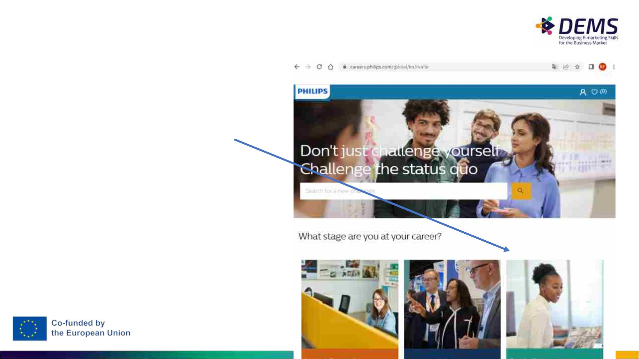
Or use subistes to address different people/needs
E.g. The graduate student

Slide 29

Assignment 2
Continue with assignment from lecture 1 (own website)
Evaluate the powerpoint of your website:
• Are the objectives of the site clear?
• Are the conversions clear?
• Which element contributing to the usability of a website are used? (see
sheet 16)
• Do you still like the site?

Slide 30
Assignment 3
Continue with assignment from lecture 1
Define the customer segmentations
Design at least two buyer persona’s
(look on the internet for a template you like)

Slide 31
Disclaimer
The DEMS material aims to enhance digital marketing skills in higher
education, comprehending the essential needs in organizations. You have
access to extensive slide sets with in-class activities and assignments, as
well as detailed user instructions for teacher.
Note: The material includes contents and figures retrieved from the internet
and is thus subject to changes. The sources have been announced
according to the rules of fair use. The publisher´s responsibility is restricted
to the original material stored at www.dems.pro. All material is produced for
open use and co-funded by Erasmus +.

