Slide 1
Websites
1B. Technical aspects of a website

Slide 2
Learning objectives
Pre-requisite for student: Basics in marketing is recommended.
The objective is to create awareness and provide the context
  on the role of websites in the digital marketing
The student will learn
  the technical aspects of a website (e.g. domain, web hosting)

Slide 3
Topics
Technical aspects of a website
The domain name
SSL certificate
What is web hosting
Hosting architecture
Things to consider when choosing your web host
How to find the right development platform for your company?

Slide 4
Technical aspects of a website

Slide 5
Terms you need to know
CMS: Content Management System. A software that you can use to create, upload and publish your website. For example: WordPress.org and Drupal. This is generally a solution for advanced users who want to create larger websites with more flexibility. Some coding knowledge is usually required.
Website Builder: a simplified version of a CMS, usually for smaller websites. It allows easy website editing and offers predefined designs for you to choose from. It also serves as your web hosting provider. Examples: Wix and Squarespace.
Theme or Template: Website builders always come with a range of pre-configured designs that you can use and customize. The theme focus on a specific use or business. e.g. portfolio websites, blogs, online stores, restaurants, consultants, musicians etc.
Apps, extensions, widgets and plugins: these are extra features you can add to your website. For example a reservation system or an online appointment booking system.

Slide 6
The domain name
https://www.unique.com
Secure transmission protocol between the client and the server
Your unique domain name
Your domain extension communicating the subject area of your site. Also calles Top Level Domain = TLD.
Subdomain specifying the section on your website the present webpages resides in
Notes:
Each part of the URL (Uniform Resource Locator) has a specific role. The Module includes one assignment on this topic.

Slide 7





Transmission protocol https://www.unique.com
If you want secure transmission on your website, choose a webhost that offers a SLL Ceriticate
Using HTTP
NO SLL Certificate
HTTP does not have passworod encryption so the hacker can see your password qwerty987
http://www.unique.com Password: qwerty987
Using HTTPS
SLL Certificate
HTTPS does have passworod encryption so the hacker cannot see your password qwerty987
https://www.unique.com Password: qwerty987
Notes:
An SSL certificate is a digital certificate that establishes a secure encrypted connection between a web server (where a website is hosted) and a web browser (the software used to access the website). SSL certificates are used to protect sensitive information such as passwords, credit card numbers, and personal data from being intercepted or stolen by hackers. When a website has an SSL certificate installed, the web address will start with "https" instead of "http", and a padlock icon will appear in the browser address bar, indicating that the connection is secure. SSL certificates are an important tool for ensuring online security and privacy.

Slide 8
Use only the secure communication protocol
HTTP - Hypertext Transfer Protocol
HTTPS - Hypertext Transfer Protocol Secure
NO SLL Certificate
SLL Certificate

Slide 9
Subdomain https://www.unique.com
The subdomain allows you to have a separate section within your website that is focused on specific content or function.
Examples (your website https://www.unique.com could have for example the following subsections):
  https://shop.unique.com
    contains your online shop
  https://support.unique.com
    is dedicated to your customer support pages
  https://gallery.unique.com
    contains your picture gallery
Notes:
A subdomain is a part of a larger domain name. It is a prefix that is added to the main domain name, creating a separate section or subdivision of the website. The subdomain appears as a separate entity and can be used to organize and categorize content or create distinct web addresses for different purposes.
For example, in the URL "blog.example.com," "blog" is the subdomain, while "example.com" is the main domain. The subdomain "blog" indicates that the web content hosted at that address is specifically dedicated to a blog.

Slide 10
Unique domain name
https://www.unique.com
The unique domain name separates your site from all other sites
Notes:
A domain is the main part of a website's address or URL that identifies the website on the internet. It is essentially the unique name or address that users type into their web browsers to access a specific website.

Slide 11
Domain extension https://www.unique.com
You can use your domain extension to communicate more about your business or the contents on your site
Examples:
    .com – originally used for commercial sites. The most widely used extension (TLD) available
    .org – primarily associated with various nonprofit organizations or charities
    .net – originally used by companies working with networking technology, now in general use
    .xyz or .icu – general use, from eCommerce websites to agencies
    .biz – generally used by various businesses
    .tech – widely used by tech companies
    .edu – used widely by educational institutions, mainly universities
Notes:
The domain extension is the suffix that follows the domain name. It identifies the type or category of the website. Common domain extensions include ".com" (commercial), ".org" (organization), ".net" (network), and country-specific extensions like ".uk" (United Kingdom) or ".de" (Germany).

Slide 12
What is web hosting?
Web hosting refers to the service of providing storage space and access for websites on the internet.
It involves storing website files and data on a server that is connected to the internet, allowing the website to be accessed by users worldwide.
Web hosting companies typically offer different types of hosting plans, e.g. shared hosting and cloud hosting.
The web hosting provider is responsible for maintaining the server, ensuring its uptime, and providing technical support to website owners.
Notes:
Shared hosting is a type of web hosting where multiple websites are hosted on the same server.
Cloud hosting is a type of web hosting where a website or application is hosted on a network of interconnected servers that form a cloud infrastructure. Instead of being hosted on a single physical server, the website or application is distributed across multiple servers, often located in different data centers and geographic locations.

Slide 13

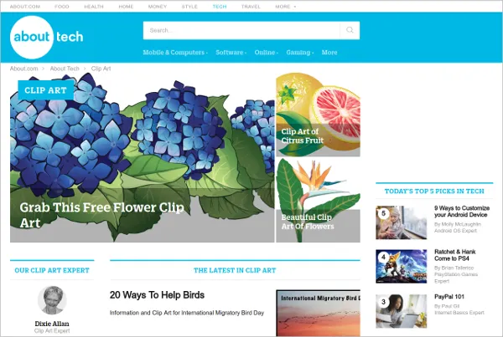

Hosting architecture
Web hosting server
(123.456.7.89)
DNS contains IP-addresses
Users search for www.unique.com sending a query from their browser
DNS server sends back the correspondign IP address: 123.456.7.89
www.unique.com
Browser asks for 123.456.7.89
2
1
3
4
Web host sends 123.45465.7.89 to the browser
Notes:
Web hosting architecture refers to the structure and setup of servers and other components that host websites on the internet. It involves various elements working together to ensure websites are accessible and functional.
Hosting architecture includes e.g.:
Web Server (A web server is a software or hardware that stores website files and responds to requests from web browsers)
Database Server (A database server stores and manages the website's data, such as user information, content, and settings)
Load Balancer (In situations where multiple web servers are used, a load balancer distributes incoming web traffic across those servers)
Content Delivery Network (CDNs are distributed networks of servers located in different geographical locations)
Firewall (A firewall is a security measure that monitors and controls incoming and outgoing network traffic)
Backup and Disaster Recovery (Web hosting architecture includes provisions for regular backups of website data and a disaster recovery plan to minimize data loss and ensure business continuity in case of server failures or emergencies)
Scalability and Redundancy (A scalable web hosting architecture can handle increasing website traffic and resource demands by adding more servers or adjusting resources. Redundancy ensures that if one server fails, another takes over to ensure uninterrupted website availability.)
These components work together to provide a reliable, secure, and high-performing hosting environment for websites. The specific architecture can vary depending on the hosting provider, the website's requirements, and the scale of the web hosting infrastructure.
The course material contains a link to a video explaining DNS servers and web hosts.

Slide 14
Things to consider when choosing your web host
Source: https://www.hostpapa.com/blog/web-hosting/definitive-guide-web-hosting/
A 1-second delay in page load time causes a 7% reduction in conversions
A 4-second delay in page load time results in a loss of 10% or more of site traffic
86% of websites have at least one serious security vulnerability
Migrating to another host can cost thousands of dollars and take weeks, even months, of planning
What kind of website are you building – will it be primarily a source of company information or will it require more interactive elements?
What functionality will your site include – will you have a customer database, and will there be a transfer of private and secure information?
What kind of traffic growth is expected – will it be a blog that sees steadily growing traffic over time, or an eCommerce site that can experience intense traffic spikes?

Slide 15
Things to consider when choosing your web host
Will you need to host multiple websites at multiple subdomains for your site?
Do you plan to scale up and add new functionality as the business grows?
Will you require software integration now or in the future, with 3rd party software (think accounting software, customer relationship management software, ERP, etc.)
Do you anticipate any special coding needs for your site (php, java, .net, etc.)?
What kind of content is being served – will you need a significant amount of reliable bandwidth for an ever-growing audience?
How many pages will your site have – some providers limit the number of pages permitted with value/economic hosting plans.
Is your site critical to the success and growth of your business – how will downtime impact your revenue? Is uptime a critical factor?
Will you need email hosting with your site?
Source: https://www.hostpapa.com/blog/web-hosting/definitive-guide-web-hosting/

Slide 16
10 most important factors when choosing a web host
1. Disk Space
2. Bandwidth
3. Security
4. Uptime
5. Website Speed
6. Pre-Installed Apps
7. Domain Names
8. Website Builder
9. Support
10. Backups
Source: https://www.bluehost.com/resources/features-a-good-web-host-should-provide/

Slide 17
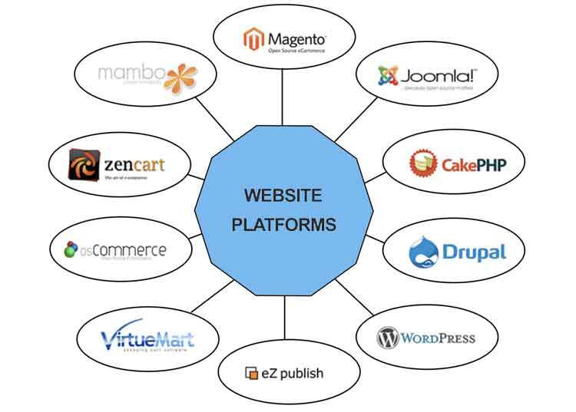
How to find the right development platform for your company?
Notes:
Finding the right development platform for the company involves careful consideration of several factors. Here are some steps to help you in the process:
Identify your company's needs and goals: Understand your company's specific requirements and objectives for the development platform.
Assess available platforms: Research and evaluate different development platforms available in the market.
Consider your technical expertise: Evaluate your team's technical skills and expertise. Determine whether your developers are proficient in specific programming languages, frameworks, or technologies that align with certain development platforms.
Evaluate scalability and flexibility: Consider the scalability and flexibility of the development platform.. Look for features like cloud integration, microservices architecture, and support for modern technologies.
Consider integration capabilities: Determine the platform's ability to integrate with existing systems, databases, and third-party services.
Security and compliance: Security is crucial for any development platform. Evaluate the platform's security features, authentication mechanisms, data encryption capabilities, and adherence to industry regulations and compliance standards relevant to your business.
Cost considerations: Assess the cost implications of the development platform, including licensing fees, hosting expenses, maintenance costs, and any additional tools or resources required.
Seek recommendations and reviews: Consult with industry peers, attend conferences, and engage with developer communities to gather insights and recommendations.

Slide 18
Start with these questions when choosing the website platform:
Do you just display information, or should site visitors be able to interact with the pages?
Are you planning to sell products or services?
Do you need to capture customer data (e.g. contact information) for email marketing or sales?
Will you be managing your site yourself or working with a third-party service provider?
Is there budget for extra features?
How much customization do you want in terms of layout and design?
Do you need to create any unique functionality like quizzes, forms, or newsletters?
https://www.forbes.com/advisor/business/software/best-website-builders/

Slide 19
What you should consider when choosing your web development platform
Mobile site optimization – responsive design
  Mobile optimization is a must, since mobile devices are the devices of choice. Make sure your web platform supports responsive design enabling it to be optimized to whether device it is used by.
SEO options
  SEO visibility is a MUST. Make sure your site give maximum support for SEO.
Design flexibility
  Design flexibility is vital. You want your website to cater to your specific needs and you also want to be able to differentiate from the competition. Also, if you plan to maintain your website by yourself, you will appreciate maximum design flexibility and ease of use.
Themes/templates
  Themes and templates make the designers job so much faster. Existing templates are fast to modify according to the customers’ needs vs. when you start from scratch.

Slide 20
What you should consider when choosing your web development platform
Ease of Use
  Can the users create, manage and update the web site themselves or do they need an (expensive and time consuming) professional to do it
Social Media tools
  Interaction with and ability to share to various social media site improves your marketing efficiency. Make sure your site support this.
Plugins and modules
  The ability to use 3rd party plugins may come in handy in order to add functionality to your site
Support
  24/7 support is very useful, since you don’t want any extra downtime for your website.
Pricing
  Check that you need everything you are paying for.

Slide 21
What you should consider when choosing your web development platform
Popularity
  Unpopular platforms may have underlying quality problems, poor support or they are difficult to use, whereas the sheer volume of users and their websites implies high-quality technical solutions, good support from the developers and peer users and the users find the platform easy enough to use for their business.
Newsletter creator
  Newsletter creator might prove very useful to keep in touch with your customer base.
Blogging, E-commerce, Membership creator
  Depending on your the of business these are not always a MUST features.

Slide 22
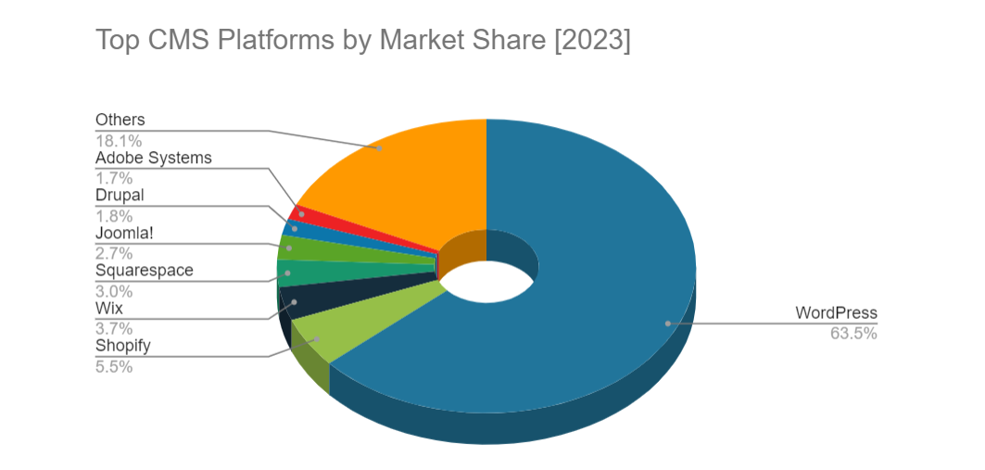
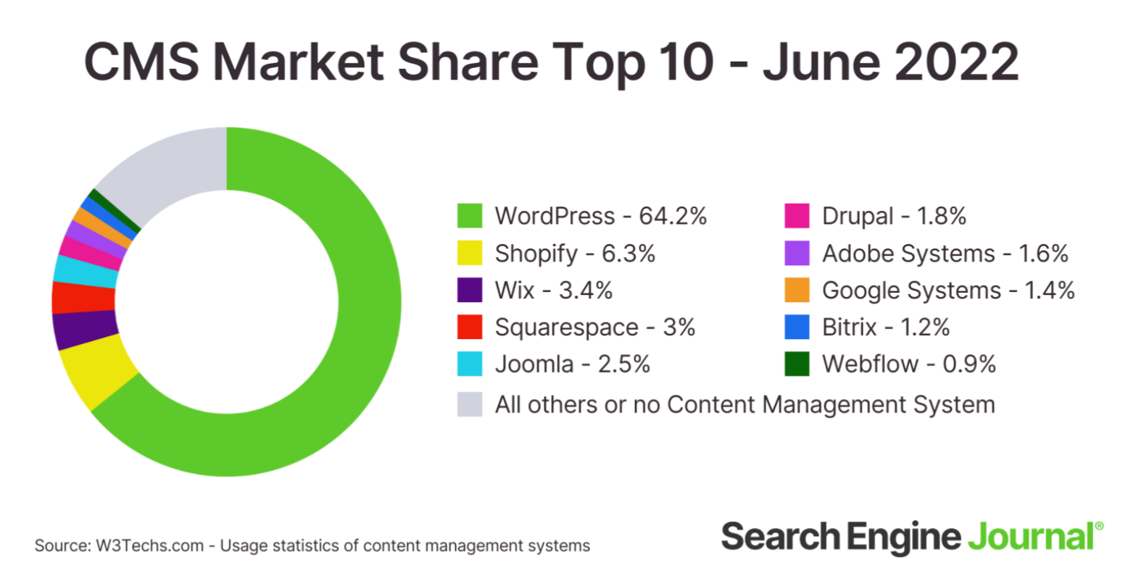
The web platform market is dominated by WordPress
The rest of the market is very fragmented
https://meetanshi.com/blog/cms-statistics/
https://www.searchenginejournal.com/cms-market-share-june-2022/455912/
Notes:
WordPress is the most popular development platform. Here’s a list of the 11 best website builders that have scalable features and professionally designed templates. They’re also quick to set up, easy to customize, beginner-friendly, and very affordable.
Ruth maak hier verwijzing naar forbes bv

Slide 23
The Best Website Builders of 2023 acc. Forbes Advisor
Weebly: “Best Overall”
GoDaddy: “Best for Service Providers”
IONOS: “Best for Startups”
Squarespace: “Best for Creatives”
HostGator: “Best for Simplicity”
Wix: “Best for Code-Free Customizations”
Shopify: “Best for Dropshipping”
Zyro: “Best for Affordability”
WordPress.org: “Best for Versatility”
Duda: “Best for Agencies”
https://www.forbes.com/advisor/business/software/best-website-builders/

Slide 24
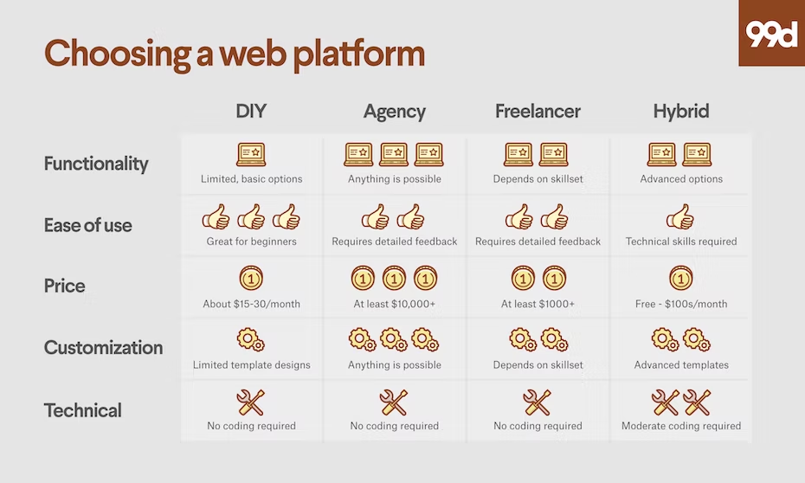
There are many options when it comes to web development
Platform type | Description | When to use | Example
DIY (do it yourself) | Easy-to-use platforms with ready made templates | When simple functionality and cost saving count | WIX, Shopify, etc.
DFM (do it for me) | Website designed and developed by a digital marketing agency | When coding is required ”to get things right” | www.porternovelli.com
Freelancer | Gives you professional support but with a lower cost than a digital marekting agency | When you need help but can live with a local partner | Your local web developer pro
Hybrid platforms | A DIY platform that enables customezed coding | When your DIY platforms needs ”just a littlebit extra” | WordPress
Source: https://99designs.com/blog/web-digital/best-web-platform-small-business/

Slide 25
Homework from section 1B: Planning for a corporate website/basic concepts
Teamwork - 4 students in 1 team
The objective of this assignment for the students to
become aware of the various components in the domain name
understand the concepts and functions on domain name server and web hosting
be aware of the various platforms available for website development
See details in the pdf (Homework from section 1B)
(Print and) Fill out the attached tables found from the Homework from section 1B pdf. file
When analyzing the domain name, pay attention to the type of business/operation the domain is created for.
When analyzing the web hosts, compare the technical differences and the service levels each provides.
When analyzing the development platform, pay attention to the design flexibility, customer support and costs of each.
Prepare to present your slides in class.

Slide 26
Disclaimer
The DEMS material aims to enhance digital marketing skills in higher education, comprehending the essential needs in organizations. You have access to extensive slide sets with in-class activities and assignments, as well as detailed user instructions for teacher.
Note: The material includes contents and figures retrieved from the internet and is thus subject to changes. The sources have been announced according to the rules of fair use. The publisher´s responsibility is restricted to the original material stored at www.dems.pro. All material is produced for open use and co-funded by Erasmus +.

