Slide 1
Websites
1A. Introduction to websites

Slide 2
Learning objectives
Pre-requisite for student: Basics in marketing is recommended.
The objective is to create awareness and provide the context
  on the role of websites in the digital marketing
The student will learn
  the key aspects of a website which contribute to the online presence of a company (e.g. conversion, user experience)
  Learn the basic principles and considerations when setting up a website

Slide 3
Topics
Why every business needs a website?
The big picture
How websites can support different business objectives?
Best practices for a good website
How to set up your website

Slide 4
Why every business needs a website?
Website is the key to a successful digital marketing strategy
  All other digital marketing elements direct users to the website
Website:
  supports the brand and increases trust
  enables organic visibility in search results
  showcases your products and services
  helps generating leads and nurturing existing customers
  delivers content and value
  supports communicating with customers
  assists sales
Notes:
The website plays a pivotal role in a successful digital marketing strategy.
All other digital marketing elements are aimed at driving traffic and directing users to the website.
Your website acts as a central hub for your brand, representing your identity and values.
It provides a professional and trustworthy online presence for your business.
A well-optimized website increases the chances of ranking higher in search engine results.
This helps potential customers find your business organically and drives organic traffic to your site.
Your website serves as a virtual storefront, allowing you to showcase your offerings to a global audience.
You can provide detailed information, images, and videos about your products and services.
By incorporating lead generation forms and call-to-action buttons, your website becomes a powerful tool for capturing leads.
Additionally, you can use email marketing and personalized content to nurture and engage existing customers
Your website is an ideal platform for publishing valuable content such as blog posts, articles, and resources.
By sharing informative and relevant content, you establish authority and build credibility in your industry.
Your website offers channels for communication, such as contact forms, live chat, or customer support portals.
Customers can reach out with inquiries, feedback, or support requests, fostering better customer relationships.
Through your website, you can showcase testimonials, case studies, and success stories to influence potential customers.
It provides an opportunity to highlight special offers, promotions, or discounts to encourage conversions.
Remember, a well-designed and user-friendly website is essential for an effective digital marketing strategy. It serves as the foundation for your online presence and helps you achieve your business goals.

Slide 5
The big picture
Notes:
Learn more from the Module 1. (Introduction to Digital Marketing, part 1. Digital marketing context)!
From the viewpoint of a website, the big picture in digital marketing involves maximizing its online presence, increasing traffic, and achieving specific goals.
Here are some key aspects to consider:
Online Visibility: The website's primary objective is to be easily discoverable by the target audience. This involves implementing effective search engine optimization (SEO) strategies to improve organic rankings in search engine results. It also includes utilizing paid advertising campaigns, such as search engine marketing (SEM) or display ads, to increase visibility on relevant platforms.
User Experience: A website needs to provide a seamless and engaging user experience to attract and retain visitors. This includes ensuring fast loading times, mobile responsiveness, intuitive navigation, and visually appealing design. By optimizing the user experience, the website can encourage visitors to explore further, spend more time on the site, and ultimately take desired actions.
Content Strategy: Content plays a crucial role in digital marketing. The website should have a well-defined content strategy that aligns with the target audience's needs and interests. By creating valuable and relevant content, such as blog posts, articles, videos, or infographics, the website can attract and engage visitors, establish authority in the industry, and encourage social sharing and backlinking.
Conversion Optimization: The website should be optimized for conversions, which means guiding visitors towards specific actions that align with the business goals. This could include signing up for a newsletter, making a purchase, filling out a form, or requesting a quote. By implementing persuasive calls-to-action (CTAs), clear and compelling landing pages, and streamlined conversion processes, the website can maximize its conversion rates.
Analytics and Measurement: To understand the effectiveness of the website and its digital marketing efforts, it's crucial to analyze and measure key metrics. This includes monitoring website traffic, user behavior, conversion rates, and other relevant data. By leveraging web analytics tools, such as Google Analytics, the website can gain insights into visitor demographics, interests, and interactions, which can inform future marketing strategies and optimizations.
Continuous Improvement: The digital marketing landscape is constantly evolving, and it's essential to stay updated and adapt to changing trends and technologies. Regularly monitoring and optimizing the website's performance, experimenting with different strategies, and implementing feedback and user insights can lead to continuous improvement and better results over time.

Slide 6
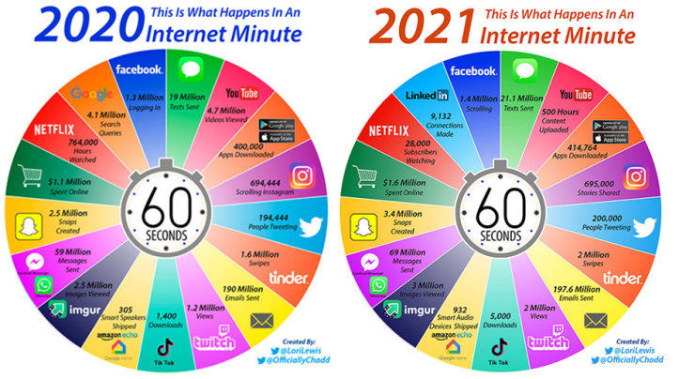
Source: https://ediscoverytoday.com/2021/04/16/here-is-your-2021-internet-minute-infographic-ediscovery-trends/
Notes:
The graphic illustrates what happens within the internet in a typical minute in 2020 and in 2021. There is a lot of activity in the social media every minute. Note that people do not end up on your website by accident.

Slide 7
Direct the discussion from social media sites to your website…
…because there you have their 100% attention
Social media
Sosiaalinen media
Omat kotisivut
Your website
Notes:
You have to engage your audience in the social media in order for attract them to your website. Learn more from the Module 3. (Content Marketing and Social media, part 4. Social media)!
In a nutshell: Social media platforms have billions of active users, providing a vast potential audience for businesses to target and attract to their websites. Social media allows businesses to share engaging content, such as blog posts, videos, and infographics, that can drive traffic to their website. By providing valuable and shareable content, businesses can attract users' attention and encourage them to visit their website for more information or to make a purchase. Overall, social media serves as a valuable channel for driving targeted traffic to a website, leveraging its extensive user base, engaging content opportunities, direct linking, social proof, and remarketing capabilities to increase conversions.

Slide 8






Your website function is to make all of this happen
Recommend
Attract
Interest
Visit
Purchase
Notes:
This slide shows the various tools used at each stage of the inbound marketing process. Learn more from the Module 3. (Content Marketing and Social media, part 1. Content marketing - Definition & Strategy)! The inbound marketing process is a customer-centric approach that focuses on attracting, engaging, and delighting potential customers through valuable content and experiences. It involves several stages that guide prospects from the initial awareness of a problem or need to becoming loyal customers and promoters of a brand.
The key stages of the inbound marketing process are as follows:
Attract: The first step is to attract the attention of the target audience. This is done by creating and promoting relevant and valuable content through various channels such as blog posts, social media, search engine optimization (SEO), and paid advertising. The goal is to drive qualified traffic to the website or landing pages.
Visit/Convert: Once the audience is attracted, the next step is to convert them into leads by capturing their contact information. This is typically done through lead magnets like ebooks, whitepapers, webinars, or gated content. By providing valuable content in exchange for their information, businesses can start building a relationship with the leads.
Interest/Nurture: After capturing leads, the focus shifts to nurturing them through targeted and personalized communication. This is done through email marketing, marketing automation, and other tactics that provide relevant content based on the leads' interests and needs. The goal is to build trust, educate, and guide the leads through the buyer's journey.
Purchase/Close: Once the leads are nurtured and qualified, the next step is to convert them into customers. This is achieved by providing tailored offers, product information, and incentives that encourage them to make a purchase. Sales teams may also play a role in closing the deals by engaging in direct communication and addressing specific needs or objections.
Recommend/Delight: The inbound marketing process doesn't end with the sale. It extends to the post-purchase stage, where the focus is on providing exceptional customer experience and support. By delivering value, addressing customer concerns, and fostering customer satisfaction, businesses can turn customers into brand advocates who are likely to promote the product or service to others.

Slide 9
Business objectives

Slide 10
Common business objectives regarding websites
Increase online visibility
Generate leads
Drive conversions
Enhance brand awareness
Provide customer support
Establish thought leadership
Improve customer engagement
Enhance user experience
Support sales and e-commerce
Gather customer feedback and insights
Notes:
When it comes to websites, there are various business objectives that organizations may have. Some common business objectives regarding websites include:
Increase online visibility: One of the primary objectives is to improve the website's visibility in search engine results, increase organic traffic, and attract more visitors to the site.
Generate leads: Websites can be designed to capture user information through lead generation forms, allowing businesses to build a database of potential customers and prospects.
Drive conversions: The goal may be to encourage visitors to take specific actions on the website, such as making a purchase, signing up for a newsletter, or requesting a quote.
Enhance brand awareness: Websites can serve as a platform to showcase the brand's identity, values, and offerings, helping to create awareness and recognition among the target audience.
Provide customer support: Websites can offer self-service options, FAQs, knowledge bases, or live chat features to assist customers with inquiries, support requests, and problem-solving.
Establish thought leadership: Publishing high-quality content, such as blog posts, articles, or whitepapers, can position the business as an industry expert and thought leader, enhancing credibility and reputation.
Improve customer engagement: Websites can be designed to encourage visitor interaction through comments, social sharing, or user-generated content, fostering engagement and building a community.
Enhance user experience: A key objective may be to provide a seamless and user-friendly experience, ensuring easy navigation, fast loading times, mobile responsiveness, and accessibility for all users.
Support sales and e-commerce: Websites can serve as online stores, providing product catalogs, secure payment options, and order processing capabilities to facilitate sales transactions.
Gather customer feedback and insights: Websites can include surveys, feedback forms, or social listening tools to gather valuable customer feedback and insights for improving products, services, and overall customer satisfaction.
These objectives may vary depending on the industry, target audience, and specific business goals. It is important to align website objectives with overall business objectives and regularly track and analyze website metrics to measure success and make necessary adjustments.

Slide 11
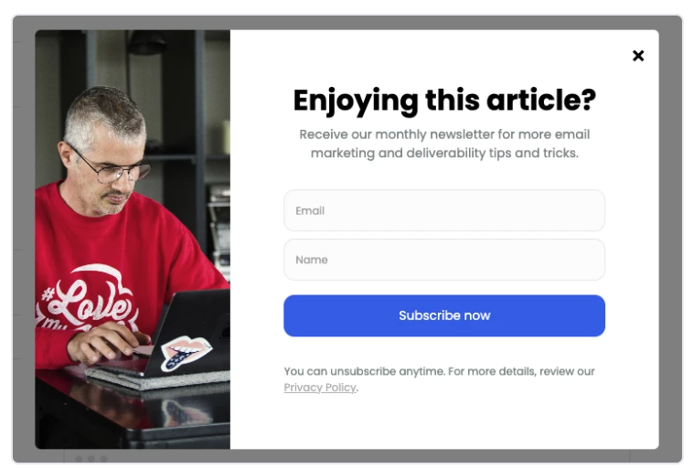
Website examples of objectives
Generate leads:
Source and more information: https://www.mailerlite.com/blog/inspiring-examples-of-email-pop-ups-and-why-they-work?
Notes:
Here’s an example how businesses can generate leads with popups.
A popup is a graphical user interface element that appears on top of the current webpage or application window. It typically displays additional information, messages, or prompts to the user. Popups can be triggered by various events, such as clicking a button, submitting a form, or navigating to a specific page. They

Slide 12
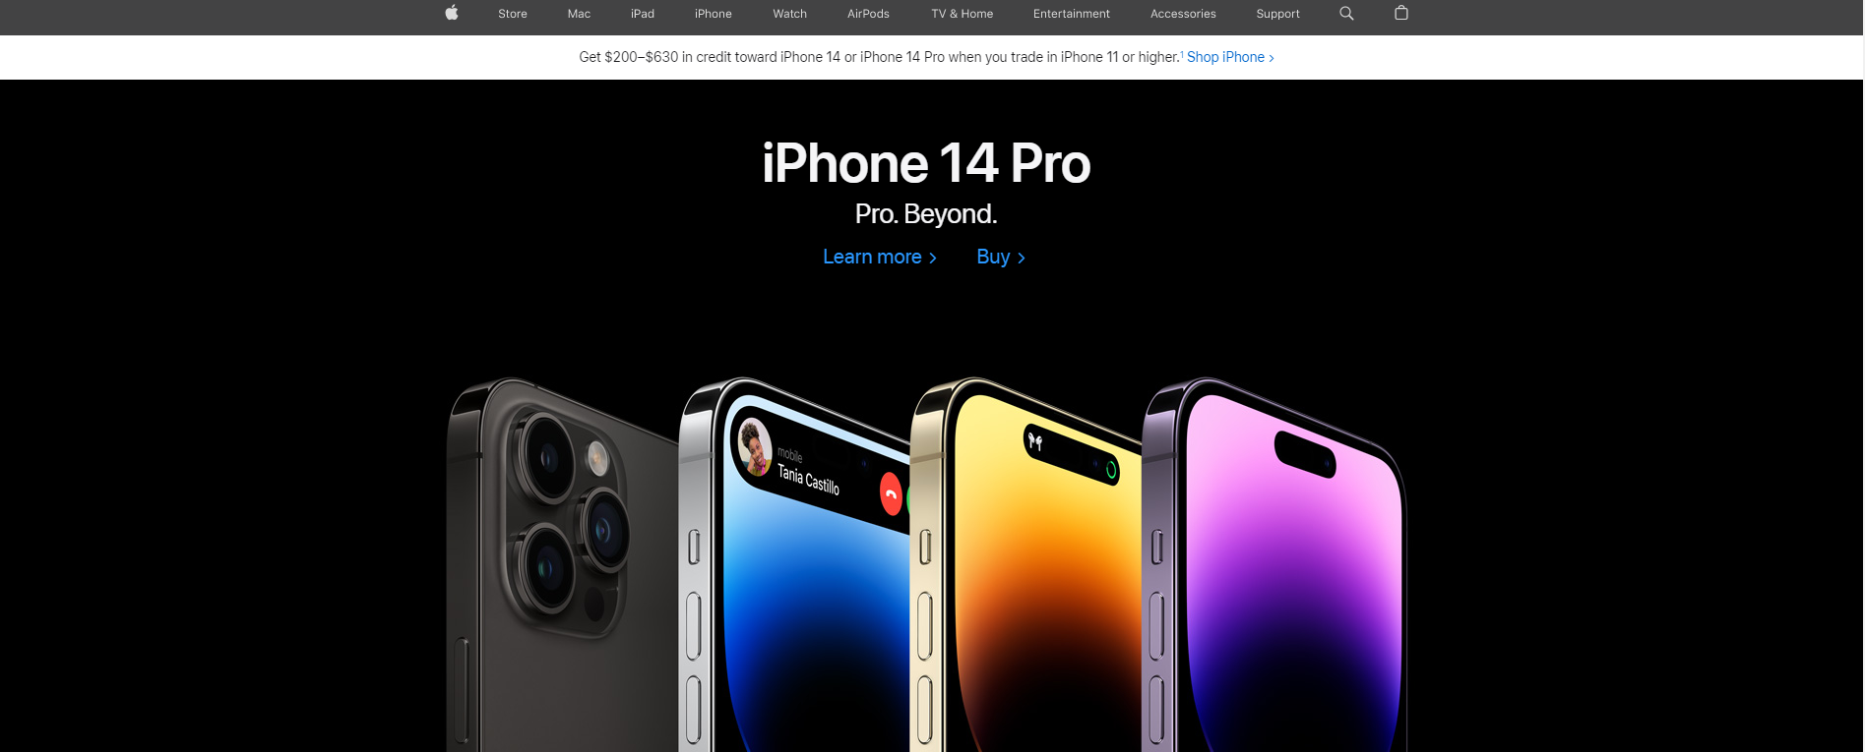
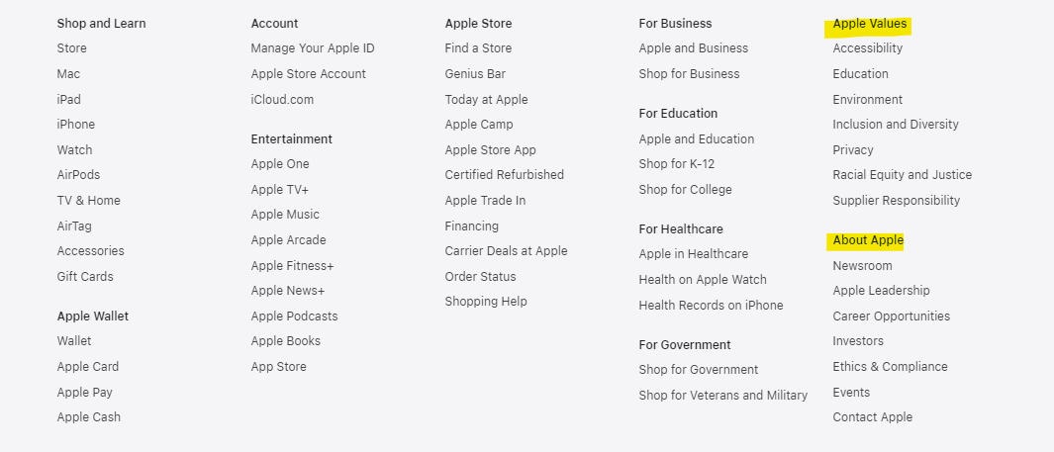
Website examples of objectives
Enhance brand awareness:
https://www.apple.com/
Notes:
Apple is always a good example of an exquisite and systematic brand work. The visual elements in their website are in line with their other marketing presence. They have also lots of info about the brand (e.g. values) in the footer of the website

Slide 13
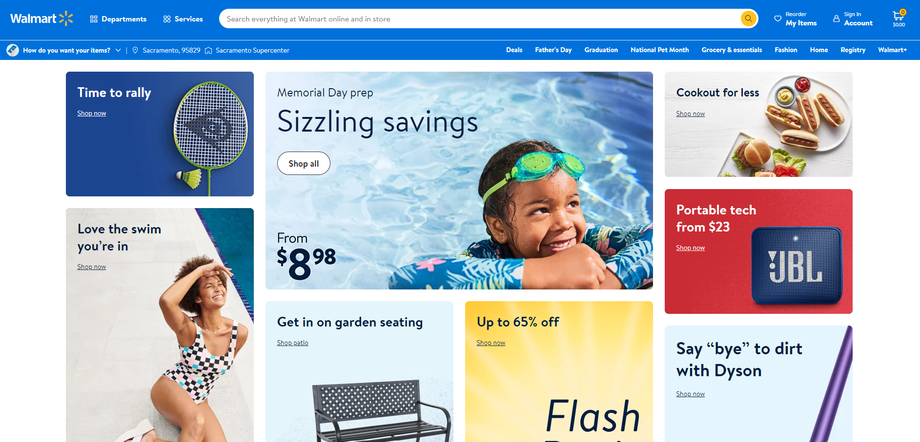
Website examples of objectives
Support sales (e-commerce):
https://www.walmart.com/
Notes:
Walmart is a multinational retail corporation that initially operated physical stores. It started as a traditional retail chain, offering a wide range of products in its physical locations. However, with the rise of e-commerce and the increasing popularity of online shopping, Walmart recognized the need to establish a digital presence. Over the years, Walmart has made significant investments in its e-commerce capabilities and launched its online platform, Walmart.com. Today, Walmart operates both physical stores and a robust e-commerce platform, allowing customers to shop online and have items delivered to their doorstep.

Slide 14
Website examples of objectives
More examples?
Notes:
Find more examples from your own country how businesses uses their website to support business objectives.

Slide 15
Best practices for a good website
Notes:
Website’s best practices should be tailored to your specific audience, industry, and business goals. Regularly evaluate and optimize your website to ensure it aligns with evolving trends and user expectations.
Here are a few noteworthy areas to mention:
Website Design and User Experience: Focus on creating an aesthetically pleasing and user-friendly design that enhances the overall user experience.
Content Strategy: Develop a comprehensive content strategy that aligns with your target audience's interests and provides valuable information or solutions.
Search Engine Optimization (SEO): Implement SEO techniques to improve your website's visibility in search engine results and drive organic traffic.
Mobile Optimization: Ensure your website is optimized for mobile devices to accommodate the increasing number of mobile users.
Conversion Optimization: Optimize your website's layout, calls-to-action, and forms to maximize conversions and achieve your desired goals.
Social Media Integration: Incorporate social media buttons and sharing options to encourage visitors to engage with your content and share it with their networks.
Analytics and Tracking: Utilize web analytics tools to track and measure website performance, user behavior, and key metrics for continuous improvement.
Security and Trust: Implement necessary security measures, such as SSL certificates, to ensure user data protection and build trust with your audience.
Speed and Performance: Optimize your website's loading speed to provide a seamless browsing experience and reduce bounce rates.
Accessibility: Ensure your website is accessible to all users, including those with disabilities, by following accessibility guidelines and standards.

Slide 16
Best practices for a good website
1. Your website satisfies user intent and has a clear goal
Know your audience! What are they looking for? What do they really need?
Uncover all the different ways of how people can end up to your site (utilize e.g. user journey map) & tailor your site to answer their questions/needs.
What is the conversion (=the desired action) for your business?
2. Your website has technical prowess
A good website is easily crawlable and shows search engines what they can and can’t index.
Good sites don’t have a huge amount of errors.
A good website loads super fast, from anywhere in the world.
Notes:
Shortly about the tech part:
Crawlability and Indexability: A good website is easily crawlable by search engine bots, allowing them to navigate and understand its content. It also utilizes techniques like robots.txt and XML sitemaps to indicate what should and shouldn't be indexed.
Minimal Errors: Good websites strive to minimize errors and issues that can hinder user experience and search engine performance. Regular maintenance and testing help identify and fix any broken links, missing pages, or other errors.
Fast Loading Speed: A good website loads quickly, providing a seamless user experience regardless of the user's location. Optimizing images, leveraging caching techniques, and employing content delivery networks (CDNs) are some strategies to ensure fast loading times.

Slide 17
Best practices for a good website
3. Your website is trustworthy, safe and secure
Search engines like Google want to give searchers the best possible result.
Google will show first the results that have proven to be a good and trustworthy Remember to work on your trustworthiness on all levels, both technical as well as in content!
In addition, your site should be a safe haven for visitors.
A hacked site is easier to prevent than it is to fix.
Use up-to-date software
Have your SSL (Secure Sockets Layer) in order
Create strong passwords
Use tools such as Cloudflare to protect your site from DDoS (a distributed denial-of-service) attacks.
Notes:
SSL (Secure Sockets Layer) is a security protocol that provides secure communication over the internet. It ensures that data transmitted between a user's web browser and a website's server remains encrypted and cannot be intercepted or tampered with by unauthorized individuals. SSL uses encryption algorithms to create a secure connection between the client and the server, protecting sensitive information such as passwords, credit card details, and personal data. When a website has an SSL certificate installed, it is indicated by the presence of "https://" in the URL and a padlock icon in the browser, giving users confidence that their data is being transmitted securely. SSL certificates are commonly used for e-commerce websites, login pages, and any other web application that requires secure data transmission. (see more later in slides)
DDoS (Distributed Denial of Service) is a type of cyber attack aimed at overwhelming a targeted website or online service by flooding it with a massive amount of traffic. The objective of a DDoS attack is to disrupt the normal functioning of the targeted system, rendering it inaccessible to legitimate users.

Slide 18
Best practices for a good website
4. Your website has a great design and awesome UX (user experience)
Your site reflects your company, your products, your services and ultimately your brand.
The design of your website needs to help fulfill the goals you set
Your message should come across loud and clear.
Site should be clear and easy to use for everyone (usability)
Site should be accessible for everyone (accessibility) e.g.:
  proper alternative text for images
  video with subtitles
Consider user experience:
  consider all aspects of the user's interaction, including their perceptions, emotions, and behaviors
  focus to create user-centered, intuitive websites, which are effective in fulfilling user needs and goals
  involves understanding the target user, their behaviors, motivations, and pain points → design solutions that addresses these factors!
Great site design = More trust = Better conversions
Notes:
UX (User Experience) refers to the overall experience that a user has while interacting with a website, especially in terms of how easy or enjoyable it is to use. It encompasses all aspects of the user's interaction, including their perceptions, emotions, and behaviors. UX design focuses on creating websites, products, services and experiences that are user-centered, intuitive, and effective in fulfilling user needs and goals. It involves understanding the target users, their behaviors, motivations, and pain points, and designing solutions that address these factors.

Slide 19
Best practices for a good website
5. Your site has helpful, relevant and user-centered content
Be user-centered, not company-centered.
Understand your user & their behavior: good content helps your users accomplish their goals → offer different content at the right moment of the customer journey while keeping the business goals firmly in mind.
6. Your site is mobile-friendly (or rather, designed mobile-first)
For the last couple of years, mobile traffic has kept growing and growing.
Mobile-first is not a new concept, but most sites are still being developed desktop-first.
Adopting a mobile-first mindset helps you focus on the tasks users should be able to perform on your mobile site.
It helps to come up with a minimal and fully focused design → Less is more!

Slide 20
Best practices for a website in a nutshell
A good website is effective
  a website is effective when it contributes to the organisation goals
  the main goal is conversion (see lecture 3)
  a positive customer experience on the website is the key to a successful conversion
A good website is user-friendly
  to achieve a positive customer experience the design and structure of the website must be user–friendly
  the overall experience of the visitor interacting with a website which should be easy and enjoyable
  UX is the key to user-friendliness (see lecture 4)

Slide 21
In-class activity
Form teams of 3-4 students
Find and analyse 2 different corporate websites
Discuss with your team and create a PowerPoint presentation which includes
  Why is the website good?
  Why is the website bad?
  How did you come to the conclusion?
  Where are you looking at to reach this conclusion?
Present your findings in class
Use 30 minutes for analysis, total 10 minutes presentation time where 5 minutes are used for presentation of your findings to the class and reserve 5 minutes for discussion on your presentation

Slide 22
How to set up your website?

Slide 23
You will need
A domain name
A web host
A web development platform

Slide 24
How to build a website?
Step 1: Select and purchase your domain
“Domain name” or “website address” is what someone will type into their web browser to reach your website
Step 2: Select the website building platform (CMS)
WordPress, Wix etc.
Step 3: Conduct a keyword research
Which are the most important keywords for your business? How do you want to be found in Google?
Utilize Google Keyword Planner
Notes:
Keyword research is the process of identifying and analyzing the specific words and phrases that people use when searching for information, products, or services on search engines. It plays a crucial role in search engine optimization (SEO) and content marketing strategies.
Detailed instructions to keyword research found e.g. from here: https://blog.hubspot.com/marketing/how-to-do-keyword-research-ht

Slide 25
How to build a website?
Step 4: Design your layout and navigation
To whom are you designing the site? Who are your customers?
Brand colors, logo, fonts, photos, videos...
Clear navigation helps user find what she/he is looking for
What are the most important keywords, products or services?
Structure: Pages, blog?
What is the purpose of the website? What is the conversion?
Minimum Viable Product (MVP): MVP decision could be not to finish a section of a site that isn’t critical in order to get the site live faster.
Remember: Less is more!
Notes:
A Minimum Viable Product (MVP) for a website refers to the initial version of a website that contains the essential features and functionalities required to satisfy early users and gather feedback for further development. It is a strategy commonly used in web development and product management to quickly launch a basic version of the website with core functionalities while minimizing time and resource investment.
For deigning for your customers and navigation and structure see also lecture 2

Slide 26
How to build a website?
Step 5: Pick and customize a design template which represents your brand
navigation bar (menu)
design (need some additional CSS code?)
functionalities & features (plugins, apps schema structured data, contact forms, anti-hacking defense, caching, newsletter opt-in forms & subscription management, SEO software, backup utilities, XML sitemap...)
→ Help from a web developer?
Step 6: Identify where will the traffic come from?
Social media channels
Blogging
Backlinks from other sites
Email marketing
Content marketing strategy
Notes:
Learn more about generating traffic to the website from the Module 3. Content marketing & Social media

Slide 27
How to build a website?
Step 7: Launch
Crawl & backup the old site
Push the site live
Post-launch diagnostics: broken links, redirects, missing assets etc. (utilize e.g. Screaming Frog)
Add your site to Google Search Console to be indexed
Celebrate your launch in social media and other marketing channels.
Step 8: How to measure your success?
SMART goals
Website KPI’s
Use Google Search Console, Google Analytics 4, Meta Pixel...
Notes:
Screaming Frog is a popular website crawler and SEO tool used for website analysis, auditing, and optimization. It is a desktop-based software that crawls through a website's URLs, analyzing various aspects such as on-page elements, technical SEO issues, broken links, duplicate content, and more.
Google Search Console is a free web service provided by Google that allows website owners to monitor and manage their website's presence in Google search results. It provides valuable information and tools to understand how Google sees and interacts with your website. Google Search Console allows you to submit your website's sitemap, which helps Google's crawlers discover and index your web pages more efficiently. It ensures that your website's content is included in Google's search results.

Slide 28
Assignment 1: Planning for a corporate website/building your own site
Teamwork - 4 or 5 students in 1 team
“Your team is the management team of a recreational company which offers lodging and recreational services of your choice.”
The objective of this assignment is to create an imaginary business
This exercise will serve as the basis for the rest of the course’s assignments
First assignment: see details in the document (Websites_Homework1)
define the company’s products and services
define its markets and marketing objectives or the next 12 months
choose a domain name

Slide 29
Disclaimer
The DEMS material aims to enhance digital marketing skills in higher education, comprehending the essential needs in organizations. You have access to extensive slide sets with in-class activities and assignments, as well as detailed user instructions for teacher.
Note: The material includes contents and figures retrieved from the internet and is thus subject to changes. The sources have been announced according to the rules of fair use. The publisher´s responsibility is restricted to the original material stored at www.dems.pro. All material is produced for open use and co-funded by Erasmus +.

