Slide 1
Introduction to Digital Marketing
3. Digital tactics and operations
Notes:
After setting strategy, this section presents shortly instruments to reach the objectives, i.e. where and how we can reach our target audiences in the digital environments. These operations form the major part of the daily work of marketing activities. Their conduct are taught more in detail in the modules ‘Website and SEO’, ‘Digital advertising’ and Content marketing and social media’..

Slide 2
Learning objectives
Prerequisites: Digital marketing context; Digital marketing strategy
The student is able to
Define target groups deriving from the corporate strategy
Outline value proposals and marketing messages
Analyze and classify digital marketing channels to reach target audiences
Create outlines for digital marketing campaigns responding to strategic objectives
Define tools and KPIs to measure results
Notes:
After completing this course you know how to:
- Define target groups deriving from the corporate strategy
- Outline…….etc.

Slide 3
Topics
From strategy to implementation
Value proposition and marketing message
Defining target audiences
Customer journey and marketing funnel
Digital media and channels
Setting objectives
Measuring marketing impact
Notes:
These are the subjects we will discuss in this module.

Slide 4
From strategy to implementation

Slide 5
From strategy to implementation
Marketing must be fitted according to the strategy set by the organization (presented in the submodule)
Essential constraints determined by the strategy are
- potential of the market and competitors
- type and purpose of web visitors to be reached
- new customers acquisition (‘awareness’)
- customer engagement (‘interest’)
- customer experience (‘desire’, ‘decision’)
- customer conversion (‘action’)
Tactics and operations cover the selected digital communication and channels to fulfill these strategic objectives.
Notes:
Earlier you learned how to set a digital marketing strategy. In this part you learn how to go from a strategy to implementation. Strategy implementation is the process of turning your strategic plan into action. Whether you’re executing a new online marketing plan to increase sales or introducing a new work management software to increase efficiency your plan is only as valuable as the implementation.

Slide 6
Defining the online opportunity
Business objectives
Evaluate digital marketing performance
Set digital marketing strategic objectives
Assess online marketplace
Selecting the strategy approach
Define customer value proposition
Define digital marketing strategy
Define segments
Implementation and practice
=Digital marketing tactics and operations
Digital marketing strategy development process.
Source: Adapted from Chaffey & Smith, 2017, p. 29.
Digital relationship marketing
Digital marketing experience
Digital marketing mix
Measure and control
Notes:
In this submodule we will deal with digital marketing tactics and operations, i.e. which marketing instruments and channels to use in order to achieve goals and objectives set. Which segments can you define in your target group and what does it mean for the digital marketing mix? What is the value proposition? What does your customer experience on the different touch points of a company/organisation/brand. And how to measure and control it in order to improve. We will examine the main elements of them and how they should be used depending on the strategic parameters.

Slide 7
Core elements and challenges of marketing tactics
Define customer
Value proposition
Define segments
Digital marketing mix
How to form your core message(s)?
You must be unique.
You must be convincing.
Which are your target audiences?
They should be comprehensive.
They must be definable.
You must be able to name channels where you reach them.
In which media and channels can you reach your target audiences?
How to select the right media out of the abundance of them?
How to find the best ROI, i.e. the impact compared to investment?
How to measure the impact?
Challenges
Notes:
These topics were discussed in the start of this module. Define customer value proposition :
A value proposition is a simple statement that clearly communicates the product or service benefit(s) you promise to deliver to your customers. It's ultimately what makes your product attractive to your ideal customer.
In a core message you describe the key points you want your audience to remember about your brand. It's the essence of who you are and what you do, boiled down to a few sentences or phrases.
Define segments
Defining different segments for you target audiences help you to better understand your target audience and enables companies to satisfy a variety of customer needs by offering different bundles and incentives. Different forms and promotional activities will be used for different segments based on that segments needs/ wants and characteristics.
Digital marketing mix
After defining your target audience and segments you analyze where they are active. Which media and channels do they use? In order to select the right media to reach them.

Slide 8
Value proposition and marketing message

Slide 9
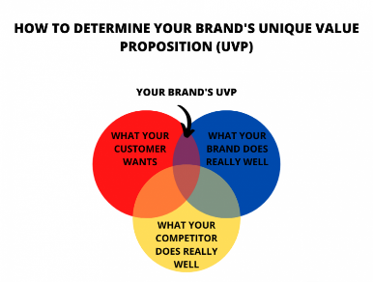
Value proposition
Is necessary for distinguishing from competition
Tells concisely why a product or service is best suited for any particular customer.
Forms the core of marketing messages
Examples and further reading on value proposition
Note: the difference between Value proposition and marketing message is that a value proposition is a long-time statement reflecting the company brand, whereas marketing messages are created for individual campaigns
Source: Clixpert
Notes:
A value proposition is a simple statement that clearly communicates the product or service benefit(s) you promise to deliver to your customers. It's ultimately what makes your product attractive to your ideal customer.
In a core message you describe the key points you want your audience to remember about your brand. It's the essence of who you are and what you do, boiled down to a few sentences or phrases.
A marketing message is the words you use to communicate with your audience to convince them to do business with you. Your message is influential in helping your target audience meet your business goals, as it can be the difference between a new acquisition or sending a customer on to your competitor.
The value of a brand needs to be translated into an understandable message. This can be over time as well; to build the brand. This is rarely an individual campaign.

Slide 10
Criteria for good advertising
Consistent in look and message
  Aligned with company total strategy
  This creates resonance
Targeted to right audiences and relevant for them.
  Meet right persons at right time
Trustworth and valuable
  Present evidence on relevance
Accessible through relevant customer touch points
  Know where your customers move!
Measurable for its impact
Notes:
THIS SLIDE CAN BE DELETED

Slide 11
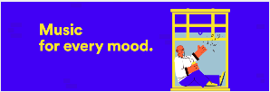
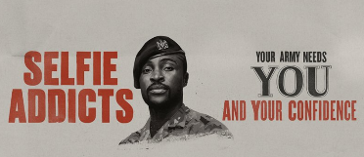
Elements of a good marketing message?
Respond to your customer´s needs, values and style
Describe your solutions and benefits
(and differentiate from competitors when possible)
Say something original
Keep it clear and concise
More examples and further reading on ‘How to create a marketing message’
Notes:
These criteria are very important if you want to create a good marketing message.

Slide 12

Example of a marketing message
Notes:
Source: chipotle.com
Chipotle
Do you think this is a good marketing message or not? Why? (You can ask about specific elements to get more specific answers.)
People with dietary restrictions or food preferences that don’t align with mainstream ideas of nutrition are often unable to find food they can eat at fast-food restaurants.
Chipotle’s marketing message, shown in the image below, reads “Find your plant power.” The brand is speaking directly to those with diverse needs, inviting them to try its expanded menu with plant-based options and letting them know that they recognize the gap in the market for their needs.

Slide 13
In-class activity
Search for a marketing message that you think meets a good message.
Analyze what it is that makes it a good message (reflect on what you learned).
Present your example in class.
Notes:
This activity would suit best to do in pairs. Time needed appx. 20 minutes. Presentation: 2-3 groups present their work. Discussion follows.

Slide 14
Defining target audiences

Slide 15
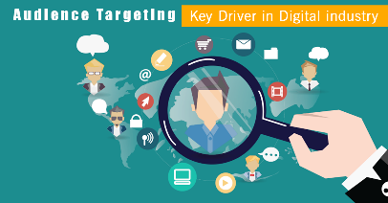
Target audience
Digital marketing campaigns are directed towards target audiences that are mentioned in the strategy
A target audience consists of people who are potential users of the product/service and benefit from it
source: Digital Floats
For stating the right message and channel, it is necessary to define the characteristics of the target audience and the media where they can be found
There are many characteristics to consider when building a picture of your target audience, for instance
    Age, income level, hobbies, location, budget
    Internet device
    Internet search history, prior purchases, prior encounters with your business
Notes:
All marketing actions cost money, thus ‘targeting’ is a key principle in marketing. If you don´t know your target audience, you won´t be able to a)state messages that apples them, nor b)select the right channels where they can be reached. All this would mean that a lot of money is wasted. The better you can identify your target audience and their needs, the better you can state clear messages, reach them, and thus get impact for your marketing activities.

Slide 16

Targeting - target audience
Notes:
Question to students: Why do you think I show this video?
The video itself should arise a wide range of thoughts. Ask your students to make a list on them! For instance: It has many references to ‘audiences’ - the differences of people, options for classifying them, etc. On the other hand, in communications and marketing one essential thing is to find similarities. One dimension is discussing the message the video aims to transmit (it is produced by the Danish TV).
We live in a time where we quickly put people in boxes. Make sure when targeting you choose the relevant ‘groups’.

Slide 17
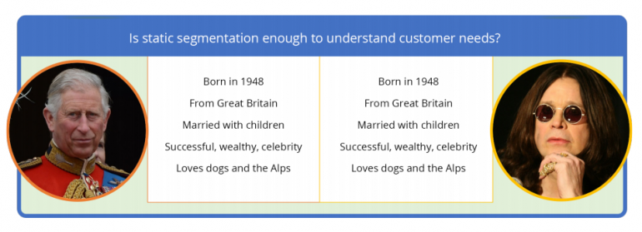
Targeting - target audience
Notes:
Demographic information alone may not be enough to design programs and products. Prince Charles and Ozzy Ozbourne are two total different personalities with different needs, problems and challenges. Make sure you make relevant segments.

Slide 18
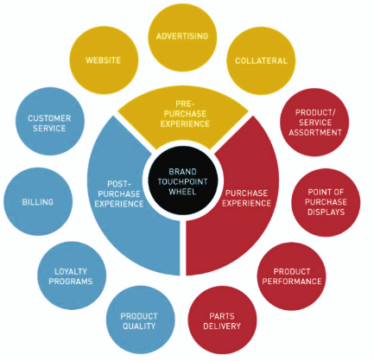
Customer touch points
Normally, a business has a number of points to meet its customers, and vice versa
It might be the website, service-desk or shop
Digital touchpoints are the different moments in which a customer comes into contact with a company through online channels.
Defining these touch points is necessary for communication with the target audiences
Source: Wikimedia, Izzy Stangl
Notes:
A touchpoint can be defined as any way a buyer interacts with a brand, whether it be person-to-person, through a website, or any form of communication. When customers interact with a brand, it gives them an opportunity to compare their prior perceptions of the business and form an opinion.
The Brand Touchpoint Wheel displays the various ways in which consumers interact with an organisation’s brand, creating higher brand education (or presence). Four main touchpoints generally represent the different dimensions of the brand-consumer relationship: pre-purchase touchpoints (factors that influence whether a prospect will consider purchasing a brand, such as advertising, word-of-mouth, DM and online); purchase touchpoints (factors moving a customer from consideration to purchase, such as field sales and physical stores); post-purchase touchpoints (factors reinforcing the purchase decision, such as customer service); and influencing touchpoints (factors that make an impression on customers and various stakeholders, such as annual reports, analysts' reports, word of mouth and recruiting materials). “Purchase Experience” is the point in the buying process that converts the prospective customer into actually buying if they see the benefits are great enough. The Brand Touchpoint Wheel demonstrates that the sales force is a large contributor in this experience, as it leaves the buyer feeling either satisfied or dissatisfied with the process.
When analyzing the customer touch points it is good to analyze all the touch points and not only the digital ones in order to get a broad idea of the experiences of the customer and to see where you can improve with the digital elements.

Slide 19
Customer journey and marketing funnel

Slide 20
Every business is in a different strategic position
Businesses are in various positions in their market (e.g. newcomers, challengers, established or declining brands)
In addition to target audiences, the market’ consists of competitors – these must also considered in the strategy
Implications:
  For all organizations, it is essential to identify their strategic positions
  Newcomers have far more challenge in creating awareness, establishing confidence and reaching new customers
  Established organizations may put more effort in reinforcing their customerships and brand
Marketing operations should be adapted to respond your business´ strategic position
Notes:
The connection between strategy and marketing are discussed in the submodule 2 of this course.
Source: “How brands grow” from Byron Sharp (part 2), a must read. It's easier to sell to an existing customer, so be careful you don’t only focus on new customers.

Slide 21
Target audience and their
‘buying processes’
Only certain consumer goods are bought on instant basis
In special goods trade and B2B,, most purchases involve a ‘buying process’
This process involves evaluation and comparison
It can take minutes, days or months
A variety of digital customer touch points are involved in this process (ads, social media, blogs, websites, etc.)
Taking these things in account facilitates a business to do successful marketing
Notes:
It is not unusual that business consider their whole target audience as a homogenous mass. In reality, there are those who just heard for first time of a product or service, and those who have been comparing different options for months. Moreover, people tend to hear and learn of products and services via distinct channels and touch points (as presented in slide 17).

Slide 22
Models to describe the buying process
Along the past decades, plenty of models have been created to describe the buying process.
The most commonly used alternatives are called the Marketing Funnel (a.k.a. AIDA), the Customer journey and the RACE models.
These models are useful in planning marketing and advertising tactics and operations, as they offer topics for messages and channels where to meet the customer. They suit well in the digital marketing processes as well.
AIDA and Customer journey are models to get more insights in the buyer’s point of view. RACE helps an organization to reply to these buyer’s stages.
Notes:
Next, these models are presented more in detail. Additional information can be found in internet as well, by using these search words.

Slide 23
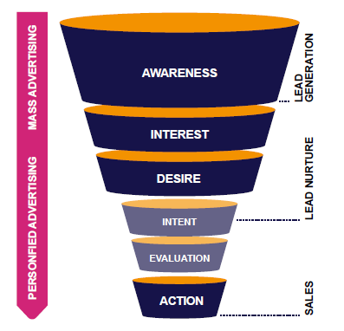
Marketing Funnel (a.k.a. AIDA)
We receive a great number of commercial signals and messages each day - most of them, as well as the businesses offering them - remain unknown for us.
Before we go to action (click a link, enter a shop, make a purchase), we want to know more about the business or the product, to get convinced.
The Marketing Funnel offers various implications:
the buying process encompasses a certain path where marketing and sales have a big role
in the upper part mass advertising is needed, whereas the mid-part is sales work, also called as nurturing the buyers
    only a few processes lead to purchase (action)
    -> businesses strive to improving the efficiency of their funnel
Further reading
Notes:
The ‘Marketing Funnel’ is a useful model in the marketing planning process. It gives closer indication to which topics are relevant in advertising and where you should advertise.

Slide 24
Marketing Funnel and buyer stage
The potential buyer:
Becomes aware of own need, or becomes affected by a certain brand
Wants to know more, searches information of brand/product/service
Knowledge has risen; overweighs best solutions
Does comparison; evaluation; intends to be convinced
Has selected most appropriate solution; makes decision
Notes:
Anyone of us has experience of buyer processes. Think about how it was when you planned the purchase of your car or setting a new garden … . For a marketer it is highly valuable to identify the character of buyer stages, and especially the thoughts, doubts and questions that potential buyers have.

Slide 25
Marketing Funnel and buyer touch points
Buyer touch points (digital):
Advertisement (Google Ads, Display ads, Shopping, Local ads, Youtube ads, …); Blogs; Websites
Content on businesses´ websites; Social ads; Reviews
Newsletters; Social media; Q&As´ on businesses´ websites; personified emails
Item related blogs & websites; social media
Conducting purchase - ordering & shopping online
Notes:
Identifying the potential touch points and media where buyers get informed helps the marketer to define the channels and media for reaching the target audiences.

Slide 26
In-class activity for applying the AIDA-model
Choose a campaign that caught your attention.
Analyze how this campaign runs through the AIDA model (buyer’s point of view). How does it create awareness, interest, etcetera?
Present your example in class.
Notes:
This activity would suit best to do in pairs. Time needed appx. 20 minutes. Presentation: 2-3 groups present their work. Discussion follows.

Slide 27
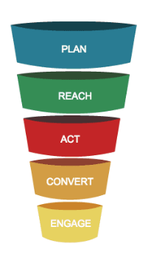
The RACE model
How a business can reply to the buyer stages:
              Make a plan (for different target audiences)
              Approach and reach customers - target the right customers at the right time and place
              Take actions - try different things and study what works best
              Turn leads into customers and monetize your marketing efforts
              Build customer loyalty - thrilled customers will spread good word
Figure source: smartinsights.com
Further reading: video by Dave Chaffey
Notes:
As we can see, the RACE model encompasses the marketer´s point of view, suggesting which types of activities should be done, to reply the buyers´ stages.

Slide 28
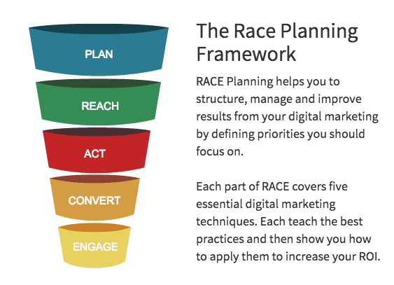
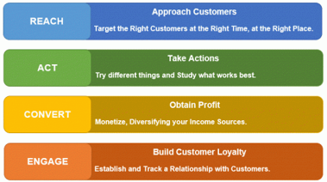
RACE
Notes:
Source: smartinsights.com
RACE covers the full customer lifecycle or marketing funnel: Reach > Act > Convert > Engage (with an initial Plan phase for your goals and programme purpose.) The four steps in the framework (R>A>C>E) map to your digital marketing activities, which seek to engage your prospective customers throughout their decision-making journey, from awareness and consideration, through trial to purchase.
With the RACE framework it becomes easier to see the woods for the trees, and to focus on the components that will improve the lead-generation and sales opportunities for the business.

Slide 29
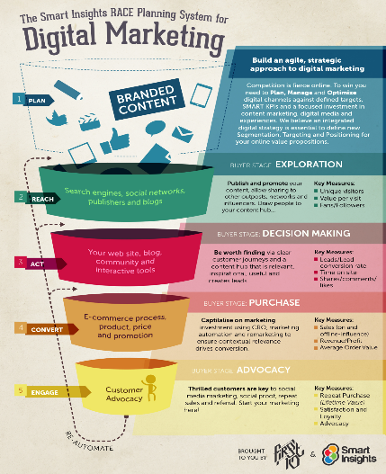

Further implications of the RACE Model
Notes:
Source Dave Chaffey: https://www.davechaffey.com/digital-marketing-glossary/race-marketing-planning-model/
Video: The RACE marketing planning framework - YouTube

Slide 30
In-class activity for applying the RACE-model
Choose a campaign that caught your attention.
Analyze how this campaign runs through the RACE-model (company’s point of view). How does it reach customers? What are the following steps that drive customers into action and establish a relationship?
Present your example in class.
Notes:
This activity would suit best to do in pairs. Time needed appx. 20 minutes. Presentation: 2-3 groups present their work. Discussion follows.

Slide 31
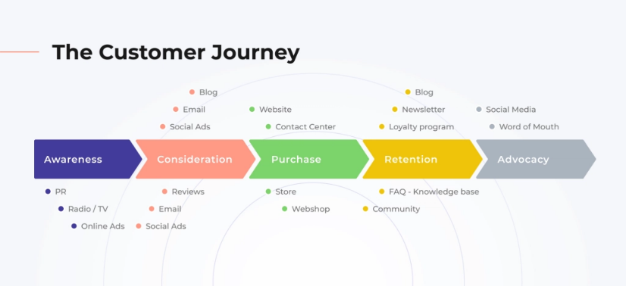
Customer journey
Source and further reading: Deviniti.com
Notes:
As we can see, the ‘Customer journey’ model is quite similar to the ‘Sales funnel’, although in horizontal dimension. Thus we can consider it as an alternative or complementary to the Sales funnel, rather than something quite different. But the customer journey forces us to focus more on the customer’s point of view.
Regardless of what product or service we sell, in every industry it is important to analyze the journey of our future customers. The key points where the customers come across our product are often a decisive factor in whether we complete a deal or not. Identification of digital touchpoints is the most important factor to turn our guests into paying customers. In this article, we will show you how to take care of your potential clients on three stages of their customer journey using just one tool.
What are your key digital touchpoints?
In the face of the multitude of digital and traditional routes that lead our business to a potential customer, it’s easy to get lost. It is difficult to determine which areas are the most important, and which absolutely cannot and should not be neglected. To put it simply – they’re just all of the points where we can start or improve our business relationship with a client or user.

Slide 32
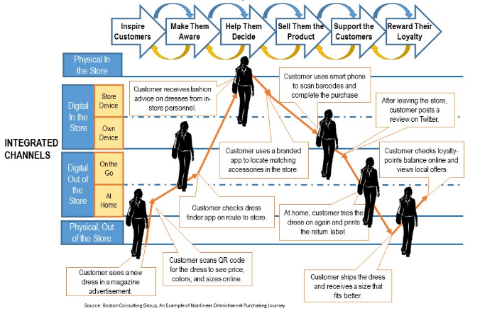
Example on ‘customer journey’ - buying a dress
Source: Chaffey, 2020
Notes:
Source: Customer journey map definition and examples - What is? - Digital marketing Glossary (davechaffey.com)
Retail example of a non-linear omnichannel purchasing journey
This Boston consulting group example of selling a dress shows physical store ad digital out-of-store touchpoints. It focuses on different digital interactions in the buying process. Other customer journey maps have more detail on options for TOFU vs MOFU vs BOFU content interactions as part of content mapping.
This illustration, related to ‘buying a designer dress’, depicts the channels and customer touch points and the type of signals that are involved in the process. In such way, it is possible to draft a ‘customer journey’ for any product or service. The position of the customer shows wether the emotion is positive or negative in the different points of the journey. This gives insights in experiences of the customer with the brand and the opportunities to improve.

Slide 33
In-class activity
Figure out and inspect a buyer process case. Below some suggestions (feel free to choose others, as well)
  a vehicle (car, bike, boat, ..)
  consumer electronics
  hobby or sports
  health care (individual, family, pet,..)
  interior design
  other
Figure out how the different stages in the buyer process?
Which kinds of triggers can lead to ‘awareness’.
How intensive is the process of seeking information?
What does it take to proceed to ‘purchase’?
What means ‘retention’ from the seller/buyer points of view?
Which channels and media are involved in the different stages?

Slide 34
Digital media and channels

Slide 35
Digital media and channels
After defining the target audiences and their phase in the buying process, the marketer has constraints to choose the channels
The picture presents the range of digital media and instruments that are available
Through them, any target group can be reached in digital ‘ecosystems and environments.
Their choices and deployment are determined according to the strategy, message and target groups
Note: The best result will be achieved when digital instruments and media are combined with traditional marketing media (multichannel marketing)
Notes:
This figure presents the areas of digital ‘instruments’ that are available. Promotion can be seen as equivalent to ‘digital marketing’. These will be described only superficially in this ‘Introduction’ module. More detailed in ‘Digital advertising’ and ‘Content marketing and social media’

Slide 36

Traditional - digital media?
Due to competition, advertising expenditures of organizations keep rising, ever since 2017
The share of digital media is rising, yet traditional marketing media are still used essentially
The graph shows an average of all advertisers
Source: Statista (2022)
It is obvious that there are huge variations between different types of organizations
Notes:
Which types of organizations use traditional media channels? For instance: local stores and service businesses.
Who distincts in digital media? For instance: eCommerce businesses.
Of course, most organizations use both traditional AND digital media (multichannel marketing)

Slide 37
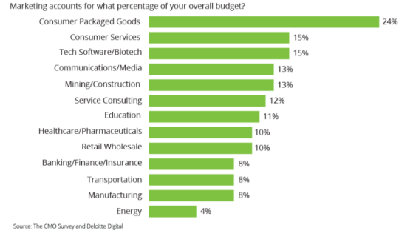
Some branches promote more than others
The need for promotion is vital when there is much competition (such as alimentary stuff, consumer electronics etc.)
Larger companies tend to use higher share of their total budget in marketing
In general, B2C companies spend higher budgets than B2B companies
Source: Merehead, 2021
Notes:
This phenomena is evident when following different media. Certain companies seem to be everywhere (national alimentary companies, big travel agencies, car retailers, retailers of special goods)

Slide 38

Social media
What & Why?
‘Social media’ cover a variety of platforms where everyone can publish and comment (e.g. Facebook, Instagram, LinkedIn, Blogs, Youtube, Twitter, TikTok)
Those who publish interesting ‘posts’ earn followers (most persons are followers, just a few are publishers)
Posts can be shared further in networks and get ‘viral’ - this creates ‘earned publicity’
Social media platforms also permit advertising to carefully selected target groups
How?
Establish accounts on the social media platforms where your customers are likely to be
Start publishing content you think might interest your target audiences, considering the
appropriate type of contents of respective media
Promote your posts and/or create new ads, deploy the targeting tools of respective social media
Keeping on for some time, you have the option to reach new audiences and activate them
Notes:
This slide explains the basics of Social media. In the module ‘Contentmarketing and Social media’ you will find further materials.
‘Social media’ covers a variety of platforms. Common for them is that different groups and types of people publish, comment and follow stories, pictures, videos and other content for public visibility. ‘Social media’ offer versatile media and channels for a wide range of interests, including hobbies, personal topics and work & business issues. This means that groups and individuals with specific interests can be found there.

Slide 39

Website
What & Why?
Ever more product & service searches are made on internet - ‘if not there, you don´t exist’
Your website permits to locate a wide range of information and make it visible to the whole world
This information can be offered as text, product descriptions, visual elements, videos and links
It is accessible to anyone, anywhere, anytime - making the organization available 24/7
A qualified website permit to improve the brand of your organization
Its role is central also, as most of your social media and ads lead to the website
How?
Smaller organizations do them by themselves (Wordpress, WIX, etc.); bigger units outsource it
Websites must be planned for the target groups and their representatives (‘buyer personas’)
Notes:
This slide explains the basics of websites. In the module ‘Webpages and SEO’ you will find further materials.
This slide exposes the central role of the website in any digital promotion activities. As marketing actions aim to fulfil specific targets (increase awareness, create sales, improve brand,...), necessary elements to achieve them can be located on websites. Thus the main role of the other digital media (social media, Google ads, email marketing) is often to direct visitors to the website.

Slide 40
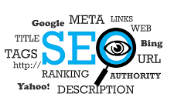
SEO (Search engine optimization)
What & why?
Search engines (e.g. Google) seek to organize relevant web pages, in order to offer appropriate results for every individual searcher (if not, Google does not have a business)
To succeed in this, Google reviews and ranks each website continuously, to define how much useful information they include for each search
Search results are also the most important source for website traffic
For this reason, it is vital to have a good position in the search engine result page (SERP)
SEO refers to all the activities that improve the position in search results, in accordance to the Google criteria for ‘website quality’
How?
SEO can be conducted in many ways: driving traffic to the website, linking the website to other websites out/in, defining the key words and adding content related to them, writing meaningful metatexts and ensuring the technical performance and security
Notes:
This slide explains the basics of SEO. In the module ‘Webpages & SEO’ you will find further materials.
To whom is SEO essential? - for all websites, that want to be found in web searches. That is, almost all websites. Why would they exist otherwise ..? You could start the topic ’SEO’ by asking your students ‘Which products/services do you think are sought in google?’ ‘Which are not?’ The discussion will make evident that most products/services are sought in google (some exceptions e.g. local restaurants and small stores). There are sites almost everyone already knows and finds directly (e.g. local restaurants), yet they could be sought by none-local travellers and foreign tourists.

Slide 41
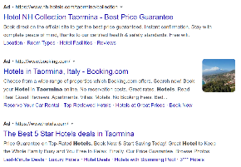

Ads - Digital advertising
What & Why?
Search engine advertising (SEA) makes possible to appear on top of search results with an ad
They are shown to users who use certain search words
This helps to drive traffic to a website and to make new product or companies known for wider audiences
Display Advertising takes place in many kinds of digital media, reaching specific audiences via display networks
It helps to increase brand awareness, by getting in front of potential customers that don't yet know your brand
How?
SEA can be bought and set directly on search engine platforms
Display advertising can be bought at digital media houses
search engine advertising
display advertising (=banner)
Notes:
This slide explains the basics of Digital advertising. In the module ‘Digital advertising’ you will find further materials.
The option to create and publish digital ads by themselves on google platform is an advantage for small organizations, as media houses are not needed. In addition, these types of ads can be run with low budgets (even 10-100€). The situations/advantages to use ads are dealed with in further slides.

Slide 42
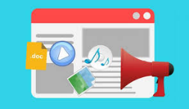
Content marketing
What and why?
Content marketing is a marketing strategy used to attract, engage,
and retain an audience by creating and sharing relevant articles,
videos, podcasts, and other media
It is often used by businesses in order to achieve the following goals: attract attention and generate leads, expand their customer base, generate or increase online sales, increase brand awareness or credibility, and engage an online community of users.
Content marketing attracts new customers by creating and sharing valuable free content. It helps companies create sustainable brand loyalty, provides valuable information to consumers, and creates a willingness to purchase products from the company in the future
How?
It all starts from the needs of your target groups and their position in the ‘customer journey’
Good content gives them answers to their questions, useful hints or other valuable information
Its form and channels should be selected according to where the target groups are
Notes:
This slide explains the basics of Contentmarketing. In the module ‘Contentmarketing and Social media’ you will find further materials.
Content marketing is a technique that revolves around creating and distributing valuable content for a specific target group. The goal is to engage, convert and retain that specific target group.

Slide 43
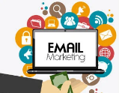
E-mail marketing
What and why?
A marketing form where you can send focused messages to registered customers in mass quantities
It has low expenses and the mails reach the recipients without any ‘algorithm filter’
E-mail marketing campaigns can be used for promoting special offers, new product releases, publications or your brand at large
A way of reinforcing brand and customer loyalty
How?
The presentation text and pics of the emails should be personal and attractive
When useful and appealing, the recipients become engage and continue opening them
Notes:
This slide explains the basics of Email marketing. In the module ‘Contentmarketing and Social media’ you will find further materials.
Email marketing is a form of Direct Marketing where a message is sent directly to the recipient. In e-mail marketing, organizations and companies send e-mails to interested parties or customers. In the e-mails you will find, for example, news, offers, purchase confirmations or a customer satisfaction survey. The best-known example of e-mail marketing is a newsletter in which an organization sends its latest news or offers.

Slide 44
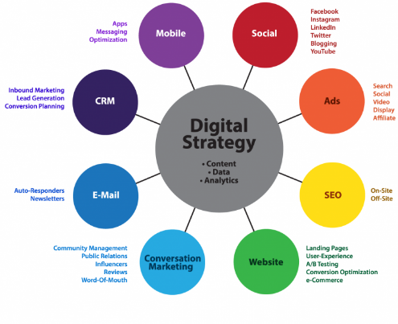
Instruments for different phases
Apt for newcomer/raising awareness:
  Social
  Website (+mobile opt.)
  SEO
  start content marketing
  Ads
Apt for boosting an existing company
  continued content marketing
  e-mail
  conversation marketing
  CRM
Further reading
Notes:
The Digital Marketing Landscape Ecosystem is a valuable tool to help you consider the entire realm of digital marketing and prioritize where to spend your resources.
There are 8 sections in the Digital Marketing Landscape to consider as a part of your strategy. While you’ll notice tools like AR/VR and AI aren’t listed separately, they are typically incorporated into other tools.
Even with the buzz around innovative new technologies, executing the tried and true marketing tools with excellence is the foundation of your success.
At the core is your Digital Strategy – what exactly are you trying to achieve? Determine this FIRST. Be sure to clearly link your goal, strategy, objective and tactic.

Slide 45
In-class activity for analyzing the different instruments
Go back to the campaign you chose for applying the RACE-model.
Analyze which instruments are used for this campaign in the different phases.
Consider whether you find these instruments suitable and explain why.
Present your example in class.
Notes:
This activity would suit best to do in pairs. Time needed appx. 20 minutes. Presentation: 2-3 groups present their work. Discussion follows.

Slide 46
Objectives and measures

Slide 47
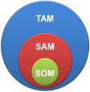
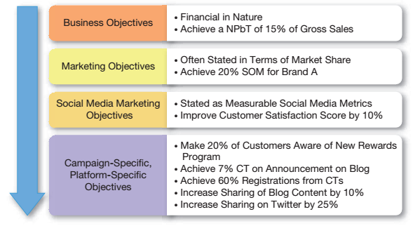
Objective levels
Source: Adapted from HubSpot
TAM or Total Available Market is the total market demand for a product or service.
SAM or Serviceable Available Market is the segment of the TAM targeted by your products and services which is within your geographical reach.
SOM or Serviceable Obtainable Market is the portion of SAM that you can capture.
NPbT= Normalized Profit Before Tax
Source: Barker et al., 2017, p. 34.
Notes:
After choosing the channels that reach the target group and different segments best, it’s important to set the objectives and targets in order to monitor and evaluate the success of digital marketing. And use it for optimization. Make sure these objectives contribute to the higher objectives like the business objectives, the strategic objectives, the tactical objectives (such as, for example, Social Media Marketing Objectives).
The key to a successful integration is incorporating content, data and analytics into every aspect of your execution and strategy. Be sure that you are incorporating great content that stands out. Make sure that you take the time to use data and analyze it to improve your marketing over time.

Slide 48
Example of goals… and KPIs
provide product information
increase awareness
drive traffic to website
create sales
build community
engage customers to return
reinforce expertise profile
strengthen company brand
number of customer contacts
awareness %
visitor rates on website
sales €
members in social media communities
rates of returning visitors, time spent on site
brand & loyalty polls, NPS
Notes:
The importance of integrating all marketing operations and setting objectives and goals was This slide presents some alternative objectives that can be reached by using digital marketing.

Slide 49
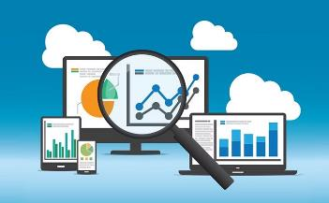
Digital analytics
What and why?
Digital platforms permit measuring their performance,
actions and behaviour of their visitors.
The processes of collection, reporting, and analysis of
such data is called web analytics.
Versatile data can be obtained e.g. from websites,
Facebook & IG accounts, blogs, Ads and
banner campaigns, etc.
This data helps virtually in launching more successful campaigns and improving customer experience
Source: Simplilearn
How?
Start from your objectives and KPIs and which actions are relevant for measuring them
Include the needed analytics elements in your website code
As tools, you can use google analytics, or a wide range of other algorithm-driven analytical tools
Notes:
Digital analytics are quantitative measurements of the performance of online content, including advertising campaigns, social media, and websites. That means digital analytics provide information from digital sources on how customers respond to or interact with your content and marketing campaigns.

Slide 50
Which are the sources of traffic to our website?
Social media
Search engines
Direct traffic
Search engines: Visitors that discover your website from a search engine.
Direct traffic: Visitors that visit your site by typing your URL into their browser.
Social media: Users who click a link in social media posts or ads.
Campaigns: Your ads on other sites or search engines.
E-mail: Link clicked in your email
Pages of referral traffic: Visitors that visit your site by clicking on a URL on another website.
Company website
Campaigns
Pages of referral
E-mail
Further reading:
Laire digital; Arimetrics
Notes:
When developing a business website, website analytics shows many things, ex. the users´ sources of traffic. The slide presents an average of website traffic sources, of course different sites have different figures.

Slide 51

What happens after the ’click’?
What can be done to improve the rates (‘conversion’)?
E.g. a banner ad:
CTR 5%
bounce rate 70%
100.000 see
5.000 click to site
1.500 stay and read
300 return
50 buy
95.000 do not click...
3.500 leave immediately...
1.200 will not
Return...
250 will not
buy…
Notes:
Digital analytics make visible what happens when we click ads or other sources and enter to websites (Web analytics is presented more detailed in the module 5). Every marketer and website owner desires high rates, but the success (=conversion) depends on how good the ads are, how well the landing pages work and how visitors are guided forward on the website. ‘Landing page’ is presented in the module 4 (Digital advertising).

Slide 52
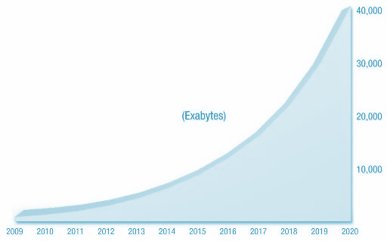
The base of analytics: algorithms
Along with digital data growing exponentially, there is a need to structure this data and sort it, by applying algorithms, in order to become useful
  An algorithm is a mathematical formula that includes factors that are seen essential in the phenomen
For instance, in website analytics: amount of visitors, time spent on website, amount of key words, …
  In this way, social, cultural and social interactions are being translated into readable data
(Urricchio, 2011)
Notes:
An algorithm in data mining (or machine learning) is a set of heuristics and calculations that creates a model from data. To create a model, the algorithm first analyzes the data you provide, looking for specific types of patterns or trends. The algorithm uses the results of this analysis over many iterations to find the optimal parameters for creating the mining model. These parameters are then applied across the entire data set to extract actionable patterns and detailed statistics.
The mining model that an algorithm creates from your data can take various forms, including:
A set of clusters that describe how the cases in a dataset are related.
A decision tree that predicts an outcome, and describes how different criteria affect that outcome.
A mathematical model that forecasts sales.
A set of rules that describe how products are grouped together in a transaction, and the probabilities that products are purchased together.

Slide 53
In-class activity for setting goals to monitor and evaluate the different instruments or channels
Go back to the different instruments you would use for the campaign you analyzed.
Define the different goals and kpi’s you can use to monitor and evaluate the success of the different instruments.
Explain how these goals and kpi’s contribute to the business and marketing objectives.
Present your example in class.
Notes:
This activity would suit best to do in pairs. Time needed appx. 20 minutes. Presentation: 2-3 groups present their work. Discussion follows.

Slide 54
Assignment “Choice of digital marketing channels”
Group work Self-selected case (students can choose a company)
Your company works since several years in the consumer goods market. You want to boost the sales and plan a marketing campaign on digital media. Create a plan for each buying stage (A-C-P-R-A) applying the Customer journey. Use course material and internet sources.
Choose a company and be acquainted on it using their website (also Q&A).
Define 3-4 target groups. Imagine them to be in different stages of their buying journey.
Make a persona for each target group.
Fill out a customer journey map and find out what the experiences are from the customer's point of view.
Based on your view of the business, plan a core message (3-4 sentences) for each group, encouraging them further in the buying process.
Notes:
Tip: to get even more insights in the customer journey and not to base the customer journey mapping on assumptions, students can conduct interviews with customers/prospects to get a better sense of the buyer journey.

Slide 55
Assignment “Choice of digital marketing channels”
Group work Self-selected case (students can choose a company)
6. Define digital media and channels to reach the target groups (for each message).
7. Set goals and kpi’s for those digital media and channels using the different stages of a digital marketing funnel framework.
8. Define how you are going to monitor, measure and evaluate the actions to learn and improve.
9. Present in 12-15 ppt slides. Note 7-8 sources used (for argumenting topics 1-4).

Slide 56
Sources
Barker, M. S., Barker, D. I., Bormann, N. F., Roberts, M. L., & Zahay, D. (2017). Social Media Marketing: a Strategic Approach (2nd ed.). Cengage Learning
Chaffey, D., & Ellis-Chadwick, F. (2016). Digital marketing: strategy, implementation and practice (6th ed). Pearson Education Limited.
Chaffey, D., & Smith, PR (2017). Digital Marketing Excellence (5th ed.). Routledge
Chaffey (2012): Digital Marketing - Strategy, Implementation and Practice
Chaffey, D. (2020, July 8). Customer journey map,
Customer journey map definition and examples - What is? - Digital marketing Glossary (davechaffey.com)
Digital Floats (2018, July 28) Top Strategies for Targeting Audience in Digital Marketing,
Top Strategies for Targeting Audience in Digital Marketing | Digital Floats
Laura Laire (2021, December 31) Website Traffic Sources Breakdown: What’s the Difference?
Website Traffic Sources Breakdown: What’s the Difference? (lairedigital.com)

Slide 57
Sources
Needle, F. (2021, December 15) How To Identify Your Core Marketing Message, https://blog.hubspot.com/marketing/marketing-message
Neher, K. (2019) Digital Marketing That Actually Works
Shepetyuk, I. (2023, March 14) What is the average marketing budget by industry?
What is the Average Marketing Budget by Industry? - Merehead
Wísnik, M. (2021, February 11) How to improve the customer journey using digital tools,
How to improve the customer journey using digital tools (deviniti.com)

Slide 58
The DEMS material aims to enhance digital marketing skills in higher education, responding to the needs in business and organizations. You have access to extensive slide sets with in-class activities and assignments, as well as detailed user instructions for teacher. You are free to use part or whole of the material available.
The material includes contents and figures retrieved from the internet and is thus subject to changes. The sources have been announced according to the rules of fair use. The material as a whole can be viewed and downloaded from www.dems.pro. All material is produced for open use and co-funded by Erasmus +.

