Slide 1
Introduction to Digital Marketing
2. Setting a strategy

Slide 2
Digital Strategy
Professor
School
Digital Marketing

Slide 3
Learning Objectives
Recognise the role of marketing strategy and digital strategy
Apply the different steps of the digital marketing strategy development process
Present a global view of the strategy using the Canvas Model

Slide 4
Topics
Digital marketing strategy development process
Evaluate digital marketing performance
Assess online marketplace
Set digital marketing strategic objectives
Define segments
Define online customer value proposition
Define digital marketing strategy
Digital relationship marketing
Digital marketing-mix
Digital marketing experience
Measure and control
Digital strategy global view
Bibliography
Notes:
In the "Setting a strategy" sub-module we will try to address 12 points. We will start by making a brief approach to the concept of strategy. Then, using a model that is presented, we will follow a set of steps, trying to answer basically three questions:
Where are we?
Where do we want to go?
How are we going?

Slide 5
“Either you have a strategy or you are part of someone else's strategy.”
Alvin Toffler
Notes:
If a company, or an organization (for example an NGO), doesn't have a strategy, it means that it's going to drift with the winds, with the tides, it's like a boat without a helmsman. In fact, these winds, these tides will be determined by the strategies of the competing companies.

Slide 6
Digital marketing strategy development process
Notes:
Let's start by talking a bit about what marketing strategy consists of and where digital marketing strategy fits in.

Slide 7
What is marketing strategy?
“The marketing strategy is the way in which the marketing function organises its activities to achieve a profitable growth in sales at a marketing mix level (…)”.
“A marketing strategy may be defined as a plan (usually long term) to achieve the organisation’s objectives as follows (…)”.
(Kotler, 1997)
Notes:
Since marketing is not an exact science, it is not surprising that there are several definitions of marketing strategy. Some are shorter, others longer. In this slide we can see one definition, authored by Philip Kotler. Before we talk about the definition itself, a few simple considerations about Philip Kotler: he is the most famous author in the marketing field, with more generic books, and other more specific ones, such as, for example, Marketing in Tourism. He was born in 1932 and is considered the father of Marketing. Talking about Marketing without taking Kotler into consideration is like talking about rock music, forgetting the Beatles.
In this definition we can highlight some aspects: in order to have a marketing strategy it is important that the organization is structured with a functional area that allows the development of all the activities that allow the execution of this strategy. This also presupposes that the organization aims with the defined strategy to achieve a profitable growth in sales supported in the tactical component of the marketing mix.
Let's consider as marketing mix, the also called 4Ps: product, price, placement and promotion.
When we talk about a company in the services area, the extended marketing mix (7Ps) applies, which in addition to the 4 Ps mentioned incorporates: People, Process, Physical Evidence.
In the definition, Kotler mentions the perspective of the marketing strategy to be seen as a plan. We can also see that it is also present the concern that the organization must have in defining a plan, where it is explicit how it will achieve the defined objectives. It is also verified that the marketing strategy should be defined in the long term (of course the concept of term may vary with culture; the long term for a European does not have the same framework as for a Japanese).

Slide 8
Digital marketing strategy
  “A digital marketing strategy is needed to provide consistent direction for an organisation’s online marketing activities so that they integrate with its other marketing activities and support its overall business objectives.”
  (Chaffey, 2006, p. 178).
Notes:
In this definition, introduced by Dave Chaffey, a digital marketing scholar, it is important that there is a digital marketing strategy, so that the activities that the company will develop online, are consistent and do not contradict other activities that are being applied, namely through offline marketing. In practice, the digital marketing strategy should be seen as a specificity of the marketing strategy, when supported by digital channels.

Slide 9
Digital marketing strategy
  The digital marketing strategy defines:
      How to achieve the intended objectives
      How to use the different digital marketing channels
      How to integrate different digital marketing channels
Notes:
The digital marketing strategy should be concerned with defining how it will contribute to the objectives that the organisation wants to achieve. These objectives may be the marketing objectives or, eventually, we may also define objectives more directed to the digital presence of the organisation.
It is also intended that the digital marketing strategy defines the role that the different digital channels will play in the development of the strategy, and how the channels will be integrated with each other, how to make them profitable in a synergistic perspective.
As main digital marketing channels, we can highlight: the website, the blog, interactive applications, social media (with special focus on social networks, but also aggregative channels, analysis sites, virtual network - for example: Metaverse), emailing and advertising.

Slide 10
Digital marketing strategy
  Digital marketing strategy presumes:
      Integration with offline marketing strategy
      Resource allocation
      Customer-oriented digital processes
Notes:
When thinking about the digital component of marketing, you have to think about how the strategic decisions that will be made will meet decisions made from a non-digital perspective. For example, are the segments that the company will work online congruent with the offline segments? How is a single experience ensured regardless of whether the touch points are online and offline, and does it provide a single view of the brand?
When defining the digital marketing strategy, it is also necessary to consider the resources required to achieve it. These resources can be financial, human resources, technology, marketing know-how, etc.
With the application of a marketing strategy, it is not surprising that there is a need to rethink processes (whether back office or related to customer interaction), in order to make the customer experience more appealing, to contribute to increase customer value. Everything the company does must meet customer expectations and contribute to customer loyalty. The implementation of redesigned or new processes may involve the use of technology, such as CRM (Customer Relationship Management) software, newsletter management software.

Slide 11
What is need to have a digital marketing strategy?
Analyse internally with a digital focus what the company has been doing
Analyse externally what is conditioning or can drive the company
Defining the strategic objectives for action in the digital area
Indicate which segments will be the target of digital marketing actions
Determine the value proposal for the segments and how it contributes to differentiation
Adjust the role of relational marketing leveraged on digital
To define, in terms of digital marketing mix, the main implications
Notes:
To be able to define a digital marketing strategy, one must take into consideration a minimum set of elements for the strategy to be built on a solid basis. It should be noted that when the strategy is defined, this definition occurs based on a set of assumptions that can and naturally tend to change. Eventually, there may be some special circumstance that may even force a radical change in the strategy being followed. For example, the pandemic caused by COVID-19 forced most companies to review their strategic marketing plan, to review their presence in digital marketing.
Thus, to define a digital marketing strategy, it is suggested that the company:
- Do an internal analysis: analyse what it has been doing in the area of digital, what its competencies are, what evolution has been happening.
- Carry out an external analysis: what constraints, what favourable factors are happening in the digital area, what are the trends. Here you should take into account the competition and consumer behaviour.
- Define the objectives clearly, objectively and realistically of what you want to achieve with digital marketing.
- Indicate which segment or segments you want to reach with digital marketing.
- Determine the value proposition, i.e. what the customer will see as special about the brand and the company. This value proposition must be unique, sustainable and lasting over time. Digital marketing must be able to communicate this value proposition to the target segments. Of course, to be a value proposition, the special benefit that we want to provide to our customer must be valued by him.
- Build a relationship with the customer (if that is the company's intention), leverage its lifetime value (the value that the customer can have for the company throughout the relationship with the company). The strategy should seek to monetize the digital component in order to strengthen this same relationship and consequently contribute to increasing customer loyalty.
When thinking about the digital strategy, we must define how the digital marketing mix will be present, what contribution it will make to brand building.

Slide 12
Defining the online opportunity
Business objectives
Evaluate digital marketing performance
Set digital marketing strategic objectives
Assess online marketplace
Selecting the strategy approach
Define customer value proposition
Define digital marketing strategy
Define segments
Implementation and practice
Digital marketing strategy development process.
Source: Adapted from Chaffey & Smith, 2017, p. 29.
Digital relationship marketing
Digital marketing experience
Digital marketing mix
Measure and control
Notes:
In this image you can see the proposed methodology for applying a digital marketing strategy. This methodology is composed of three phases.
In the first phase there is the definition of online opportunities, where the digital marketing objectives are defined, taking into account that they must be in line with the organization objectives. The current performance of the company's digital marketing and its ability to evolve must also be taken into consideration, as well as all the external elements that may limit its performance or provide opportunities.
In the second phase, the appropriate strategy is selected taking into account the objectives to be achieved, the segments to be served and the defined value proposition.
The third phase consists in the implementation and achievement of the strategy, where the tactical and operational components contribute to success. In this phase, the online experience is defined, namely using techniques such as the consumer journey. This online experience is driven by the defined digital marketing mix and by the dynamics of the customer relationship that the company wants to achieve supported by digital.
Finally, it is necessary to measure and control the whole online experience that the customer has with the organization, in order to make the necessary adjustments, not only due to possible deviations between what was planned and what was verified, but also due to the dynamics of the market, the evolution of technology and the innovation of digital marketing itself.

Slide 13
Quiz
Classify the following statements as true and false. In the statements that you consider to be false, justify your choice.
The objectives should be defined according to the chosen strategy.
Only the environment conditions the choice of strategy.
Differentiation is not always a company's concern.
The digital strategy is worked out autonomously.
Notes:
Statements 1, 2 and 4 are false. Statement 3 is true.
1. The strategy chosen by the company is the one which is considered the best to achieve the defined objectives, taking into account the company's reality and the surrounding environment, with special focus on the competition. Two companies may have the same objectives, yet different strategies. It makes no sense to define how we are going (strategy), without knowing where we want to go (objectives).
2. It is true that the environment conditions the strategy. For example, facing an economic crisis, a company may choose to create a low-cost brand that is only marketed online. But there are other conditioning factors, such as the internal resources available to the company to implement the strategy. The choice of strategy is also conditioned by the objectives themselves.
3. Usually marketing is concerned with differentiating the brand and the products from what exists on the market, from what is available from the competition. However, the company may choose to "stick" to a competitor, normally the market leader, in an attempt to confuse the consumer. In other words, there is a concern with imitating the competitor's strategy, going as far as the packaging of the products is similar.
4. The marketing of a company is one. Digital marketing reflects the company's concern to optimise its digital presence as much as possible and to take advantage of some tactics inherent to technology that are then translated into operational actions, such as, for example, the development of a Facebook ad campaign.

Slide 14
Evaluate digital marketing performance

Slide 15
Evaluate digital marketing performance
Analyse the presence at different digital marketing channels
Website
emailing
Social networking
Add
Notes:
To know where we are going, we need to know where we are in terms of digital marketing. It is possible, using models, to analyse in which phase of digital marketing application the company is. But the main objective is for the company to reflect how it is monetising the main digital channels quantitatively and qualitatively. Thus, the company should seek to analyse the website, the use of email, its presence in social networks and the use of ads. Ideally, this analysis should not only be carried out at the current moment, but it should also be possible to have a perception of the last 3 years, in order to check if there is any evolution.
To analyse the current digital presence, it is suggested:
Website
- SEO
- Usability
- Speed
- Timeliness of information
- Convertion Rate of Optimization (CRO)
Email analytics in sending:
- Newsletters - helps to increase brand awareness and drive traffic with what's new to the website.
- Seasonal emails - makes it easier for the brand to stay on customers' radar (examples: Christmas or birthday emails.
- Exclusive offers - allows you to make loyal customers feel special with an odd discount or offer.
- Reminders - helps to remind and eventually lead to a certain action (e.g. send if a subscription is ending).
- Flash ads - help increase sales with flash discounts, such as a 48-hour sale.
Social media presence should be analysed from a quantitative (e.g. number of posts, engagement rate,...) and qualitative perspective (message coherence, tone of voice,...) considering the specificity of each network.
To help assess the brand's presence on the Facebook social network it is suggested that the company seeks to answer a set of questions:
- How many likes do we have?
- How often do we post?
- What is our push/pull mix? (push=advertising; pull=sales promotions, PR, direct marketing, sales force, patronage/sponsorship; merchandising)
- What types of media do we use?
- Does our Facebook link to our website?
- Do we have update cover and profile?
- Do we respond to comments?
- Do we have a rating? What is it?
- What is our social media voice?
- What do the comments on our page and photos typically say?
- Do we share articles? How often?
With regard to Instagram one can also seek to answer the following questions to assess the profitability of this social network:
- How many followers do we have?
- What is our media mix for posts?
- What kind of hashtags do we use?
- Does our profile link to our website?
- What is our social media voice?
- Who do we follow?
- Do we respond to comments?
- What are the comments on our photos saying?
- What is our push/pull mix?
YouTube is also a social network widely used by companies and, in this sense, if the company under analysis uses this network, it should be analysed taking these questions into consideration:
- Do we use YouTube?
- What type of video content do we post?
- Are these videos shared on our other social channels?
- How many subscribers do we have?
- What are the comments on our videos saying?
- Do we respond to comments?
- Does our profile link to our website?
- How many views do we receive, on average, for a video?
- How many Likes do we receive, on average, for a video?
The social network LinkedIn allows you to create pages associated with entities, projects, ... that is, pages that are not personal. These pages have several potentialities namely institutional communication, promotion of events, recruitment, products,... It can be used in an internal marketing perspective, but also to communicate with clients, with influencers, with distributors, that is, you can direct the publications to different target audiences.
Thus, if the company has a Linkedin presence, it is necessary to analyse how it is being profited from by answering the following questions:
- Is CompanyPage being boosted?
- Are the showpages being monetized? (Showcase Pages are extensions of LinkedIn CompanyPage, ideal for spotlight individual brands, business units and initiatives).
- Are the employees connected to the company page?
- Do employees share the company's page posts?
- Is the 4-1-1 rule being applied? (The 4-1-1 rule says that for every single piece of content you share about yourself (or your organization), share an update from another source, and most importantly share four pieces of content written by others).
- How are we doing on metrics (Page Followers; Post Clicks; Engagement; Inquiries & leads; Event registrants)?

Slide 16

In-Class Activity
Activity to be developed in groups of 3 or 4 persons
Each member of the group on their computer or other device, enters the address https://pagespeed.web.dev/
Each member of the group enters the address of the brand's website they wish to analyse on their computer or other device (preferably brands competing with each other)
Compare the data obtained
Notes:
Objective of this activity: using a tool to evaluate the performance of websites; by comparing 3 or 4 brands it will be possible to have a broader view of the results.
In this link it is possible to obtain documentation on the functioning of the tool proposed in the activity: https://developers.google.com/speed/docs/insights/v5/about

Slide 17
Topics
Assess online marketplace

Slide 18
PESTEL Analysis
What are the trends in the environment and how can they influence the decisions to be made in marketing and specially in digital marketing?
  Political factors
  Economic factors
  Social factors
  Technological factors
  Environmental factors
  Legal factors
Notes:
The company must monitor the forces that act in the society in which it operates. There are specific forces related to the activity sector where the company operates (the so-called transactional environment or also called microenvironment) and there are other more generic forces that act on the transactional environment and also directly on the company. Thus, the company should seek to analyse the so-called contextual environment or also called macro-environment.
This analysis will allow the company to anticipate possible actions that reduce risks or increase its chances of success.
Thus, the organisation should try to verify how these external forces manifest themselves, how they tend to evolve and how this evolution affects the company from the point of view of creating opportunities or threats for the company's performance in the digital component.
Thus, it is suggested to analyse the following forces:
- Political factors
- Economic factors
- Social factors
- Technological factors
- Environmental factors
- Legal factors
This analysis is called PESTAL analysis.

Slide 19
Competition analysis
Identification of the main competitors
Analysis of the presence in digital channels
  Understanding objectives
  Analyse metrics
  Qualitative analyse (Example: site - role, structure, technology,…)
e-commerce analyse (product, price, sales promotion, payment solutions)
Integration of online presence with offline strategy
Mention competitors' strengths and weaknesses
Notes:
Competition conditions a company's activity. It is not surprising that it is not possible to monitor all competitors and therefore it is necessary to define which are the main competitors, using, for example, geographical criteria, or similar strategies, or selecting the competitors that sell more,...
The analysis of the competition, from the digital perspective, should be as exhaustive as possible, trying to understand what objectives they are trying to achieve with the use of digital channels, analyse metrics related to the website, social networks,... A qualitative analysis is also important. For example, on the website assess the role it plays, the structure of the site, the technology used. On social networks, you can analyse the quality of photos, the quality of videos, the storytelling used, the diversity of publications.
The way in which the competition integrates its online presence with its offline action should also be checked, in all possible aspects, but with a special focus on the marketing mix developed. For example, are the products, the brands that are marketed online also offline? Is the price charged online and offline the same? Are there specific sales promotions on the Internet?
An overview of the strengths and weaknesses of the competition will give some indications for possible company actions.

Slide 20

In-Class Activity
Activity to be developed individually
Use the following links to compare the social networks of 2 brands:
https://www.rivaliq.com/free-social-media-analytics/instagram-head-to-head/
https://www.rivaliq.com/free-social-media-analytics/facebook-head-to-head/
https://www.rivaliq.com/free-social-media-analytics/tiktok-head-to-head/
Notes:
Objective of this activity: using a tool to evaluate the performance of brands on the social networks Instagram, Facebook, TikTok.
The professor may suggest the following link for the student to watch a set of videos on the use of the RivalIQ tool: https://www.rivaliq.com/social-media-competitive-audit-course/
Part of this activity can be done during class and part outside of class.
It is suggested that the viewing of the videos about the tool and the analysis of the marks be done outside of class. Then, in class, you can have a discussion about the results obtained.

Slide 21
Analyse the current customers and potential customers
Who are the customers?
What is their level of loyalty?
Which channels are used to interact with the company?
Analyze the customer portfolio
Classify the customers
Satisfaction surveys
Notes:
To be able to interact with customers through digital channels and maximize that interaction, there is a need to know who the customers are. There are businesses in which the company does not know who its customers are, does not know them and therefore the company must create mechanisms to know them, for example, a loyalty card. The presence of the brand/company in the digital favours the knowledge, namely at loyalty level, which channels are used to interact with the company. To buy on the internet, a customer needs (usually) to identify himself and that already favours knowing who the customer is.
Loyalty is important, especially if the company wants to maintain a long-lasting relationship with the customer. It is necessary to think how to increase this loyalty, how to make the customer emotionally connect to the brand, because this connection tends to contribute to increase loyalty.
Analyse the customer portfolio: we can do this analysis from different perspectives: economic capacity, propensity to buy online, propensity to innovate, propensity to risk, payment method, seasonality of purchase, etc.
Classify customers: not all customers have the same value for the company. You can classify customers, for example, by applying the Customer Lifetime Value (CLV). In other words, how much to consider how much a client is worth throughout the relationship that we estimate will exist.
Satisfaction surveys: it is easy to do satisfaction surveys using digital tools and it is also more enticing for the customer to answer quick surveys on their mobile phone or other device.

Slide 22
Analyse intermediaries, influencers, and online partners
Influencers
Third-party blogs
Affiliate Marketing
Comparison sites
Review sites
Notes:
The analysis of the brand's presence on digital should also look at other entities:
Influencers: which channels do they use, what do they talk about our brand, how often, what is their relationship with the brand (formal with contract, informal,...).
Third-party blogs: are there blogs of other brands that mention our brand, possibly partner brands from other areas?
Affiliate Marketing: does our brand use it? What business areas are the affiliates from? What results are obtained?
Comparison sites: these are normally sites which are concerned with price comparisons. Do our products appear? How can we influence this? Example: http://www.pricegrabber.com/
Review sites: do our products appear? Are the technical characteristics of our products correct? What position do our products tend to have compared to competitors' products? Example: https://www.capterra.com/

Slide 23
Use digital to learn more about the market
Using digital to conduct market research
Who buys
What is being bought
Where they buy
When we buy
Why we buy
How we buy
Notes:
Digital marketing brings the company closer to the customer. The company can use this opportunity to learn more about customer behavior, develop questionnaires and disseminate them through different channels (website, blog, social networks, emailing, ads,...)
Also involving the consumer in marketing decisions gets easier with digital. Example: make a post with 2 packages and let the customer decide which package should be produced.
So, it is important to analyze how the company is taking advantage of the potential of digital to learn more about the market and the customer or potential customer.

Slide 24
Set digital marketing strategic objectives

Slide 25
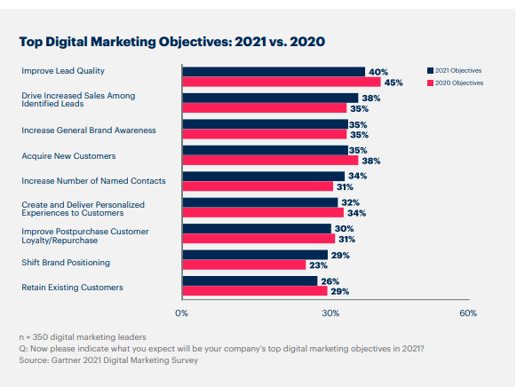
Source: Gartner
Notes:
On this slide we can see what are presented as objectives and what companies are trying to achieve. However, we can question whether they are actually objectives, whether they fulfill the characteristics that objectives should have (this issue will be addressed on slides 27 and 28).
Regardless of the correct use of the word objective, we can see that there is a variation in the concerns of companies from the year 2020 to 2021.

Slide 26
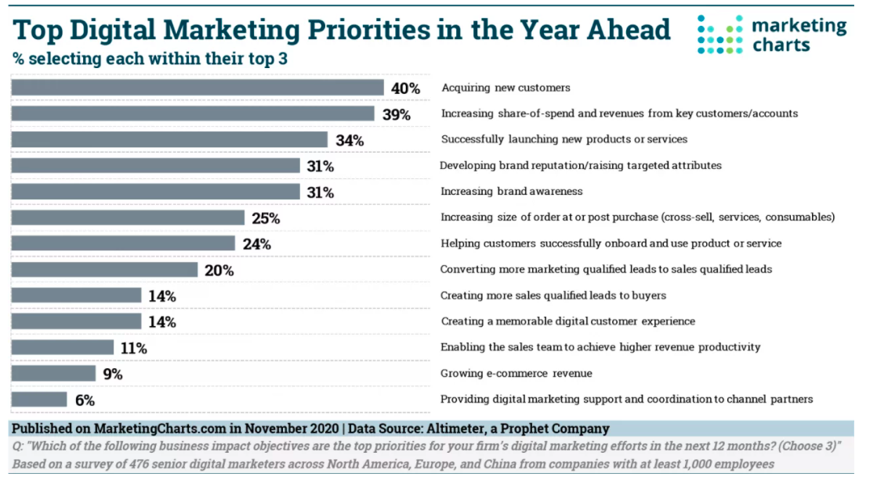
Source: Marketingcharts
Notes:
With this slide we can see that some of the companies' concerns/priorities differ in terms of importance compared to the previous slide.
However, it is possible to find common concerns/priorities, such as, acquire new customers.
It is not surprising that there are different results in similar studies, because the elements under analysis are not always the same, the timing of the study may also differ, and the incidence may also be different, for example, the sector of activity may differ.
However, these are always indicators that should be read carefully and properly framed.

Slide 27
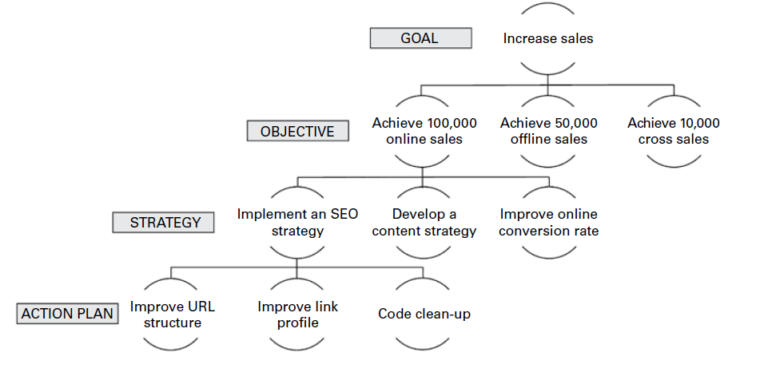
Set digital marketing strategic
objectives
Fonte: Kingsnorth, 2016 , p. 76.
Notes:
Objectives are responses to goals that are intended to be achieved. Goals are general intentions. A goal can have more than one objective.
Example:
Goal: Increase the company's commercial presence in the market.
Goals: Increase sales volume by 10% in 2024; Increase the market share of the cosmetics range by 3 percentage points in 2024; Achieve customer loyalty by 10% by 2024
Objectives can be strategic, tactical or operational.
Strategic marketing objectives
- These are the global objectives resulting from strategic marketing action and are defined in the long term, i.e. between two to five or more years
- Example: increase by 5% the market share in the electric car segment in 3 years
Tactical marketing objectives
- These are intermediate level objectives, for example the responsibility of a product manager, a brand manager, and which contribute towards achieving strategic objectives
- Example: choose the brand's digital ambassador in the second quarter of 2020
Operational marketing objectives
- These are the specific, short-term objectives aimed at executing day-to-day marketing operations and generally refer to each task or operation specifically
- Example: making 5 posts daily on Facebook
For strategic objectives, it is necessary to define the most appropriate strategy and then define how it will be implemented.
The non-existence of objectives tends to lead to the disorganisation of the company, the panacea. Let us recall the following dialogue between Alice and the Cheshire Cat (story "Alice in Wonderland" by Lewis Carroll):
- Could you please tell me which way I should go to get out of here?
- That depends a lot on where you want to go, said the Cat.
- The place doesn't really matter - said Alice.
- Then it doesn't matter which way you go, said the Cat.

Slide 28
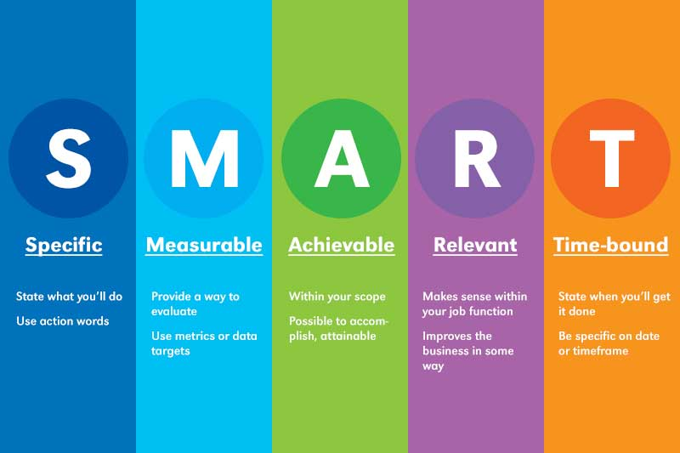
Characteristics of the objectives
Specific
Measurable
Achievable
Relevant
Time-bound
Notes:
The main function of objectives is to ensure that everyone is rowing in the right direction and that no one is working on something unrelated to the purpose of the company. But for this to happen, the objectives must have a set of characteristics:
Specific: it must be clearly defined what is to be achieved, there should be no ambiguity in its interpretation. The more detailed it is, the easier it is to understand, making the effort to achieve it easier.
Measurable: there must be a way to measure whether or not it has been achieved.
Achievable: the objective needs to be attainable. It is important that it is ambitious, but not impossible. Consideration needs to be given to the motivational aspect of who will work towards achieving the goal.
Relevant: the goal needs to be strategically important for the business, it needs to be decisive. There is no point in establishing goals that do not contribute to the growth of your business
Time bound: the period of time must be defined, the deadline for achieving the goal. This characteristic of the goal has consequences on the possibility of being achievable and also influences the prioritisation of goals.
Example of a well-defined objective "Obtain 10% of the monetary value of sales through the website by the end of the first semester (affirmative, clear, precise, relevant, achievable, realistic and time-defined)
Poorly formulated objective. "Expect to have more customers on the website" (does not have a specific situation, does not have a defined time to achieve it, does not establish quantities, nor allows its formal analysis).

Slide 29
Goals, objectives and metrics
Goals | Objectives | Metrics
Increase the company's commercial presence in the market | Increase sales volume by 10% by 2023 | Invoicing value in monetary units
 | Increase the market share of the cosmetics range by 3 pp by 2023 | Market Share
 | Achieve customer loyalty by 10% by 2023 | Dropout Rate Retention Rate Number of referrals
Reduce marketing and commercial costs | Reduce sales cycle costs by 10% by 2023 | Conversion Rate Cost per Lead ROI
 | Reduce sales promotion costs by 5% by 2023 | Value of the promotional benefit ROI Promotion disclosure value
Notes:
After defining the objectives, according to the goals, it is also necessary to establish the metrics that allow us to evaluate whether the objectives are achieved.

Slide 30
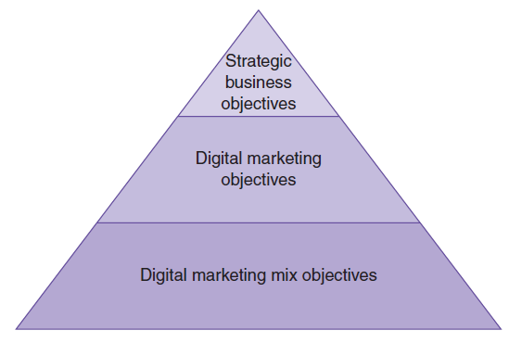
Objective levels
Hierarchy of objectives.
Source: Halon, 2019, p. 242.
Notes:
The objectives defined for digital marketing should be in line with the strategic objectives of the business. Based on the objectives defined for digital marketing, the objectives for digital marketing-mix are defined (tactical level objectives) so that when they are implemented, the strategic objectives are achieved.

Slide 31
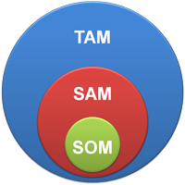
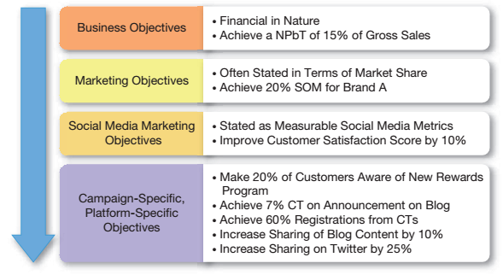
Objective levels
Source: Adapted from HubSpot
TAM or Total Available Market is the total market demand for a product or service.
SAM or Serviceable Available Market is the segment of the TAM targeted by your products and services which is within your geographical reach.
SOM or Serviceable Obtainable Market is the portion of SAM that you can capture.
NPbT= Normalized Profit Before Tax
Source: Barker et al., 2017, p. 34.
Notes:
In addition to the business objectives, the strategic objectives, the tactical objectives (such as, for example, Social Media Marketing Objectives), we must try to carry out activities on a daily basis that should be associated with operational objectives.

Slide 32
Topics
Define segments

Slide 33
Define segments
Define segmentation criteria
Detailed study of the characteristics of each segment found
Dimension, quantification of potential
Needs
Motivations
Consumer behaviour with special focus on digital
Buying and information habits with a special focus on digital
Choose the segments you want to reach
Clarify if the segments to be worked by marketing are the same as those worked by non-digital marketing
Notes:
The segmentation process involves choosing which segmentation criteria are to be used.
Most commonly used criteria:
Demographic: age, gender, race, ethnicity, income, education, occupation, family size, family life cycle, religion, social class.
Geographic: population, region, environment (urban, suburban, rural), city size, market density, climate.
Psychographic: personal attributes, motivation, lifestyle.
Behavioural: occasions of use (special occasion, common occasion,...), status (occasional users, regular users, ex-users, potential users,...), frequency of use (low, medium, strong,...), loyalty (none, medium, strong, total,...), predisposition to buy, attitude to the product (enthusiastic, positive, indifferent, negative,...), attitude to new products (experimenter, conservative,...), benefits sought.
After applying the criteria, we must study the segments found that can be served by digital, trying to characterize them exhaustively in relation to their size, quantification of potential; needs; motivations; consumer behavior, buying habits especially associated with digital. It is of interest that each segment be as homogeneous as possible based on the elements mentioned.
Then we choose the segment or segments that we want to serve through digital marketing. This segment or segments may be different from those that the company is working with in offline marketing. A reflection on why the segments are different, what justifies this difference, and how it is reflected in the marketing mix.

Slide 34
Topics
Define online customer value proposition

Slide 35
Define online customer value proposition
The value proposition consists of the entire set of benefits and promises of the company
It is necessary to distinguish the brand from the competition
Tells in a concise way why a product or service is best suited for any particular customer
Forms the core message to be delivered in all marketing communication activities
Notes:
The company must define a value proposition for the brand, for the product, which consists of the benefit or benefits that it will be able to provide to the customer. It helps to distinguish the brand from its competitors. This value proposition will be communicated by the communication component of marketing. It should be very well structured, because it is not a good practice to change it, it is a strategic decision. Eventually, as a last resort, we may change it, but all communication work will have to be restarted.

Slide 36
Define online customer value proposition
A successful value proposition should be persuasive and help turn a prospect into a paying customer
How can digital marketing leverage the company's value proposition?
  What benefits can it highlight?
  What benefits can it reinforce?
  What new benefits can it create?
Notes:
The value proposition should encourage the customer to purchase the product/service, so it should be seen by the customer as superior to the value proposition of the competition. In practice it is what makes the customer buy our product.
For this proposition to exist digital marketing can play a special role, acting as a lever. So, we need to evaluate how digital marketing can highlight the benefits, and/or reinforce them, or even contribute to the creation of new benefits.

Slide 37
Define digital marketing strategy

Slide 38
Define digital marketing strategy
Type of digital marketing strategy initiative | Marketing mix implications | Examples
New customer proposition (product and pricing) | New site features or other online communication which are direct related to offering new products or services that will generate revenue | Bank: introducing new product requiring different quotations Publisher: introducing a price comparison service
Customer acquisition or inbound marketing strategic initiatives | Strategic projects designed to enhance a site’s capability and deliver diferente online marketing techniques aimed to attract new customers | Content marketing Search Engine Optimization (SEO) Pay-per-click (PPC) Affiliate marketing Aggregators
Typical focus for main types of strategic digital marketing initiatives. Source: Adapted from Chaffey & Ellis-Chadwick, 2016, p. 181.
Notes:
In this table, divided into 5 slides, we can check some ideas of initiatives that fall in the capture of customers, their conversion and their retention and development.
Thus, in this slide the company's focus is on developing a new proposition based on product and price. Another initiative is to attract customers through inbound marketing.

Slide 39
Define digital marketing strategy
Type of digital marketing strategy initiative | Marketing mix implications | Examples
Customer conversion and customers experience strategic initiatives | Investments in new customer features designed to engage the audience and increase conversion rates and average order values. New functionality, e.g. new online store components; special functionality, e.g. real-time stock checking. Strategic initiatives aimed at improving the customers’ brand experience. | Implement online shop/secure payment Introduce customer reviews and ratings Merchandising capability for offer tailored promotions Interactive tools to help product selection Buyers’ guides
Typical focus for main types of strategic digital marketing initiatives. Source: Adapted from Chaffey & Ellis-Chadwick, 2016, p. 181.
Notes:
One of the concerns of businesses is that unknown visitors become acquaintances and then customers. That is why it is necessary to define strategies to achieve this purpose.
The experience of the potential client/customer in every moment of contact with the brand is important for the sale to take place. So strategies must be defined to achieve this purpose.

Slide 40
Define digital marketing strategy
Type of digital marketing strategy initiative | Marketing mix implications | Examples
Customer development and growth strategic Initiatives | Investments to improve the experience and delivery of offers to existing customers | Personalised recommendations and services for existing customers Email contact strategy focused on the customer journey and level of brand awareness Communities, social media, blogs or to encourage advocacy and repeat purchase
Typical focus for main types of strategic digital marketing initiatives. Source: Adapted from Chaffey & Ellis-Chadwick, 2016, p. 181.
Notes:
The strategy may also involve developing existing customers, seeking to increase sales by improving the customer experience with the brand and/or increasing the product/service offering to customers.

Slide 41
Define digital marketing strategy
Type of digital marketing strategy initiative | Marketing mix implications | Examples
Social media, content marketing or social business initiatives | A narrow social media initiative will look at how social media can support acquisition, conversion and retention. A broader social business strategy also includes improving product and service | Social media listening Developing content hub Encouraging review Influencer outreach Communities
Typical focus for main types of strategic digital marketing initiatives. Source: Adapted from Chaffey & Ellis-Chadwick, 2016, p. 181.
Notes:
Another strategic suggestion is to develop a wider application of content marketing on social media and other channels to improve customer acquisition, conversion and retention.

Slide 42
Define digital marketing strategy
Type of digital marketing strategy initiative | Marketing mix implications | Examples
Enhance marketing capabilities through site infrastructure improvements | These typically involve ‘backend or back-office features’ which won’t be evident to users of the site, but will help in the management or administration of the site | CRM or personalisation Content management system Performance improvement –improve management information, web analytics systems including systems for multivariate and AB testing Improve customer feedback facilities
Typical focus for main types of strategic digital marketing initiatives. Source: Adapted from Chaffey & Ellis-Chadwick, 2016, p. 181.
Notes:
The site as the hub of the strategy, continually investing in improving its facilities and infrastructures, namely from other platforms that are related to the site, such as CRM system.

Slide 43
Define digital marketing strategy
Type of digital marketing strategy initiative | Marketing mix implications | Examples
Resourcing and governance strategies | Changes need to marketing management given the increased importance of digital media and technology | Process change Skills development Team structure
Typical focus for main types of strategic digital marketing initiatives. Source: Adapted from Chaffey & Ellis-Chadwick, 2016, p. 181.
Notes:
Finally, this final part of the table highlights the importance of defining how the digital aspect of marketing will be incorporated into the organisation, namely in the design of the organisational structure.

Slide 44
Topics
Digital relationship marketing

Slide 45
Digital relationship marketing
Differentiate clients by the relationship
Monetise lifetime value through digital channels
Define loyalty programmes supported by digital
Optimising technology to manage customer relationship
Notes:
Relationship marketing is the name of the strategy that requires building long-term partnerships with customers.
Building these relationships with customers involves offering value and satisfaction
Companies benefit from repeat purchases.
Costs fall because serving existing customers is cheaper than attracting new ones. Keeping a customer costs about ¼ of what it would cost to attract a new one; and the profitability of keeping a customer is over 60% while the profitability with a new customer is less than 30%.
The Internet is a very useful tool in creating customer relationships because of its ability to interact with customers. With the Internet the company can offer quick services to its customers and research the buyers' habits to customize products and thus increase the value proposition and improve the relationship with the customer. Also the creation of loyalty programmes can take advantage of the characteristics of the Internet.
Digital media allow high interactivity and personalisation (website, landing page email, banners, mobile marketing - sms, mms -, fax, automatic voice calls,...) which helps to improve the relationship with the customer.
So, it is necessary to decide how to leverage digital to boost actions that strengthen the company's relationship with the customer.

Slide 46
Digital marketing-mix

Slide 47
Digital marketing mix: product
Are all products marketed offline marketed online?
Is there a range, line of products or are there some products that are only commercialised online?
Are there specific brands to be commercialised online?
Notes:
The marketing-mix is translated into the company's ability to define tactics that meet the defined strategy. Thus, regarding the product policy made available through the Internet, some decisions need to be made:
Will all products marketed offline be marketed through the Internet? Will there be specific products, only available through the Internet? Are the brands the same? Or will there be specific brands developed to be marketed only through the Internet?
Also in relation to product policy, other aspects must be considered, such as: packaging, guarantees, product assistance, services associated to the product,...

Slide 48
Digital marketing mix: price
Is the online price the same as the offline price?
Are discounts and terms of sale different online?
What payment methods are available online?
Notes:
In pricing policy there are also several decisions to be made:
Will the prices charged be the same (offline versus online)? And within online (website versus mobile app)?
Will prices be constant throughout the days of the week?
Will certain digital marketing techniques be used, such as group buying or reverse auctions?
Will there be different discounts on the Internet compared to what is practised at the point of sale?
What means of payment will be available?

Slide 49
Digital marketing mix: distribution
Role of the site
Social commerce
Social shopping
Role of markets
Notes:
The Internet provides a channel for marketing products/services. But even within the Internet this marketing can take on different models: through the website, through social commerce or through social shopping.
Social commerce differs from e-commerce, which takes place on a company’s digital store, branded app, or in a marketplace. It is the e-commerce supported by social media marketing and can be categorized into evaluations and reviews, recommendations and references, blogs, social networks, communities, forums, aggregators of content, price comparators, participatory commerce, social cashback and social shopping.
Social shopping allowing users to directly buy your products from social platforms like Instagram and Facebook. It’s done via specialized posts with links to product pages. Some platforms, allow to set up shop pages which give access to all the ecommerce tools need to sell on the platform, including payment.
These decisions may be conditioned by the market in which the company operates and the role it wishes to play in that market (for example, leader, follower of the leader, imitator of the leader, innovator,...).

Slide 50
Digital marketing mix: communication
Advertising
Sales Promotions
PR
Social selling
Direct marketing
Affiliate marketing
Notes:
The communication of digital marketing has several aspects similar to offline marketing, differing mainly by specific channels. Thus, the company has at its disposal means such as the website, blog, email, social networks, third-party sites, platforms such as Google.
Through these channels the company can do:
- advertising (for example, on social networks to advertise a new product);
- sales promotions (for example, sending discount coupons via email);
- public relations actions (for example, a webinar in which the company presents the sponsorship of an animal from the zoo);
- social selling actions (e.g. trying to raise prospects through the social network LinkedIn);
- direct marketing (e.g. sending a catalogue through email);
- affiliate marketing (for example, using a famous sports commentator's website to promote the company's sport products).
With this in mind, it is necessary to define how the company will boost the communication mix and how it will integrate it into the different digital channels).

Slide 51
Digital marketing mix: people
Determining the profile of people to support digital marketing
Evaluation of people's involvement in the different digital channels
People's contribution in the sales funnel
People's role in brand humanisation
Notes:
The aim is to make decisions about the intervention of people in digital marketing, namely to define which competencies and skills they should have, how they will intervene in the different digital channels, what contribution they will make to a positive evolution of the customer along the sales funnel and how they will contribute to humanise the brand, bringing them closer to the customers, contributing to an H2H connection without jeopardising the automation of processes that optimise time and contribute to improving the consumer experience.

Slide 52
Digital marketing mix: processes
Determination of processes for the 360º customer view
Level of process automation
Role of digital channels in the processes
Digital tools required for the processes
Processes to exist in the value chain

Slide 53
Digital marketing mix: physical evidences
Brand design
Level of incorporation of testimonials through digital
Role of video and image
Standardisation of the experience in the different digital channels
Notes:
The main role of physical evidence is to convey trust to the customer. To this end, we must take advantage of digital to introduce or reinforce other physical evidence already used by offline marketing.
Thus, it is expected that there will be a concern to conceive a design applied to the brand that is transversal to all digital and non-digital channels.
It is necessary to strategically define how the different sources of testimonials (customers, collaborators, suppliers,?) in the various digital media will be enhanced.
How video and image will be used to reinforce trust and the role played in content marketing?
Define strategic guidelines to ensure a uniform omnichannel experience.

Slide 54
Topics
Digital marketing experience

Slide 55
Digital marketing experience
Define how digital marketing can leverage customer experience across physical or digital touchpoints
Use the customer journey map to represent the customer experience
Notes:
The customer sees the company as unique regardless of how he interacts with it. Therefore it is necessary to integrate the whole experience, paying special attention to how digital marketing can contribute to improving the experience that the customer has at every moment that he interacts with the brand, regardless of the form of contact. The graphical representation of the customer journey can help make decisions about what to communicate, what to boost, what actions to take to improve the customer experience throughout the process.

Slide 56
Topics
Measure and control

Slide 57
Measure and control
Define what will be monitored
Define which metrics will be used
Define responsibilities
Notes:
Strategic marketing planning presupposes an external and internal analysis from the marketing perspective, a definition of the marketing strategy and its implementation.
But, the process is dynamic, it should be checked if there are changes in the circumstances of the strategy definition, if the implementation is going as planned and if the objectives are being achieved. The company should evaluate the aspects it considers relevant based on defined metrics. For this process to be possible, it is also necessary to define in the digital marketing strategic plan who is responsible for the whole evaluation process.
The customer journey can be a good starting point to define which moments to control and what to control. More information on the customer journey is provided in the following sub-module (Digital tactics and operation).

Slide 58
Assessment
Choose a brand and taking into consideration the digital marketing strategy development process frame the brand in the various items.
Notes:
This activity is to be done in groups, part in class and part outside of class. Time estimated: 3 hours in class and 9 hours outside of class.
Students are expected to use the digital strategic marketing planning model shown on slide 12 for their chosen brand.
It is suggested that the student starts by analysing the digital presence of the brand, trying to analyse the website, the emailing (it is suggested that the student subscribes to the newsletter to see the frequency, content,...), the presence on social networks (checking which networks are used, the frequency, the message,...) and the advertisements made by the brand. Thus, the ideal is to try to respond to what was mentioned in the notes on slide 15 and following.
Results classification:
Fail: there is no description in all items of the model, or the description presents itself very superfluous in most items.
Mediocre: the description is not clear enough in all items of the model.
Outstanding: all items of the model are well described.

Slide 59
Digital strategy global view
Notes:
Will all products marketed offline be marketed over the Internet? Will there be specific products, only available through the Internet? Will the brands be the same? Or will there be specific brands developed to be commercialised only through the Internet?
In relation to product policy, other aspects must also be considered, such as: packaging, guarantees, product assistance, services associated with the product,...

Slide 60
Digital strategy global view
The Canvas model is used to carry out strategic planning based on marketing principles
The Canvas model allows to define the role of digital marketing in the strategic conceptualization of the business
The Canvas model synthesizes a set of related digital elements, where these relationships allow the company to express the logic of how digital marketing allows it to make money
Notes:
The Canvas model was created by Osterwalder and Pigneur and is used for strategic planning based on marketing principles.
One of its characteristics and that has contributed to its adoption and success is that it should be filled out on a single sheet of paper, which allows a focused view of the business from the marketing perspective. In practice, it is a visual map that contains nine blocks to be filled in.
It allows sketching or developing business models (new or pre-existing) and from the perspective that we are addressing in this module, it can be used to synthetically represent the digital marketing strategy based on the nine blocks defined by the authors of the model.

Slide 61
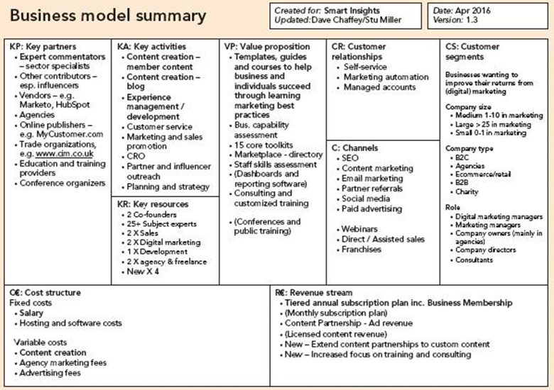
Role of digital marketing
in the strategic conceptualization of the business
Source: www.smartinsights.com
Notes:
Before characterising the Canvas model, a short approach to the concept of business model. Using the definition of the authors Osterwalder and Pigneur, it can be said that "A business model describes the rationale of how an organization creates, delivers, and captures value".
To help fill in the nine blocks, a set of questions can be used, the answers to which facilitate the definition of the business and, when answered from the perspective of digital presence, contribute to understanding the role of digital marketing in the strategic conceptualisation of the business.
To start filling out the Canvas model, it is good practice to begin by defining which segment or segments you want to serve, followed by the value proposition block.
Aspects to reflect on in the different blocks:
Segments
Who are we going to create value for?
Who are our most important customers?
Do these customers have common needs?
Are these customers reached in the same way?
Customer groups are different when:
- Needs require and justify different offering
- Distribution channels are different
- They require different relationships with clients
- Generate different profitability
- Customers accept to pay for different offers
The limit of segmentation is the size of the market, which may not be sufficient to make the business viable, even temporarily.
Value Proposal
What value proposition will we deliver to each customer segment?
What are the customer problems that the company helps to solve?
What products and services will we offer to each customer segment?
What customer needs will we satisfy?
Sources of value creation for the customer:
- Novelty (satisfaction of new needs often without the use of technology)
- Performance (products/services with better performance)
- Customisation (adapting to specific needs)
- Design (fashion industry)
- Brand (reputation and notoriety gives social status)
- Price (free or low)
- Cost reduction for the company (cloud computing)
- Accessibility (making accessible to many products that only a few could aspire to. Ex. low cost air travel)
- Convenience/ease of use (Nespresso)
Communication channels
What is the best way to communicate with customers?
What is the best channel that helps to pass the desired message?
How to integrate online and offline communication?
Distribution/sales channels are used to:
- Customers to know about the existence of products/services;
- Provide after-sales support
- Assist in the evaluation of the value proposition
- Deliver the value proposition
- Offer specific products and services
Questions to consider in channel design:
- Through what channels will the customer segment be reached?
- How are they being reached today?
- How are the channels connected to each other?
- Which channel works best?
- Which channel is the best value for money?
- How will the channels fit into the routines of the customers?
Types of channels
- Own channels (sales force; online; own shops;...)
- Indirect channels (partner shops (franchise); wholesalers; retailers;....)
Customer Relationships
What type of relationship does the customer segment expect from the company?
What relationships are already established?
How do these relationships relate to other aspects of the business?
How much do existing relationships cost? (e.g. personalised assistance)
Revenue Stream
What value is the customer segment willing to pay for?
What are they currently paying for?
How does the customer segment pay today?
How would they prefer to pay?
What is the contribution of each revenue stream to total revenue?
Revenue types: asset sales; usage fee; subscription fee; renting/leasing; licensing
Pricing mechanisms:
- Fixed prices (price list; product characteristics and attributes function; market segment function (type and characteristics); volume function (quantity purchased))
- Variable prices depending on the market (negotiation; yield management (hotel occupancy rates, airline seats, etc.); real-time market (supply and demand - stock exchange); auction (price results from competitive bidding))
Key Resources: most important assets to make the business model work
Resource categories: physical, intellectual (patents, brands, rights,...), human, financial
What key resources does the value proposition require?
What about for delivery channels?
What about for the relationships?
What about for the revenue sources?
Types of key resource:
- Physical (manufacturing facilities, buildings, vehicles, machinery, point-of-sale systems and distribution networks)
- Intellectual (brands, patents, copyrights, customer databases)
- Human (people working in the business)
- Financial (financial resources, bank guarantees, etc.)
Many of the resources may belong to the business itself, be rented or be from key partners
Key Activities: activities essential for the company's business model to function properly.
What key activities does the value proposition require?
What are the key activities for the distribution channels?
What key activities are required for customer relations?
What key activities are required for revenue sources?
Key Partners: network of suppliers and partners who make the business model work (complement or alternative to key activities)
Who are our key partners?
Who are our key suppliers?
What key resource can the company obtain through key partners?
What key activities do key partners perform?
Partnerships are important to optimise business and obtain economies of scale, reduce risks and uncertainties, acquisition of resources and activities
Partnerships can be:
- Strategic alliances between non-competitors
- Cooperation/partnerships between competitors
- Joint ventures for new business development
- Buyer/supplier relationships to ensure regular and reliable supplies of resources or activities
Costs Structure
What are the most important costs of the business model?
What are the most expensive key resources?
Which are the most expensive key activities? (e.g. is the business more value-driven or more cost-driven?)
Distribution of fixed costs/variable costs?
Role of economies of scale?
Once you have the Canvas model filled out you have to take into consideration that any change in one of the blocks tends to have implications in another block or blocks. For example, a change in the distribution channels of a product (let's imagine that the company starts to commercialise products through social shopping), may force the company to develop new key activities, which in turn requires the existence of new key resources and also a change in the cost structure.
The image shown on the slide is an example of the application of the Business Model Canvas.

Slide 62
Assessment
Using the same brand used in the previous activity, elaborate the Business Model Canvas from the digital marketing perspective.
Notes:
This activity is to be done individually.
Maximum duration: 2 hours.
Results classification:
Fail: there is no description in all items of the Canvas model, or the description presents itself very superfluous in most items.
Mediocre: the description is not clear enough in all items of the Canvas model.
Outstanding: all items of the Canvas are well described.

Slide 63
Bibliography

Slide 64
Bibliography
Barker, M. S., Barker, D. I., Bormann, N. F., Roberts, M. L., & Zahay, D. (2017). Social Media Marketing: a Strategic Approach (2nd ed.). Cengage Learning
Chaffey, D., & Ellis-Chadwick, F. (2022). Digital marketing: strategy, implementation and practice (8th ed). Pearson Education Limited.
Chaffey, D., & Smith, PR (2017). Digital Marketing Excellence (5th ed.). Routledge.
Hanlon, A. (2019). Digital Marketing: strategic planning & integration. Sage.
Kingsnorth, S. (2016). Digital Marketing Strategy An integrated approach to online marketing. KoganPage.
Kotler, P., & Andreasen, A. R. (1987). Strategic marketing for nonprofit organizations (3rd ed.). Prentice-Hall.
Osterwalder, A., & Pigneur, Y. (2010). Business Model Generation. John Wiley & Sons, Inc.

Slide 65
The DEMS material aims to enhance digital marketing skills in higher education, responding to the needs in business and organizations. You have access to extensive slide sets with in-class activities and assignments, as well as detailed user instructions for teacher. You are free to use part or whole of the material available.
The material includes contents and figures retrieved from the internet and is thus subject to changes. The sources have been announced according to the rules of fair use. The material as a whole can be viewed and downloaded from www.dems.pro. All material is produced for open use and co-funded by Erasmus +.

